Slide 1
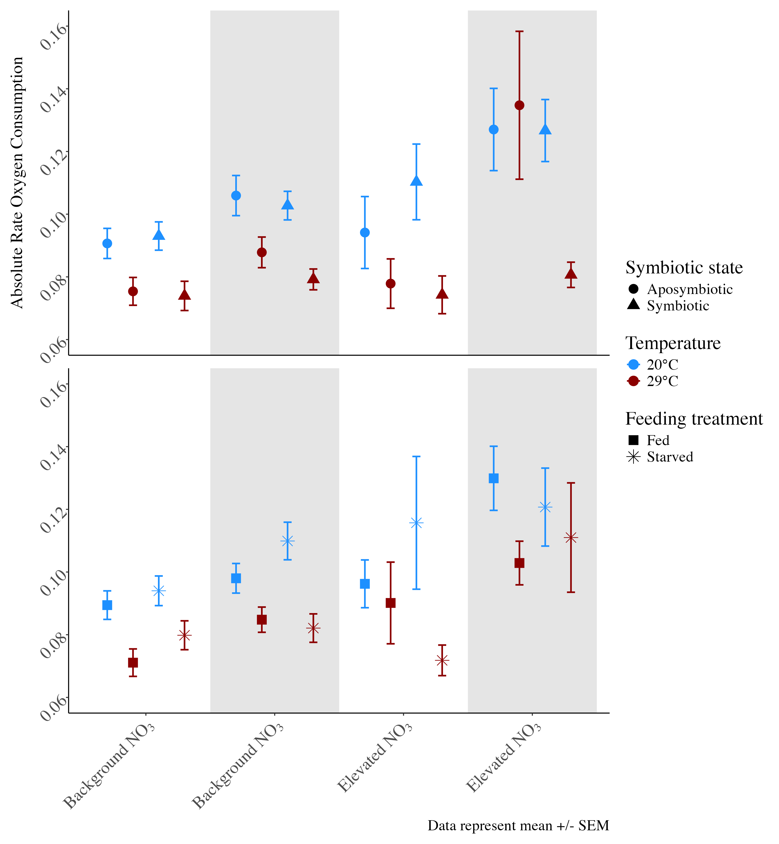
Absolute rate O₂ consumption (µmol/min/cm²)
E. coli challenge
No E. coli
E. coli

Slide 2
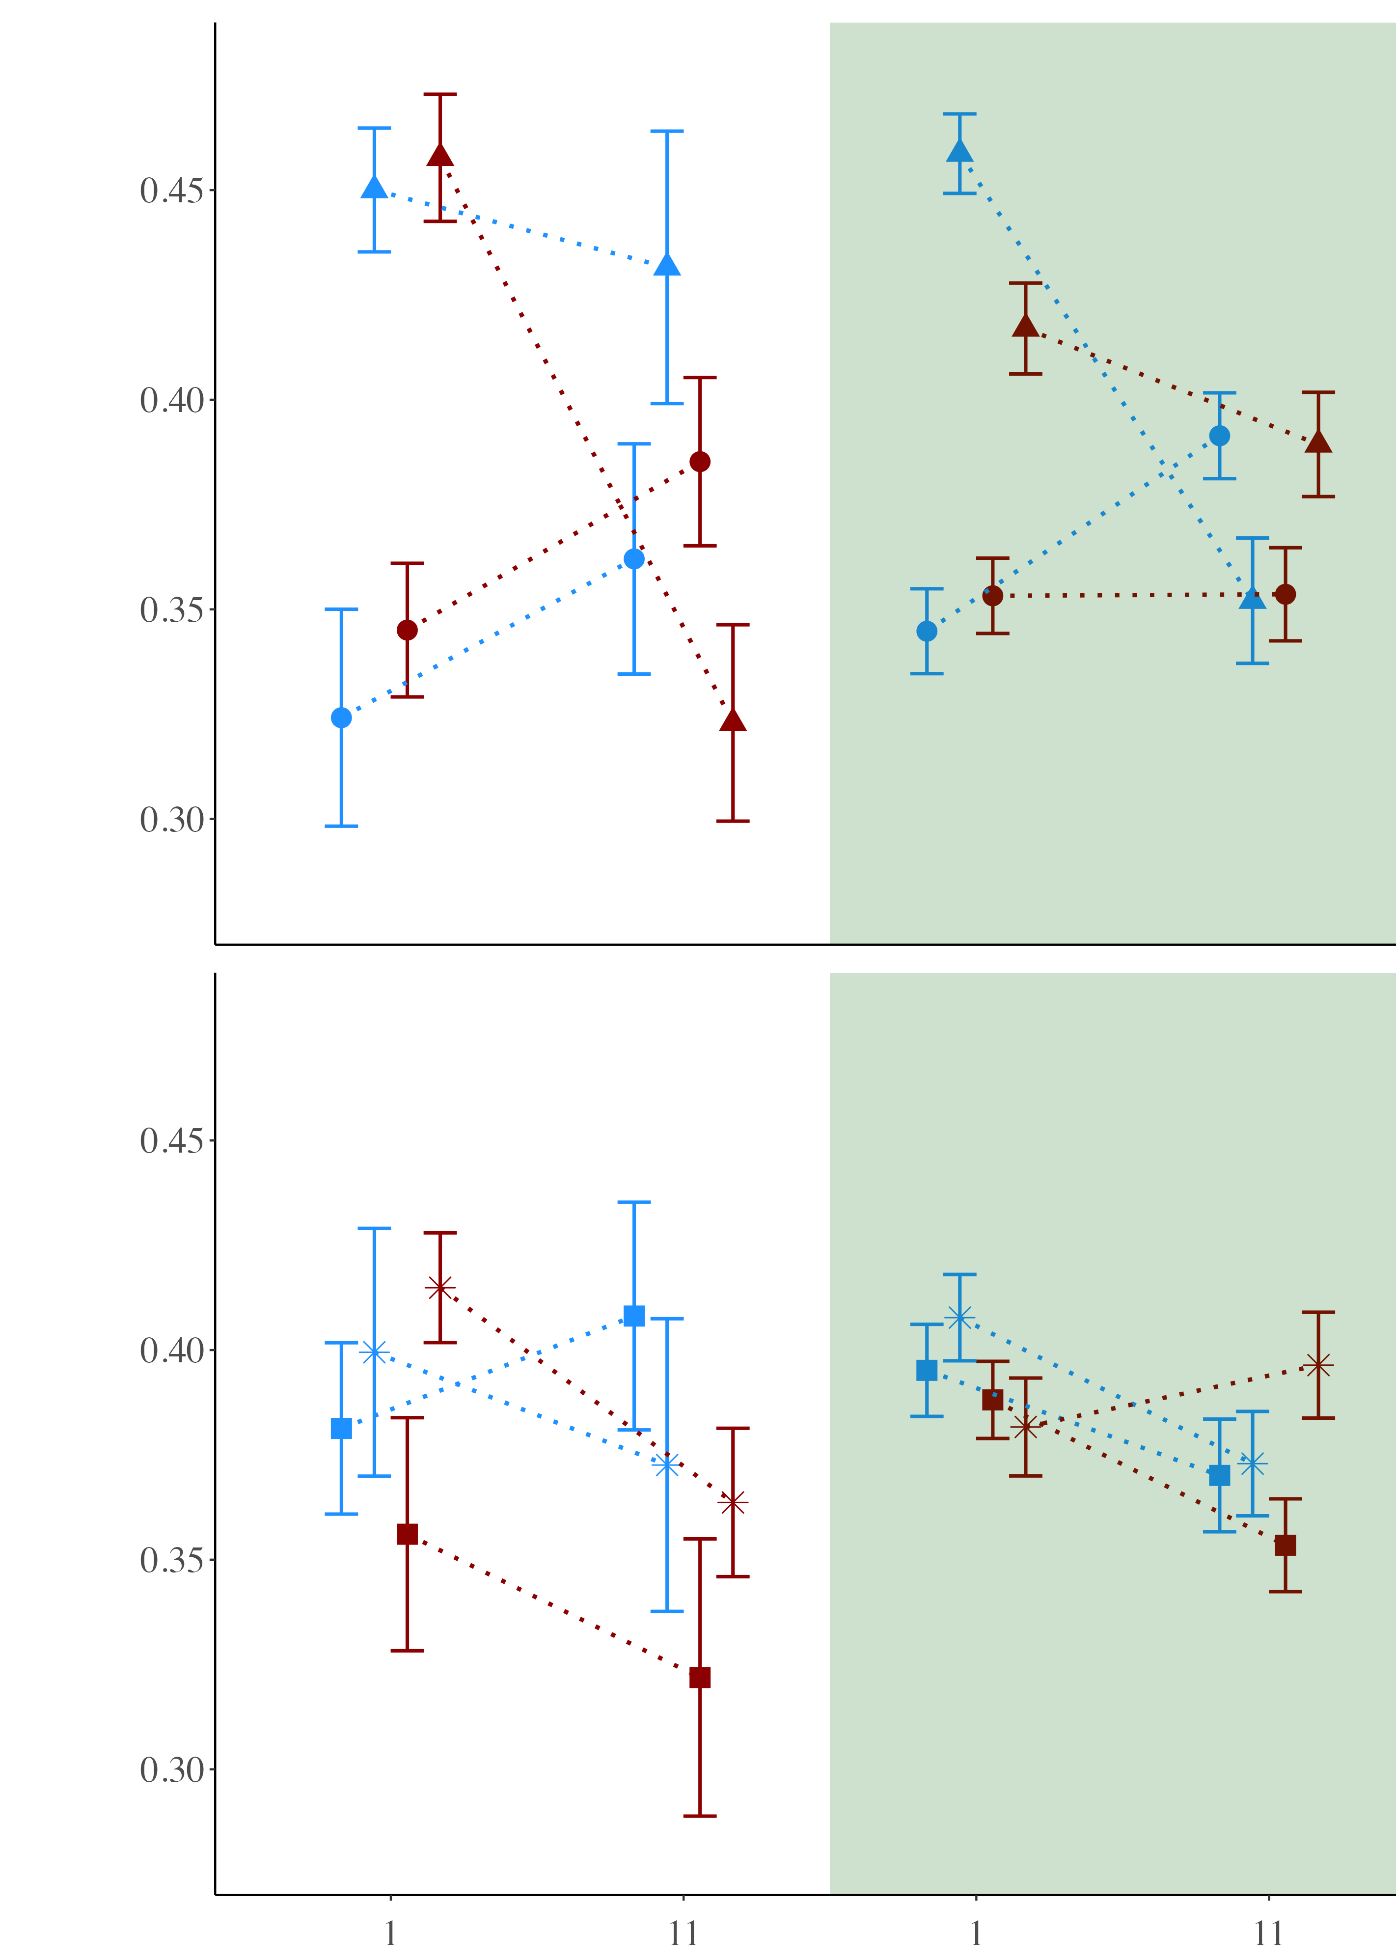
Photosynthetic efficiency (Fv/Fm)
NO₃ Level
Background
Elevated
Day of experiment

Slide 3
12-day experimental condition
4-hour acute challenge
NO₃
30°C
Symbiotic
Starved
E. coli
↑ Photo efficiency
↓ Polyp extension
↑ Respiration rate
↑ Mortality
↓ Respiration rate
↓ Polyp extension
↓ Photo efficiency
No effect
No effect

