Slide 1
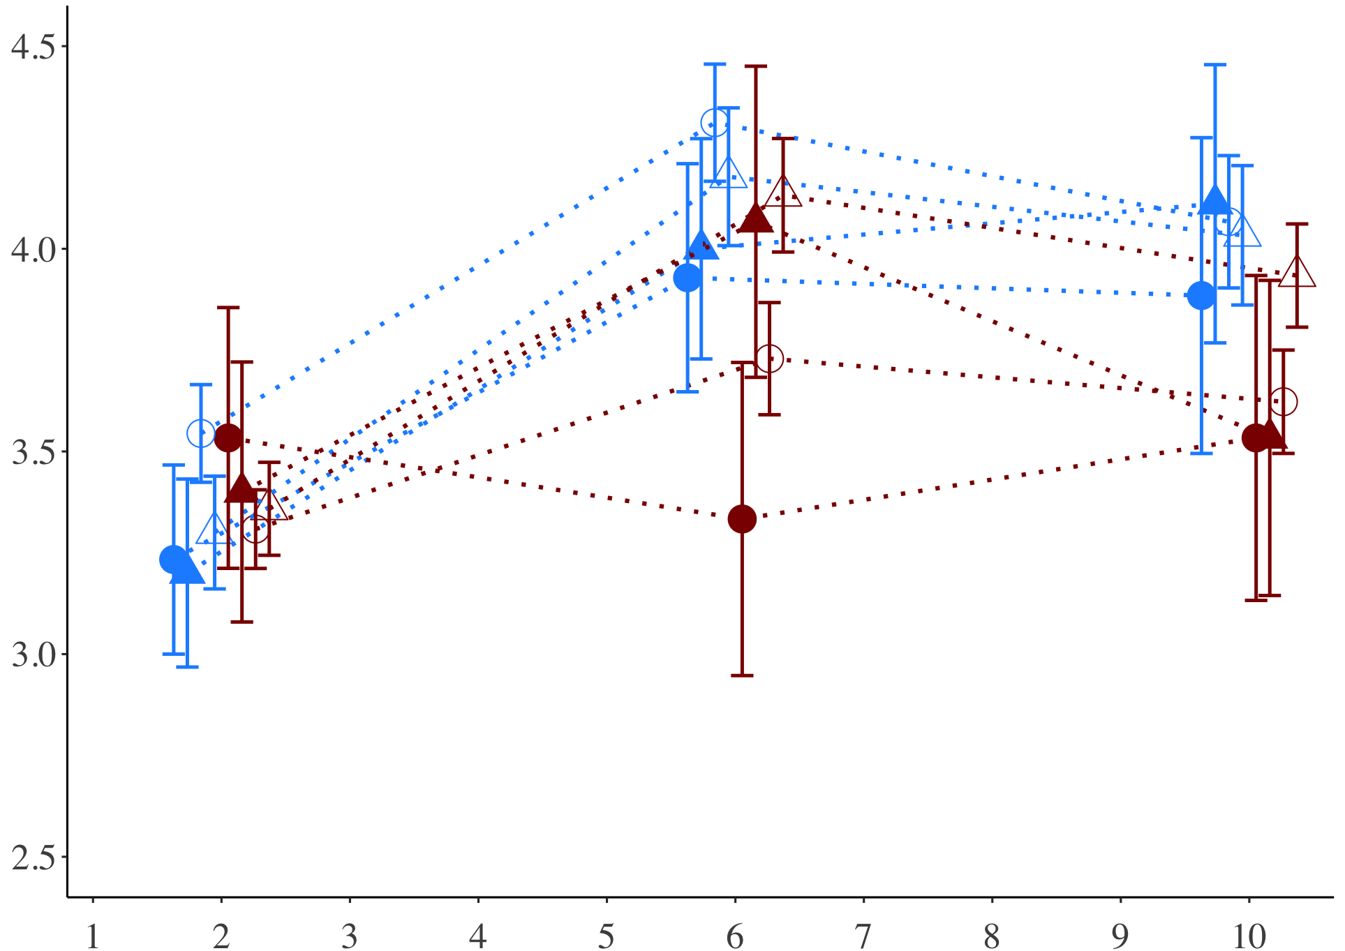
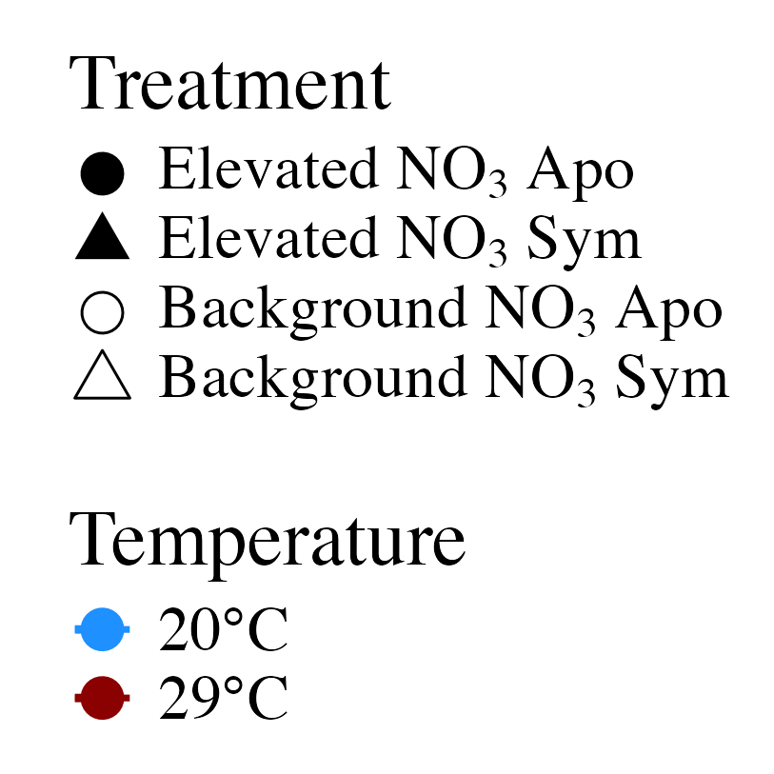
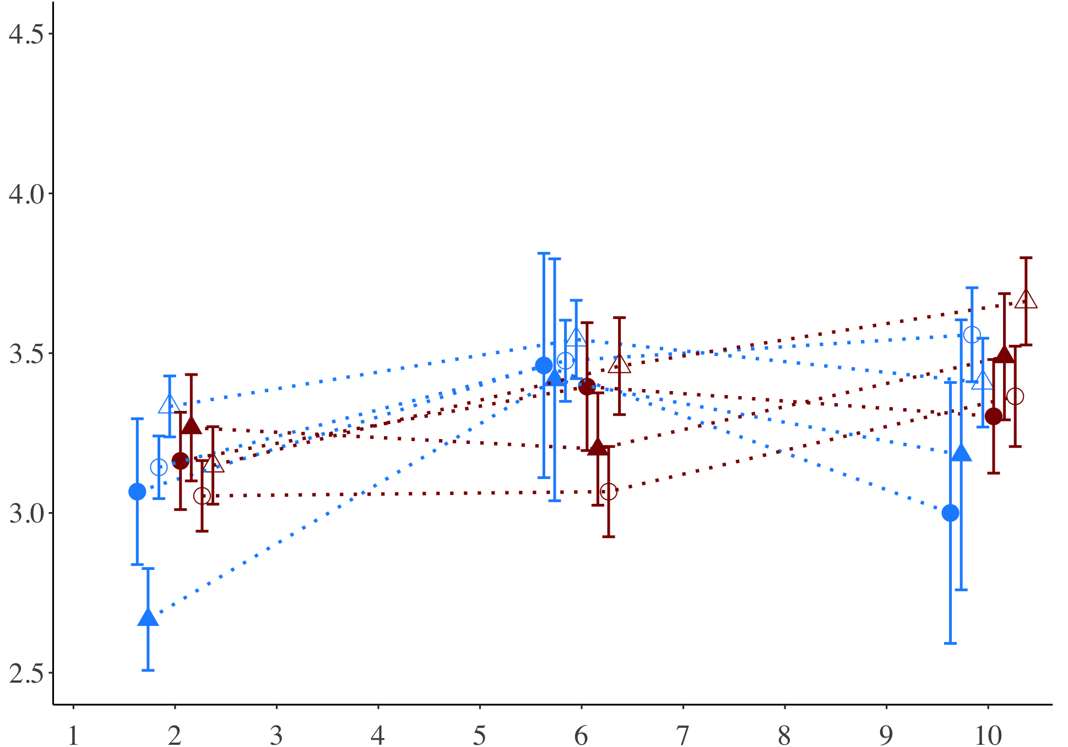
A) Fed
Average polyp extension score
B) Starved
Day of experiment

Slide 2
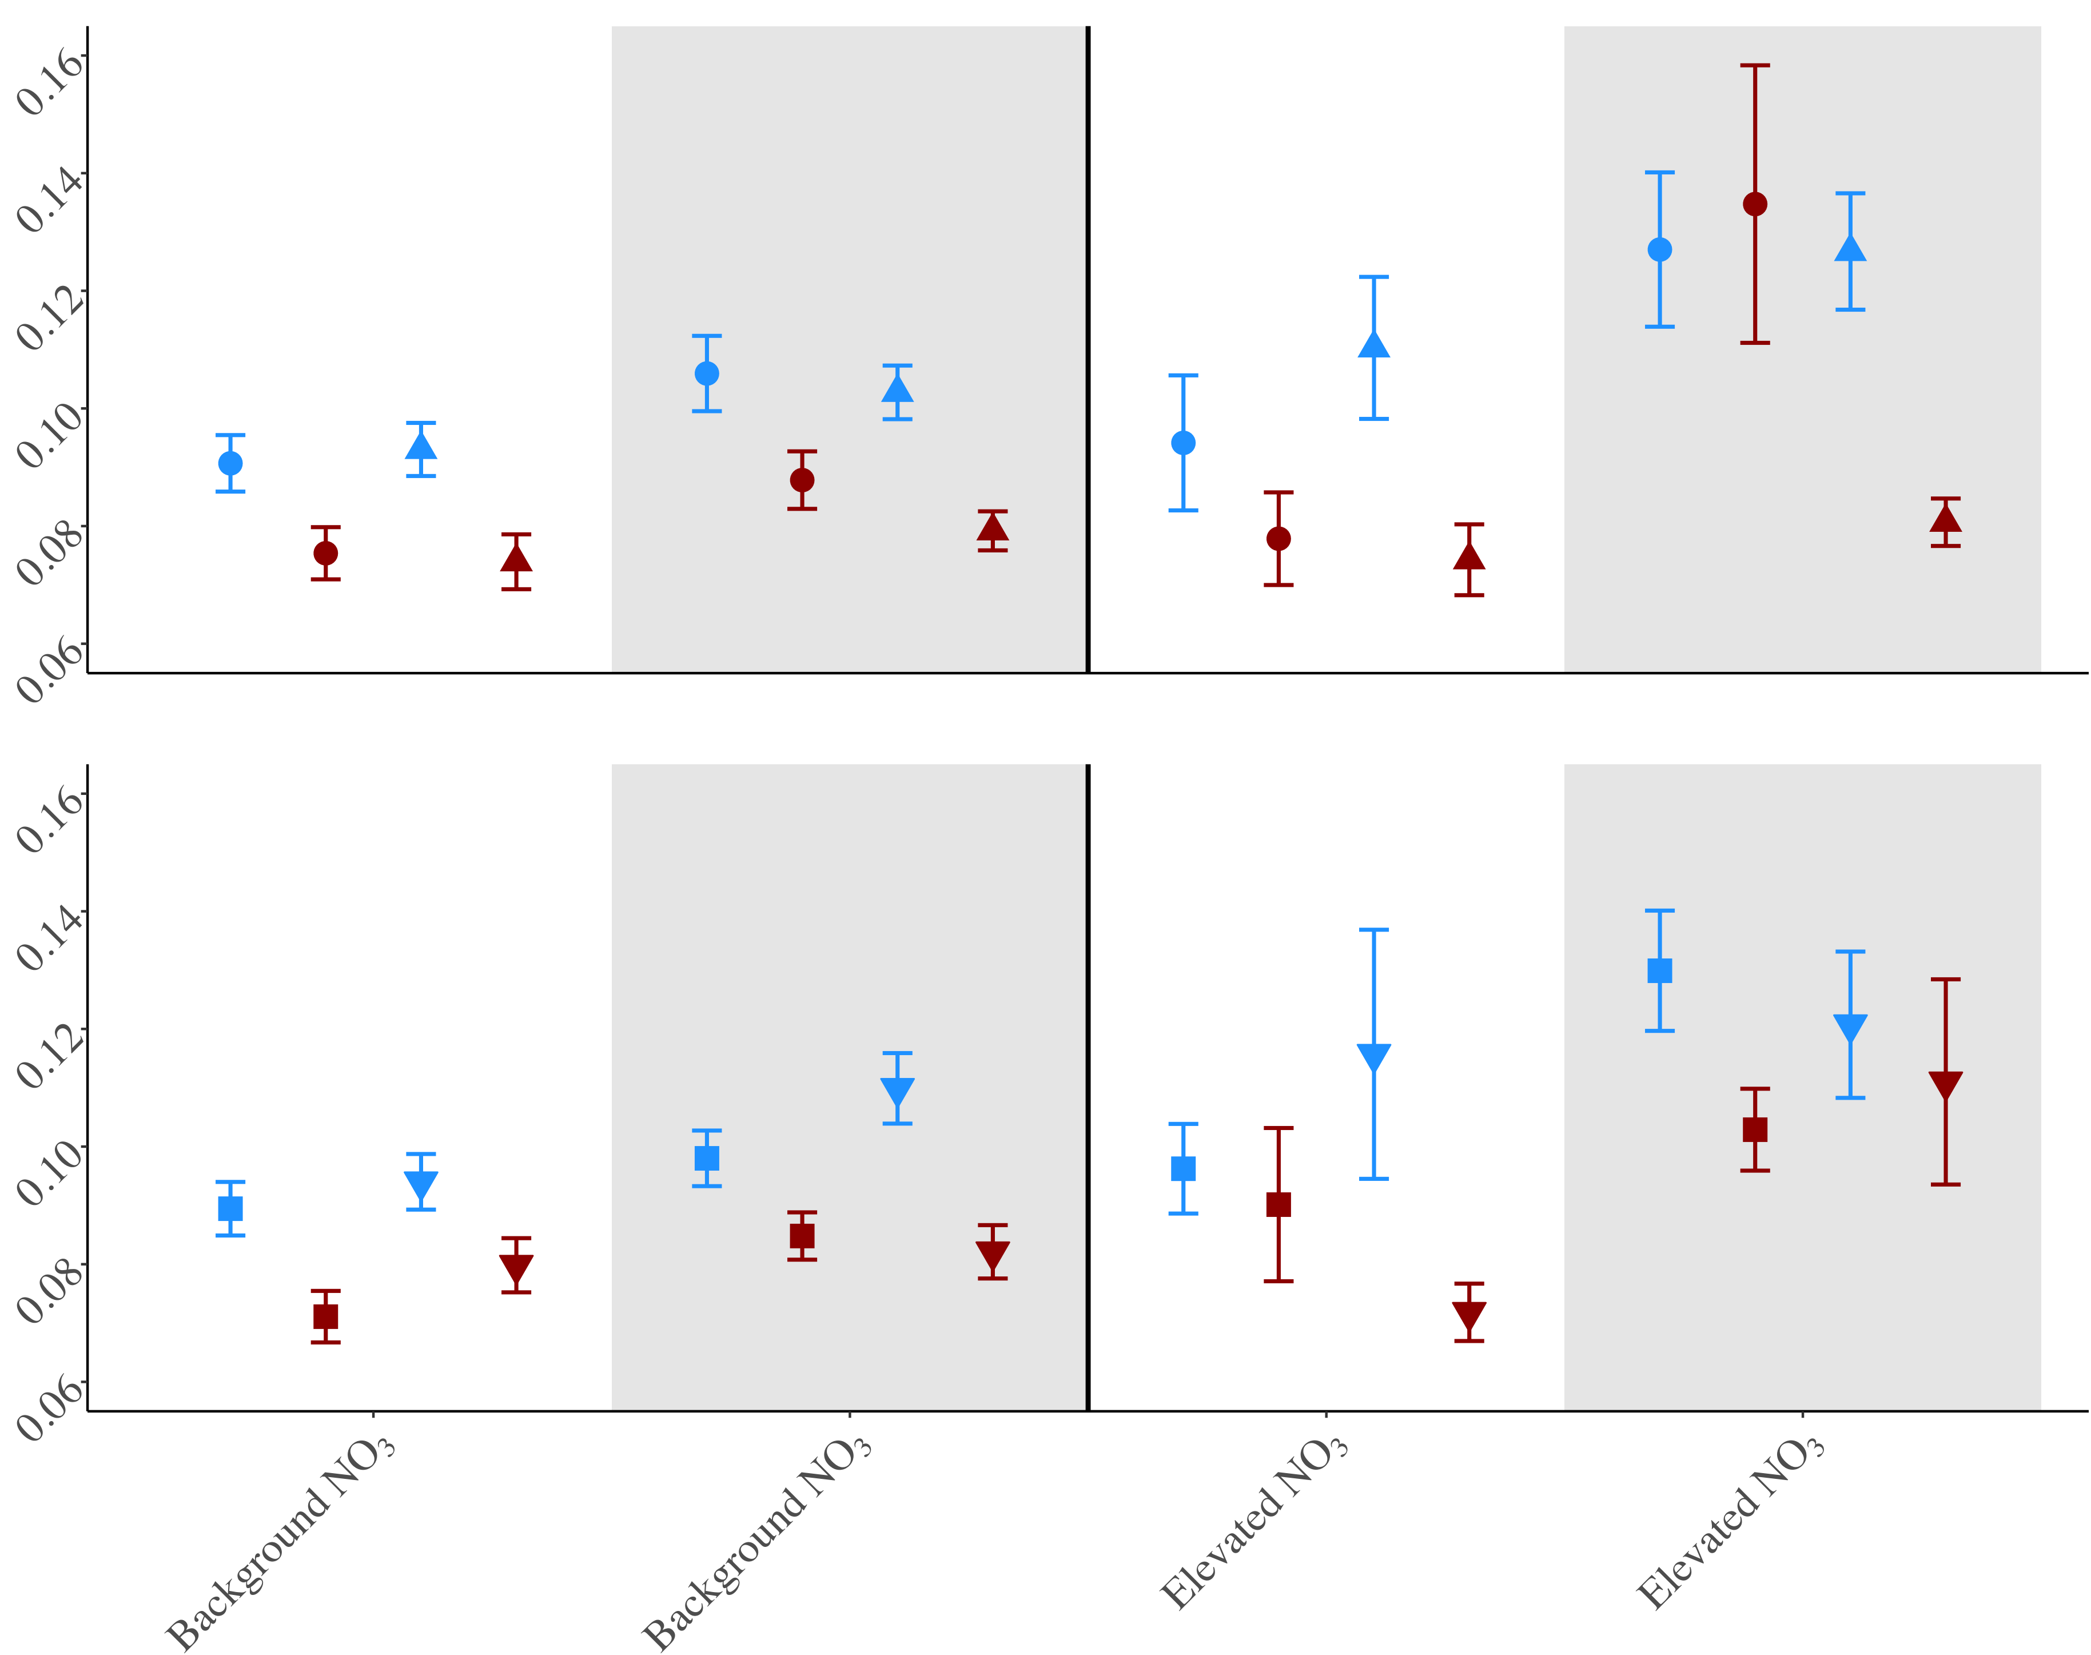
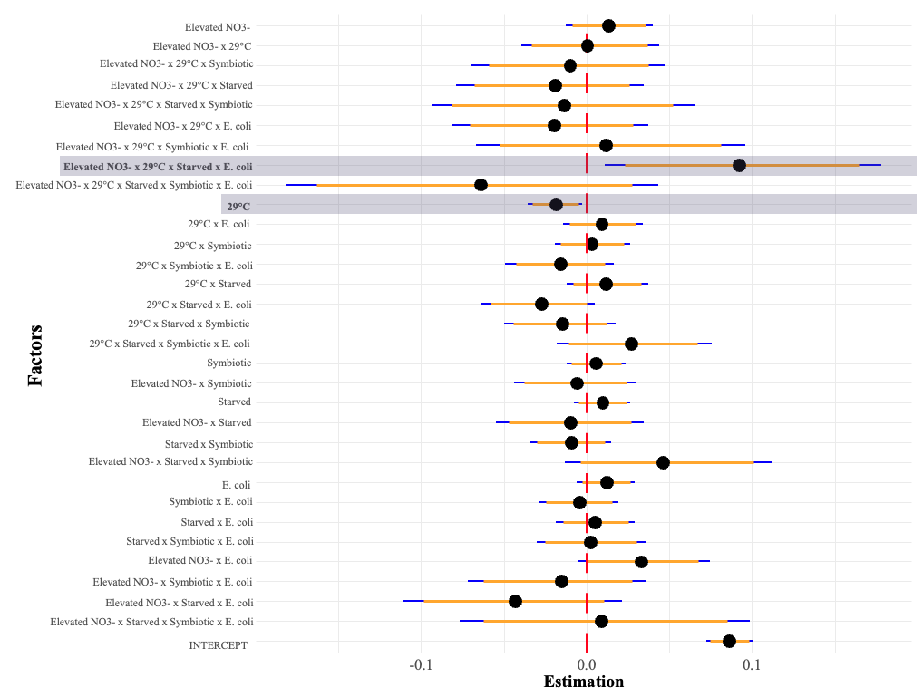
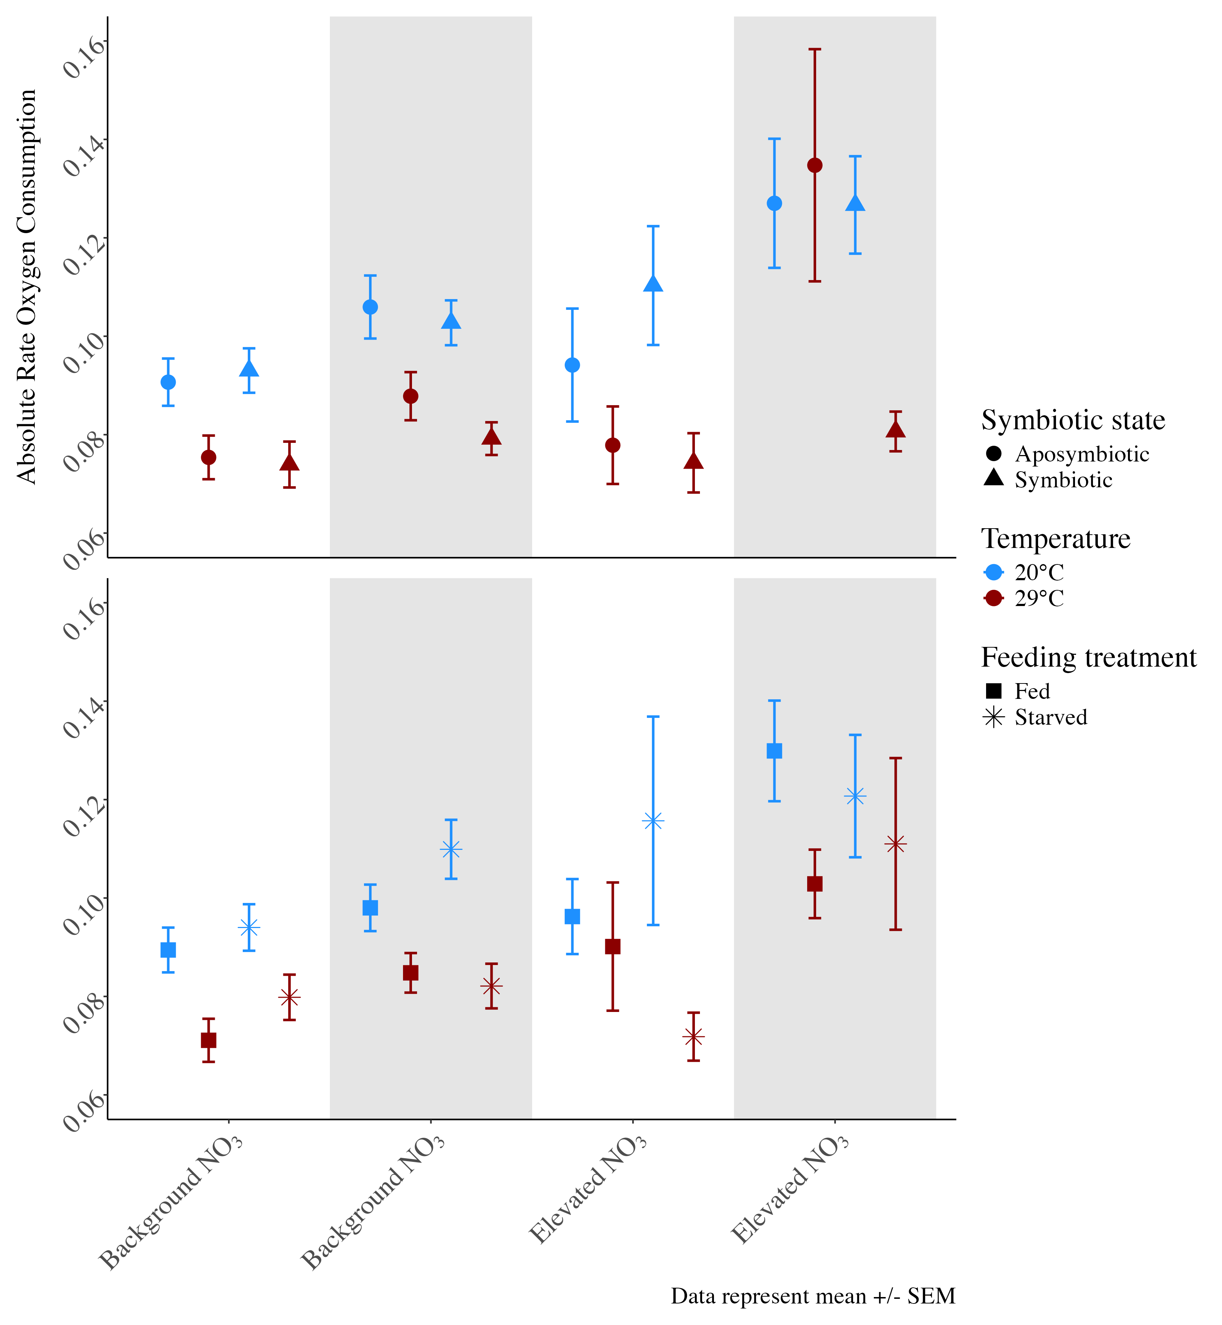
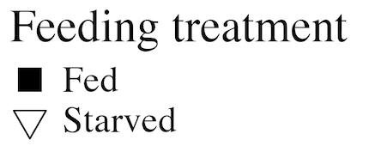
Symbiotic state: symbiotic vs. aposymbiotic
E) Bayesian Coefficients
A)
B)
Absolute rate O₂ consumption (µmol/min/cm²)
Feeding treatment: fed versus starved
B) Feeding treatment: fed versus starved
C)
D)
Background NO₃
Elevated NO₃
E. coli challenge
No E. coli
E. coli

Slide 3
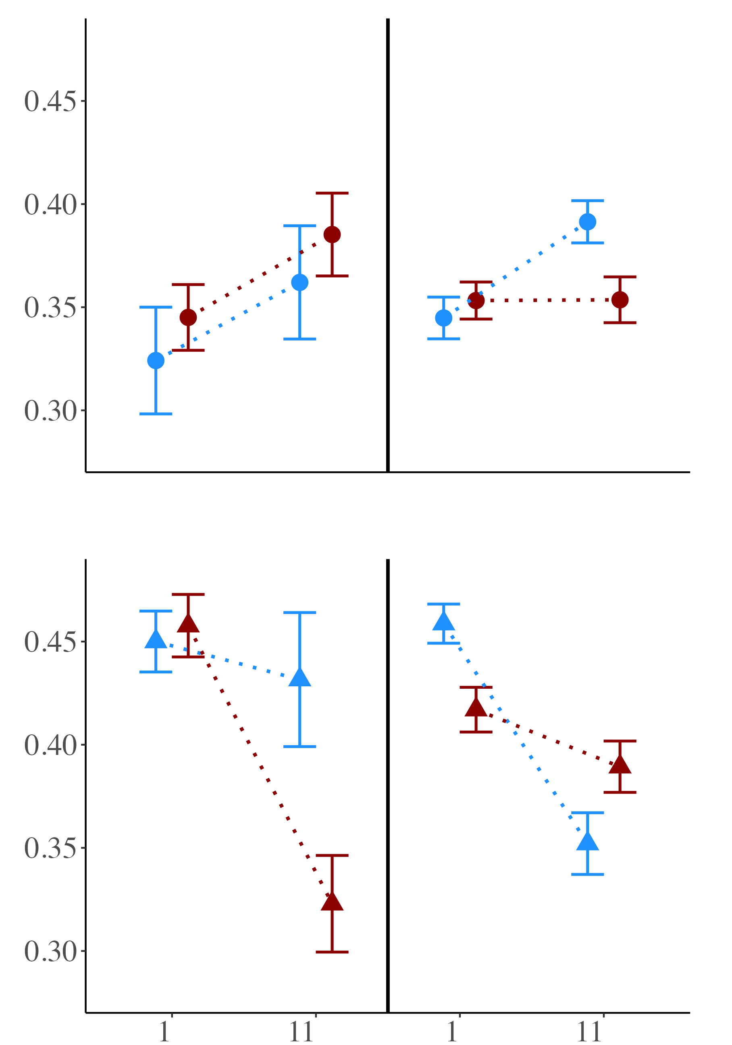
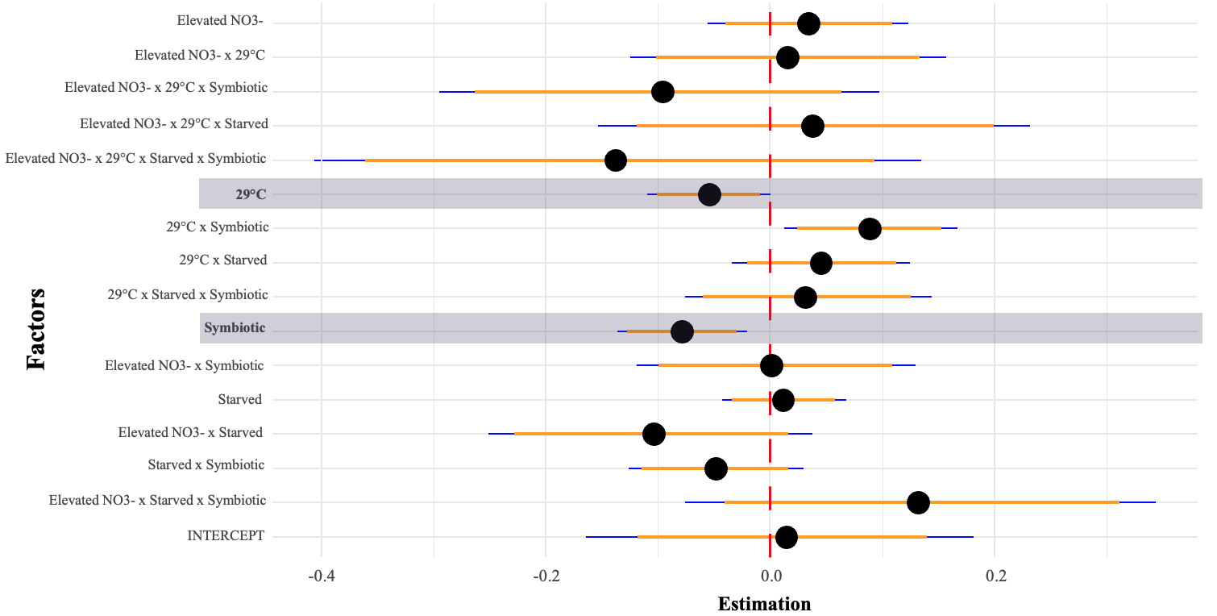
Aposymbiotic corals
A)
B)
E)
Symbiotic corals
Photosynthetic efficiency (Fv/Fm)
C)
D)
Background NO₃
Elevated NO₃
Notes:
25

Slide 4
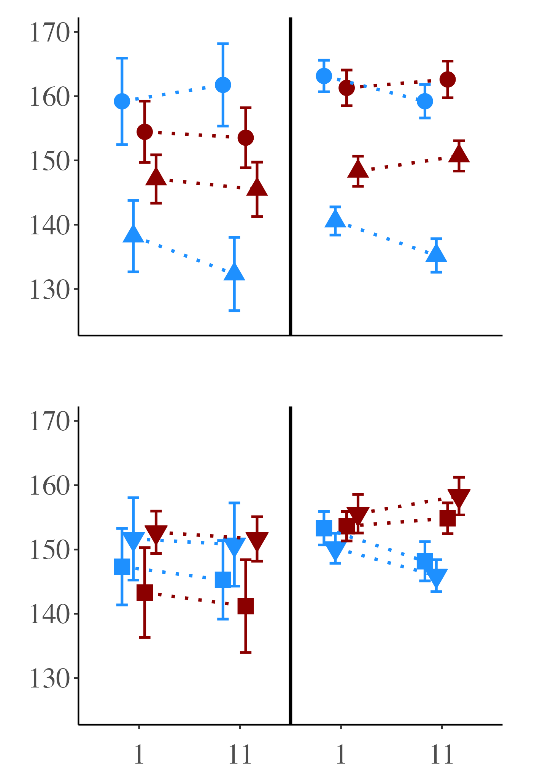
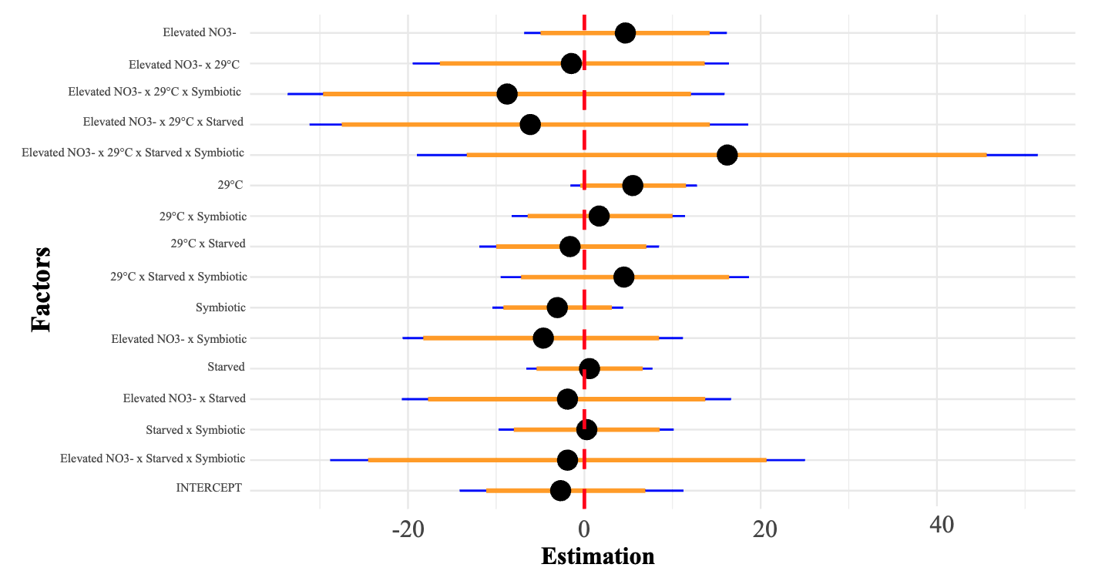
Symbiotic state: symbiotic vs. aposymbiotic
A)
B)
E)
Red Channel Value
Feeding treatment: fed vs. starved
C)
D)
Background NO₃
Elevated NO₃
Notes:
25

Slide 5
Elevated NO3-
Elevated NO3- x 29°C
Elevated NO3- x 29°C x Symbiotic
Elevated NO3- x 29°C x Starved
Elevated NO3- x 29°C x Starved x Symbiotic
Elevated NO3- x 29°C x E. coli
Elevated NO3- x 29°C x Symbiotic x E. coli
Elevated NO3- x 29°C x Starved x E. coli
Elevated NO3- x 29°C x Starved x Symbiotic x E. coli
29°C
29°C x E. coli
29°C x Symbiotic
29°C x Symbiotic x E. coli
29°C x Starved
29°C x Starved x E. coli
29°C x Starved x Symbiotic
Factors
29°C x Starved x Symbiotic x E. coli
Symbiotic
Elevated NO3- x Symbiotic
Starved
Elevated NO3- x Starved
Starved x Symbiotic
Elevated NO3- x Starved x Symbiotic
E. coli
Symbiotic x E. coli
Starved x E. coli
Starved x Symbiotic x E. coli
Elevated NO3- x E. coli
Elevated NO3- x Symbiotic x E. coli
Elevated NO3- x Starved x E. coli
Elevated NO3- x Starved x Symbiotic x E. coli
INTERCEPT
-0.1
0.0
0.1
Estimation

Slide 6
Elevated NO3-
Elevated NO3- x 29°C
Elevated NO3- x 29°C x Symbiotic
Elevated NO3- x 29°C x Starved
Elevated NO3- x 29°C x Starved x Symbiotic
29°C
29°C x Symbiotic
29°C x Starved
Factors
29°C x Starved x Symbiotic
Symbiotic
Elevated NO3- x Symbiotic
Starved
Elevated NO3- x Starved
Starved x Symbiotic
Elevated NO3- x Starved x Symbiotic
INTERCEPT
-0.4
-0.2
0.0
0.2
Estimation

Slide 8
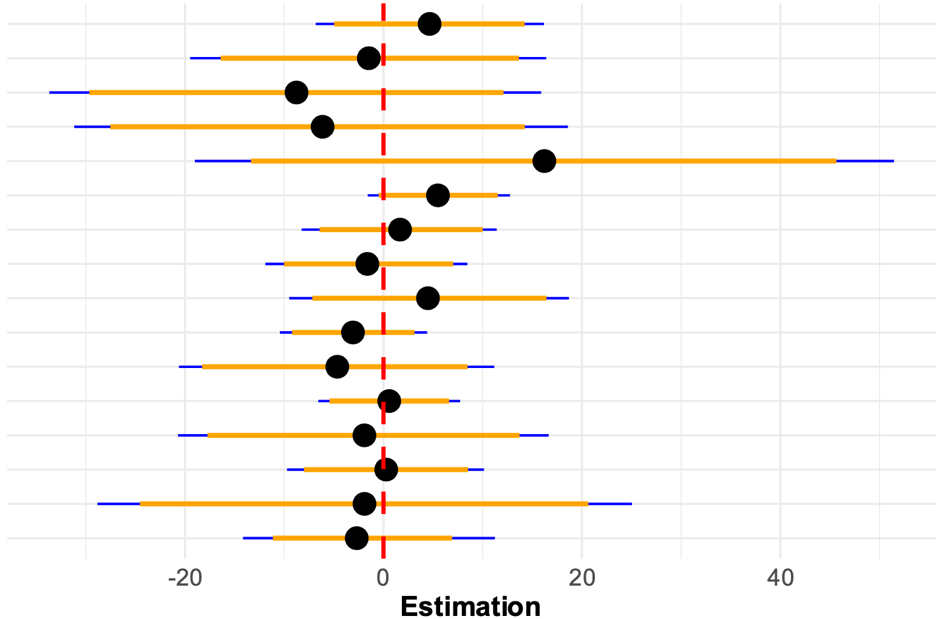
Elevated NO3-
Elevated NO3- x 29°C
Elevated NO3- x 29°C x Symbiotic
Elevated NO3- x 29°C x Starved
Elevated NO3- x 29°C x Starved x Symbiotic
29°C
29°C x Symbiotic
Factors
29°C x Starved
29°C x Starved x Symbiotic
Symbiotic
Elevated NO3- x Symbiotic
Starved
Elevated NO3- x Starved
Starved x Symbiotic
Elevated NO3- x Starved x Symbiotic
INTERCEPT
-20
0
20
40
Estimation

Slide 9
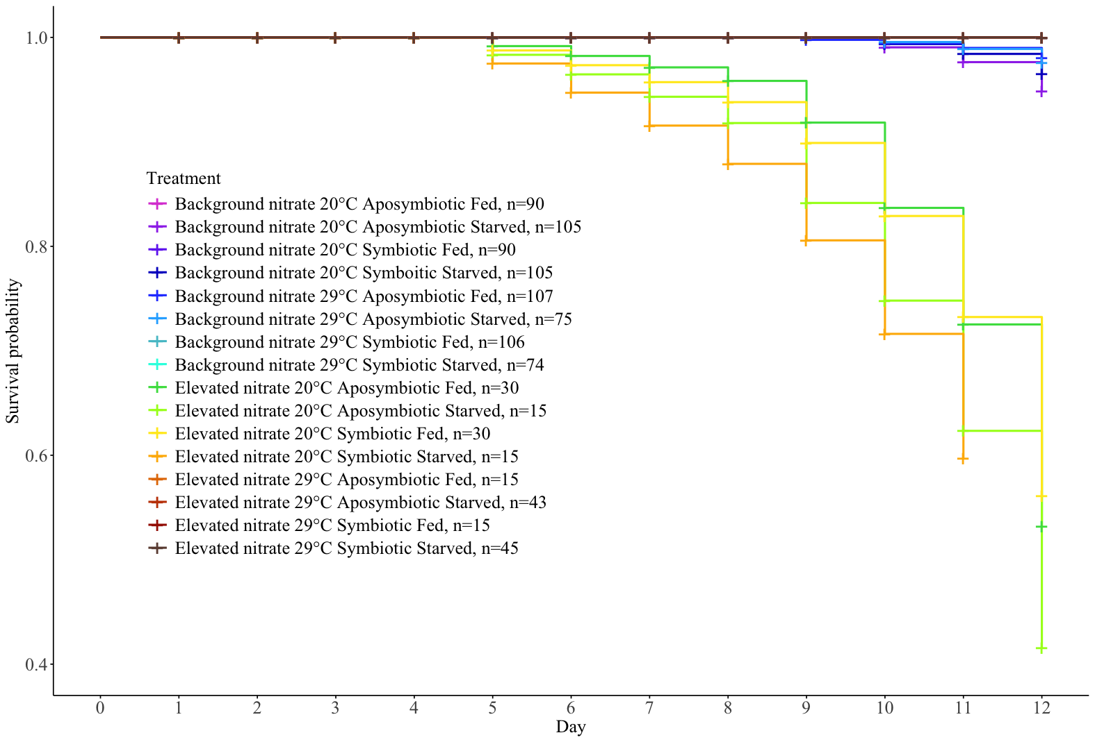
Nitrate Level | Temperature | Symbiotic State | Feeding status | Sample size | Color
Background | 20 | Aposymbiotic | Fed | 90
Background | 20 | Aposymbiotic | Starved | 105
Background | 20 | Symbiotic | Fed | 90
Background | 20 | Symbiotic | Starved | 105
Background | 29 | Aposymbiotic | Fed | 107
Background | 29 | Aposymbiotic | Starved | 75
Background | 29 | Symbiotic | Fed | 106
Background | 29 | Symbiotic | Starved | 74
Elevated | 20 | Aposymbiotic | Fed | 30
Elevated | 20 | Aposymbiotic | Starved | 15
Elevated | 20 | Symbiotic | Fed | 30
Elevated | 20 | Symbiotic | Starved | 15
Elevated | 29 | Aposymbiotic | Fed | 15
Elevated | 29 | Aposymbiotic | Starved | 43
Elevated | 29 | Symbiotic | Fed | 15
Elevated | 29 | Symbiotic | Starved | 45

Slide 10
Nitrate Level | Temper -ature | Symbiotic State | Feeding status | Sample size | Color
Background | 20 | Aposymbiotic | Fed | 90
Background | 20 | Aposymbiotic | Starved | 105
Background | 20 | Symbiotic | Fed | 90
Background | 20 | Symbiotic | Starved | 105
Background | 29 | Aposymbiotic | Fed | 107
Background | 29 | Aposymbiotic | Starved | 75
Background | 29 | Symbiotic | Fed | 106
Background | 29 | Symbiotic | Starved | 74
Elevated | 20 | Aposymbiotic | Fed | 30
Elevated | 20 | Aposymbiotic | Starved | 15
Elevated | 20 | Symbiotic | Fed | 30
Elevated | 20 | Symbiotic | Starved | 15
Elevated | 29 | Aposymbiotic | Fed | 15
Elevated | 29 | Aposymbiotic | Starved | 43
Elevated | 29 | Symbiotic | Fed | 15
Elevated | 29 | Symbiotic | Starved | 45
Notes:
Gray background for 29, black background white text for Elevated

Slide 11
12-day experimental condition
4-hour acute challenge
Key
Single factor response
Dual factor response
Multi-factor response
NO₃
29°C
Starved
Symbiotic
E. coli
↑ Respiration rate
↑ Mortality
No effect
↓ Photosynthetic efficiency
No effect
↑ Photosynthetic efficiency
↓ Polyp extension
↓ Polyp Extension
↓ Respiration rate
↓ Photosynthetic efficiency

Slide 12
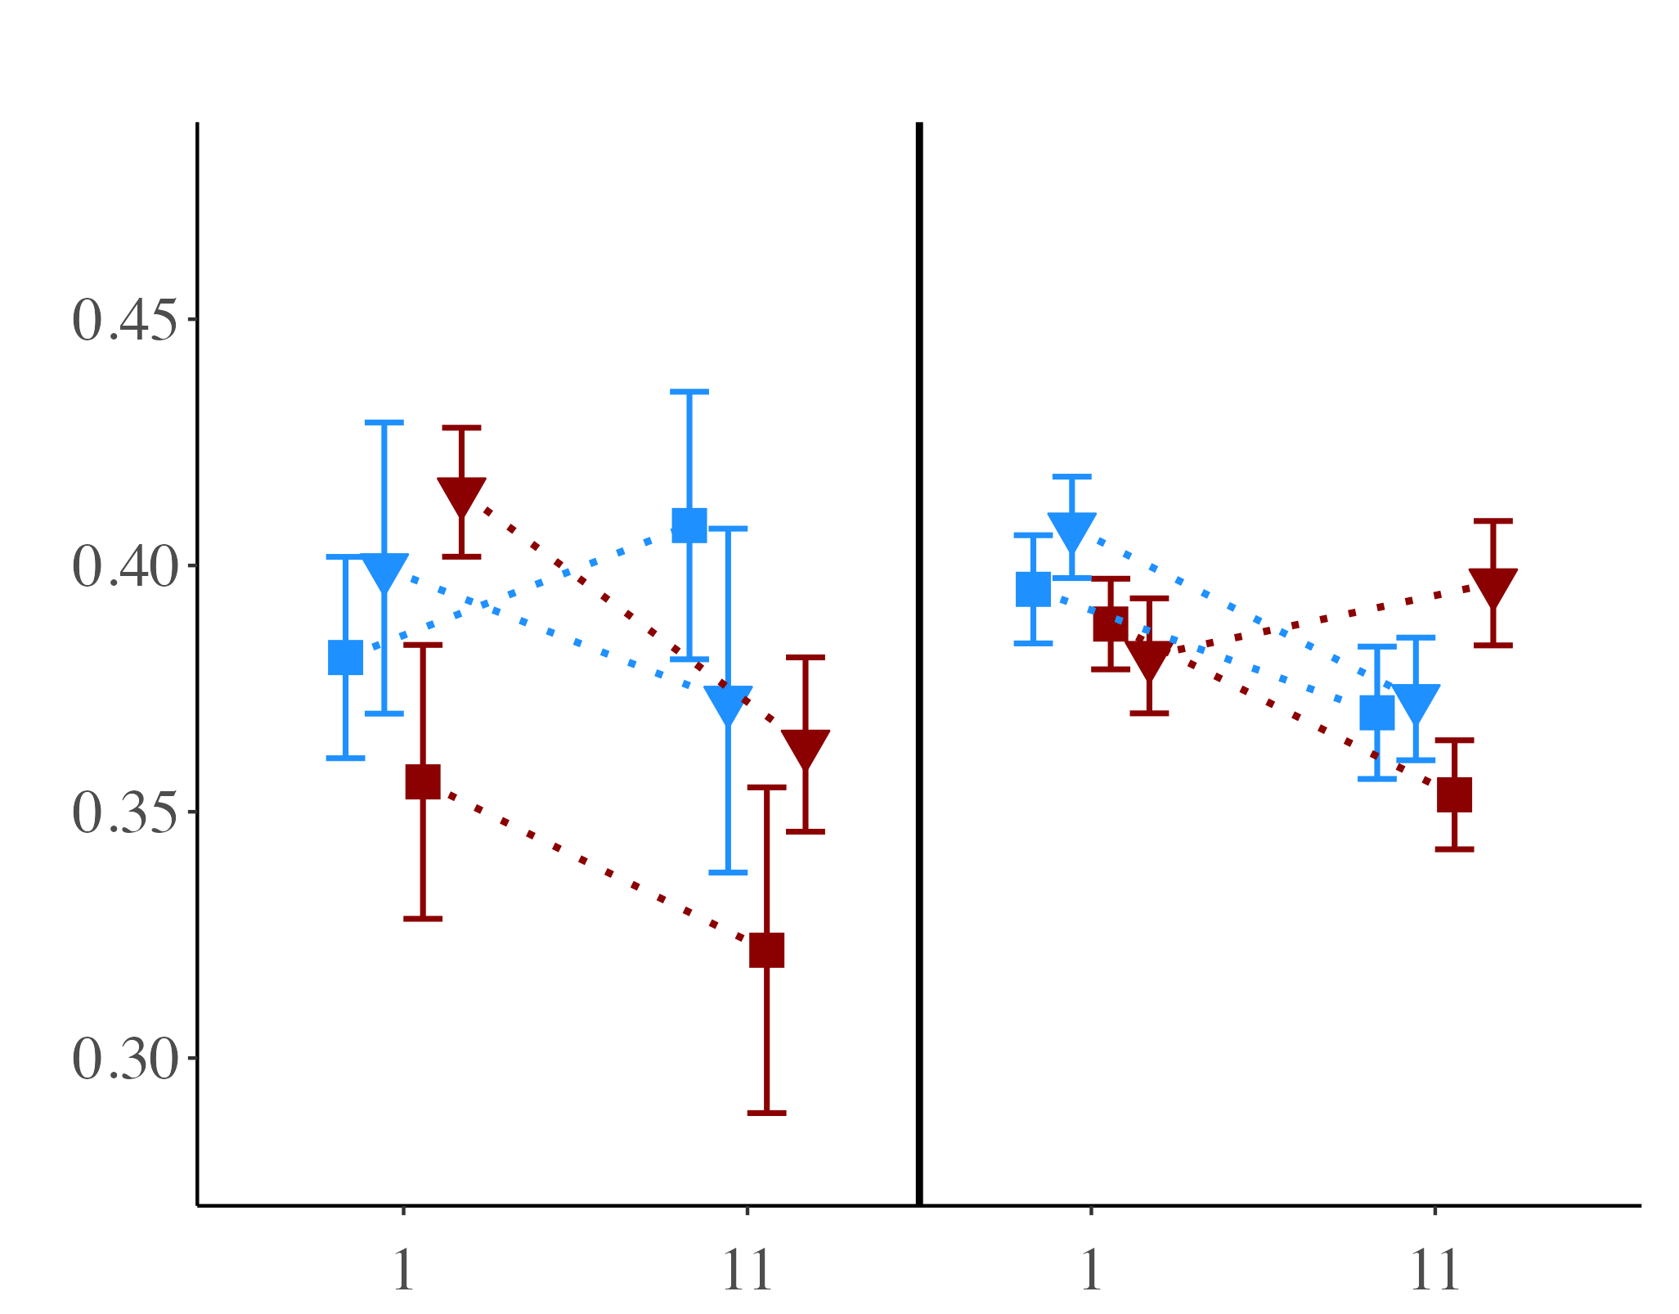
A)
B)
Photosynthetic efficiency (Fv/Fm)
Background NO₃
Elevated NO₃
Notes:
25

Slide 13
Death table
Total mortality 32/960
 | 20°C | 29°C
Elevated | 8 - Fed Apo 5 - Starved Apo 7 - Fed Sym 5 - Starved Sym | 0 - Fed Apo 0 - Starved Apo 0 - Fed Sym 0 - Starved Sym
Low | 0 - Fed Apo 3 - Starved Apo 0 - Fed Sym 2 - Starved Sym | 1 - Fed Apo 1 - Starved Apo 0 - Fed Sym 0 - Starved Sym

Slide 14
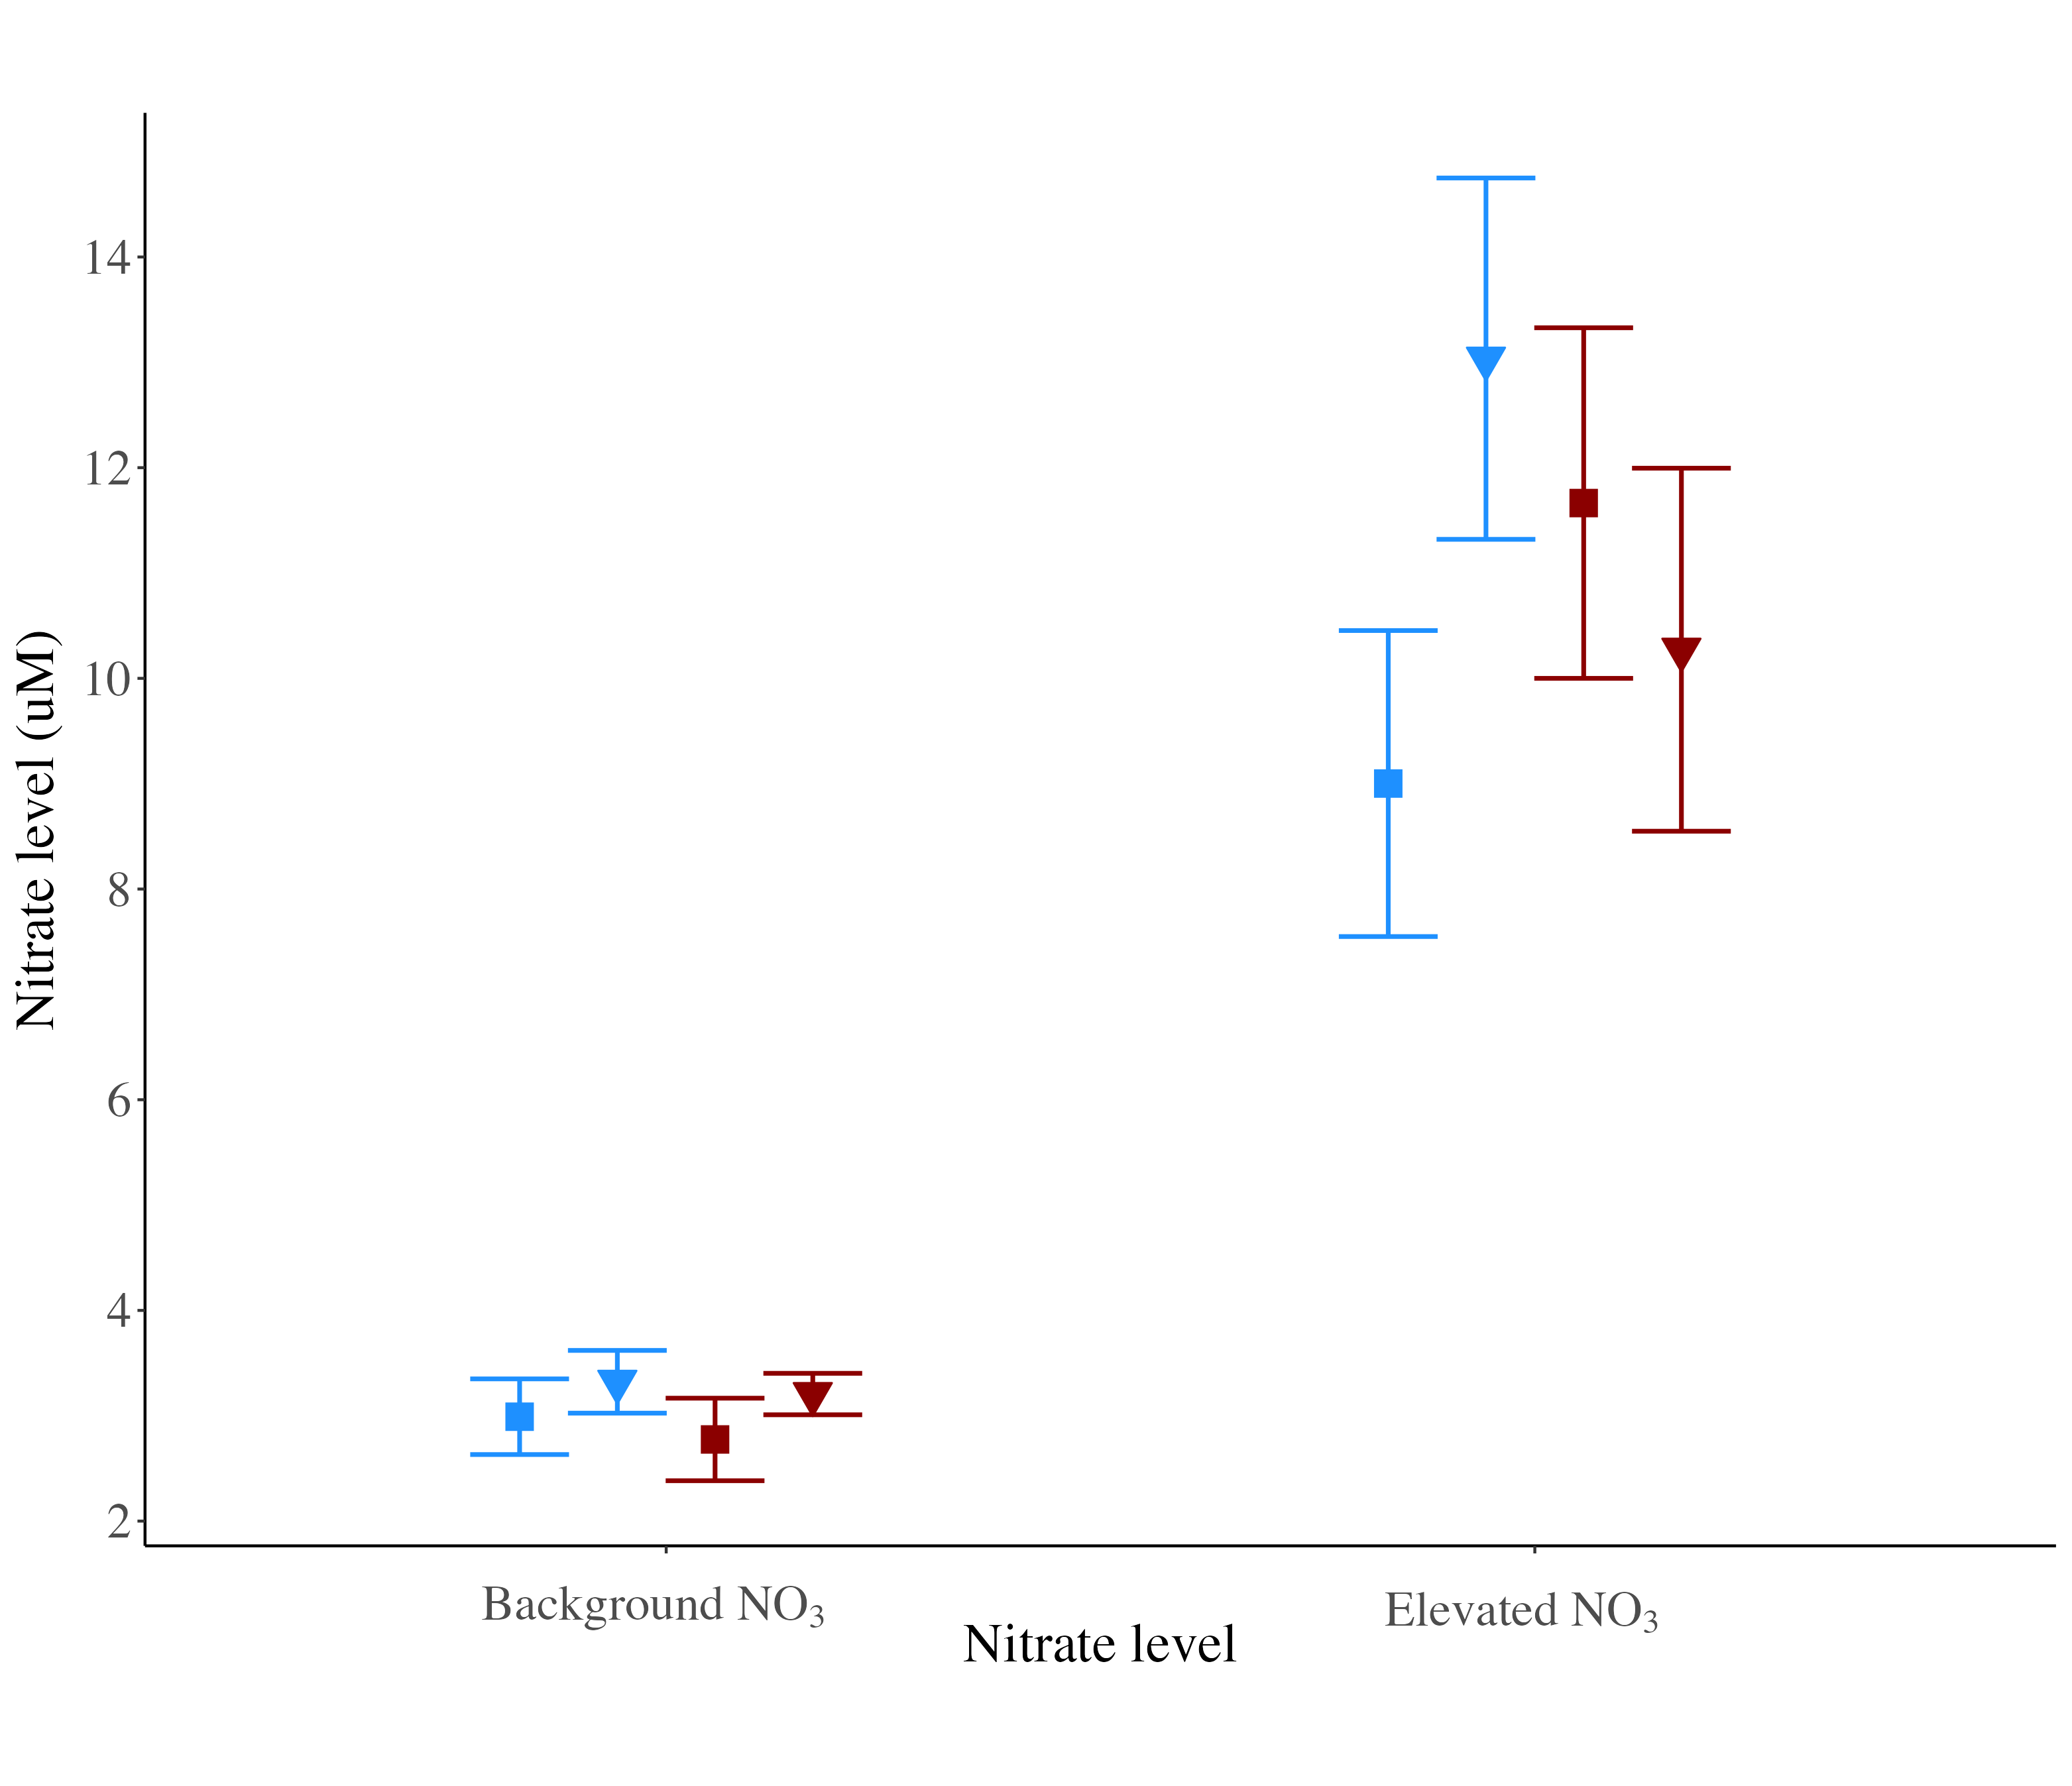

Slide 15
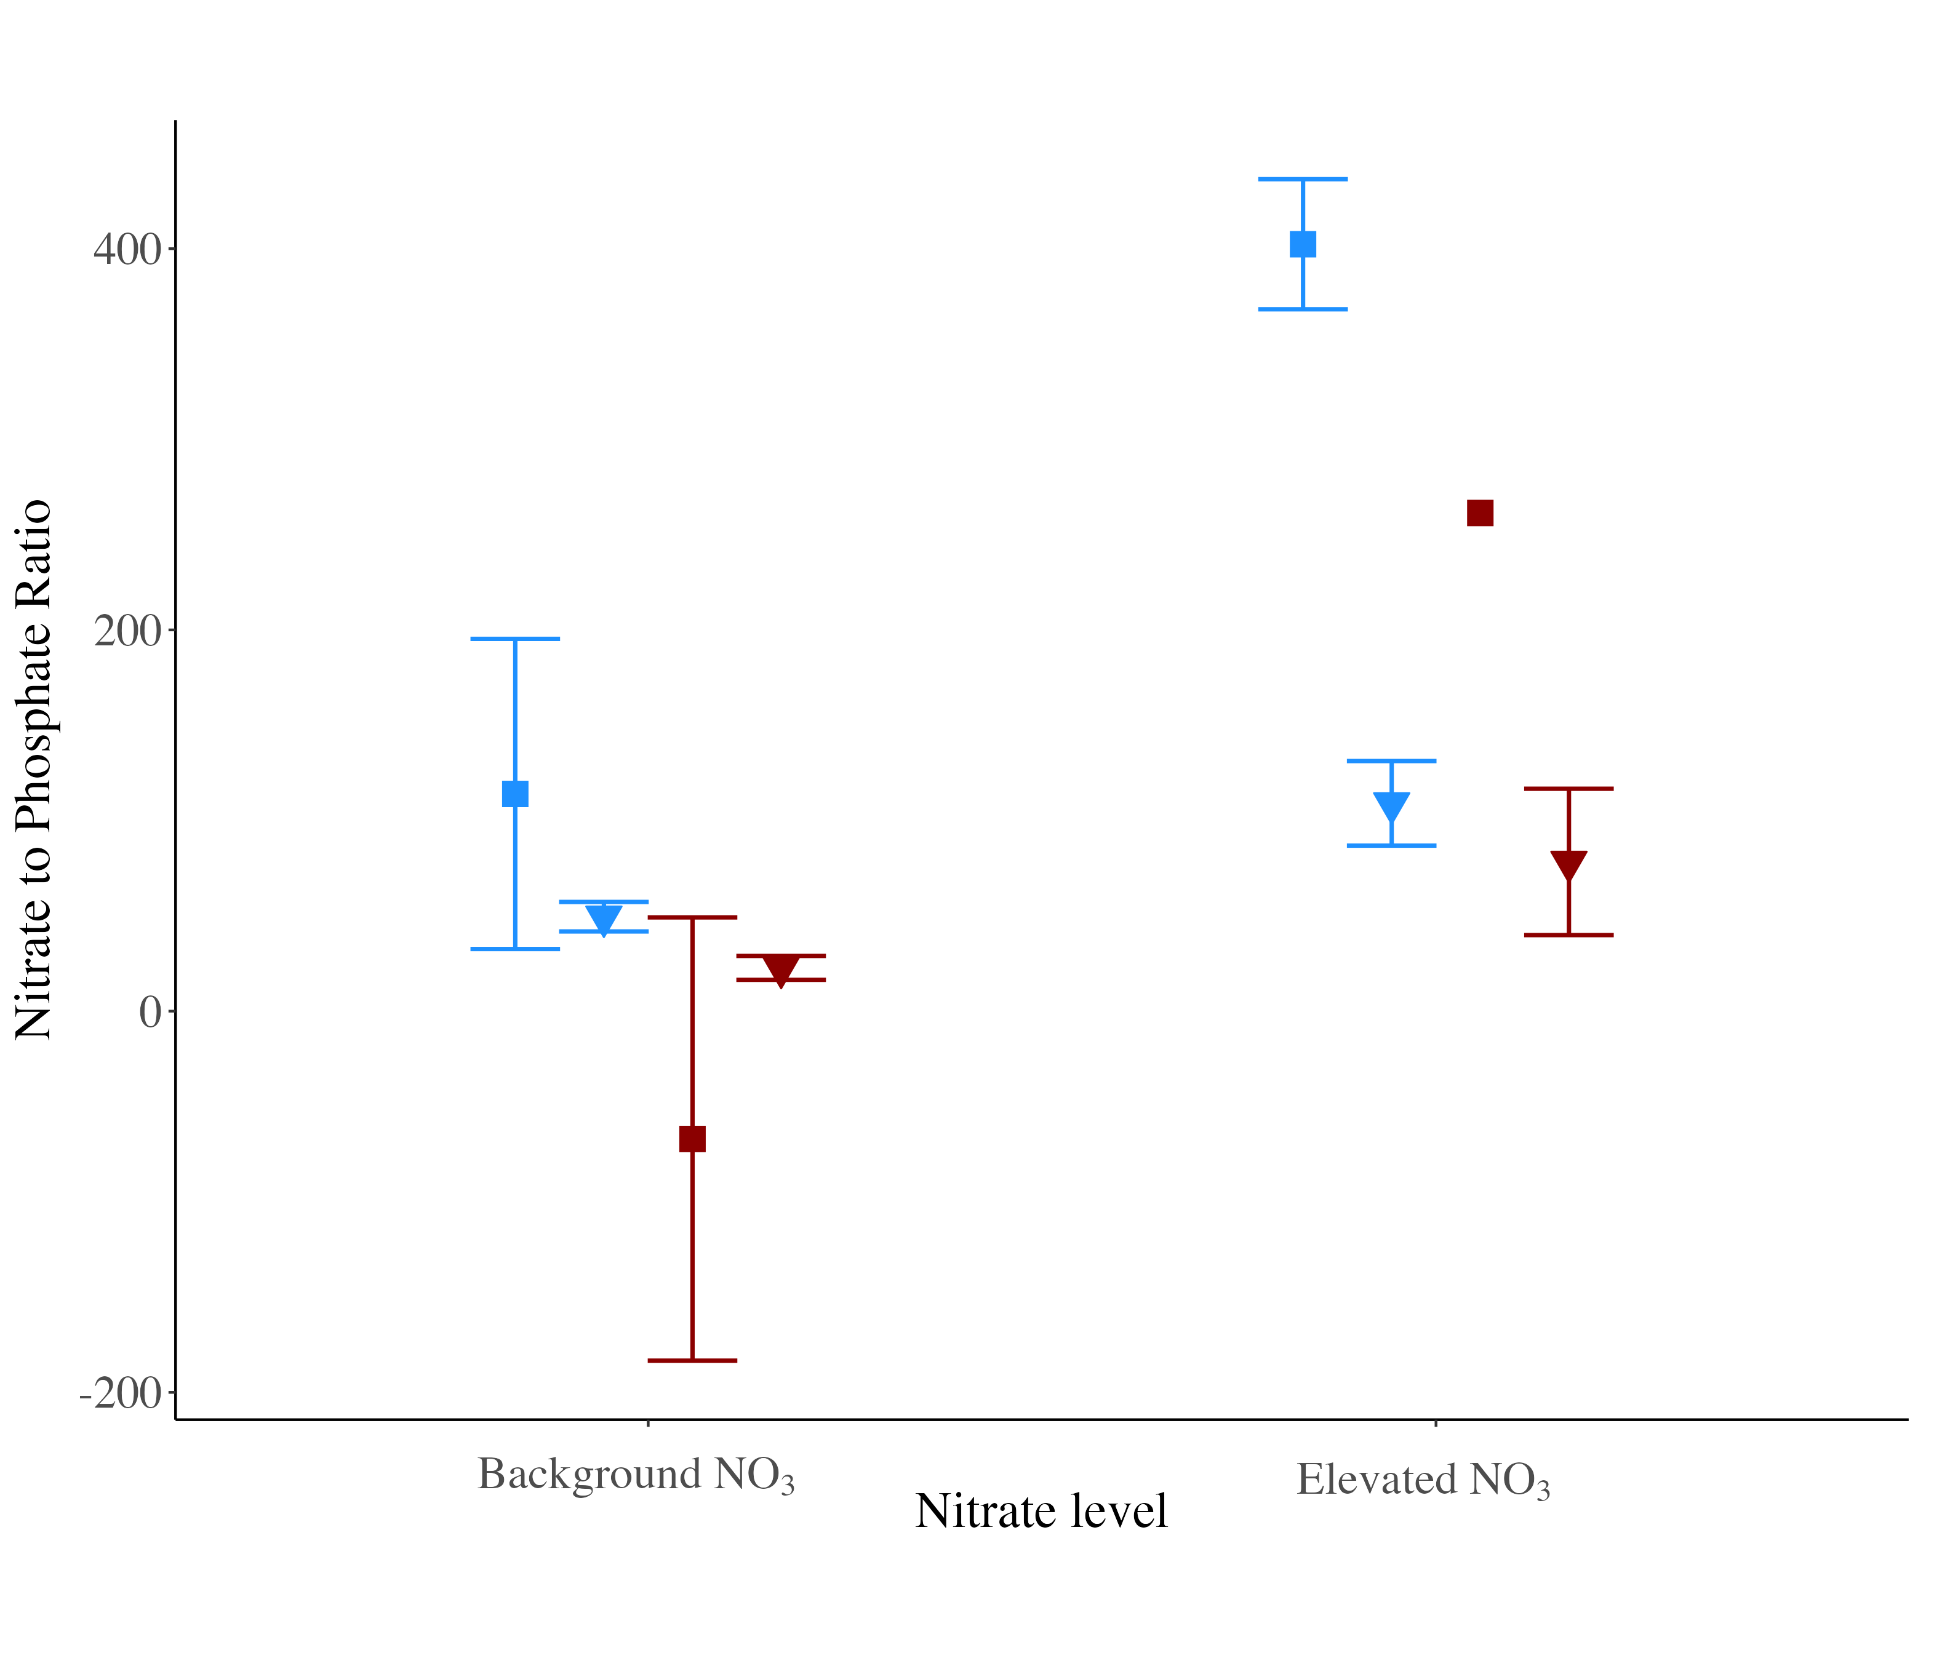

Slide 16
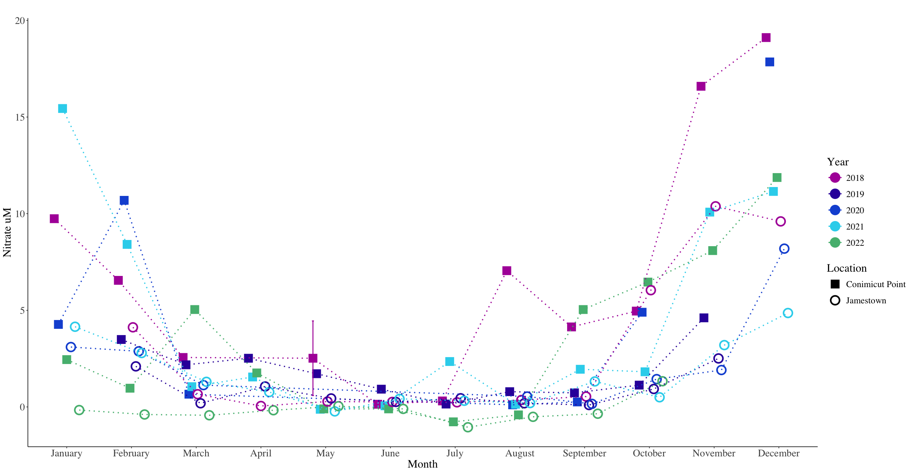

Slide 17
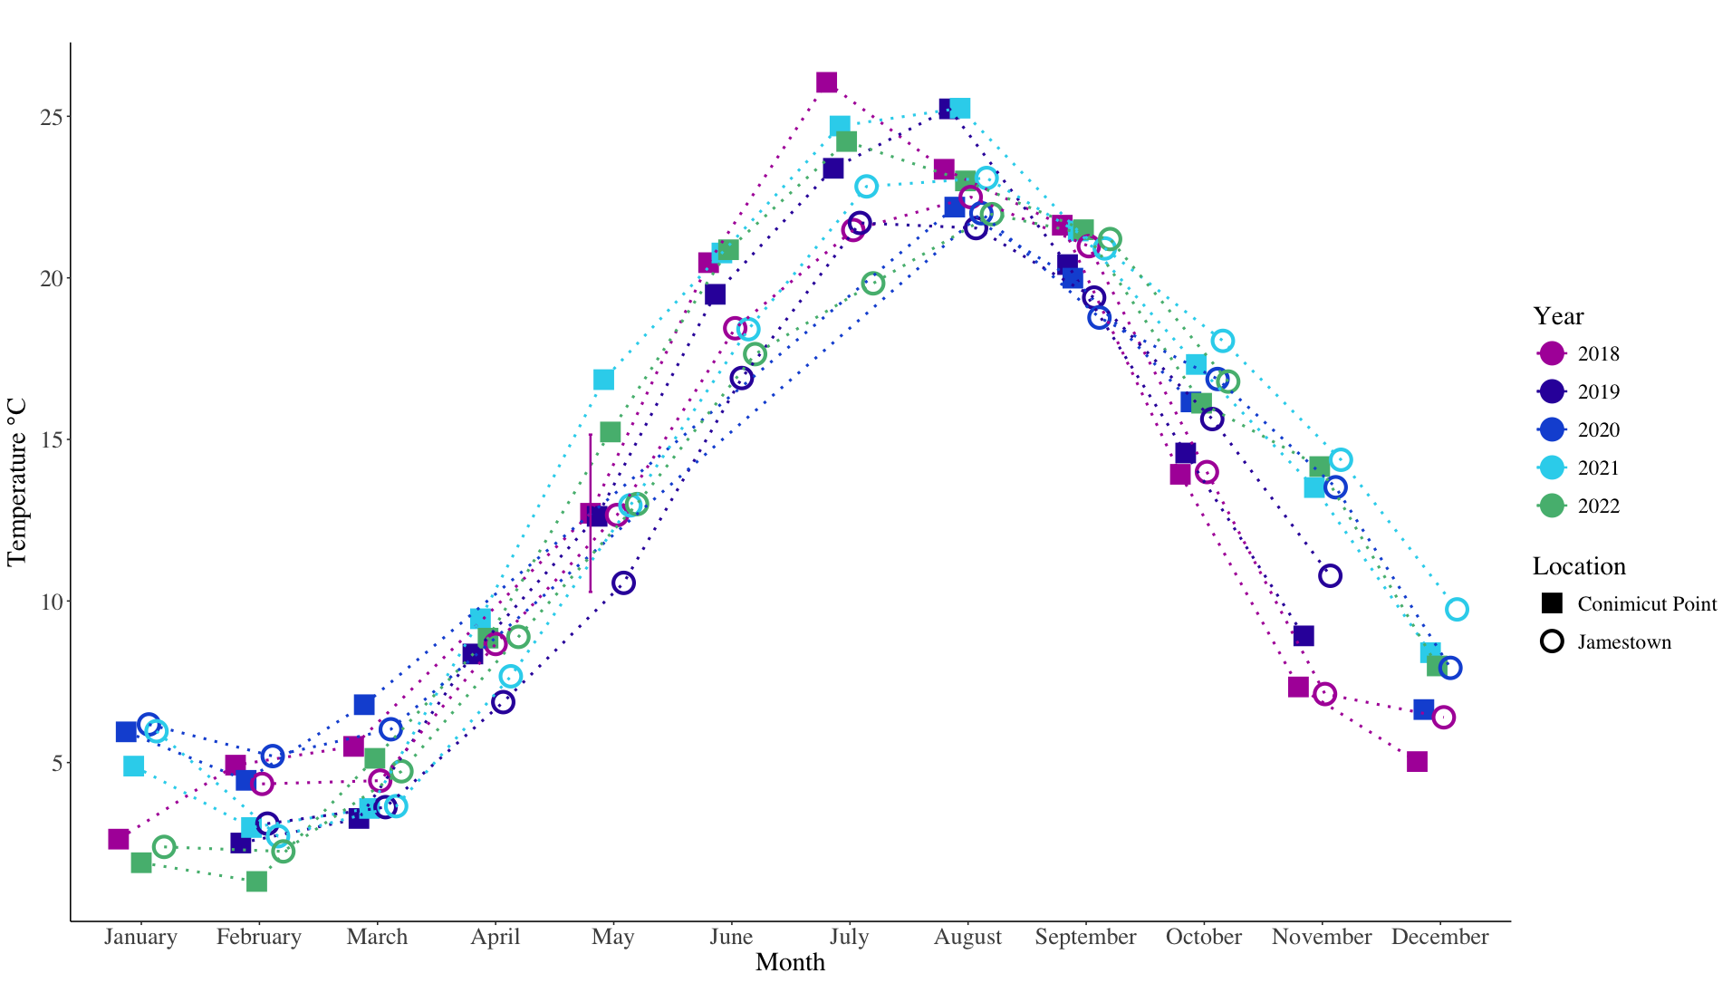

Slide 18
