Slide 1
TLS and PKI
CS 361S
Fall 2021
Seth James Nielson

Slide 2
Secure Authenticated Channel
(Entity) Authentication – Assurance of party identity
Confidentiality – Unreadability of data by unauthorized parties
(Data Origin) Authentication – Unwritability of data by unauthorized parties

Slide 3
TLS 1.2 Handshake
Goal
Agree on a cipher suite for encryption, authentication, etc.
Goal
Identify the server (and optionally the client)
Goal
Create session keys for bi-directional communication

Slide 4
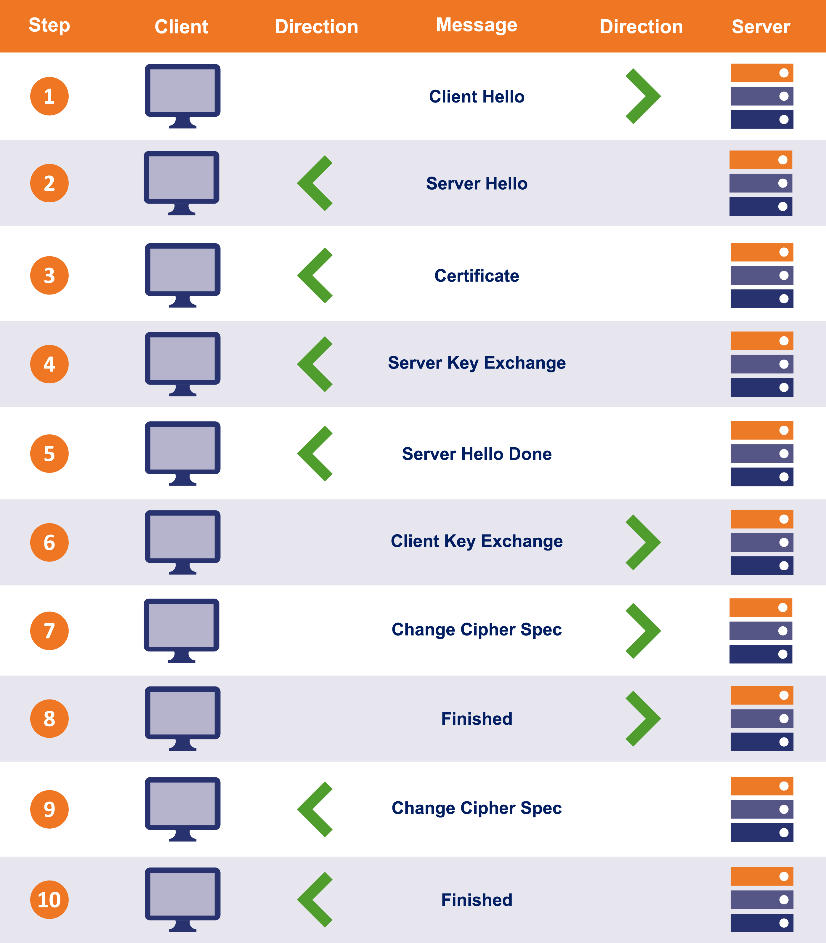
TLS 1.2 Handshake

Slide 5
Handshake Visualization 1
Client Hellio
WEB BROWSER
WEB SERVER
Server Hello, Cert, KeyShare, HelloDone

Slide 6
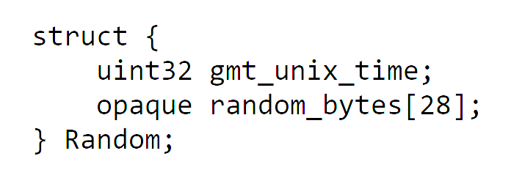
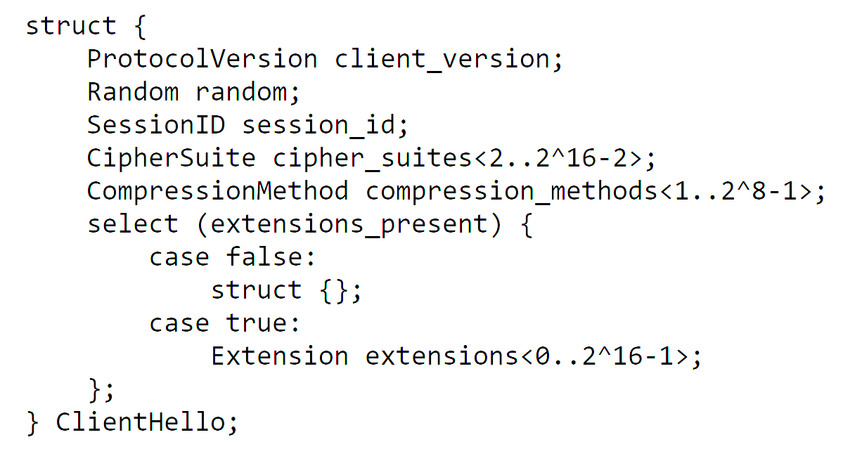
Client Hello
client_version: 0x303 for TLS 1.2
random: prevents “replay” attacks
cipher_suites: see next slide

Slide 7
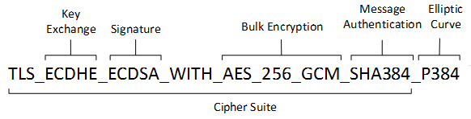
Cipher Suites
TLS_ECDHE_ECDSA_WITH_AES_128_GCM_SHA256
TLS_ECDHE_ECDSA_WITH_AES_256_GCM_SHA384
TLS_ECDHE_ECDSA_WITH_AES_128_CBC_SHA256
TLS_ECDHE_ECDSA_WITH_AES_256_CBC_SHA384
TLS_ECDHE_ECDSA_WITH_AES_128_CBC_SHA256
TLS_ECDHE_ECDSA_WITH_AES_256_CBC_SHA384
TLS_ECDHE_RSA_WITH_AES_128_GCM_SHA256
TLS_ECDHE_RSA_WITH_AES_256_GCM_SHA384
TLS_ECDHE_RSA_WITH_AES_128_CBC_SHA256
TLS_ECDHE_RSA_WITH_AES_256_CBC_SHA384
TLS_ECDHE_RSA_WITH_AES_128_CBC_SHA256
TLS_ECDHE_RSA_WITH_AES_256_CBC_SHA384
TLS_DHE_RSA_WITH_AES_128_GCM_SHA256
TLS_DHE_RSA_WITH_AES_256_GCM_SHA384
TLS_DHE_RSA_WITH_AES_128_CBC_SHA
… (there are MANY more!)

Slide 8
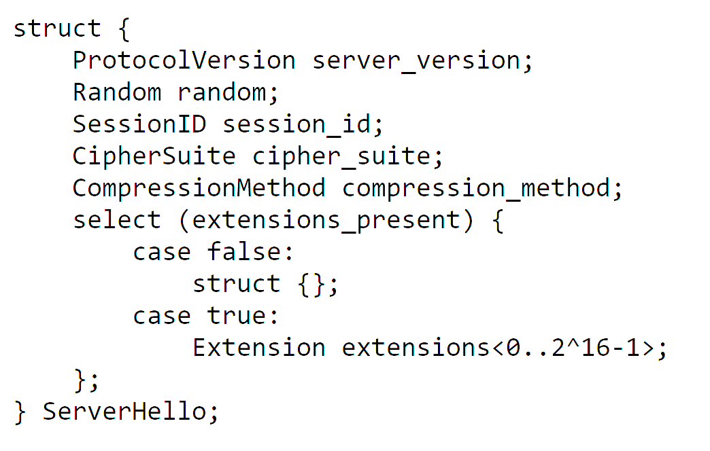
Server Hello
Note that the client offers a list of cipher suites and the server picks one

Slide 9
Server Certificate
A “chain” of certificates
Usually X509 certificates
Lowest certificate identifies the server’s name (e.g., “www.amazon.com”)
Includes a public key such as an RSA public key
The public key must be compatible with the ciphersuite

Slide 10
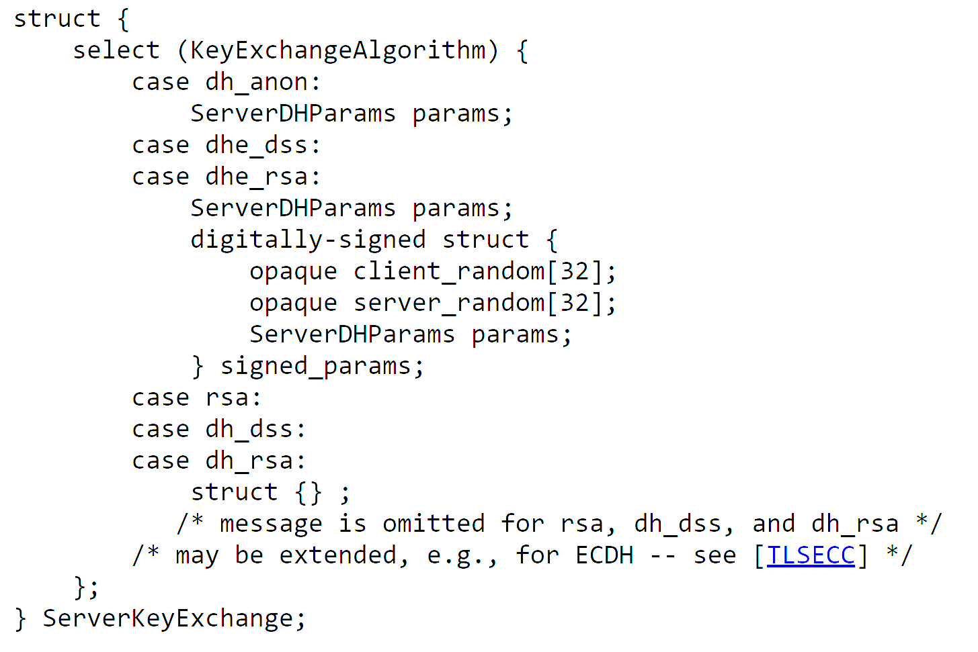
Server Key Exchange
If RSA key transport is used, this message is not sent
If DHE key agreement is used, this message sends the DHE public key
Notice the signature…

Slide 11
Server Hello Done
Server Hello Done carries no extra information
Marks the end of the Hello part

Slide 12
The Problem of Trust
How does the browser know the received public key is the server’s
What if BadGuy.com transmitted HIS key and CLAIMED it was Amazon’s?
X509 Certificates bind identity information to a key; this helps
But it’s not enough. BadGuy.com can generate a fake cert
PKI, Public Key Infrastructure, binds all keys to already trusted keys
Client validates the chain of server certificates to a common key

Slide 13
Certificate Verification
CERTIFICATE
-----------------------------
Subject CN: amazon.com
Not Valid Before: 2001
Not Valid After: 2030
Issued By: amazon CA
Signature Blob: <sig>
WEB BROWSER
Verify “amazon.com” is the URL
Verify the validity period
(Other Verification)
Who issued the cert?

Slide 14
Certificate Chains
Subject CN: amazon CA
…
Issued By: GlobalSign
Signature Blob: <sig>
The certificate for the Host may be signed by an INTERMEDIATE Certificate Authority
Because the web browser probably doesn’t have this intermediate cert, the TLS handshake includes both certificates.
Subject CN: amazon.com
…
Issued By: amazon CA
Signature Blob: <sig>

Slide 15
Root CA Certificates
Certificate chains MUST have a ROOT
A Root Certificate is SELF SIGNED
Browsers trust a set of root certificates AXIOMATICALLY
Certificate chains must have a trust chain to one of these roots.

Slide 16
Trusting Diffie Hellman
Recall that DH keys are EPHEMERAL
The Server’s cert includes a long-term public key
The Server’s DH key is signed by this key pair
IF the client trusts the cert, THEN it can validate the DH key

Slide 17
End-to-End Handshake Visualization #2
KeyShare, Change Cipher Spec, {DONE}
WEB BROWSER
WEB SERVER
Change Cipher Spec, {DONE}

Slide 18
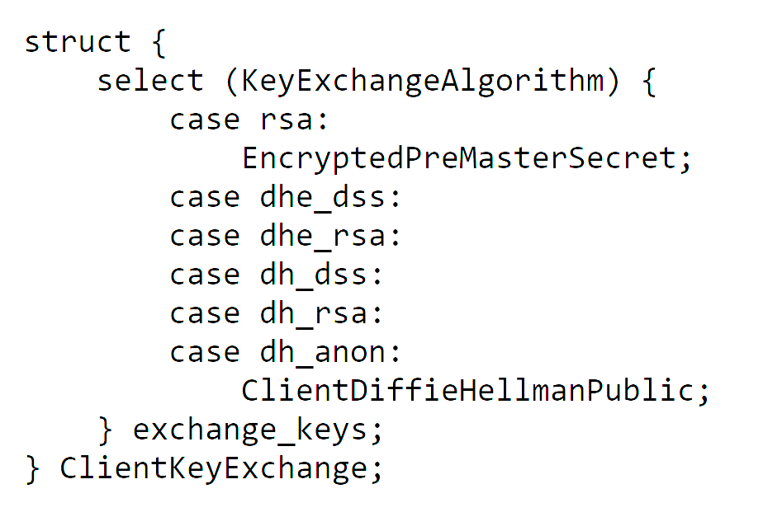
Client Key Exchange
If RSA key transport, sends a “pre master secret” encrypted under the server’s RSA public key from the server’s certificate
But, for DHE key agreement, sends DHE public key. “pre master secret” computed

Slide 19
Deriving Keys
For bi-directional communication, EACH SIDE needs its own keys
Step 1: Compute a master secret from a pre-master secret
Step 2: Compute a key expansion on the master secret
Step 3: Split up the key expansion block into the session keys

Slide 20
Cipher Suites and Key Deriviaton
The side of each key depends on the algorithm
Some cipher suites don’t need IV’s; some don’t need MAC’s
PLEASE NOTE: a client WRITE key is a server READ key

Slide 21
Generating the Key Block
DHE
PRF(pms, “master secret”,
client_random, server_random)
PRF(ms, “key expansion”,
server_random, client_random)
Pre-master Secret
Master Secret
Key Block

Slide 22
Data Origin Authentication
After entity authentication, ensure data received is from that party
Ensure that data is unaltered
Can use something like MAC – Message Authentication Code

Slide 23
HMAC
Hash Message Authentication Code
Details are outside this lecture
Basic concept:
Hash + key
E.g., h(key + data)

Slide 24
Splitting Key Block into Keys
Client Write Mac Key
Server Write Mac Key
Client Write Enc Key
Server Write Enc Key
Client IV
Server IV

Slide 25
Change Cipher Spec
Sent by the client after Client Key Exchange
Indicates that all future messages will be encrypted and MAC’d

Slide 26
Client Finished
Includes a hash of all handshake messages sent so far
Excludes Change Cipher Spec, which is not a handshake message
Excludes the current message (client finished)
Hash is computed as:
PRF(master_secret, “client finished”, Hash(handshake_messages))

Slide 27
Server Change Cipher Spec
Server verifies the client’s finished message
Remember, this message is AFTER change cipher spec, so encrypted
Server sends its own change cipher spec

Slide 28
Server Finished
Server sends its own encrypted Finished message
Hash of handshake messages includes client’s finished message
PRF(master_secret, “server finished”, Hash(handshake_messages))

Slide 29
It All Depends on the Cert
IF a browser trusts MY certificate to be Amazon’s certificate
THEN the browser will trust my DH public key
IF the browser trusts my DH public key
THEN the browser will derive the same MAC key I do
IF the browser derives the same MAC key I do
THEN the browser will believe my messages are from Amazon

Slide 30
TLS Visibility
Typically, a browser/client MUST have a new root CA installed
This root CA is a self-signed certificate from the Visibility appliance
The appliance can now generate ANY cert and the browser believes it!
We will discuss the huge security concerns in a later lecture

Slide 31
TLS Visibility Handshake Visualization
Client Hello
Client Hello
Server Hello, FAKE CERT, KeyShare, HelloDone
TLS Visibility
Server Hello, Cert, KeyShare, HelloDone
WEB SERVER
WEB BROWSER
KeyShare, Change Cipher Spec, {DONE}
KeyShare, Change Cipher Spec, {DONE}
Change Cipher Spec, {DONE}
Change Cipher Spec, {DONE}

