Slide 1
Usable Security Design
Technology of Cybersecurity
Fall 2021

Slide 2
The Most Powerful Security Tech
Year ago a Dental Hygienist asked me what was the best home security for her computer.
Her question was obviously broad
Security against worms/vulnerabilities?
Security against viruses?
Data security?
Anyone wish to guess my answer?

Slide 3

What is a warrior’s Most Powerful Tool?

Slide 4
NO! NO! NO! NO! NO!
This scene convinced me the Jedi were idiots!
It isn’t the Lightsaber that made the Jedi so dangerous
Battles aren’t won during the fighting; they are won in the thinking before hand
Weapons aren’t you most powerful weapon
YOUR MIND IS YOU GREATEST WEAPON (and tool)
My answer to my Dental Hygienist?

Slide 5
Wisdom
&
Knowledge

Slide 6
Your Mind is your Most Powerful Tool
“There is no knowledge that is not power” (Ralph Waldo Emerson)
Tools serve to amplify, not replace, mental powers
Some of the most effective attacks simply take advantage of the mentally weak
The Nigerian Email Scam – Yes, people do fall for these
Other attacks take advantage of systems that are too complicated to fully understand

Slide 7
Non-Thinking: A Danger of Technology
“The real question is not whether machines think but whether men do” (B.F. Skinner)
Thousands of years went in to developing our ability to detect physical fraud
Humanity has not had time to evolve with the technology changes
The most common attacks are not really about the technology, but the people
“Only amateurs attack machines; professionals target people” (Bruce Schneier)

Slide 8
Market Realities
Unfortunately, humanity isn’t going to evolve much during your life time
And, equally unfortunately, they aren’t going to get much smarter (as a group)
This is where you come in
The most valuable security professional protects people not systems
You want to learn to create tools that helps idiots be safer
You need to be the strong mind that protects the weak

Slide 9
Security Objectives
Confidentiality
Integrity
Availability
Privacy

Slide 10
But How?
Security objectives can be expressed as a “policy”
Anderson’s policy.
Short statements about the protection profile
Policies are enforced with mechanisms
Critical to use an appropriate mechanism

Slide 11
Context is **EVERYTHING**
In-class reading of Anderson 1.3-1.6
Consider the following:
What is being protected?
Who is the main adversary?
Who are the legitimate users and user classes?
What is the interface?
How does authentication work?
These examples are from 2007-ish. Has anything changed?

Slide 12

Psychology is Significant

Slide 13
Social Engineering: Pretexting
Pretexting: phoning someone for info while pretending to be someone else
The goal is to get information that gets you in the system, often a password
Attacks of this sort are often conducted in stages
Attacker starts by getting non-sensitive information
Attacker uses non-sensitive information to convince others of his deception
Your book points out one health institution had 30 such calls a week!

Slide 14
Possible Solutions
Operational Security
Limit who has access (AH HA! PRINCIPLE OF LEAST PRIVILEGE!!!)
Train absolutely everyone that must have access
Periodically test the staff (e.g., by sending them a phishing email)

Slide 15
Social Engineering: Phishing
Phishing: Sending an email that appears to be authentic to get private info
Easy to create an email that looks authentic.
Especially modern emails with HTML and media
The resources are often online, so the phishing email simply points to them
Email is easily forgible
Example attacks:
Tell user they need to change password (and enter old password first)
Tell user they need to update profile including SSN

Slide 16
Spear Phishing
A targeted email to a specific potential victim
Aren’t these names clever?

Slide 17
Possible Solutions
Big problem: the target is your customers
Can’t really limit them, unless you want to go out of business
Can’t really train them
Psychology
Make it hard for them to do the wrong thing
Make it easy to do the right thing
(Obviously easier said than done…)

Slide 18
Limiting Human Error
Errors spring from many sources
Human automation (drive to the wrong place because its common)
Following the wrong rule (information overload)
Not understanding the problem/context

Slide 19
Understanding Human Bias
Humans are not rational
Humans are designed with a bias toward action
If we thought about everything we’d never do anything
We’re programmed to act without thinking
Examples of bias:
We’re more afraid of dying in a plane crash than a car crash

Slide 20
When Emotion Takes Over
When human logic/thinking reaches the end, emotions take over
If we don’t know explicitly what to do, we respond emotionally
So, sometimes education has limited value
The bad guys will always learn how to exploit the part the users don’t know
One solution is safe defaults (AH HA! FAIL SAFE/FAIL SECURE!)
“Our bank will never, ever send email”

Slide 21
Abuses of Authority
Read carefully the book’s examples of how people behave
Under someone else’s authority
When they have authority
Also, people do not like to admit they make mistakes
“Hustlers” take advantage of this
AGAIN, you cannot design assuming the user is dispassionate and rational

Slide 22
Passwords
Three ways of authenticating:
Something you have (token, fob)
Something you are (biometrics)
Something you know (password)
Passwords are the most common because it is the cheapest solution

Slide 23
Password Psychology: Strength?
It’s a good idea to require long complicated passwords, right?
Unless the user writes it down (easily compromised)
Or has to keep resetting it (easily compromised)
It’s a good idea to require the user to change passwords regularly, right?
See the problems above
KEY POINT:
If you make security hard, the user will opt out

Slide 24
Password Security Usability
Protecting the entry form-factor
Bad example: PINs at ATMs

Slide 25
Password Guessing Issues
Common solution is to freeze account or entry after multiple bad attempts
This can open up denial of service attacks
Can’t use this, for example, in the military
Better solution is to require good passwords that cannot be guessed
However, watch out for “side channel” attacks on password guessing

Slide 26
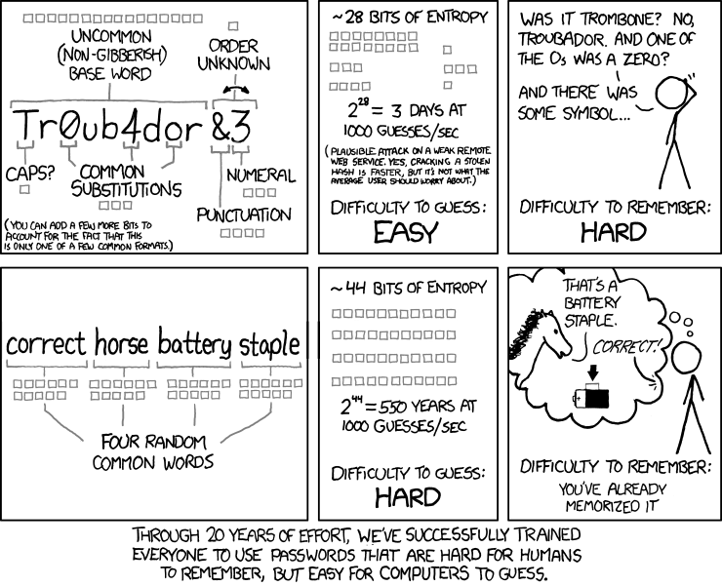
A Word about choosing Passwords
My favorite method is to choose 4 random words
XKCD #936:

Slide 27
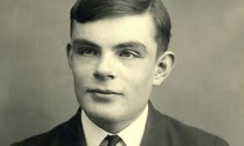
CAPTCHAs
Good case study!
Combine psychology, usability, and system design nicely
Designed around what humans do well that computers do not
“Completely Automated Public Turing Test to Tell Computers and Humans Apart”
Thanks Alan Turing!

