Slide 1
Cryptography in Network Security
UT Law 379
Fall 2021
Lecture Notes

Slide 2
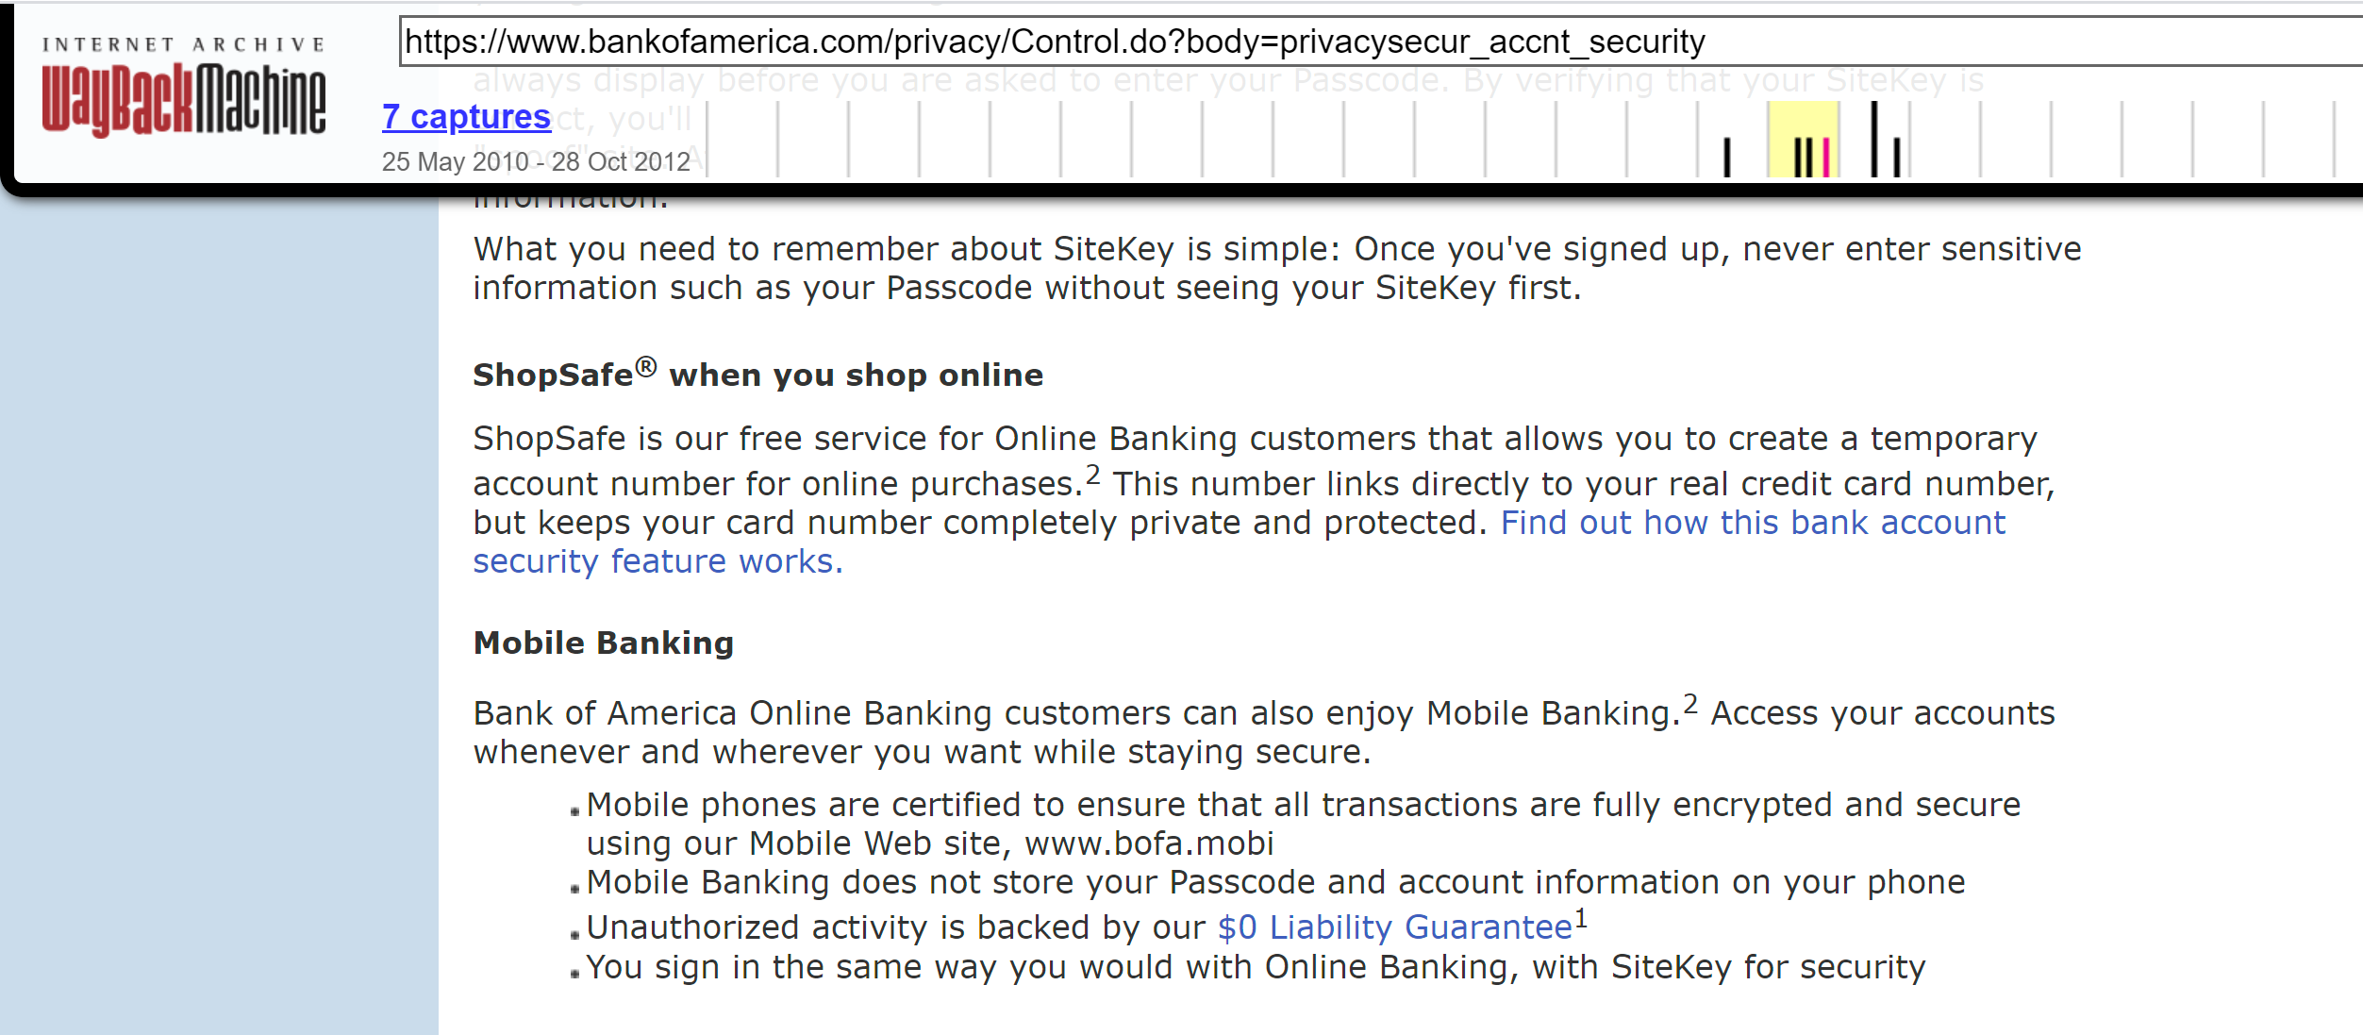
What is “Cryptography”?

Slide 3
Cryptography ≠ Confidentiality
“Secret” codes usually gets the most attention from non-experts
Websites used to emphasize “security” by talking encryption
In crypto terms, encryption typically provides “confidentiality”
Confidentiality is not the only property, nor even the “most important”

Slide 4
Cryptography Definition
Assume definition of “information” is axiomatic
Study of mathematical techniques related to information security such as
confidentiality,
data integrity,
entity authentication, and
data origin authentication
(See, HAC Definition 1.1)

Slide 5
Information Security
“Protect” information
This is the goal (i.e., the (Anderson) security policy)
Cryptography is just one approach (i.e., mechanism) to enforcement

Slide 6
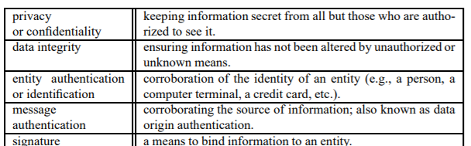
Information Security Objectives

Slide 7
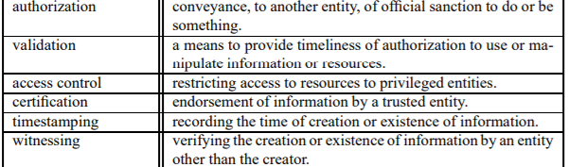
Information Security Objectives

Slide 8
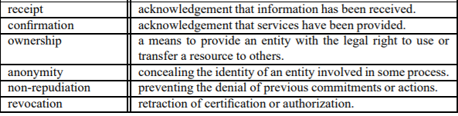
Information Security Objectives

Slide 9
Crypto’s Primary Objectives
Confidentiality
Data Integrity
Authentication
Entity Authentication
Data Origin Authenticaiton
Non-repudiation
Other objectives built on top of these four properties

Slide 10
States* of Data
Data at Rest
Data in Motion
Data in Use
*Analogous to States of Matter (solid, liquid, gas)

Slide 11
Crypto in Network Security
Protecting Data In Motion gets most of the attention
Common objective: Over-the-network entity authentication
Common objective: Secure Authenticated Channel
Protecting Data-at-Rest and Data-in-Use from network-based adversaries
Common objective: Maintain data confidentiality (prevent exfiltration)
Common objective: Maintain data integrity (prevent tampering)
(* Not a comprehensive list!)

Slide 12
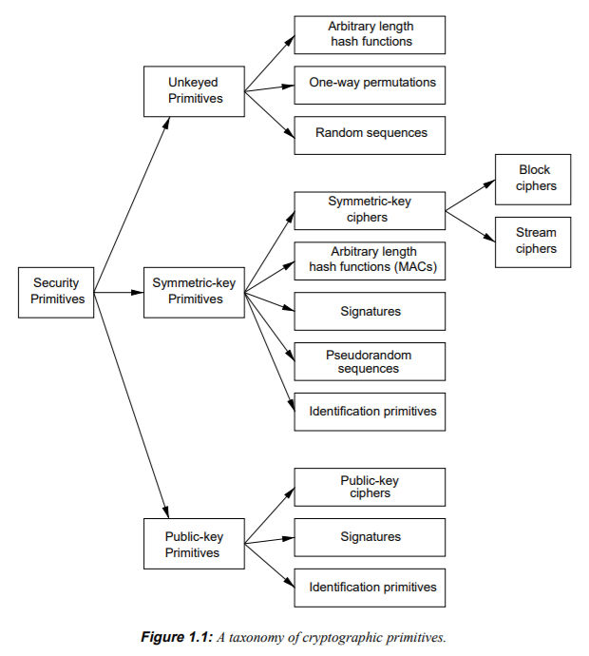
Cryptographic “Primitives”

Slide 13
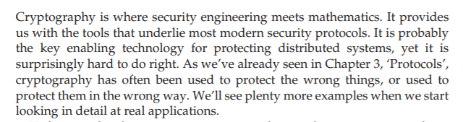
Anderson’s Intro

Slide 14
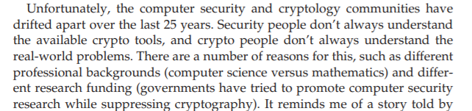
Security vs Cryptography

Slide 15
YANAC
YOU ARE NOT A CRYPTOGRAPHER
You will acquire some knowledge in this class
That could make you more dangerous, not less!
Do NOT roll your own cryptography
Know when to tell your boss to hire a cryptography expert

Slide 16
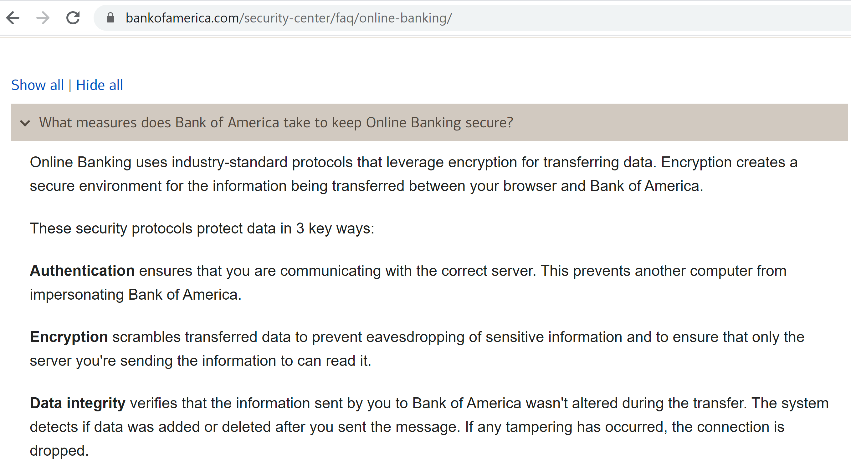
Improvement!

Slide 17
Technology Review

Slide 18
Symmetric Cryptography
All parties in the protocol share a unique key
If |parties| is 1, “secret key”
If |parties| > 1, “shared key”
For today’s examples, assume pre-shared key

Slide 19
Symmetric-Cipher Types
Block Cipher
Data split in fixed-size blocks
1:1 map from plaintext block to ciphertext block
“Substitution Cipher”
Stream Cipher
Encrypted 1 symbol at a time
Combined with a Stream of key material (key stream)

Slide 20
Monoalphabetic Substitution (Caesar cipher)
Each letter of plaintext maps to exactly one cipher symbol
(Block Size: 1 letter)
Let’s race! Decrypt the following:
RYG WKXI CSLVSXQC NY IYE RKFO?
It’s a question, when you decrypt it, shout out the answer!

Slide 21
Caesar Cipher: “Shift” Cipher
Write out all letters and move them over (wrapping around)
A B C D E F … X Y Z
X Y Z A B C … U V W
KEY SPACE: How many keys are there for this algorithm?

Slide 22
Permutation Cipher
Any letter can be mapped to any letter:
A B C D E F G H I J K L M
X N B Y A M L S V P R K W
N O P Q R S T U V W X Y Z
Z C G I U D T F O H J Q E
Key space is now how big?
Block size is still 1

Slide 23
Why Size Matters
Key Space is related to exhaustive/brute-force search
Even without a computer, a 25/26 key space is easy to brute force
Block Size is related to cryptanalysis e.g., frequency analysis
A one-letter block does not conceal enough information

Slide 24
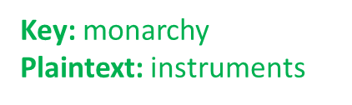
Playfair Cipher
1854 by Charles Wheatstone
Named after Lord Playfair who promoted it (classic politician)
Example: https://geeksforgeeks.org/playfair-cipher-with-examples

Slide 25
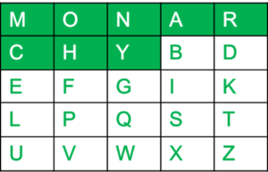
Playfair Keyblock
5×5 grid of alphabets that acts as the key (Key Expansion)
One letter of the alphabet (usually J) is omitted from the table
(If the plaintext contains J, then it is replaced by I)

Slide 26
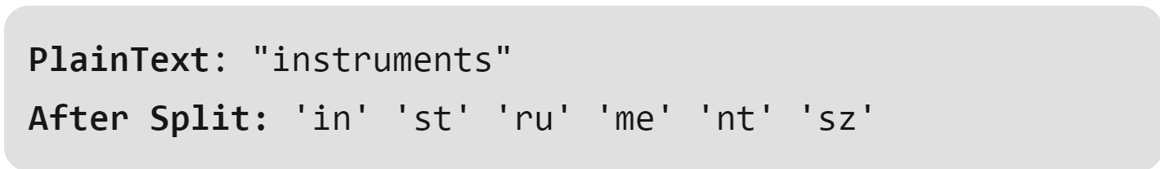
Playfair Encipherment
The plaintext is split into pairs of two letters (digraphs).
If there is an odd number of letters, a Z is added to the last letter

Slide 27
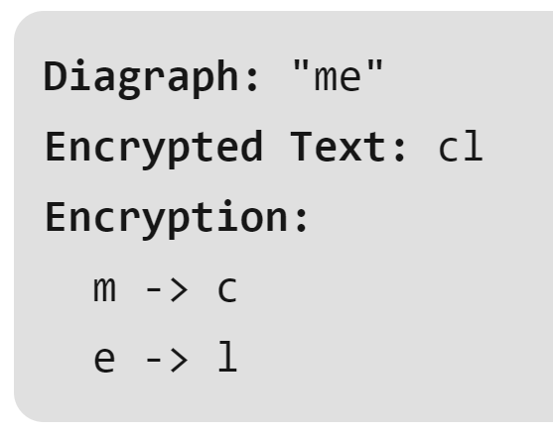
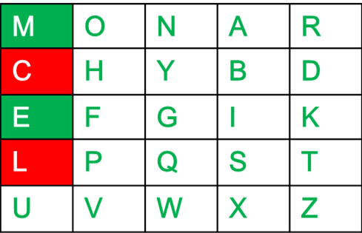
Playfair Encipherment
If both the letters are in the same column:
Take the letter below each one

Slide 28
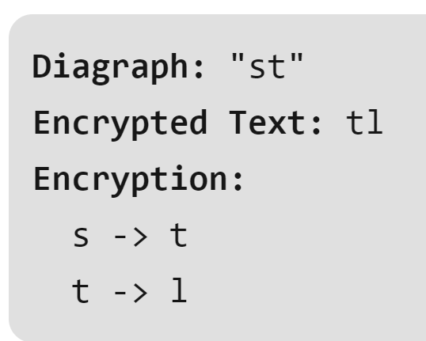
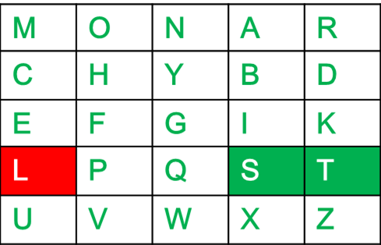
Playfair Encipherment
If both the letters are in the same row:
Take the letter to the right of each one

Slide 29
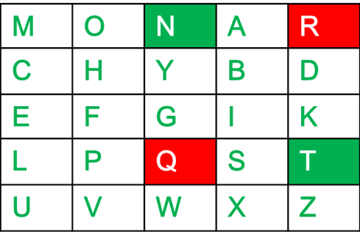
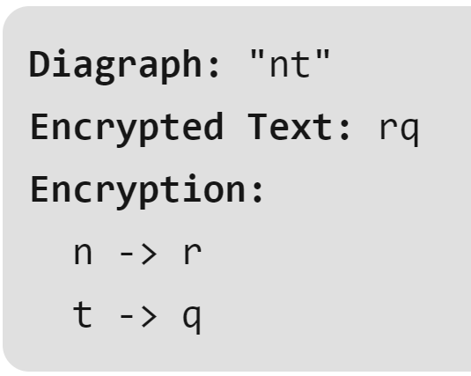
Playfair Encipherment
If letters do not share a row or column:
Form a rectangle with the two letters and take the letters on the horizontal opposite corner of the rectangle

Slide 30
Playfair Ciphertext:
Plain Text: "instrumentsz"
Encrypted Text: gatlmzclrqtx

Slide 31
How “Strong” is Playfair?
What’s the key space? How long to brute force?
What about “cryptanalysis”?

Slide 32
Cryptanalysis Considerations
Our example playfair ciphertext might be “uncrackable”
But what if the plaintext was longer?
How much ciphertext before patterns emerge?
Digraph (2-letter “blocks”) are better, but not good enough

Slide 33
Modern Requirements*
Symbols are just bits (can represent all info)
Blocks are large (used to be 64, now 128 bit)
Key size is large (currently 128 min, soon 256 bit min)
Algorithm has “Avalanche” property
*Not a formal list of all requirements; These are the ones that
Dr. Nielson runs into most often

Slide 34
AES: Common Block Cipher
Block size is ALWAYS 128 bits
Key size can be 128, 192, or 256
But at its core, still a “substitution” cipher.
AES-128 encryption of ”My name is Seth!” w/ a “zero” key:
E94B 69E7 13C6 B4F9 B834 FEA5 95F7 8F2A

Slide 35


Block Cipher Weaknesses
What happened here?

Slide 36
Patterns
Remember, AES still 1-to-1 mapping of 128 bits
If input 128 bits is the same, output 128 bits is the same
Patterns between blocks NOT ERASED
Solution: “link” output in some way

Slide 37
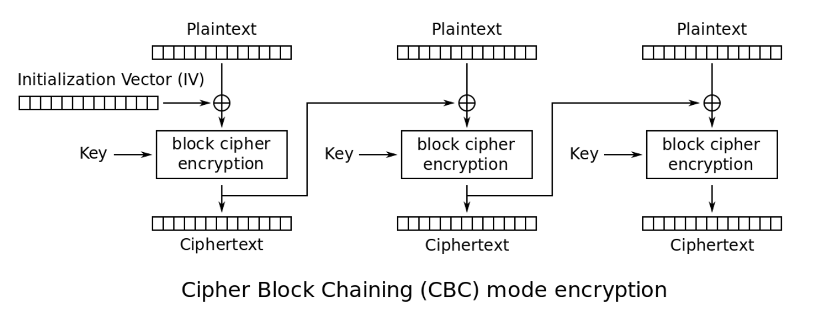
Cipher-Block Chaining (CBC)

Slide 38
What is an IV?
Initialization Vector
Similar to “salting” a hash
Eliminates deterministic output
You should almost never reuse a key
BUT YOU SHOULD NEVER EVER reuse a KEY and IV

Slide 39
Quasi-Deprecated CBC
CBC “works” when used correctly
However, has various weaknesses and is error prone
In many cases, CBC is being deprecated

Slide 40
Counter Mode (CTR)
Converts a block cipher into a STREAM CIPHER
Does NOT encrypt the plaintext directly
Rather, is used to generate a key stream
Keystream = AES( IV + 0 ), AES( IV + 1 ), AES( IV + 2 )…
Ciphertext = Plaintext XOR Keystream
Plaintext = Ciphertext XOR Keystream

Slide 41
Don’t Reuse Keystream
C1 = K1 xor M1
C2 = K1 xor M2
C1 xor C2 = K1 xor M1 xor K1 xor M2
= K1 xor K1 xor M1 xor M2
= M1 xor M2

Slide 42
Confidentiality does NOT provide Integrity
Start with a ciphertext C1 = K XOR M1
Suppose an attacker knows the plaintext M1 (or part of it!)
Suppose attacker can intercept/change the message
Attackers wants to change M1 to M2
Attacker produces C2 = C1 xor (M1 xor M2)
= K xor M1 xor M1 xor M2
= K xor M2
ALSO WORKS ON OTP (“provably secure”)

Slide 43
Integrity in History
Message integrity also pre-dates modern cryptography
Bank transfers in the 19th century used the telegraph
How to keep a telegraph operator from sending a false message?
Banks developed code but this did nothing for message integrity
Banks developed code books with a “test key”
The test key had one-way calculations for money, dates, currency, etc
The test key computed and the test key transmitted had to match
Not great by today’s standards, but worked until the 1980’s!!!

Slide 44
Modern Hashing
Compression
Ease of Computation
Preimage Resistance
2nd Preimage Resistance
Collision Resistance
In practice, also has the Avalanche property

Slide 45
Message Authentication Code
MAC is a symmetric key code that is used for message integrity
Commonly implemented as a keyed hash
Super simple MAC: hash(message + key)
HMAC is more complicated, but same basic idea:
HMAC_k(M) = h(k xor A, h(k xor B, M))
A = repeated 0x36
B = repeated 0x5c

Slide 46
Composite Mode
Also known as
Authenticated Encryption or
AEAD – Authenticated Encryption with Additional Data
Integrity + Confidentiality
AES-GCM is counter mode with a built-in MAC (called a “tag”)
AES-CCM is counter mode with CBC-MAC
Only AEAD ciphers supported in TLS 1.3
TAKEAWAY MESSAGE: USE AEAD WHENEVER POSSIBLE!!!!!!!!

