Slide 1
Network Security and Privacy
UT CS361S
Fall 2021
Lecture Notes

Slide 2





About the Instructor

Slide 3
What about You?
Why did you take this course?
What is your programming background like?
What has been your favorite course so far? Why?
What is your learning style?
What is your favorite teaching style?

Slide 4
The 5 Orders of Ignorance
0th Order: Known Knowns
1st Order: Known Unknowns
2nd Order: Unknown Unknowns
3rd Order: Unknown methods for discovering unknown unknowns
4th Order: Unknown methods for exploring the orders of ignorance
(Adapted from Phillip Armour, “The Five Orders of Ignorance”)

Slide 5
The 5 Orders of Ignorance
0th Order: Known Knowns
1st Order: Known Unknowns
2nd Order: Unknown Unknowns
3rd Order: Unknown methods for discovering unknown unknowns
4th Order: Unknown methods for exploring the orders of ignorance
(Adapted from Phillip Armour, “The Five Orders of Ignorance”)
SKILL
EDUCATION

Slide 6
A Few Introductory Notes
This course is still a little new for me
I’m still developing the materials
Please feel free to make suggestions or raise concerns

Slide 7
Past Student Comment - #1
While the course material covered was interesting, I felt that we skimmed over many advanced concepts. Too much of the course was focused on obvious security considerations rather than the backing theory. The professor seemed to not always have a great grasp over the concepts, which made some explanations hard to grasp. Despite this, the professor made himself available a great deal to the class, and he was an enthusiastic lecturer. I think this course would be great with just a few tweaks.

Slide 8
Past Student Comment - #2
Use Canvas. If more than half of your students aren't understanding something, it's probably not their fault. Your lectures weren't very structured and it was hard to follow what you were talking about a lot of the time. See: The Curse of Knowledge.Lastly, use Canvas.

Slide 9
Past Student Comment - #3
Streamline your assignments. Also, stop talking about Hitler so much. People might get the wrong idea.

Slide 10
Past Student Comment - #4
I almost dropped the course because the first two labs were incredibly difficult for me and I wouldn't even know where to begin. Especially for the first lab. I've never cried because of a lab, but lab 1 made me cry due to the amount of frustration I had. The lectures were more theory based, so when it came to actually practicing this I didn't know where to begin, and the instructions were not very helpful and assumed a lot of prior knowledge…

Slide 11
Early Criticism
I would prefer criticism *before* the class reviews
It gives me a chance to improve before being evaluated
You may send anonymous emails if you need anonymity

Slide 12
Grading
NO EXAMS!
60% labs
30% In-class Labs
We will do these together
Finish later if you miss class
(Class is Recorded)
10% Reading discussions

Slide 13
In-Class Mini Labs (5% Each)
Lab 1 – Buffer Overflow and GDB
Lab 2 – Networking and Wireshark
Lab 3 – Cryptography 1
Lab 4 – Cryptography 2
Lab 5 – HTTP and Web
Lab 6 – Cookies

Slide 14
Labwork (10% Each)
Lab 1 – Return Oriented Programming
Lab 2 – Authentication/Authorization
Lab 3 – TLS 1.2 Server
Lab 4 – TLS Visibility
Lab 5 – Oauth SSO
Lab 6 – CTF Exercises

Slide 15
Labwork Policies
Bare minimum requirements for each lab
80% score if minimum requirements reached
ZERO POINTS if minimum requirements not met
Code alone, debug in assigned groups
10% off per day late to a maximum of 50%
Any one lab can be redone for no penalty by end of class

Slide 16
Readings
I’ve tried a bunch of books. I hate them all
All free materials available online
Ross Anderson’s “Security Engineering”
This IS a great book
Second edition is free online

Slide 17
Reading Policies
Read before class for class discussion
Each week, in groups, discuss previous week’s reading
Discuss via text-based system and submit transcript

Slide 18
Class Discussions
I hate slides and I hate “lectures”
I only use them because I haven’t found something better
Please read before class, come prepared to discuss
You will be assigned to discuss out-of-class as well

Slide 19
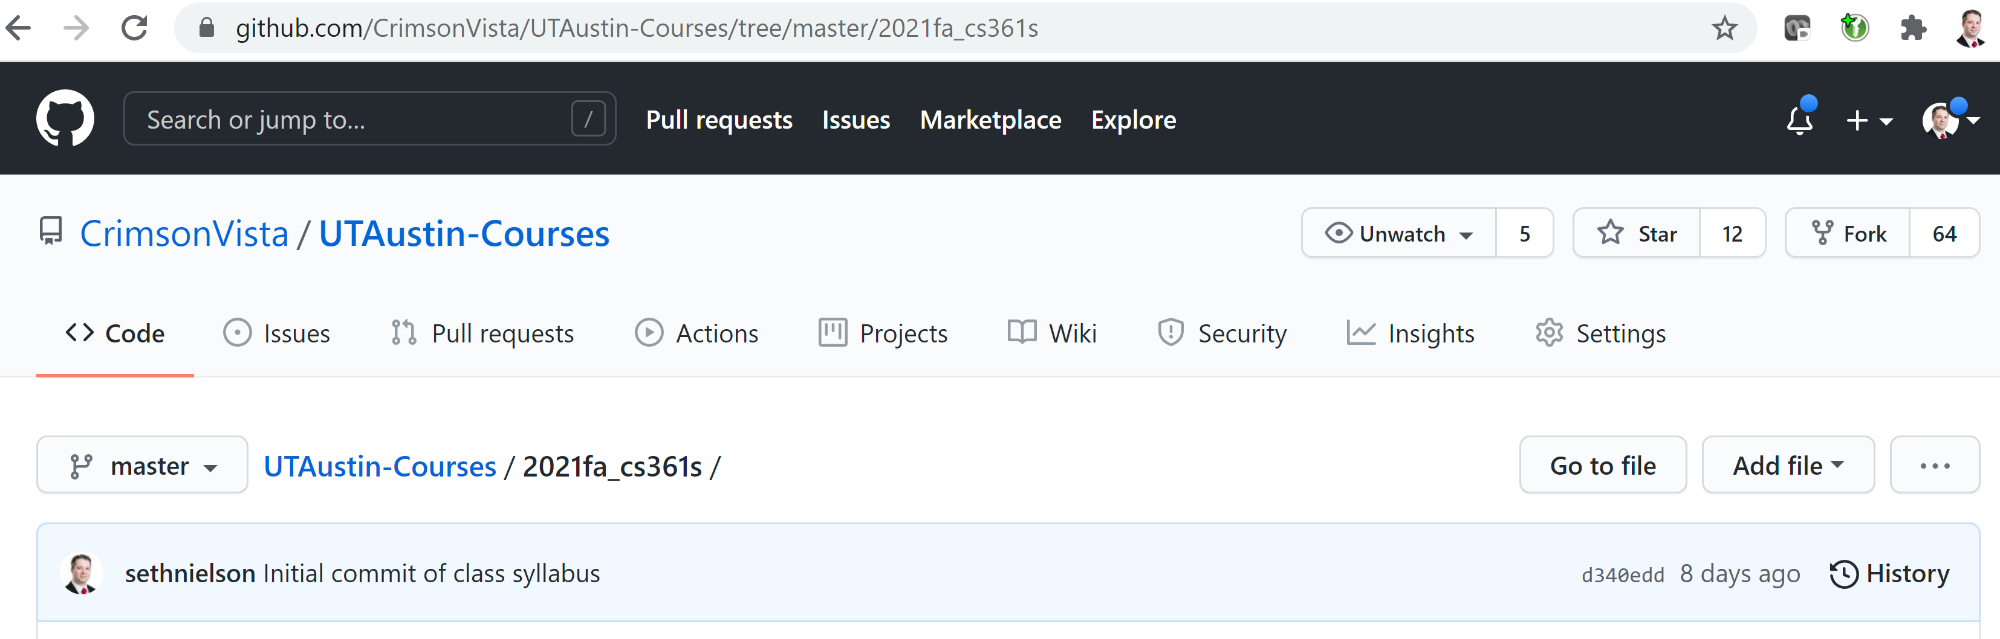
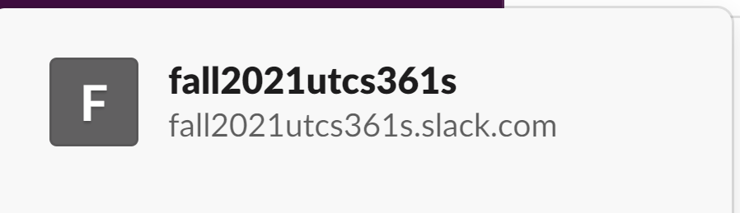
Two Resources

Slide 20
Typical Security Objectives
Confidentiality
Integrity
Availability
(CIA Triad)
(See, NIST 800-12)

Slide 21
Security Engineering
“[It] is about building systems to remain dependable in the face of …”
Malice
Error
Mischance.
“As a discipline, it focuses on the…”
Tools
Processes
Methods

Slide 22
Application
Confidentiality, Integrity, Availability
For new systems:
Design security
Implement security
Test security
For existing systems:
Adapt them for increased security
Adapt them as their environment evolves

Slide 23
Key Observation
Anderson, Ch 1, p. 4

Slide 24
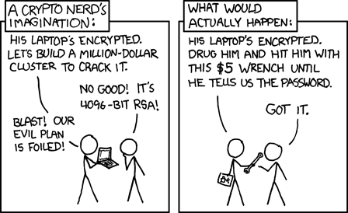
Illustrations
See http://xkcd.com/538/

Slide 25
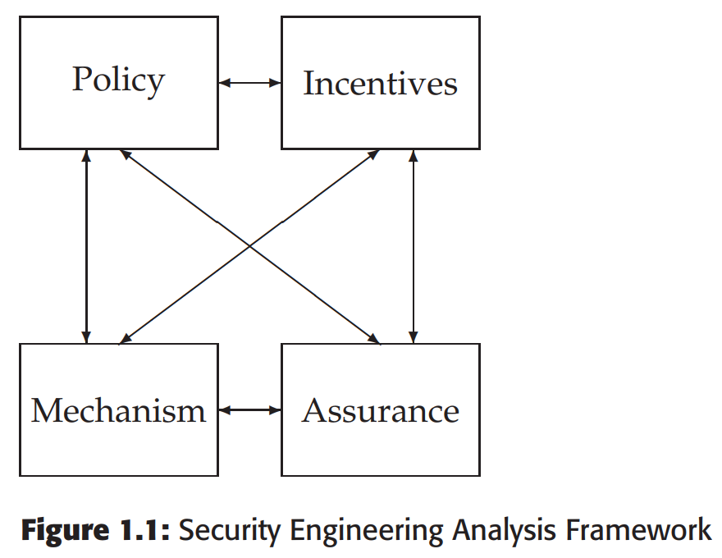
A Framework
Policy
Mechanism
Assurance
Incentives

Slide 26
Start with Policy
“…a succinct statement of a system’s protection strategy” (Anderson ch1 p. 15)
Examples:
Each credit must be matched by an equal and opposite debit
All transactions over $1,000 must be authorized by two managers
Practice:
What are the security policies for TLS?

Slide 27
Then figure out mechanism
This is where most security people like to start
But really we only need mechanism to enforce policy
Some mechanisms aren’t even technical (e.g., legal)
MUST understand threat model

Slide 28
Incentives
Anderson’s example of airport security
What motivates the behavior?
What is “Security Theater?”
Everyone should learn a little game theory
Read up on Prisoner’s dilemma
Understand “mechanism design”
Anderson’s “Moral Hazard” (Chapter 25)

Slide 29
Assurance
Just how strong/resilient/comprehensive is the mechanism?
Requires a solid understanding of the threat model
Applications at every stage!
Design – solid security engineering principles
Implementation – coding practices, development processes
Testing – adversarial, comprehensive assessment

Slide 30
In this Class
Focus on POLICY and MECHANISM
In NETWORK SECURITY
Much of our focus will be on network protocols/systems
Cryptographic protocols like TLS
Authentication/Authorization protocols like OAuth/OIDC
Web security mechanisms
Touch on other elements:
Host security
Incentives
Assurance

