Slide 1



iMAP
towards low-dose iL2 Market APproval
for autoimmune diseases
ANR- 16-RHUS-0001
2019

Slide 2
From data production to data integration
Caroline Peltier, François-Xavier Lejeune, Ivan Moszer, Encarnita Mariotti-Fernandiz
Comité Scientifique iMAP - .../2019

Slide 3
Ordre du jour
Etats des lieux des bio-collections
Tâches définies par partenaire
Questions biologiques
Analyses: qui, quoi et comment?
Infrastructure et partage de données: update

Slide 4
WP4- Bio-collections
TRIALS | LUPIL-2 | MS-IL2 | DIABIL-2 | HEALTH-IL2 | FACIL-2
Patients # | 60 | 30/30 | 132/138 | 6/40 | 10
Flow Cytometry sample # | 296 | 190 (Frozen PBMC) | 319 for Paris (Frozen PBMC) | All In real time +pStat5 | Q1 2020
Transcriptome Repertoire Treg/Teff RNA sample # | 191 (each techno)
Cytokines sample # | 329 | 206 (Plasma collected) | 330 for Paris (Plasma collected)
Microbiota Sequenced sample # | 184 | 86 | 37 | 0
 |  | End of the Follow up Q2 2020 | Other centers: samples shipment to schedule
<numéro>

Slide 5
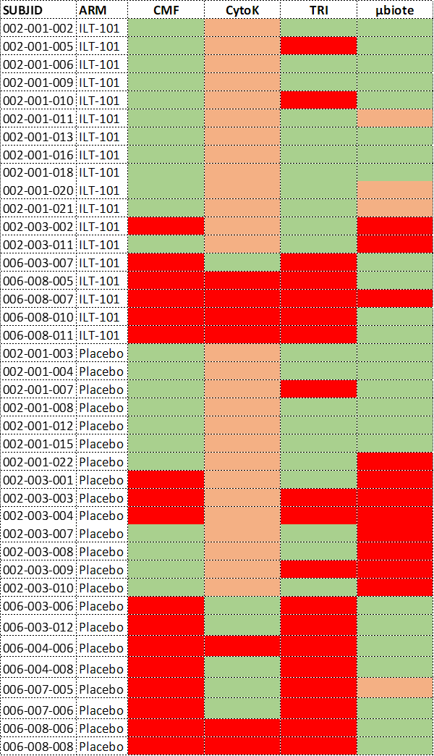
WP4- Bio-collections
Bulgaria and Mexico
All without Bulgaria and Mexico
OK
Only Baseline for µBiota
NO
Cytokines: Plasma frozen but not assayed

Slide 6
les tâches de chaque partenaire dans le WP3 (document soumis)
Description | Partenaires | Type d’analyses envisagées
Task 3.1 Identification of cell- and serum-derived immune signatures | APHP/SU, ILTOO, Ligan-MP | Analyses univariées
Task 3.2 Identification of Treg and Teff functional transcriptomic signatures | APHP/SU, ILTOO, Ligan-MP | Analyses univariées
Task 3.3 Identification of Treg and Teff TCR signatures | APHP/SU | Analyses univariées
Task 3.4 Identification of microbial signatures relevant for IL2 treatment | MGP | Analyses univariées
Task 3.5 Toward integrative biomarker discovery | IHU-A-ICM | Analyses multivariées
Task 3.6 Mechanisms of actions of ld-IL2 (interprétation biologique des résultats d’analyses univariées) | All partners | Analyses univariées
Task 3.7 Towards definitions of tools for immunomonitoring and theranostics | IBC/ILTOO | NA

Slide 7
Questions biologiques:
Objectives initially planned
Define biological questions for iMAP, and list potential expectations
Practical questions for statistical analyses
First ideas of who does what

Slide 8
Possible axes for biological questions
Descriptive analysis: What are the composition of our groups?(characteristics)
Exploratory analysis: What are the main reasons of biological variability in the experiment ? (presence of groups, outliers… ?)
Discriminant analysis: (signature, biomarkers...)
What is the IL2 action? (IL2 vs. Placebo)
How to define IL2 response? (Respondant vs. Non-respondant)
Placebo effect? (placebo respondant vs placebo non respondant)

Slide 9
Multi-scale and multi-time
These axes can be investigated at different scales;
By variable (univariate)
By block (multivariate)
Multiblock
… but also at different times
By timepoint ?
Comparison to baseline (paired analyses)
Across timepoints

Slide 10
Expectations for LUPIL2
 | Immun | Transcr (RNASeq) | Cytokines | Repertoire TCR | Microbiote | Clinique
IL2 action
Lupus characteristics
IL2 response
Placebo effect

Slide 11
Other hypotheses to test?
Potential links between blocks?
Clinical variables of interest? How to detect a lupus flare ?
Relative to Task 3.6. « Mechanisms of action of ld-IL2 »
Mechanisms of action and dynamics of Tregs
Cross-talk between Treg dynamics, immune response to ld-IL2 and microbiota
Deciphering Treg and Teff repertoire dynamics and characteristics in healthy donors vs patients

Slide 12
Block- specificities
 | Immun | Transcr (RNASeq) | Cytokines | Repertoire TCR | Microbiote | Clinical
Who?
Specificity of data |  |  | Batch effect | Very sparse | Hierarchical structure of variables
Dataset(s) in output | Counts or percent
Pretreatment |  | Threshold DESeq2 | Quantile Normalization
Exploration |  | Enrichment

Slide 13
Ideas of analyses
 | By variable | By block | Multiblock
At one given timepoint | summary/t-test | PCA/(s)PLS-DA, Random forests? | RGCCA
Comparison between two timepoints | Same but on the difference between t1 and t0
Accross timepoints | Curves by groups, Mixed model with time effect | PCA with trajectory MANOVA with time effect ? | RGCCA with trajectory ? MANOVA with time effect ?

Slide 14
Next steps
Git for iMAP analyses?
Who does what?

