Slide 1
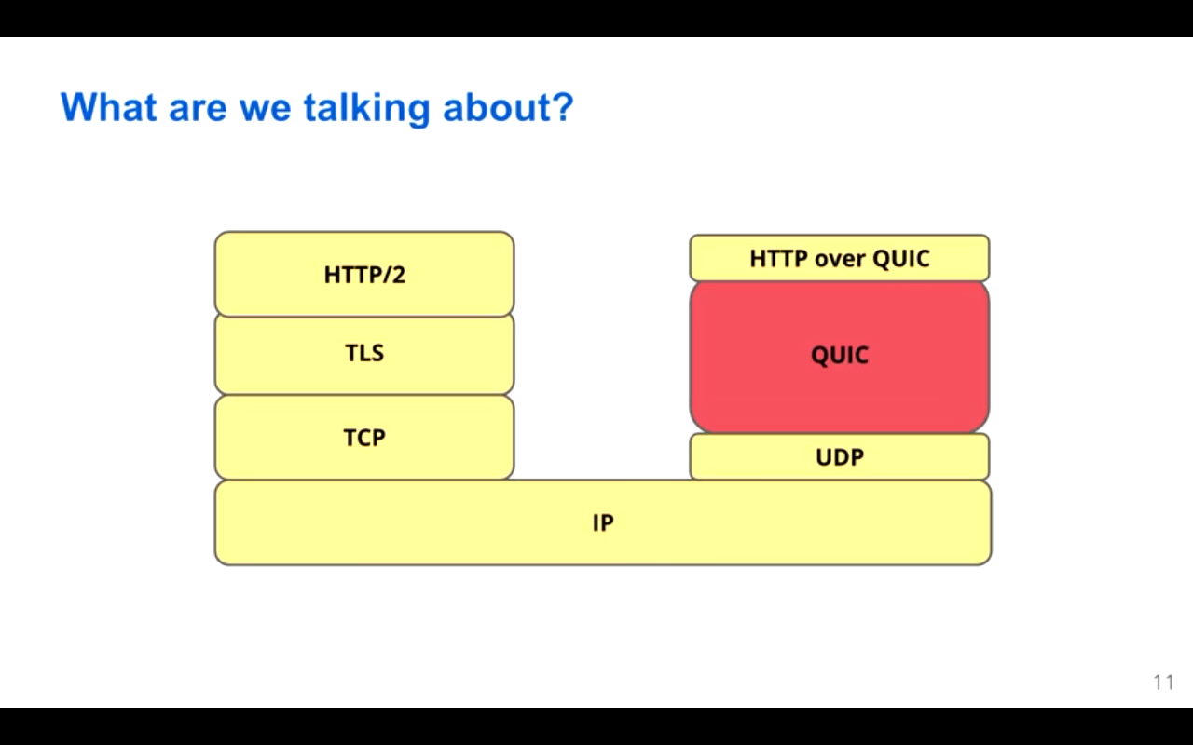

Slide 2
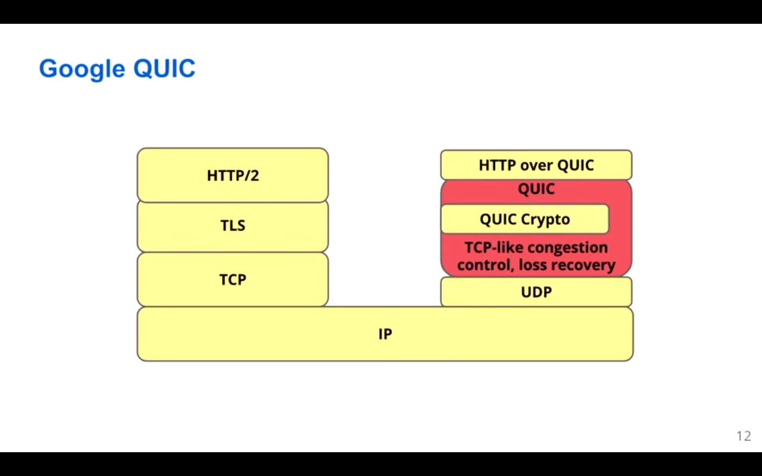

Slide 3
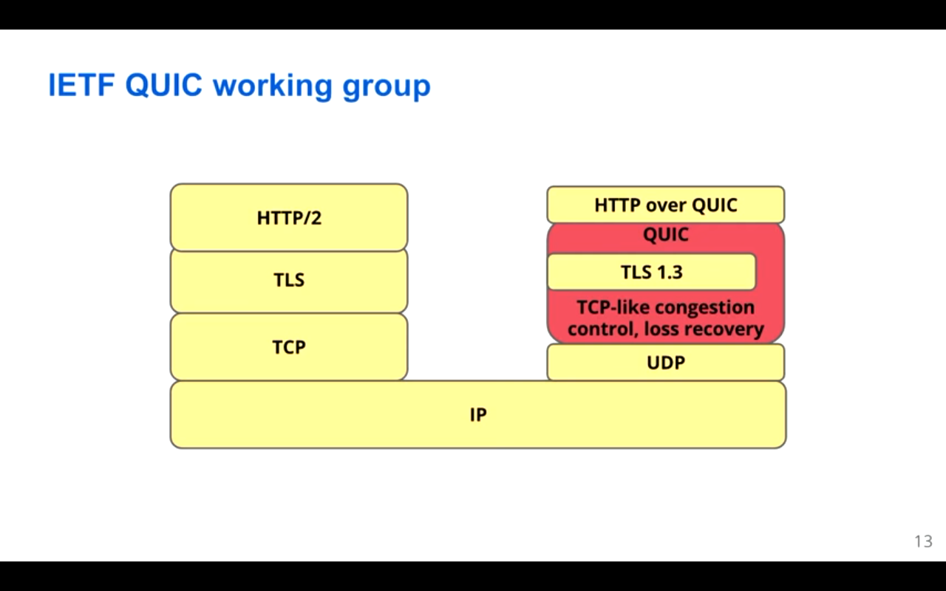

Slide 4
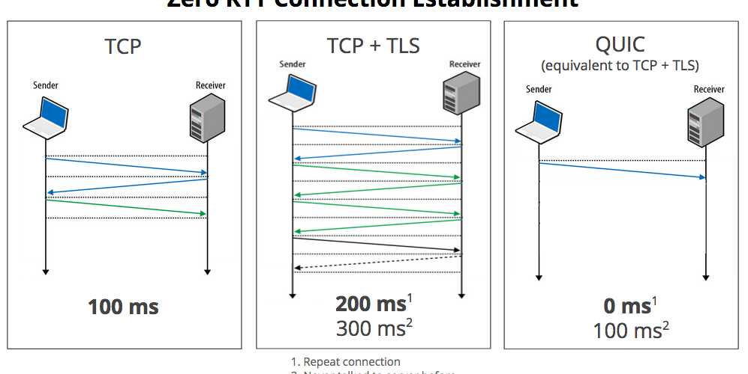

Slide 5
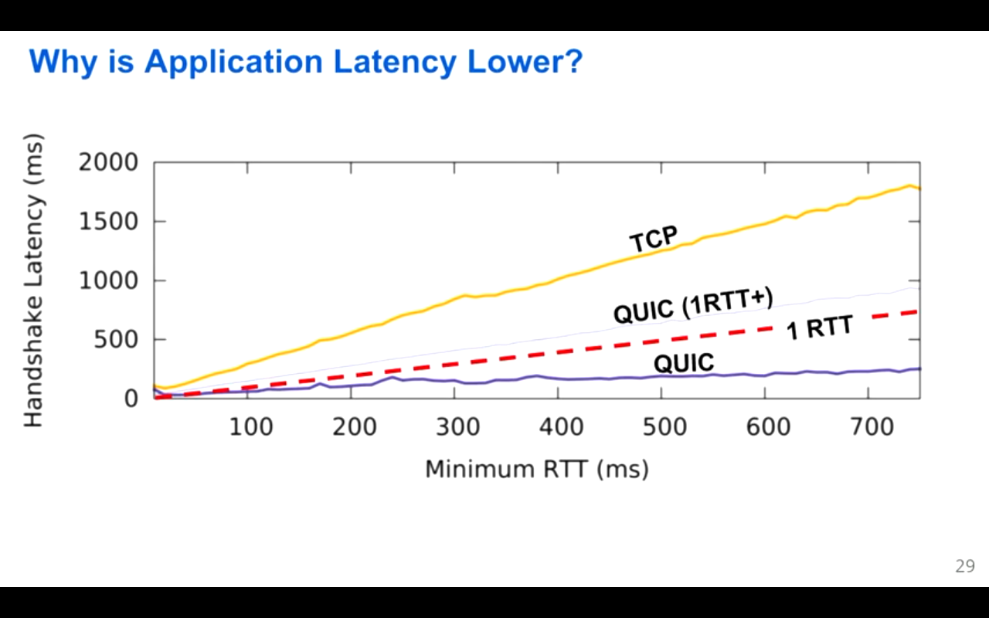

Slide 6
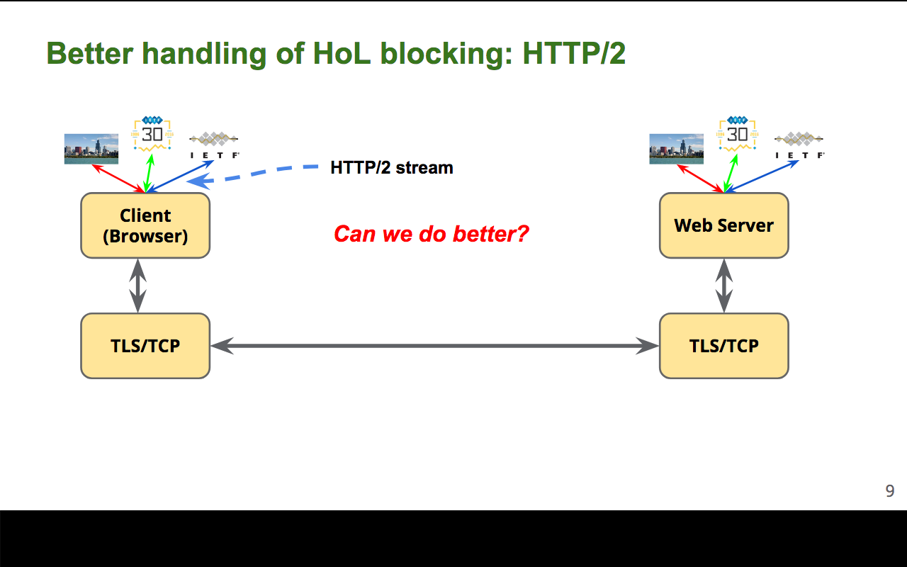

Slide 7
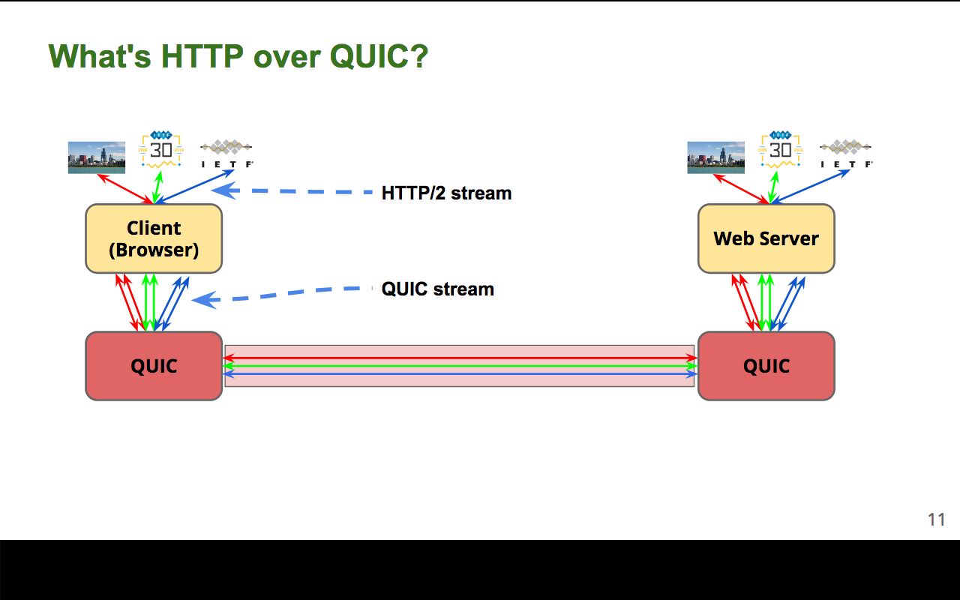

Slide 8
Advantages of QUIC over TCP:
Congestion Control
Richer Information
Forward Error Correction
FEC packets
Connection Migration
64 bit connection ID[Random]

Slide 9
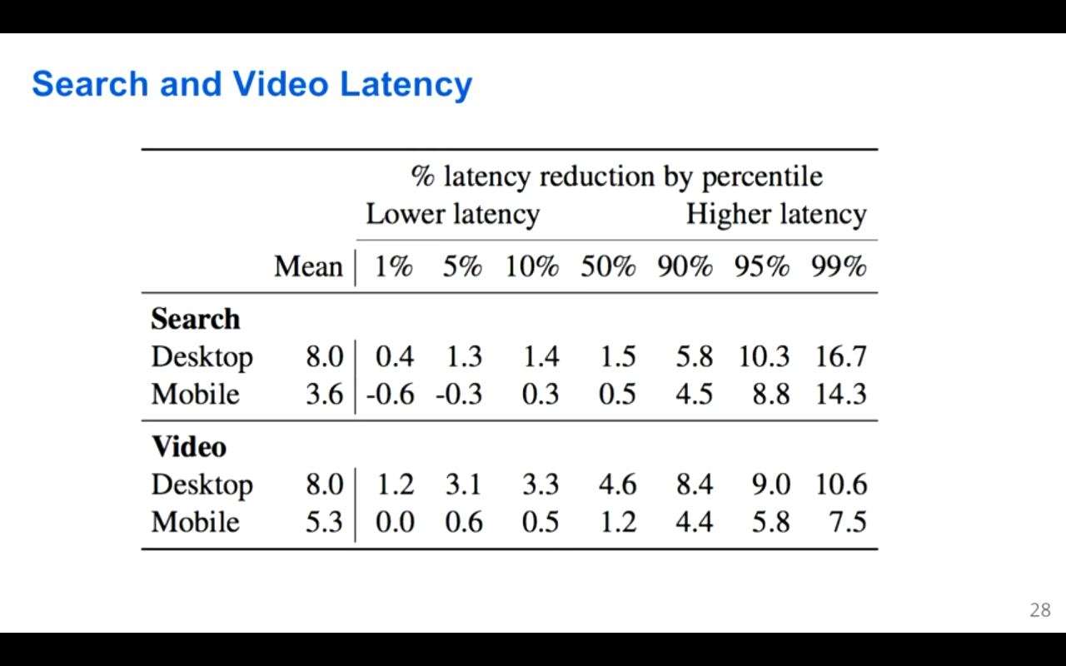

Slide 10
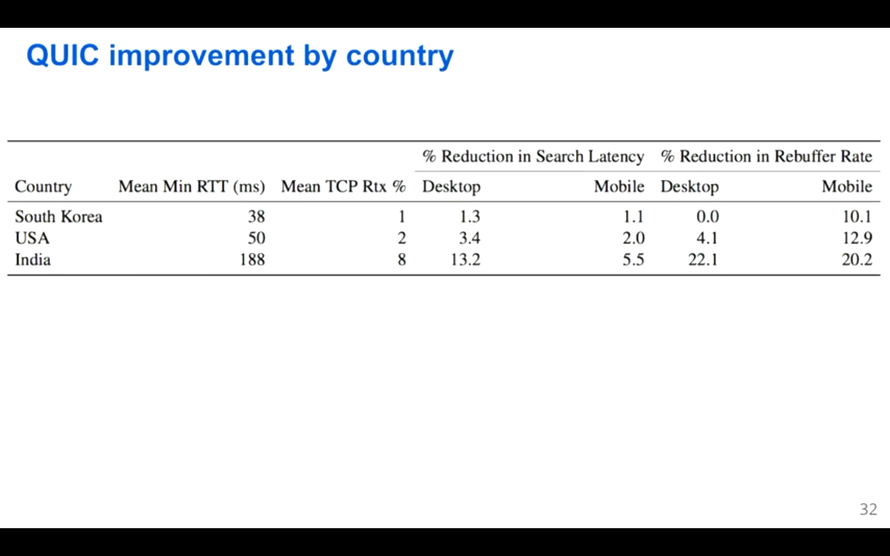

Slide 11
Drawbacks of QUIC

Slide 12
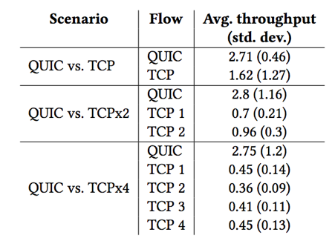
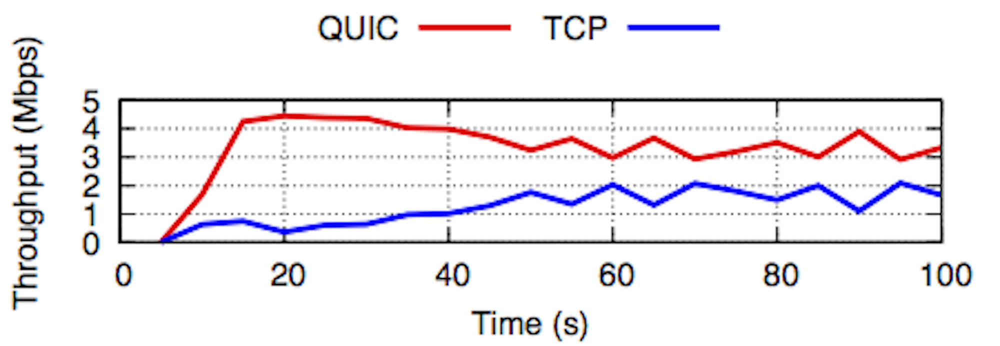
1)Unfairness

Slide 13
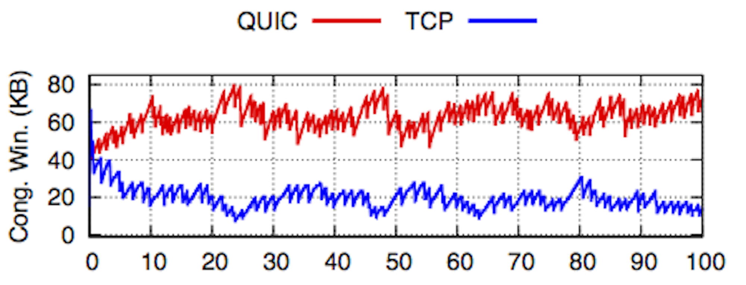

Slide 14

2) QUIC Performance Object sizes and object number

Slide 15
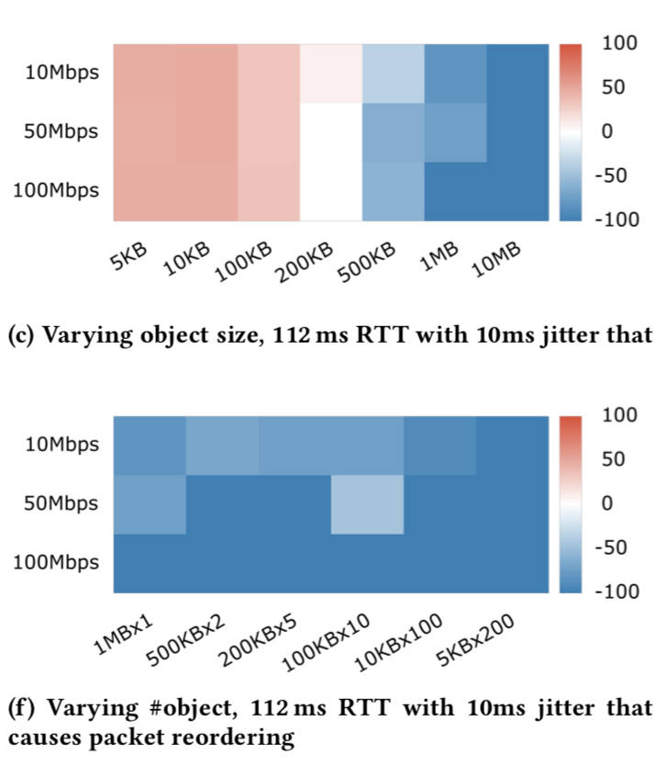
3) Packet Re-ordering

Slide 16


Performance on Mobile devices

Slide 17
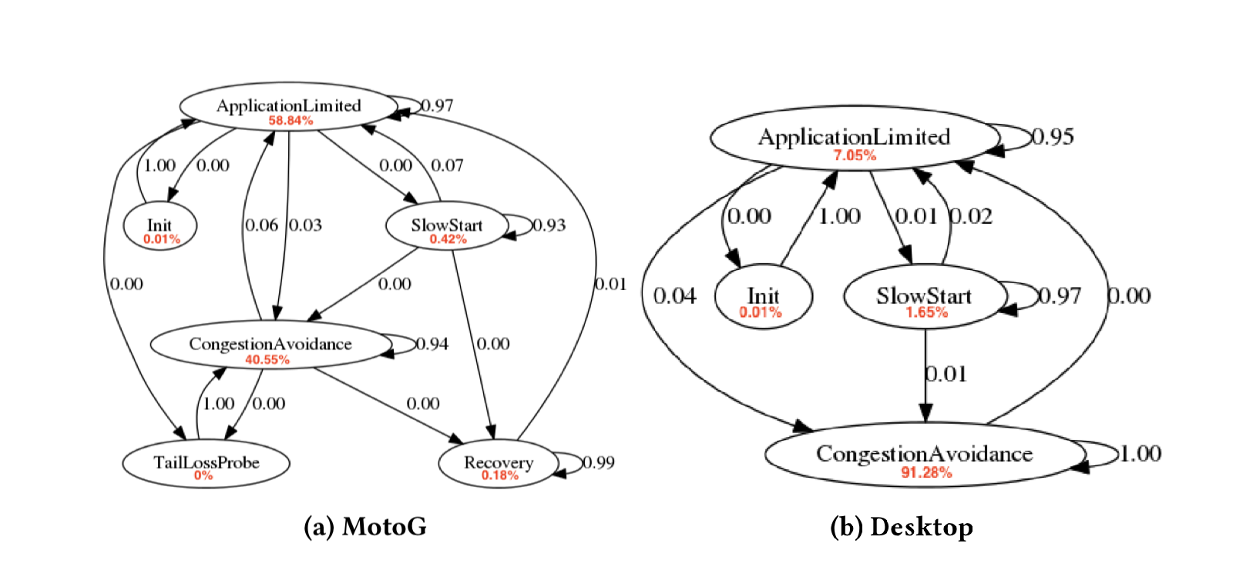
State Diagram Analysis

