Slide 1
Welcome to STAT 545A!
Tuesday, September 4, 2018

Slide 2

Who am I?
Dr. Vincenzo Coia
Core teaching team of MDS
Department of Statistics
UBC
Background:
PhD in Statistics at UBC
MSc in Mathematical Statistics at Brock U
BSc in Math + Stats at Brock U
BSc in Biology w/ Earth Science at Brock U

Slide 3



Meet your TA’s!
Hossam
Rashedul
Chad
Sherrie

Slide 4
Today’s Learning Objectives
By the end of today’s class, students are expected to be able to:
Navigate the STAT 545 resources
Name families of tools that aid in data analytics

Slide 5
Today’s learning objectives:

Slide 6

Course Tool: Slack
stat545-2017.slack.com

Slide 7
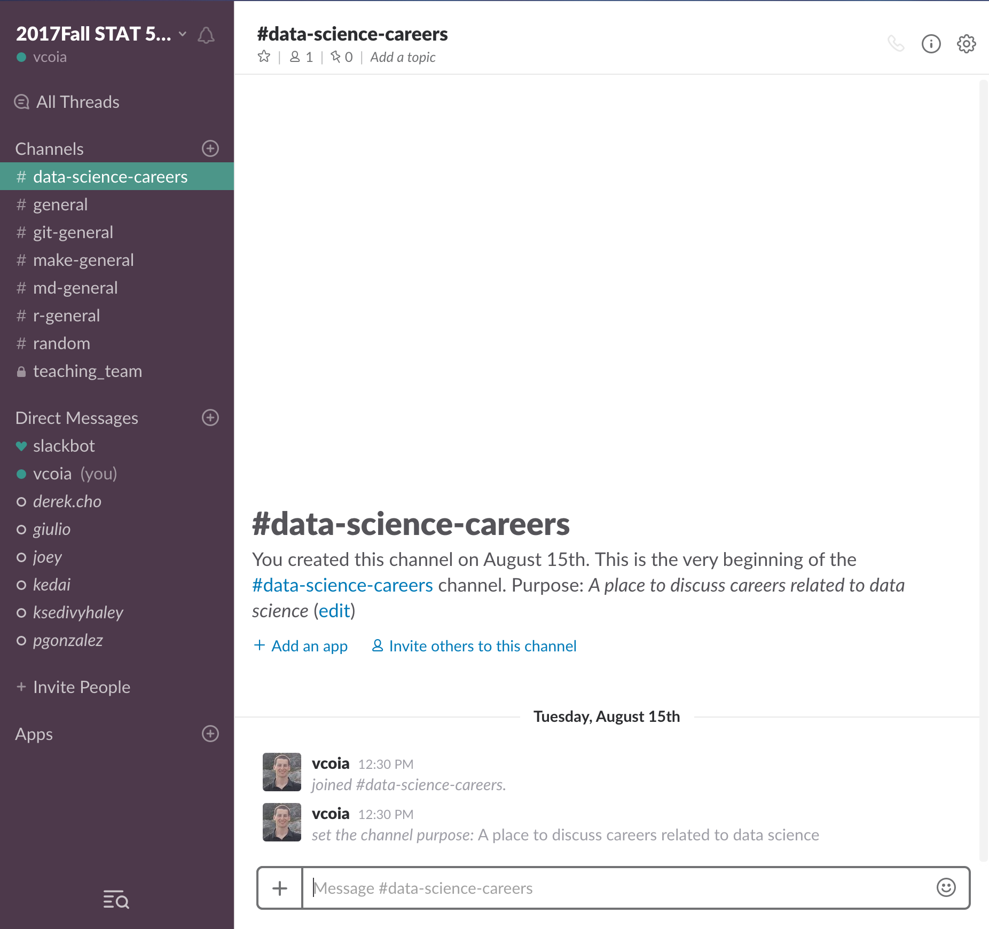
…because not all correspondence needs to be through GitHub issues!
We’ll use Slack for general correspondence. Sign up for an account!
We will let you know if a query is more appropriate for GitHub.
Make mistakes! STAT 545 is a forgiving environment.

Slide 8
Course Goals
explore, groom, visualize, and analyze data
make all of that reproducible, reusable, and shareable
using R

Slide 9


Data Science TOOL: git and github

Slide 10


Data Science TOOL: R and RStudio

Slide 11


Data Science TOOL: (R) Markdown and html (or pdf)

Slide 12

Data Science TOOL: Make

Slide 13
Data Science Tools – Get to know your Neighbour!
Turn to a neighbour you don’t know. Ask:
Their name
Their program
What data science tools they use (Excel? R? …)
Volunteer to share what you find out!

