Slide 1
STAT 545A: Class Meeting 001
Course Intro + prompts to install and sign up for lots of stuff!
Web companion: STAT 545 web home > syllabus > cm001
Tuesday, September 5, 2017

Slide 2

Who am I?
Dr. Vincenzo Coia
Department of Statistics
University of British Columbia
vincen.coia@stat.ubc.ca
https://github.com/vincenzocoia
https://twitter.com/VincenzoCoia
Background:
PhD in Statistics at UBC
MSc in Mathematical Statistics at Brock U
BSc in Math + Stats at Brock U
BSc in Biology w/ Earth Science at Brock U

Slide 3


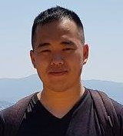


Meet the Teaching Team!
Pedro Gonzalez-Espinosa, TA
Vincenzo Coia, Instructor
Katharine Sedivy-Haley, TA
Derek Cho, TA
Giulio Valentino Dalla Riva, Instructor
Joey Bernhardt, TA
Ke Dai, TA

Slide 4
Instructor Schedule
STAT 545A
STAT 547M
Week | cm | Date | Instructor
1 | cm001 | Sept. 05 | Vincenzo
 | cm002 | Sept. 07 | Vincenzo
2 | cm003 | Sept. 12 | Vincenzo
 | cm004 | Sept. 14 | Vincenzo
3 | cm005 | Sept. 19 | Vincenzo
 | cm006 | Sept. 21 | Vincenzo
4 | cm007 | Sept. 26 | Vincenzo
 | cm008 | Sept. 28 | Giulio
5 | cm009 | Oct. 03 | Giulio
 | cm010 | Oct. 05 | Giulio
6 | cm011 | Oct. 10 | Vincenzo
 | cm012 | Oct. 12 | Vincenzo
7 | cm013 | Oct. 17 | Vincenzo
 | cm014 | Oct. 19 | Tamara Munzner
Week | cm | Date | Instructor
1 (8) | cm101 | Oct. 24 | Giulio
 | cm102 | Oct. 26 | Giulio
2 (9) | cm103 | Oct. 31 | Giulio
 | cm104 | Nov. 02 | Giulio
3 (10) | cm105 | Nov. 07 | Giulio
 | cm106 | Nov. 09 | Giulio
4 (11) | cm107 | Nov. 14 | Giulio
 | cm108 | Nov. 16 | Giulio
5 (12) | cm109 | Nov. 21 | Vincenzo
 | cm110 | Nov. 23 | Vincenzo
6 (13) | cm111 | Nov. 28 | Giulio
 | cm112 | Nov. 30 | Giulio

Slide 5
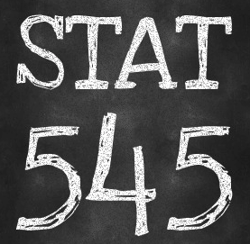
Course Tool: STAT545.com

Slide 6

Course Tool: Slack
stat545-2017.slack.com

Slide 7
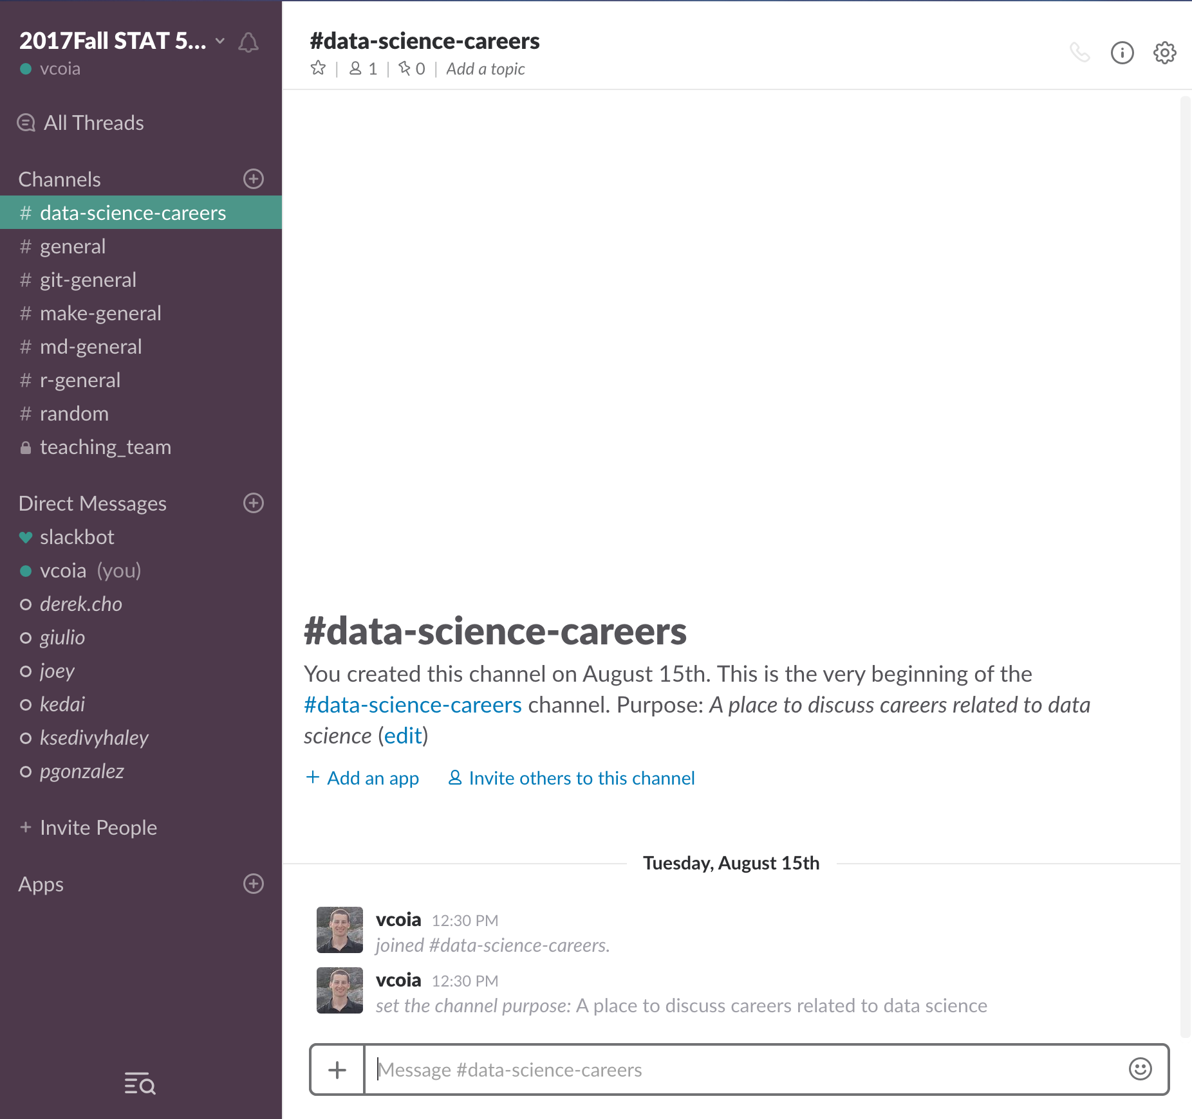
…because not all correspondence needs to be through GitHub issues!
We’ll use Slack for general correspondence. Sign up for an account!
We will let you know if a query is more appropriate for GitHub.
Make mistakes! STAT 545 is a forgiving environment.

Slide 8
Course Goals
explore, groom, visualize, and analyze data
make all of that reproducible, reusable, and shareable
using R

Slide 9


Data Science TOOL: git and github

Slide 10


Data Science TOOL: R and RStudio

Slide 11


Data Science TOOL: (R) Markdown and html (or pdf)

Slide 12
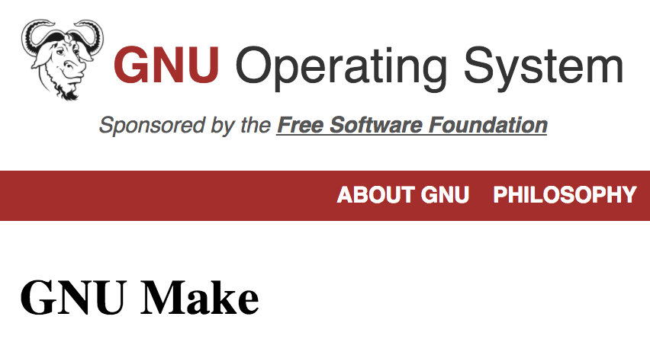
Data Science TOOL: Make

Slide 13
Data Science Tools – Get to know your Neighbour!
Turn to a neighbour you don’t know. Ask:
Their name
Their program
What data science tools they use (Excel? R? …)
Volunteer to share what you find out!

