Slide 1
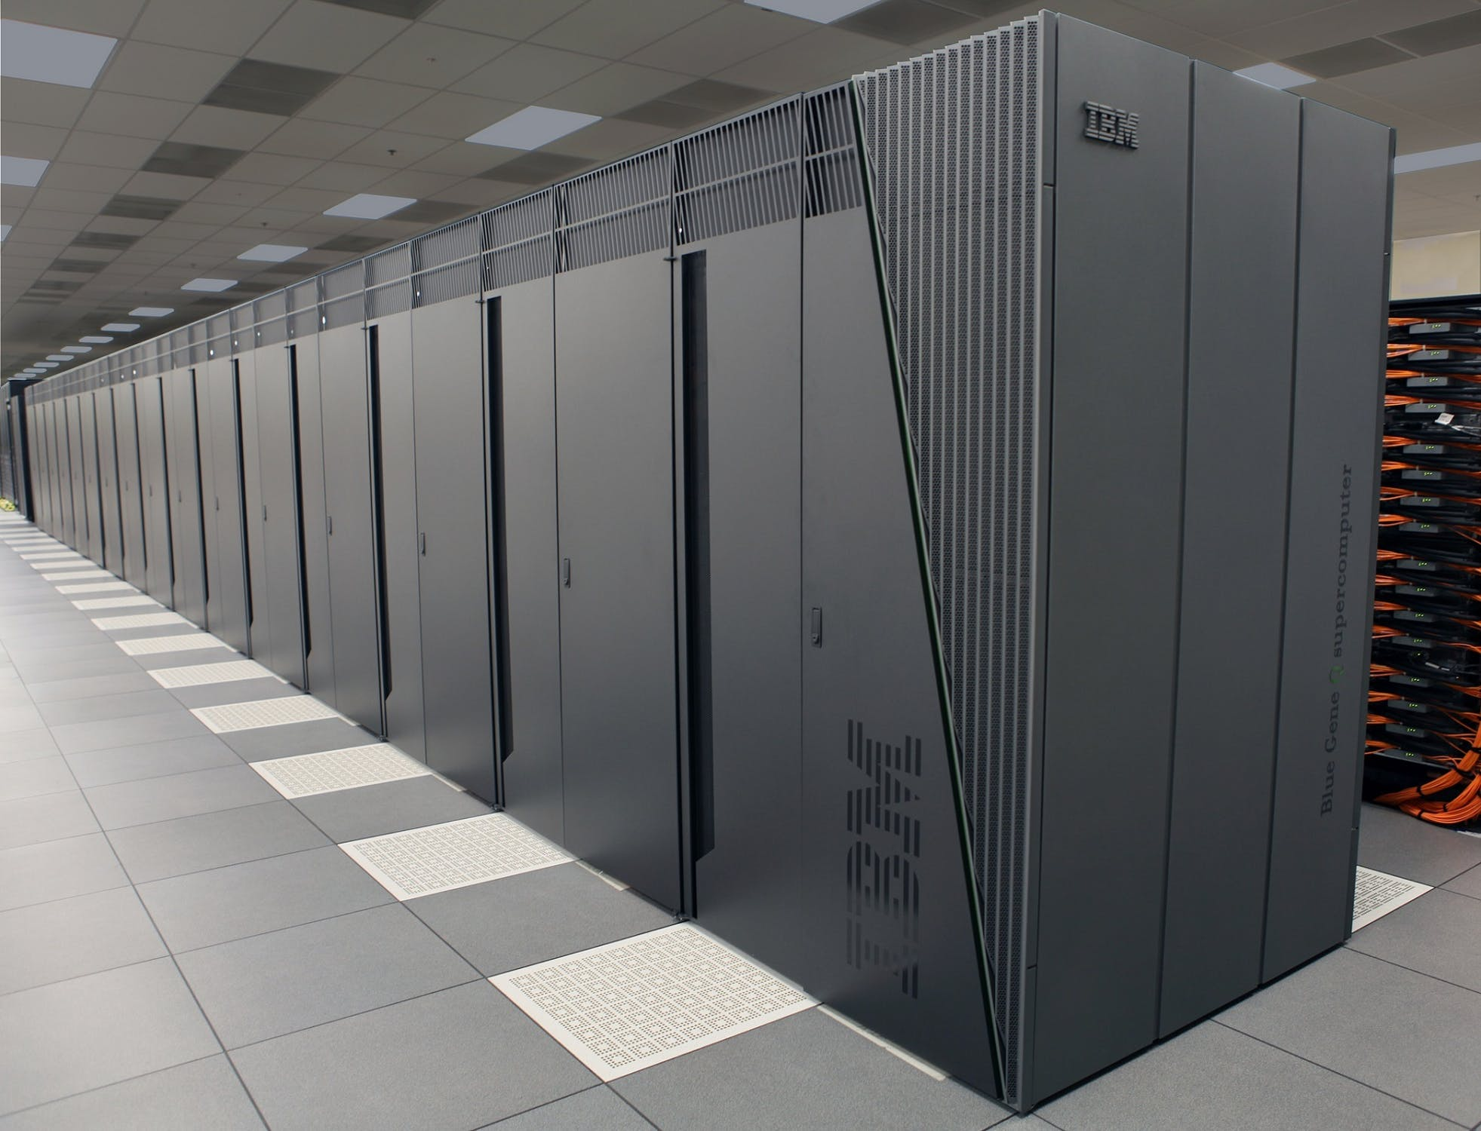
IBM Watson Python Bot
Cobra

Slide 2
What is it?
- Cobra is an intelligent question bot that is able to assist beginning Python programmers with their struggles.
- Watson Assistant is a preexisting interface produced by IBM that is being used as the base for the bot you will see.

Slide 3
Relevant work
-There do not seem to be any other "Python bots" in the sense of what we have made. There are bots created using Python, but we were unable to find another bot that was made to teach beginner Python users.

Slide 4
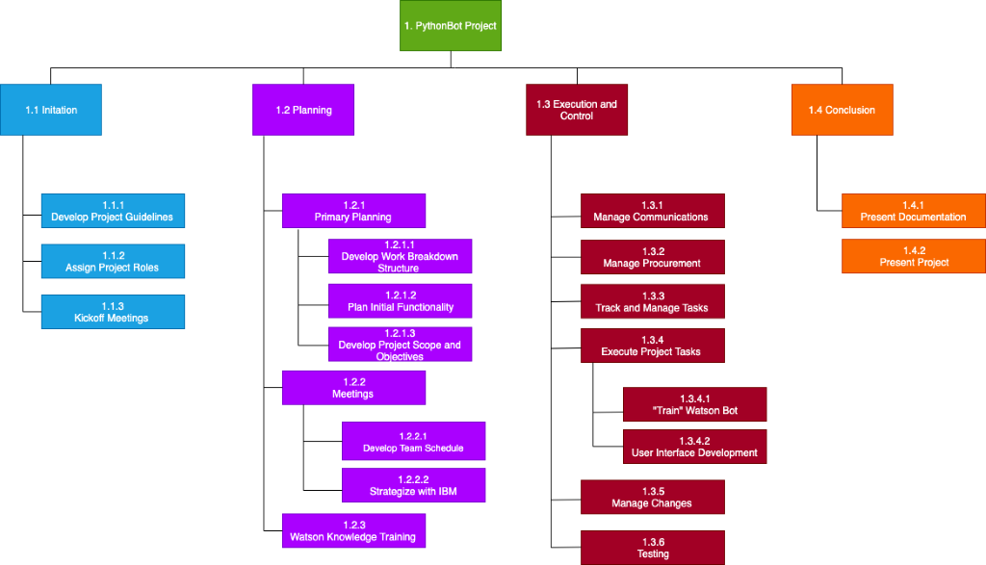
Project Schedule
Notes:
This is our Project Schedule. It shows our planning for the Initation, Planning, Execution, and then finally the conclusion of the project. Starting out, we had to assign our project roles and attend kickoff meetings with IBM specialists to help us delegate what we needed to do with Watson Assistant. As of right now, we continue to do meetings weekly for the grouping and organization of question data that comes in, so that we can sort into “intents and entities” which trains Watson as we continue further into the project.

Slide 5
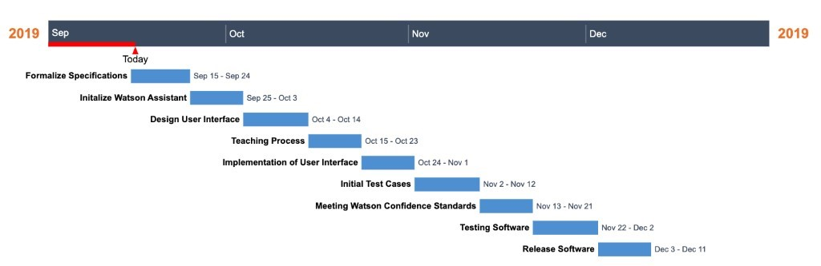

Gantt Chart
Notes:
Here is our Gantt Chart – this is a visualization of what our timeline looks like as we continue throughout the time we spend developing on the project. Most of our time is currently spent on the “Teaching Process” which has recently became an ongoing process which we have been told by our IBM contacts that will take a lot of time to categorize our data we gather from our sample of early computer science learners. The Teaching Process of IBM Watson Assistant is the largest component of our timeline, even if it’s not set in one continuous sprint. We adapted the idea of this Gantt Chart from Agile methodology namely “Sprints”.

Slide 6
Analytical Tools and Software Engineering Techniques
For the project we used a combination of 2 different software techniques. We use the planning side of the waterfall method and primarily stuck with using this software technique as it was the easiest to follow. However we also have part techniques from the SCRUM agile method where we made biweekly meetings with IBM mentors to help assist with the chat bot and set workable targets to meet before each new meeting.
The development strategy that was used for this project was the waterfall model. The advantages to using the waterfall method include helping to make things much more manageable within the team. Waterfall can also be helpful as it can be easier to be able detect any problems early on into the project to avoid having to deal with them later on. The disadvantages to using waterfall include that one a phase has been started, the going back would be very hard/ if not undoable without restarting from scratch. This would then cause a lot of time to be wasted on the project doing what has essentially already been done. It would also be hard to gauge how long the project would take to completion with this method.
The agile ‘SCRUM’ methodology is used well for projects that work closely with their client. This has the product manager (the IBM mentors in this case) have a say for each ‘sprint’ of the development cycle. This ensures that the final product they are given is to their standards and expectations.

Slide 7
Project Risks
# | Risk | Severity | Probability of Occurring | Mitigation Plan
1) | Hurricane Occurring | 4 | 15% | Organize an appropriate amount of extra group meetings to recover from lost time.
2) | Data Collection Issues | 3 | 30% | Find volunteers that fit the category of users we are targeting and gather as much possible data from here.
3) | Loss of Files without Backup | 4 | 5% | Recover or remake the data that was lost to the best of our abilities.
4) | Time Issues | 3 | 45% | Plan accordingly to meet set deadlines.
5) | Watson Platform Down | 5 | 15% | Contact IBM mentors for information on when the system will be back up.
6) | Communication Issues Between Group Members | 1 | 30% | Make sure every team member is up to date with current activities and project information.
7) | Team Member not Submitting Assigned Portion of Assignment | 2 | 20% | Team works together to make up for the missing assignment.
8) | Overall Organization Problems | 2 | 10% | Overall reorganization of current data and assignments.
9) | Unable to Contact IBM Mentors | 3 | 45% | Contact Dr. Vetter for possible next steps.
10) | Wrong Answer Data Input into Chatbot | 1 | 35% | Change the answer data when necessary.

Slide 8
Challenges (technical/logistic)
- As mentioned earlier, we originally planned to use Angular to create our webpage. After attempting multiple different methods to connect our bot to this project, we realized that in order to complete the project in time, we would have to move to a different framework or method.
- With some our questions we had an issue with ambiguity.
Ex. What is a for loop vs How do I write a for loop?

Slide 9
Hardware and Software Used
Hardware:
Computer
Laptops
Phones
Software:
Slack
Teams
WebEx
OneDrive
GitHub

Slide 10
Website Interface
- Angular was going to be the original framework we used to create our webpage; however, the Watson interface does not play well with Angular.
- We ended up migrating to pure html and used Adobe Dreamweaver to assist with some of the webpage design.

Slide 11
Technical analysis
-Website appearance creation
-Question Classification (Intents/Entities)
-Data Collection and storage
Notes:
(major technical hurdles, justify the conclusions drawn/design choices made)

Slide 12
Data Collection
At the beginning of the semester, we visited current 112 and 131 classes to obtain questions from our target users, AKA beginning Python learners.
A platform that we ended up using in order to improve our bot's accuracy is the Python Documentation, which was integrated using Watson Discovery.

Slide 13
Data Collection
Data collection was an essential part of our project. Without questions to base our bot on, nothing could have been done. At first, we did not have enough questions, but after contacting a couple more professors, everything came together to net us a total of a couple hundred questions.

Slide 14
Question Categorization
Intents - An intent represents the purpose of a user's input. You define an intent for each type of user request you want your bot to support.
Entities - An entity represents a term or object that is relevant to your intents and that provides a specific context for an intent. This is the possible values for each entity and synonyms that users might enter.
"I want to create code and implement a for loop"
Intent: #code_example
Entity: @for_loop

Slide 15
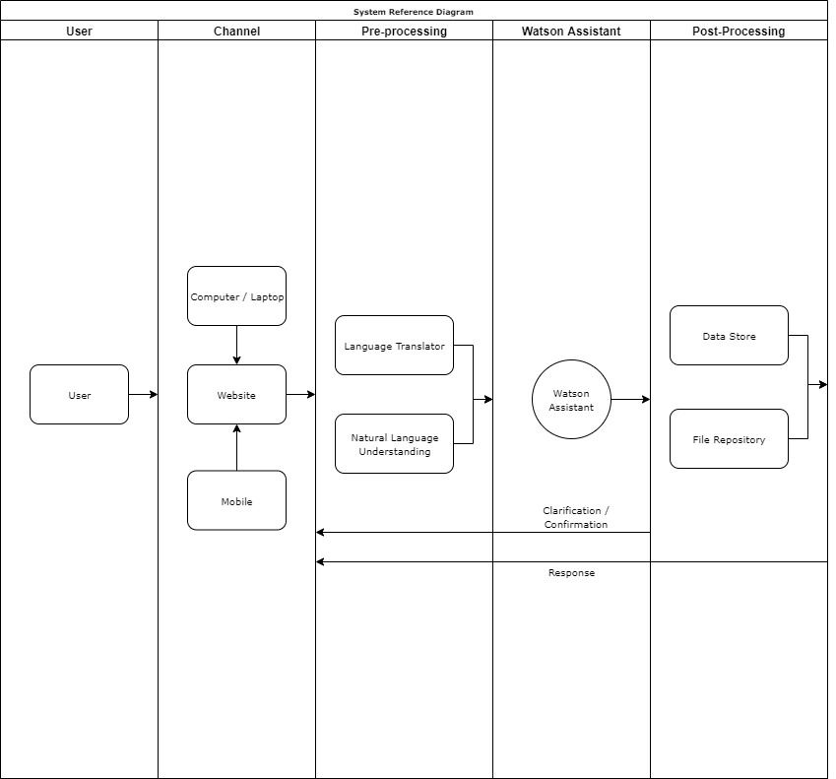
System Reference Diagram

Slide 16
State Transition Diagram

Slide 17
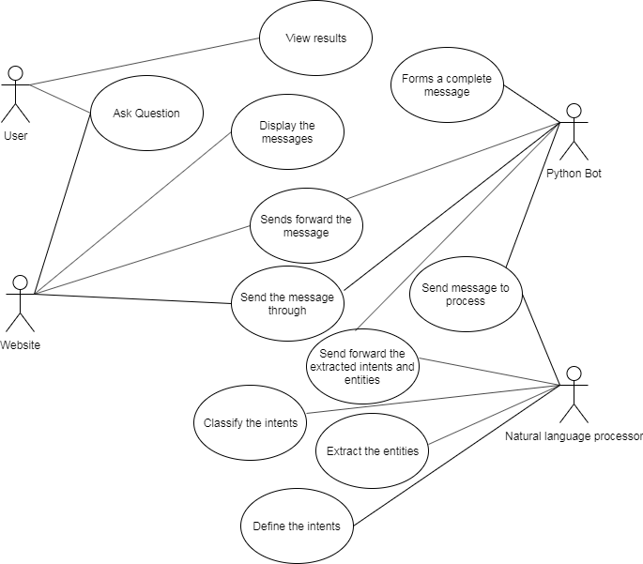
Use Case Diagram

Slide 18
System Requirements
An Internet connection
User Interface
Objects to store any phrases / questions with their respective answers

Slide 19
Quality Management
IBM Watson Assistant is a standardized platform that we are using throughout this project. It has been tested and proved to be up to standards by IBM professionals.
The main concern with our quality is making sure that our responses are accurate to the current information concerns of our users
Spell Check
Fuzzy Matching
Keywords
Punctuation Correction

Slide 20
Systems Constraints
Schedule: We can arrange at least one meeting per week to discuss what needs to be done that week. However, most of the development will be on everyone’s own time. Furthermore, most people in the group have out-of-class responsibilities (jobs/clubs/etc.) that will conflict with the time to be working on the chat-bot.
Scope: A fully realized chat-bot will be extremely hard to implement with the available time we have for this project. When the project is released, it will work as intended but not to its full potential.
Cost: Hopefully, we do not need to forward any money to this project. This will also cost some of our mental health.
Notes:
- Schedule: aside from weekly meetings with the group, also have bi-weekly meeting with our IBM mentors

Slide 21
Risks that Happened
Bot gone.

Slide 22
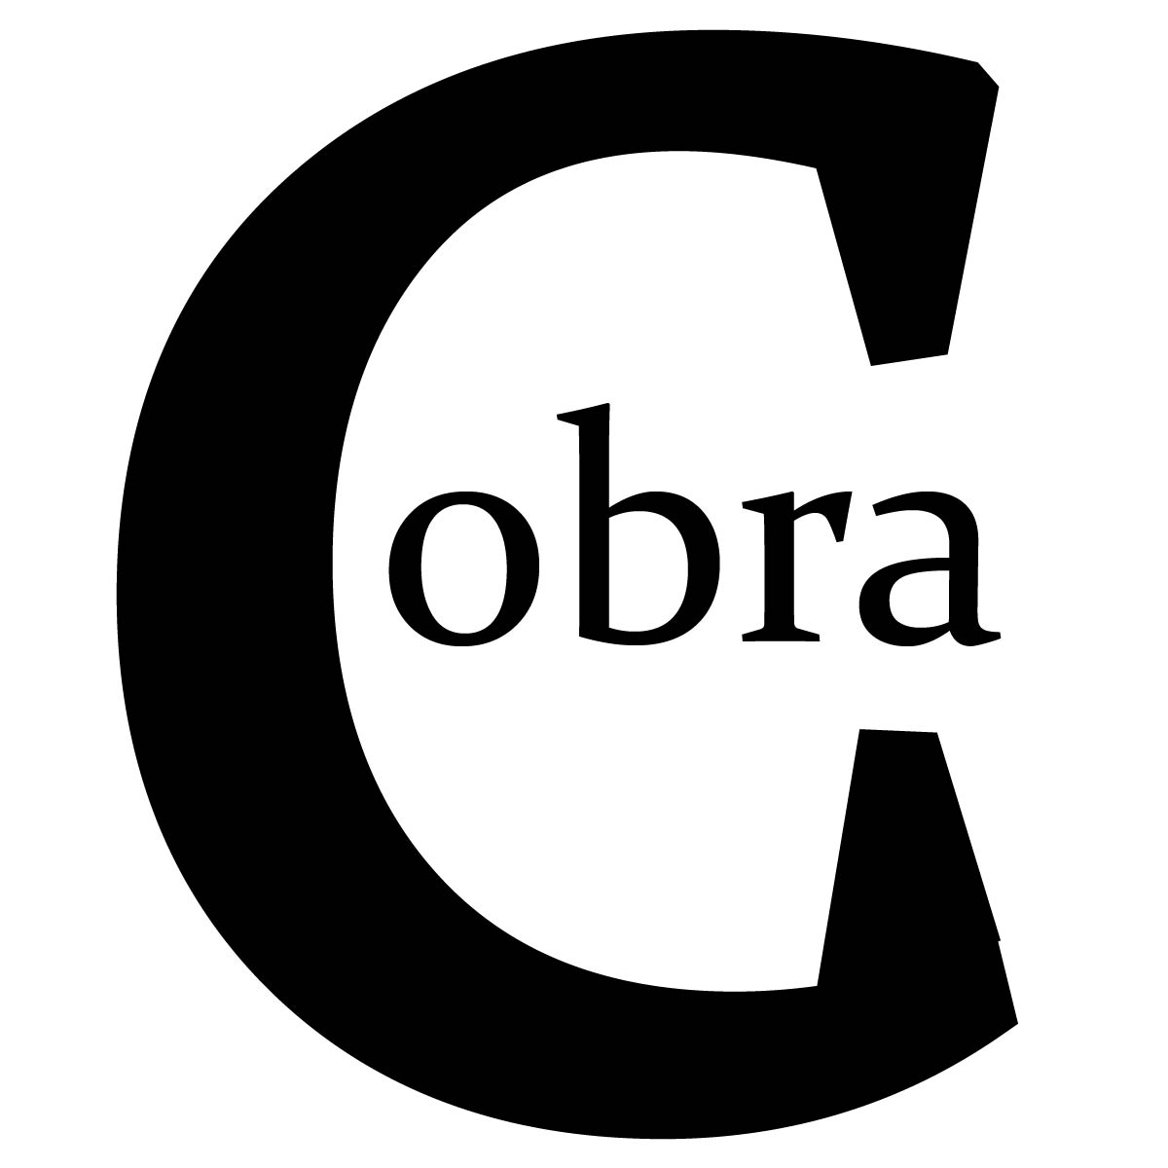
Demo
Cobra Bot

Slide 23

Questions?

