Slide 1
Aviation Accident Analysis
Analysis by Caroline Kamusi

Slide 2
Overview
This project reviews data from the NTSB aviation accident database contains information from 1962 up to 2023 about civil aviation accidents and selected incidents within the United States, its territories and possessions, and in international waters.
As the company expands into new industries, it acknowledges the crucial need to assess and manage the risks linked to aircraft operations. Although the aviation sector is profitable, it involves inherent risks that require careful analysis to ensure well-informed purchasing decisions.

Slide 3
Understanding the problem
Embarking on a high-flying adventure in the world of aviation! As we venture into the aviation industry it’s crucial to understand the landscape of airline safety.
We’re conducting an in depth analysis of aircraft accidents. This will guide our strategic decisions ensuring safety remains our top priority as we expand into this new domain.

Slide 4
Analysis Method
Narrowed down to the following 10 manufacturers from 89,000 NTSB accident records:
Boeing
Airbus
Bombardier
Embraer
Dassault
Gulfstream
Cessna
Pilatus
Hawker
Mitsubish

Slide 5
Business Understanding
The company seeks to broaden it’s portfolio by venturing into the aviation sector, intending to acquire and manage aircraft for both commercial and private uses. The objective is to pinpoint the aircraft that carry the most risks, thereby ensuring safety through the actions to be taken and reducing potential liabilities. This information will guide the purchasing decisions for the new aviation division, focusing on safety reliability.

Slide 6
Understanding of the data
The dataset includes temporal data with incident dates and information on accident identification from National Transportation Safety Board(NTSB) available on Kaggle up to ‘2023’ such as distinct event identifies and inquire kinds.
There is location information available, including precise locations and Countries of occurrence, nevertheless there is up to 40% missing data in certain variables.

Slide 7
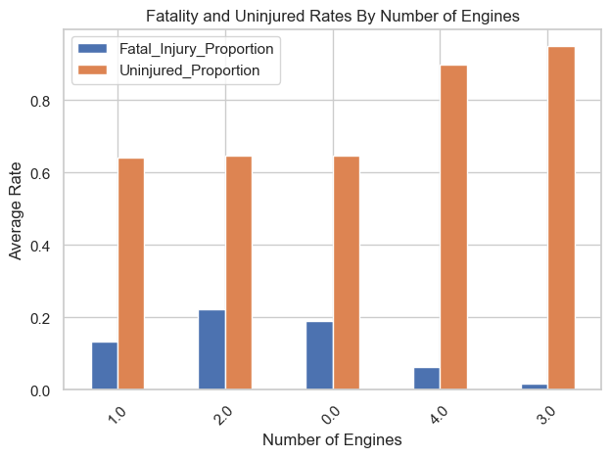
Fatality and Ununjured Rates By Number of Engines.
This plotting shows that Aircrafts with 3 engines hold both the highest uninjured rate and the lowest rate followed by aircrafts with 4 engines.

