Slide 1
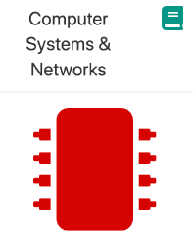
Welcome!!
Thursday 16th June, 2022

Slide 2


Computer Systems & Networks
Caroline Cahill
Caroline.cahill@setu.ie
Dr Frank Walsh
frank.w.walsh@setu.ie

Slide 3
Computer Systems & Networks
10 Credit
Module delivery split between Frank & Caroline
Timetabled for TWO sessions per week

Slide 4
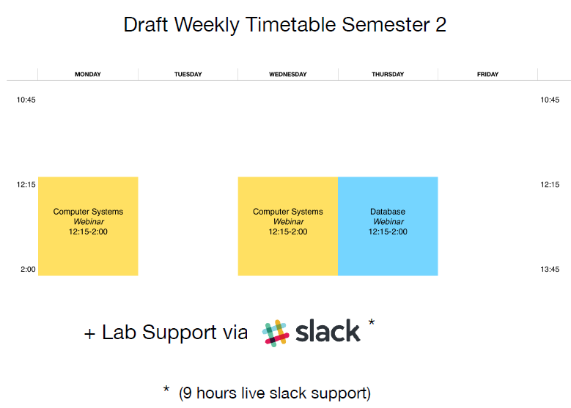
Notes:
Sometimes you might need to watch video, read article before lecture. - Same as programming.
Lectures are a mix of live and pre-recorded.
Labs every week (practical skills module) . Build something.

Slide 5
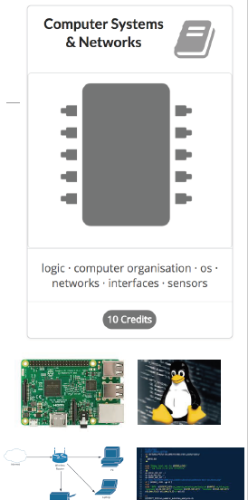
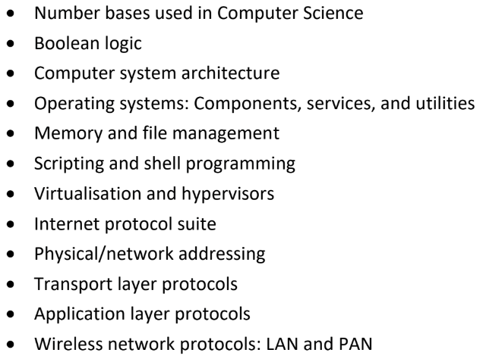
Module Overview: (Available on Handbook)
Notes:
Generally split into two parts: - Computer Systems (Caroline) - Networks (Frank) - Computer systems
Networking: protocols and function of computer networks – how the internet works.
Through the lense of the Internet of Things.

Slide 6


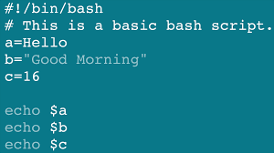
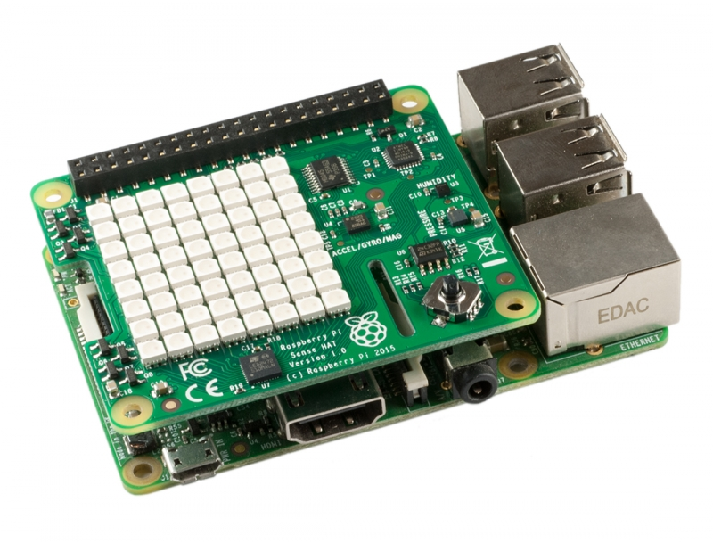


Development Tech (tentative)

Slide 7

Assignment Structure
25% Exam
On-site in December
75% Continuous Assessment
30% Assignment 1 (Computer Systems/Operating Systems)
45% Assignment 2 (Networking/Devices)

Slide 8
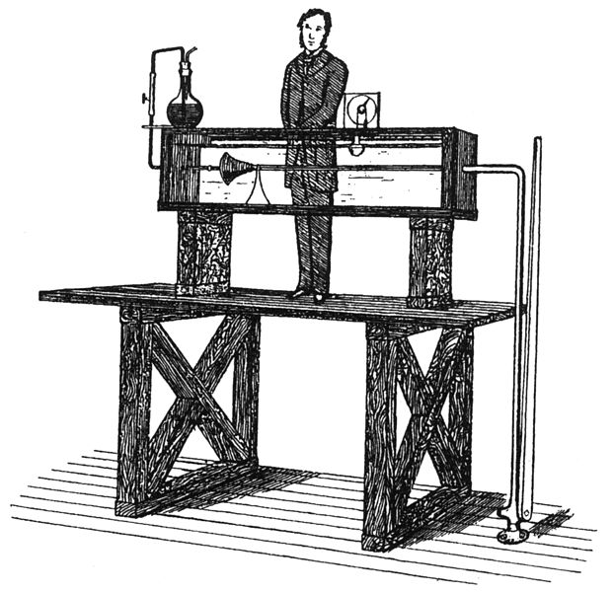
Ethos
Focus on practical skills
Good idea to stay current with module:
Some lectures will require reading/viewing of talks before.
Experiment/build something interesting:
You will have the opportunity to propose your own assignment!

Slide 9


We’ll use the Ubuntu Operating System

Slide 10
Some Basic Linux Commands to try out inside your Ubuntu Terminal
Open Terminal now

Slide 11
Linux Basics: Linus IS case sensitive
Caroline.txt is not the same as caroline.txt
File & Directory naming conventions (NO SPACES!!!)
CarolineCahill is a good filename i.e. capitalising the first letter of each word
The Linux prompt (Shell prompt) ends with a $ when logged in as a regular user

Slide 12
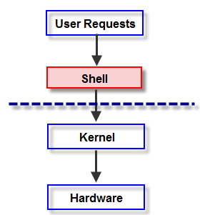
The Shell
In Linux, the shell is
a program that interprets commands
acts as an intermediary between the user and the inner workings of the OS

Slide 13
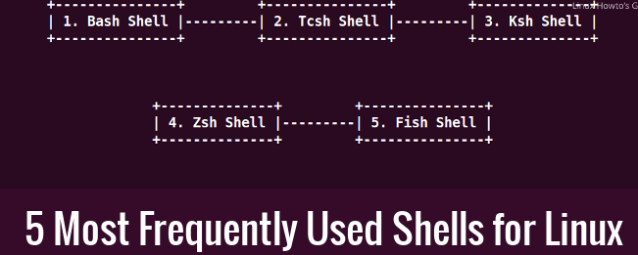
Which Shell is your system using?
Try out what happens if you type “echo $shell”
Find your system default by echoing the variable:
echo $SHELL
To close a shell, simply type:
exit

Slide 14
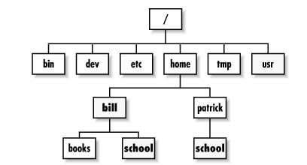
Directory Tree Structure
Type the ls command

Slide 15
Directory Tree Structure: what does yours look like?
Based on this hierarchy, can you
visualise how your filesystem looks?

Slide 16
Basic file & directory exercise
From home, create a new directory called OnSiteJune
$mkdir OnSiteJune
Inside this OnSiteJune directory, create two subdirectories caroline and frank using the same mkdir command
Check they’re actually created.. [HOW??]

Slide 17
Solution:
home
OnSiteJune
caroline
frank
tempAnyFile
Create another subdirectory tempAnyFile inside the frank directory

Slide 18

Type $cd ../ to return home
how can you check that you’re home?
From home, delete(remove) the empty caroline directory using the rm command
Do you get an error? Try adding the –r argument
$rm –r caroline
Check it’s removed … how?
3. From here, check that the tempAnyFile exists using
$ls frank

Slide 19
Command Manual
Every command has it’s own manual page
man <<command>>
Try it out:

Slide 20
Don’t forget Linux IS case sensitive!!!
$cd usr
IS NOT THE SAME AS
$cd Usr
Be mindful with creating names - make good use of $ls to view your directory names

