Slide 1
Collaborative Filtering Algorithms: Implementation and Evaluation
Group 5 Members:
Gao, Xin
Hao, Shuyao
Li, Peter
Qiu, Peilin
Tan, Chaoyue

Slide 2
0. Procedures:
Methods and Components
Objective of our report
Dataset and Evaluation Criteria
Output analysis and discussion
Reference

Slide 3
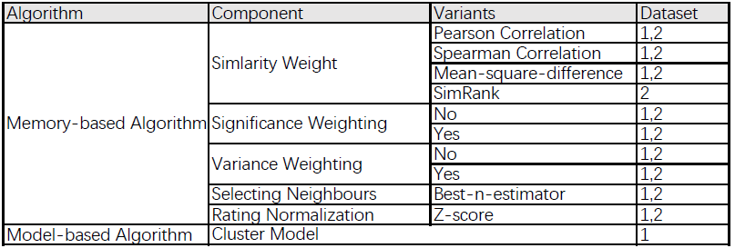
1. Methods and Components
Notes: All methods and algorithms in our report are cited from paper 1, paper 2 and paper 3.

Slide 4
2. Objectives
Compare the performance of each variant within the Similarity Weight
Compare the performance between with and without Significance Weighting
Compare the performance between with and without Variance Weighting
Compare the performance between Memory-based and Model-based algorithm

Slide 5
3. Dataset and Evaluation Criteria
(1) Dataset
The first data set is Anonymous Microsoft Web Data (https://archive.ics.uci.edu/ml/datasets/Anonymous+Microsoft+Web+Data). It’s an example of implicit voting data, with each vroot characterized as being visited (vote of one) or not (no vote).
The second data set is EachMovie (http://www.gatsby.ucl.ac.uk/~chuwei/data/EachMovie/eachmovie.html). This is an explicit voting example using data, with votes ranging in value from 0 to 5.
(2) Evaluation
For the first data set, we use ranked scoring for evaluation and prefer the model with higher rank score, as introduced in Paper 1.
And for the second data set, we use mean absolute error (MAE) and ROC sensitivity, as introduced in Paper 2. We will prefer the model with lower MAE and higher ROC

Slide 6
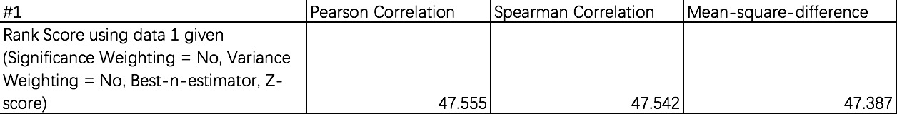
4.1 Performance of Similarity Weighting
For simplicity, we first compute these similarity measures using data1, and then pick the best method and compare with SimRank using data2
Notes: To compare the performance of these correlation methods, we control other components to be the same.
Discussion: from the output above, we see that the model with Pearson correlation has the highest rank score. In this case, we will prefer the model with Pearson.

Slide 7
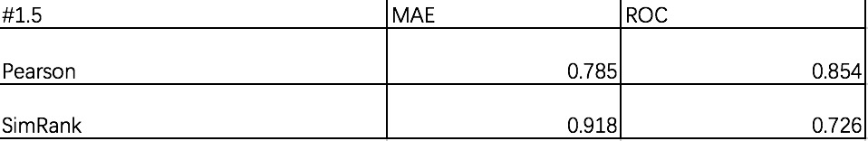
4.1 Performance of Similarity Weighting
Discussion: from the output above, we see that the model with Pearson has lower MAE and higher ROC. In this case, we will prefer the model with Pearson correlation.

Slide 8
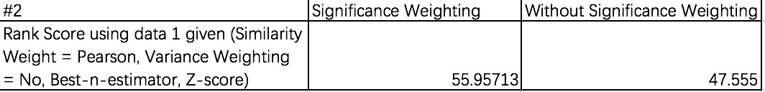
4.2 Performance of Significance Weighting
Discussion: from the output above, we see that the model with significance weighting has much better performance. In this case, we will prefer the model with significance weighting.

Slide 9
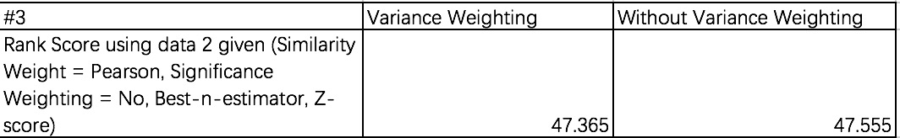
4.3 Performance of Variance Weighting
Discussion: from the output above, we see that the model with variance weighting has almost the same performance as the model without . In this case, we will prefer the model without variance weighting.

Slide 10
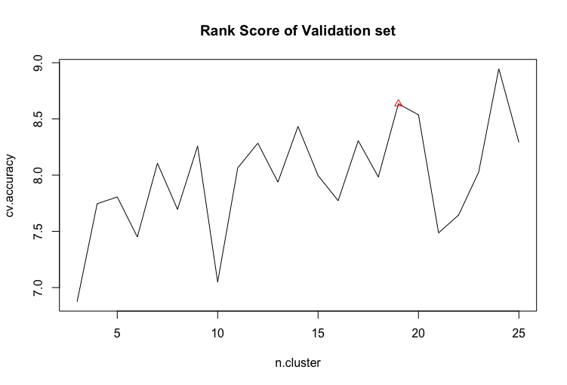
4.4 Memory- and model- based
Before comparing memory-based model and model-based model, we first need to figure out the best number of clusters to use in the cluster model.
From the plot in the right, there is no much difference between the rank score of 19 clusters and that of 24 clusters. Thus, we choose 19 clusters to avoid overfitting.

Slide 11
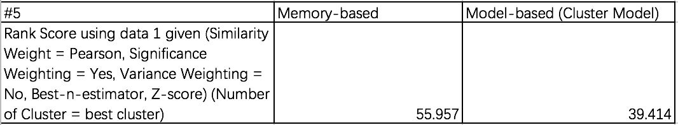
4.4 (continued)
Discussion: the rank score of our cluster model with 19 clusters is 39.414 which is much lower than the best performance of our Memory-based model before. Thus, we conclude that the memory-based model may have superior performance over the cluster model while treating data1.

Slide 12
Thank you!
Reference:
Breese, J. S., Heckerman, D., & Kadie, C. (1998, July). Empirical analysis of predictive algorithms for collaborative filtering. In Proceedings of the Fourteenth conference on Uncertainty in artificial intelligence (pp. 43-52). Morgan Kaufmann Publishers Inc..
Herlocker, J. L., Konstan, J. A., Borchers, A., & Riedl, J. (1999, August). An algorithmic framework for performing collaborative filtering. In Proceedings of the 22nd annual international ACM SIGIR conference on Research and development in information retrieval (pp. 230-237). ACM.
Jeh, G., & Widom, J. (2002, July). SimRank: a measure of structural-context similarity. In Proceedings of the eighth ACM SIGKDD international conference on Knowledge discovery and data mining (pp. 538-543). ACM.

