Slide 1
Predictors of chocolate ratings
Caroline Hussey
Codecademy Data Science Project
June 2021

Slide 2

Project Objectives
Aquire data from source and format to pandas dataframe
Analyse how ratings have changed over time
Assess the impact cocoa percentage may have on product rating
For each feature, identify the top 10 chocolate products
Find out which features are associated with the product rating
Test different machine learning models to see which can most accurately predict new product rating

Slide 3





Methods and Languages
Jupyter Notebook
Python
Beautiful Soup
Pandas
NumPy
Data Visualisations
Hypothesis Testing – Chi-Squared
Machine Learning – Logistic Regression, K-nearest Neighbours

Slide 4
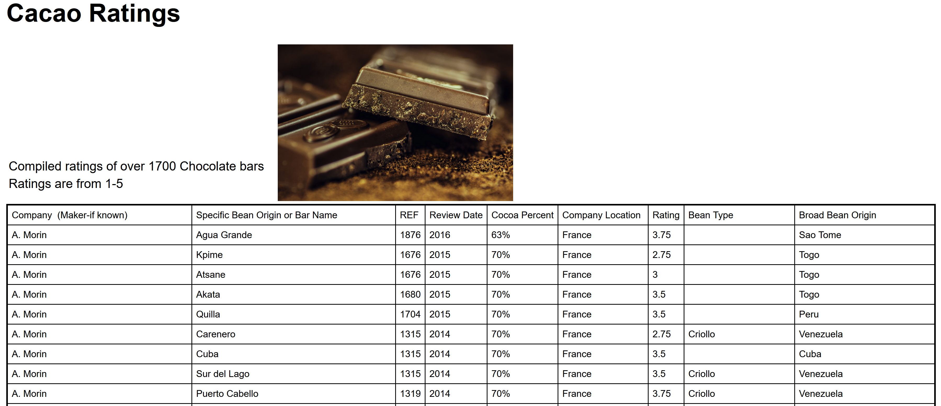
Data acquisition
Extraction Method
Beautiful soup to parse html
The target content is labelled with class names
.select(class): this method takes the class name as parameter and returns all html elements (including code) with that class name.
.get_text(): extracts text from the html element
Here we will loop through all elements with that class name, use the get_text() method on each iteration, and append the results to an array.
Repeat for each feature in the html table.
Combine all arrays to pandas dataframe.
HTML Structure
<tr>
<td class="Company">A. Morin</td>
<td class="Origin">Agua Grande</td>
<td class="REF">1876</td>
<td class="ReviewDate">2016</td>
<td class="CocoaPercent">63%</td>
<td class="CompanyLocation">France</td>
<td class="Rating">3.75</td>
<td class="BeanType"> </td>
<td class="BroadBeanOrigin">Sao Tome</td> </tr>

Slide 5
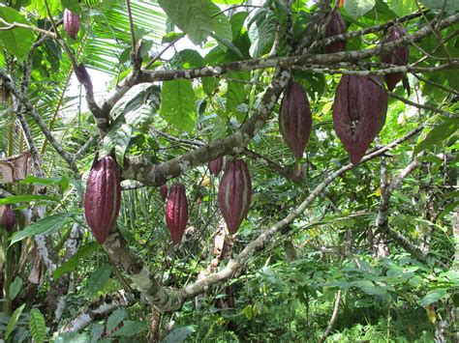
Exploratory Data analysis
Pandas .info() and .describe() to view summary statistics, data types and size of dataframe
Split dataframe into sections based on ratings boundaries for clearer visualisations (eg. Rated under 1.5 to plot lower rated products, rated above 3.5 to plot higher rated products)
Create a separate dataframe for each year to visualise ratings per year
Split into a separate dataframe for cocoa percentage boundaries to visualise ratings based on cocoa percentage
Remove null values for more accurate assessment of analyses focusing on Bean Types and Broad Bean Origin (the two series containing null values)

Slide 6
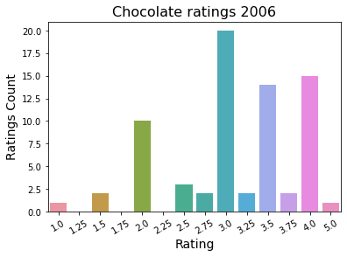
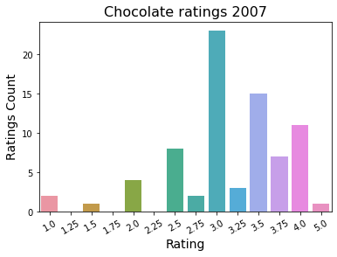
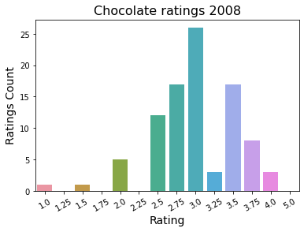
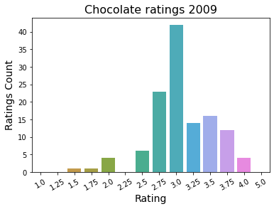
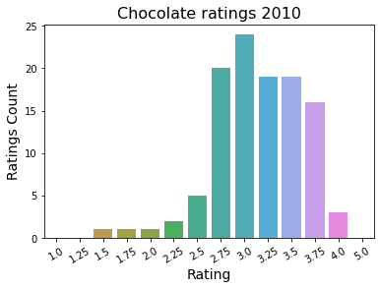
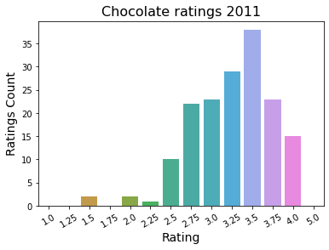
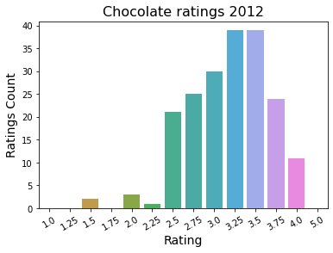
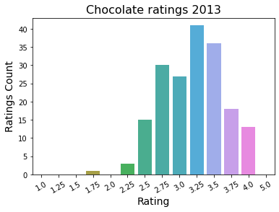
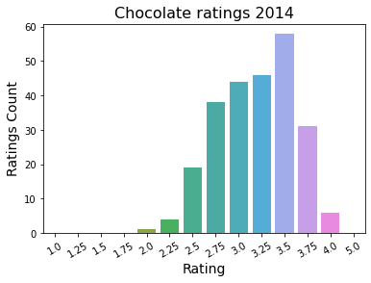
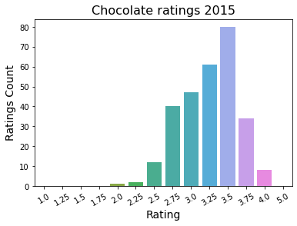
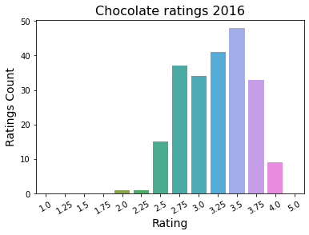
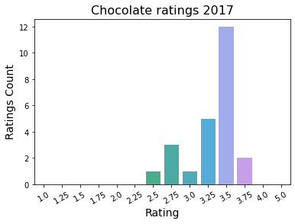
CHOCOLATE RATINGS BY YEAR

Slide 7
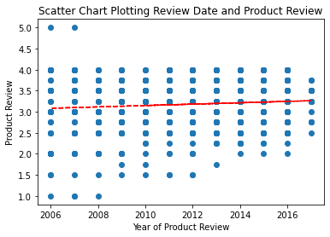
Chocolate ratings by year
Annual ratings show a greater range, but lower number of ratings before 2010.
1.0 and 5.0 ratings are only given in 2006, 2007 and 2008.
Higher ratings (3.5 +) were more common from 2010.
Chocolate products increase steadily from 2010.
Scatter plot shows a linear correlation between the product review and the year it was given.
The sample size from 2017 appears smaller in 2017 with a much lower number of products rated (possibly the data was collected part way through the year)

Slide 8
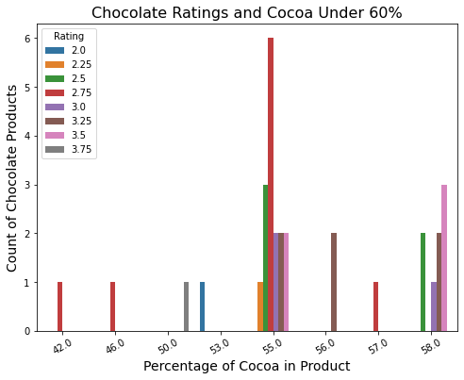
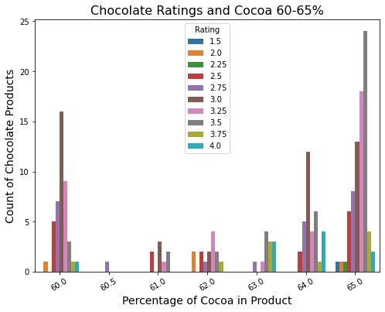
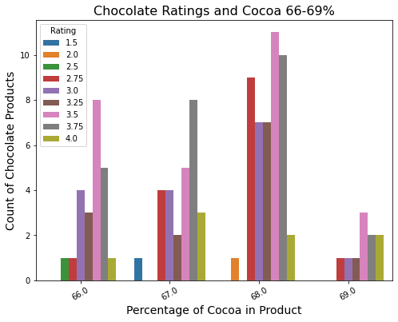
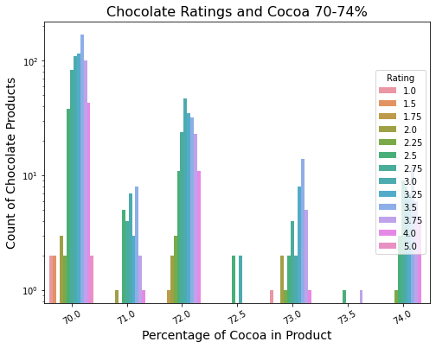
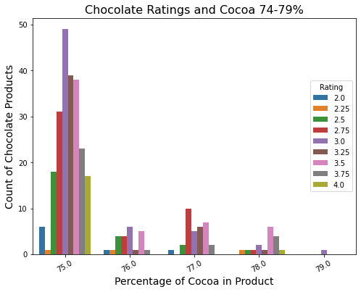
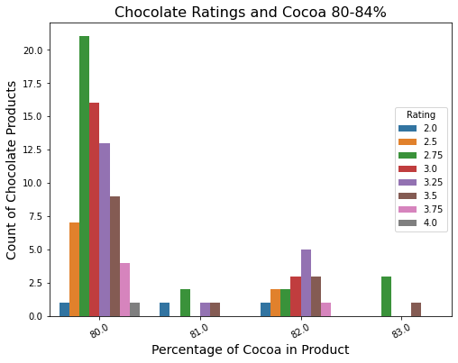
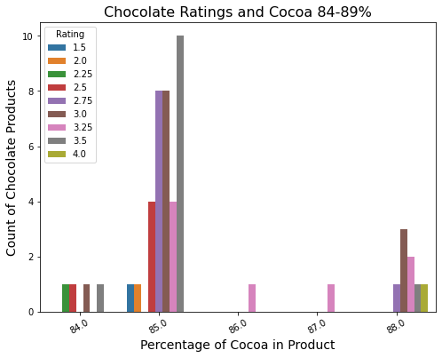
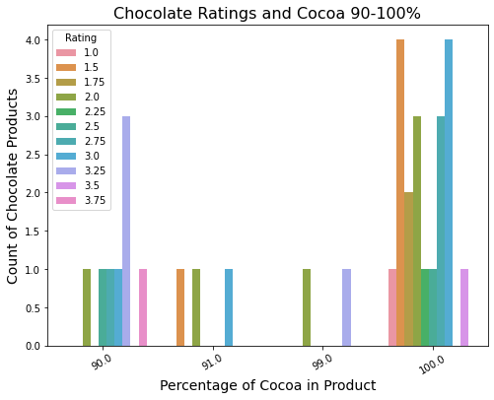
Chocolate ratings by COCOA PERCENTAGE

Slide 9
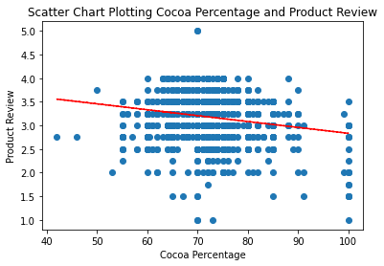
Chocolate ratings by cocoa percentage
Barplots show a greater number of reviews at specific ranges of Cocoa Percentage
Most chocolate products contain between 70-75% of cocoa (this graph is scaled using a log scale for easier viewing)
It is possible the higher number of reviews in these ranges is due to the higher number of products produced with that percentage of cocoa
Scatter plot shows a linear correlation between the product review and the percentage of cocoa.

Slide 10
top 10 average ratings for Bean origin grouped by year
Origin | Review Date | Review
Chuao | 2007 | 5
Toscano Black | 2006 | 4.5
ABOCFA Coop | 2015 | 4
Alto Beni, Cru Savage | 2006 | 4
Asante | 2009 | 4
Bali, Sukrama Bros. Farm, Melaya, | 2011 | 4
Bellavista Coop, #225, LR, MC, CG | 2013 | 4
Cabosse | 2007 | 4
Carenero Superior, Urrutia, Barlo | 2011 | 4
Chuao | 2006 | 4
Bean origin reports the local origin of the cocoa product. This can refer to a region in a country, a farm, or a co-operative.
The highest average rated chocolate product based on bean origin is Chuao, with an average rating of 5.0. in 2007.
A closer look at products whose origin is Chuao show that beans originating from here were marketed throughout the timescale covered in this dataset. These products received good ratings (3.5+) in 2006, 2007, 2011 and 2015, but ratings on other years showed average or less than average ratings.

Slide 11
top 10 average ratings for broad bean origin
Broad Bean Origin | Review
Dom. Rep., Madagascar | 4
Gre., PNG, Haw., Haiti, Mad | 4
Tobago | 4
Ven, Bolivia, D.R. | 4
Venezuela, Java | 4
DR, Ecuador, Peru | 3.75
Dominican Rep., Bali | 3.75
PNG, Vanuatu, Mad | 3.75
Peru, Belize | 3.75
South America | 3.75
Broad Bean Origin reports the wider origins of the cocoa product.
Usually refers to the country of origin
Top Rated chocolate products from broad bean origins average review is 4.0.
Top rated products based on broad bean origin include mixed origin products
Dominican Republic/Madagascar, Gre./PNG/Hawaii/Haiti/Madagascar, Tobago, Venezuela/ Bolivia/Dominicn Republic, and Venezuela/ Java are the highest rated broad bean origins in the products rated.

Slide 12
top 10 average ratings for bean type grouped by year
Bean Type (Overall) | Review
Criollo (Ocumare 67) | 4
Criollo (Wild) | 4
Trinitario (85% Criollo) | 3.875
Amazon mix | 3.75
Blend-Forastero,Criollo | 3.75
Criollo (Ocumare 77) | 3.75
Forastero (Amelonado) | 3.75
Trinitario, Nacional | 3.75
Trinitario, TCGA | 3.75
Amazon, ICS | 3.625
Bean Type | Review Year | Rating
Criollo (Ocumare 67) | 2007 | 4
Criollo (Wild) | 2006 | 4
Criollo, Trinitario | 2006 | 4
 | 2007 | 4
Beniano | 2016 | 3.875
Trinitario (85% Criollo) | 2007 | 3.875
Amazon mix | 2016 | 3.75
Amazon, ICS | 2016 | 3.75
Blend | 2010 | 3.75
Blend-Forastero,Criollo | 2008 | 3.75
A significant number of null values in this dataset, so null values were removed prior to analysis
Bean Types analysed both overall and grouped by year to compare the ratings of bean types in these categories.
Criollo – both wild and Ocumare 67 - Bean Type shows the highest average rating amongst bean types both overall and in 2006 and 2007 with an average rating of 4.0.
A closer look shows that overall products with Criollo beans have an average overall rating (3.2), and when grouped by year the average rating each year is also about average.

Slide 13
top 10 average ratings for Company grouped by year
Tobago Estate (Pralus) shows the highest average of ratings amongst companies with an average rating of 4.0.
A closer look shows only one product review for Tobago Estate (Pralus) – in 2012.
Heirloom Cacao Preservation (Zokoko) and Ocelot both have only two product entries (Heirloom in 2016 and Ocelot in 2015). Both companies received a rating of 3.75 and a second of 4.0, giving an average rating of 3.875 for both companies.
Company | Review
Tobago Estate (Pralus) | 4
Heirloom Cacao Preservation (Zokoko) | 3.875
Ocelot | 3.875
Amedei | 3.846154
Matale | 3.8125
Patric | 3.791667
Idilio (Felchlin) | 3.775
Acalli | 3.75
Chocola'te | 3.75
Christopher Morel (Felchlin) | 3.75

Slide 14
top 10 average ratings for Company Location grouped by year
Companies based in Equador show the highest rating of cocoa products in 2016.
Belgium, Australia and Scotland show high ratings in 2011, 2013 and 2015 respectively.
The overall average rating for companies whose location is Ecuador is 3.009.
Ratings for companies whose location is Ecuador show a steady improvement in ratings over time, with lower ratings received prior to 2010 and average – high ratings received since.
Company Location | Review Date | Review
Ecuador | 2016 | 4
Belgium | 2011 | 3.875
Australia | 2013 | 3.8125
Scotland | 2015 | 3.8125
Bolivia | 2011 | 3.75
Canada | 2010 | 3.75
Chile | 2015 | 3.75
Colombia | 2015 | 3.75
Iceland | 2016 | 3.75
Italy | 2006 | 3.75
Ecuador Mean Ratings over time
2007 | 3.416667
2008 | 2.822917
2009 | 2.725
2010 | 3
2011 | 3.375
2012 | 3.375
2014 | 3.357143
2015 | 3.416667
2016 | 4

Slide 15
Chi Squared – statistical significance of features of chocolate production
The rating of each product is compared against it’s feature to test the hypothesis that that feature has a significant association with the product rating.
Calculation is carried out using SciPy’s chi2 _contingency (from SciPy's stats module)
Significance threshold: 0.05. Pval above that value is not significantly different from the other. Anything under that is significantly different.
N/A values were removed from Bean Type and Broad Bean Origin prior to testing.
Features that do not show a statistically significant association with the rating are highlighted in green.
The chi-squared contingency test indicated there is no association between the origin of a cocoa bean and their rating.
Features that show a statistically significant association with the rating are highlighted in red.
This indicates there is an association between the company, company location, bean type, cocoa percentage and the year the product was reviewed, and their rating.
Feature | Pval
Origin | 0.8878288022134178
Broad Bean Origin | 0.9999999999999815
Bean Type | 0.004829483755625918
Company | 1.5671040278099777e-25
Company Location | 0.00010569966557185
Review Year | 2.180736007035077e-25
Cocoa Percentage | 8.550113133375805e-26

Slide 16
MACHINE LEARNING – predict ratings of chocolate products
Linear Regression
K-Nearest Neighbours
A simple model for continuous datatypes
Model is trained using cocoa percentage and date of review features.
The label is product rating.
Data is scaled using sklearn’s standard scaler and scored with .score()
Linear Regression shows a very low accuracy score, suggesting this model is not the best for this dataset.
A new column is added to the dataframe to label ‘Ratings’ as either 1 for good, or 0 for bad.
n/a values are removed from the dataframe prior to testing
Features selected are those that showed a positive association with chocolate rating: Company, company location, bean type, cocoa percentage and year of review.
Label encoder and onehotendoder are utilised to convert each feature to numeric and binary format so that it can be processed by machine learning models.
K-Nearest Neighbours shows the highest accuracy score (82%).

Slide 17
MACHINE LEARNING – predict ratings of chocolate products
Logistic Regression
The same method to select and transform features for K-Nearest Neighbours is applied to the logistic regression model.
The model is trained and tested using sklearn’s built in LogisticRegression() method.
Logistic Regression shows a good accuracy score (80%).
‘New' data is created to test-predict logistic regression model
Sklearn’s .predict() method is used to predict the rating of new test products
Sklearn’s .predict_proba() method is used to show the probability that the new test products will be rated either good or bad. The output is two dimensional array showing the pair probability for eachthe possible ratings for each product, with the first probability being for 1, or good, and the second for 0, or bad.
Test Product 1 : [[9.99794560e-01 2.05439761e-04]; result = bad
Test Product 2 : [3.70502592e-04 9.99629497e-01]; result = good
Test Product 3 :[0.00000000e+00 1.00000000e+00]]; result = good
The model shows that there is no doubt that the third test product is good and little doubt that the first is bad and the second is good.

Slide 18
Project Findings
Aquire data from source and format to pandas dataframe
Data was scraped from a website using the python beautiful soup library. Data was converted into a pandas dataframe and split for various analyses.
Find out which features are associated with the product rating
Chi squared contingency testing shows that there is an association between Bean Type, Company, Company Location and Year of Review, and the rating of the product.
For each feature, identify the top 10 chocolate products
The top ten chocolate products for each feature are detailed on individual slides.

Slide 19
Project Findings
Analyse how ratings have changed over time
Annual ratings show a greater range, but lower number of ratings before 2010.
Lowest rating (1.0) and highest rating (5.0) are only given in 2006, 2007 and 2008.
From 2010 the number of Chocolate products increase steadily. Higher ratings (3.5 +) were also more common from this year.
Chi squared contingency testing shows an association between year of rating and rating received.
Assess the impact cocoa percentage may have on product rating
Most chocolate products contain between 70-75% of cocoa (this graph is scaled using a log scale for easier viewing)
Chi squared contingency testing shows an association between cocoa percentage and rating received.
Test different machine learning models to see which can most accurately predict new product rating
Linear Regression is the least reliable at predicting chocolate product rating.
Logistic regression and K-Nearest neighbours showed similar accuracy scoring, with K-Nearest Neighbours being slightly more accurate at 82%.

