Slide 1
UX/UI Money Management Challenge
MSC
Malika Shady Caroline

Slide 2
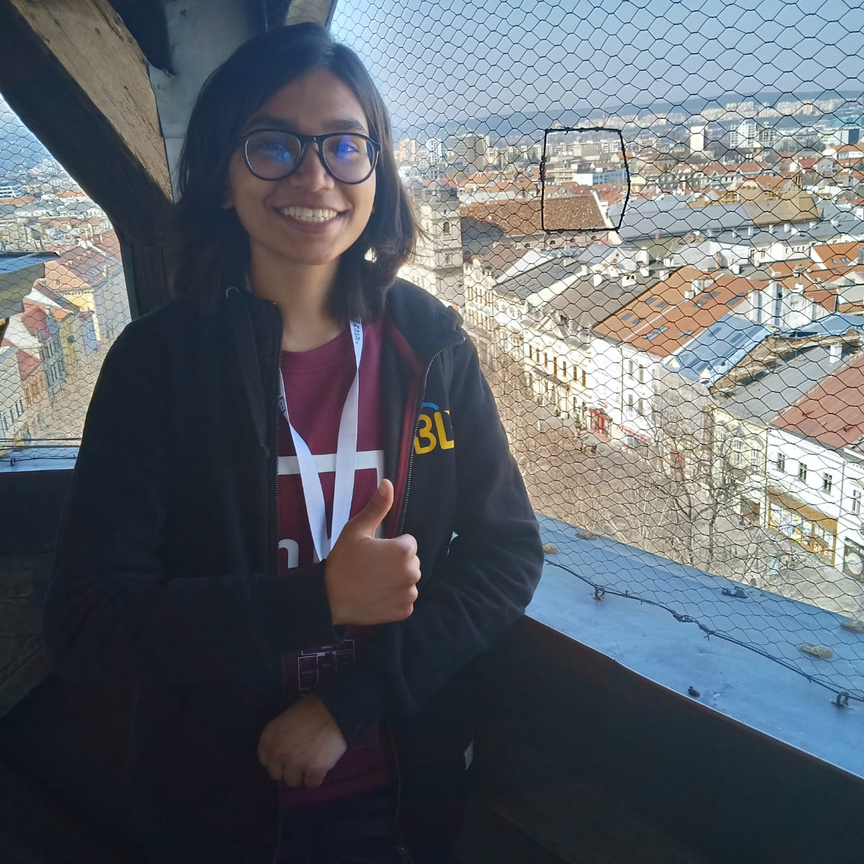
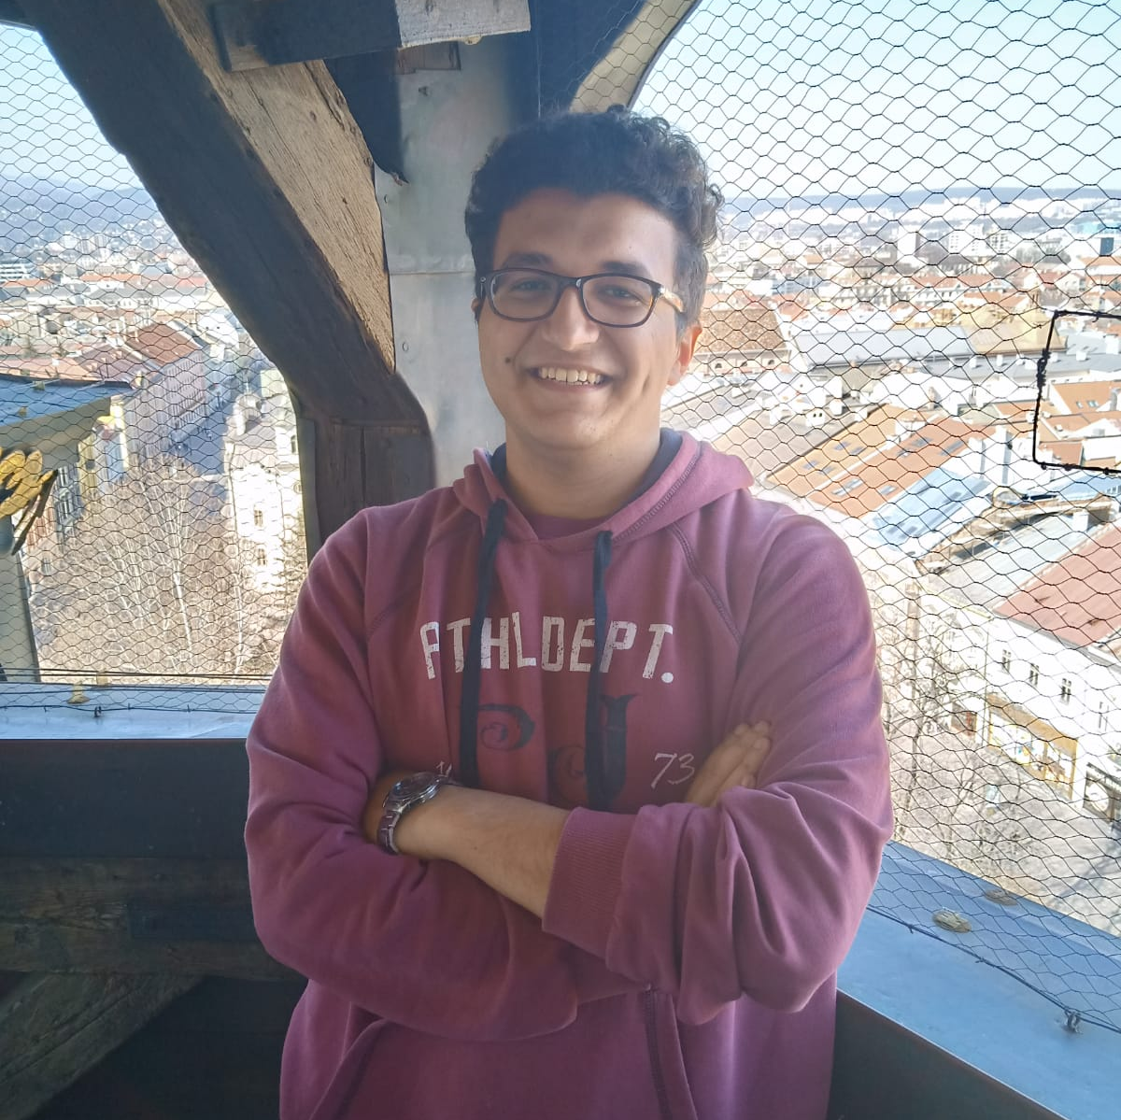
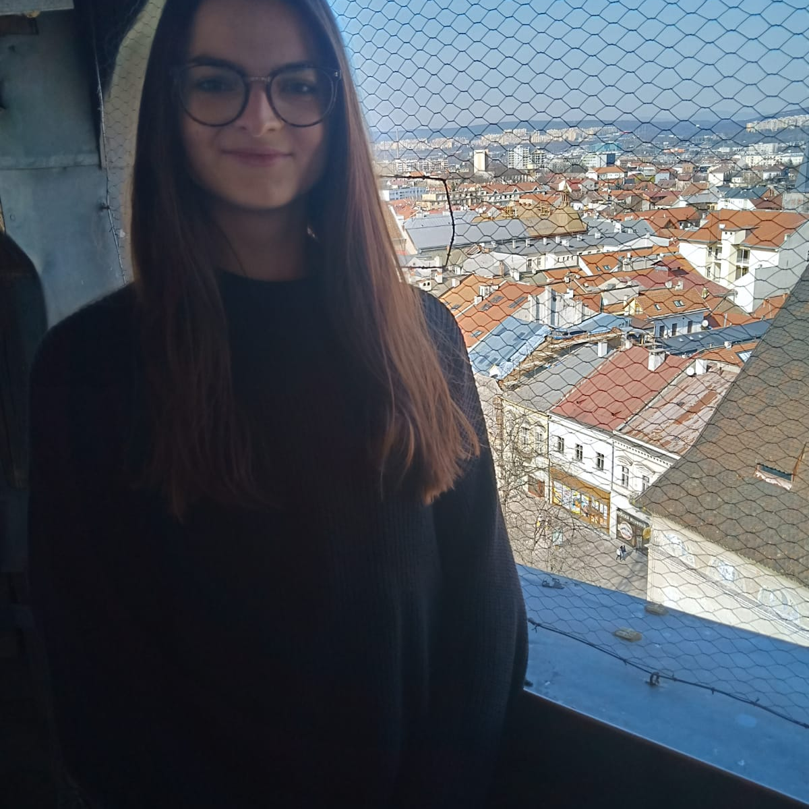

Persona
1
2
3
Malika
Shady
Caroline
Malika is moving around a lot and would like to see the average living costs of the respective cities
Shady lives on a scholarship and he wants to save more. However, since he lacks clear goals he often fails to do so
Caroline regularly overspends as she is poor at money management. She needs a tool to set a monthly budget to avoid overspending

Slide 3
Feature 1
Clear comparison of living costs
Feature 2
Saving goals
Feature 3
Easy budget setting

