Slide 1
Christmas Final Year Project Demo
By Caroline Percy

Slide 2
What am I doing?
I want to create a hidden object game
I want the art assets to be given by a third party
d

Slide 3

What is A hidden object game?
They are video games that task the player to find an object within a busy landscape
They will often ask you to find several objects in one scene
There will also be objects called distractors

Slide 4

What is REST api?
REST API is an interface that two systems use to transfer information
It is defined by a set of constraints to keep it reliable and secure (REST)
A request is sent to the server in form of a URL, and a reply is sent back, often in JSON form.

Slide 5
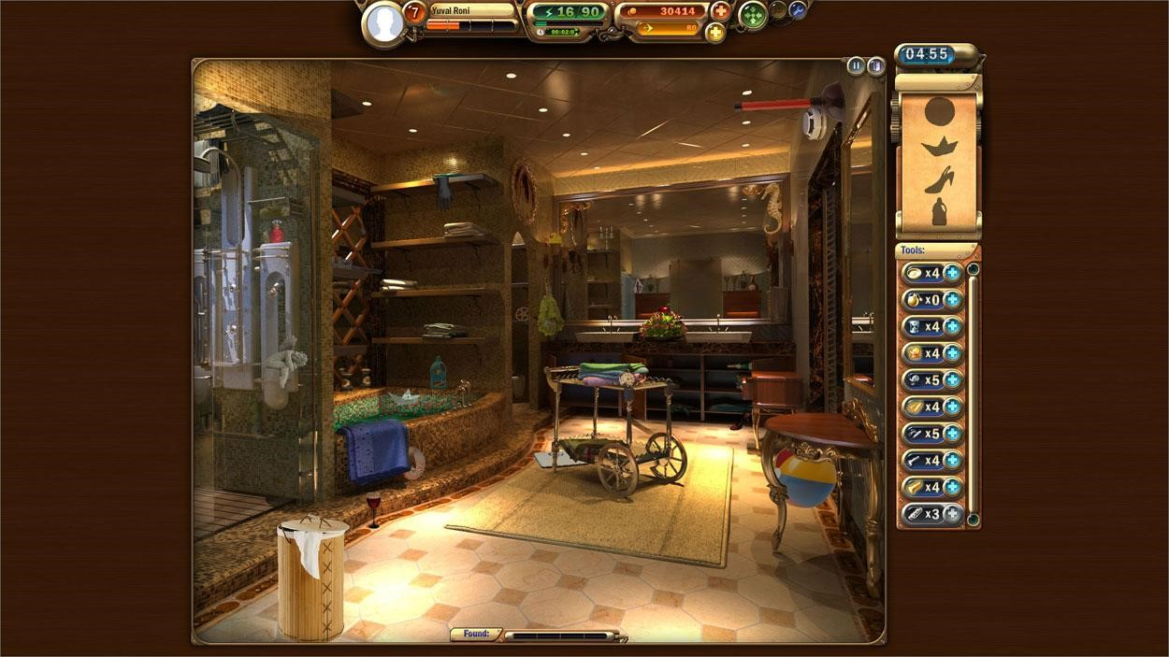

Slide 6
Why am I Doing it?
Hidden object games are often underestimated for their simplicity and lack of challenge
f

Slide 7
My Research question(s)
Can I make a hidden object game that relies on a third party to deliver the game assets dynamically?
Will such a game be seamless to the player? Can I make levels theme-based?

Slide 8
What am I using for this?

Slide 9
Python and pygame

Slide 10
Pixabay & third api
Pixabay is a website where people upload and share royalty free images, videos and music.
D
D
d

Slide 11
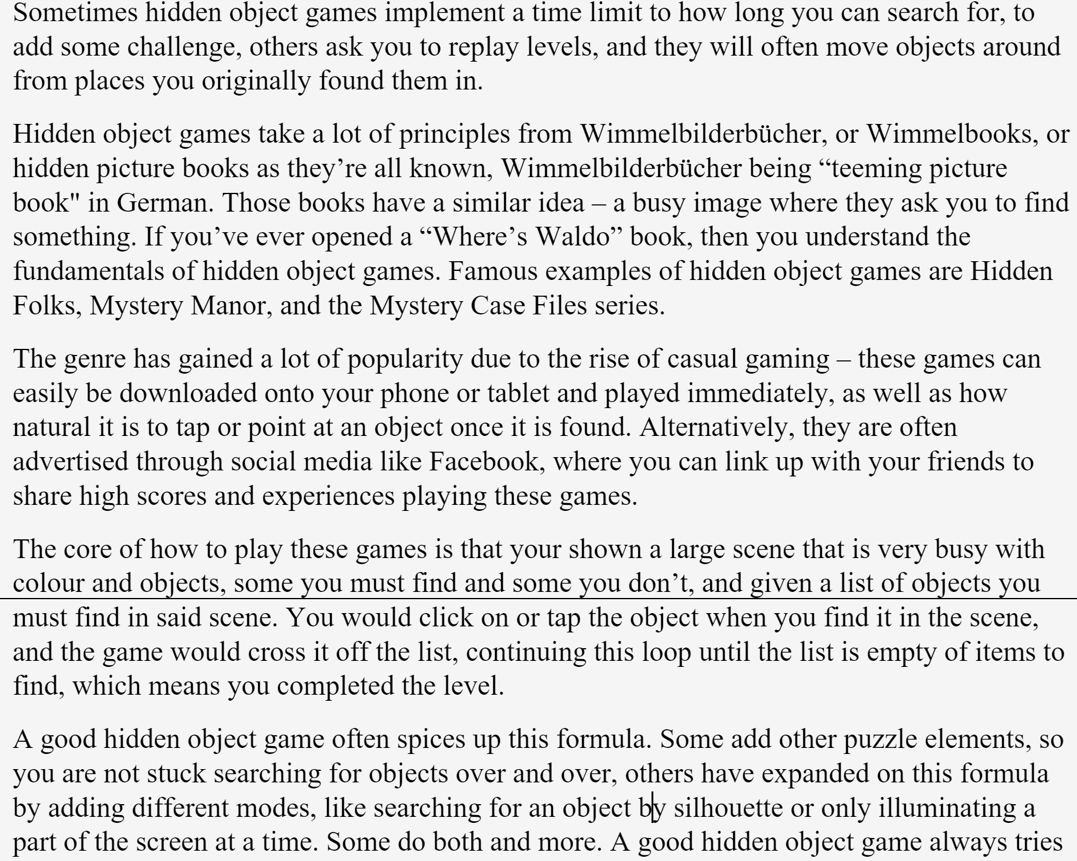
What I have done thus far?
Most of my Project Report
A Demo

Slide 12



What’s next?
Base Game
Documentation
Implement third-party
I still need to complete a base hidden object game. This is for both testing and a project to build on for my REST API
I need to finialise the report, as well as move on to other documents like the GDD and TDD
I need to fully implement the REST API so that I can prove (or disprove!) my research questions

Slide 13
Thank you for Listening!
Any questions?

