Slide 1
FASHION BRAND
EXPERIMENT
Yesol Lee, Yongxian Lun, Chris Chang, Linh To

Slide 2
TABLE OF CONTENTS
1.
4.
2.
5.
3.
6.
Project Overview
Average Treatment Effect
Goal of the Experiment
Overall ATE
Conditional ATE
Methodology
Randomization Check
Survey Design
Procedure
Pre experimental variables
prop.test
Exploratory Data Analysis
Conclusion
Number of treat/control
Distributions of Score/Duration
Conclusion and Limitations

Slide 3



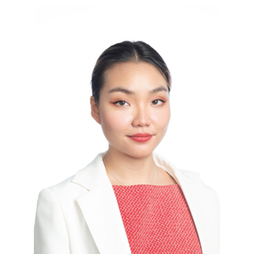
Our Team
Chris Chang
Yongxian (Caroline) Lun
Linh To
Yesol (Sally) Lee

Slide 4
1
OVERVIEW OF EXPERIMENT

Slide 5
OUR EXPERIMENT
The goal of our experiment is to find out how brand name affects the preference of clothing products, especially amongst young consumers.
Thus we conducted a survey to measure how people's preferences change among very similar designed clothing of high-end brands and fast fashion brands.
Branded Clothing

Slide 6
2
METHODOLOGY

Slide 7

One long survey with a lot of logics
Control/Treatment randomization
Question randomization
Randomization in individual level
Randomly assigning 10 questions to participants
Question choices randomization
Survey display logic
Randomly assigning all 3 choices in each question
Match gender question to displaying right question to the right gender (blocking method)
Scoring
Match each high-brand choices to the scores
Notes:
Qualtrics options allowed us to randomly assign the participants into the control and treatment groups equally. If the participant answered male or female to the first question, they will be assigned randomly to the control or treatment group of their respective gender questions. The survey will equally display each gender to their control or treatment assignments to ensure the probability of the assignment.

Slide 8
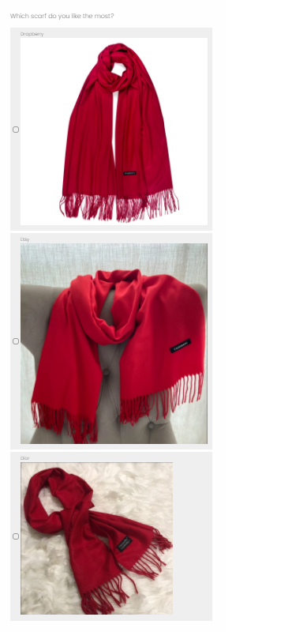
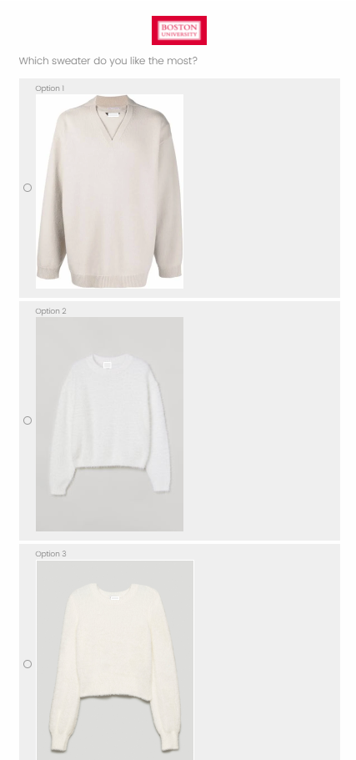
QUALTRICS Survey
Here is 2 samples of our control and treatment surveys for female groups

Slide 9
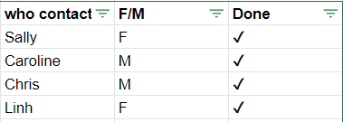
Procedure
Conducted surveys on graduate students in BU and other institutes
Google spreadsheet to track progress to avoid duplicates

Slide 10
Result
10 types of products
1. Treatment: 19
Male
2.Control: 19
10 types of products
Gender
3.Treatment: 23
10 types of products
Female
4.Control: 20
10 types of products

Slide 11
3
EXPLORATORY
DATA ANALYSIS

Slide 12
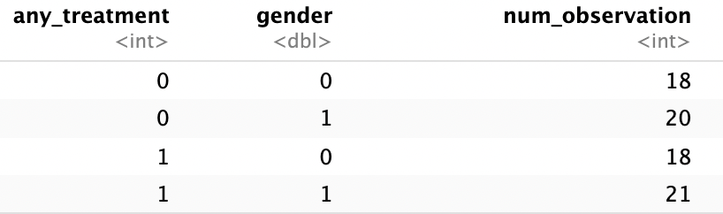
Number of Treatment and Control Samples
any_treatment
0 = Control
1 = Treatment
gender
0 = Male
1 = Female

Slide 13
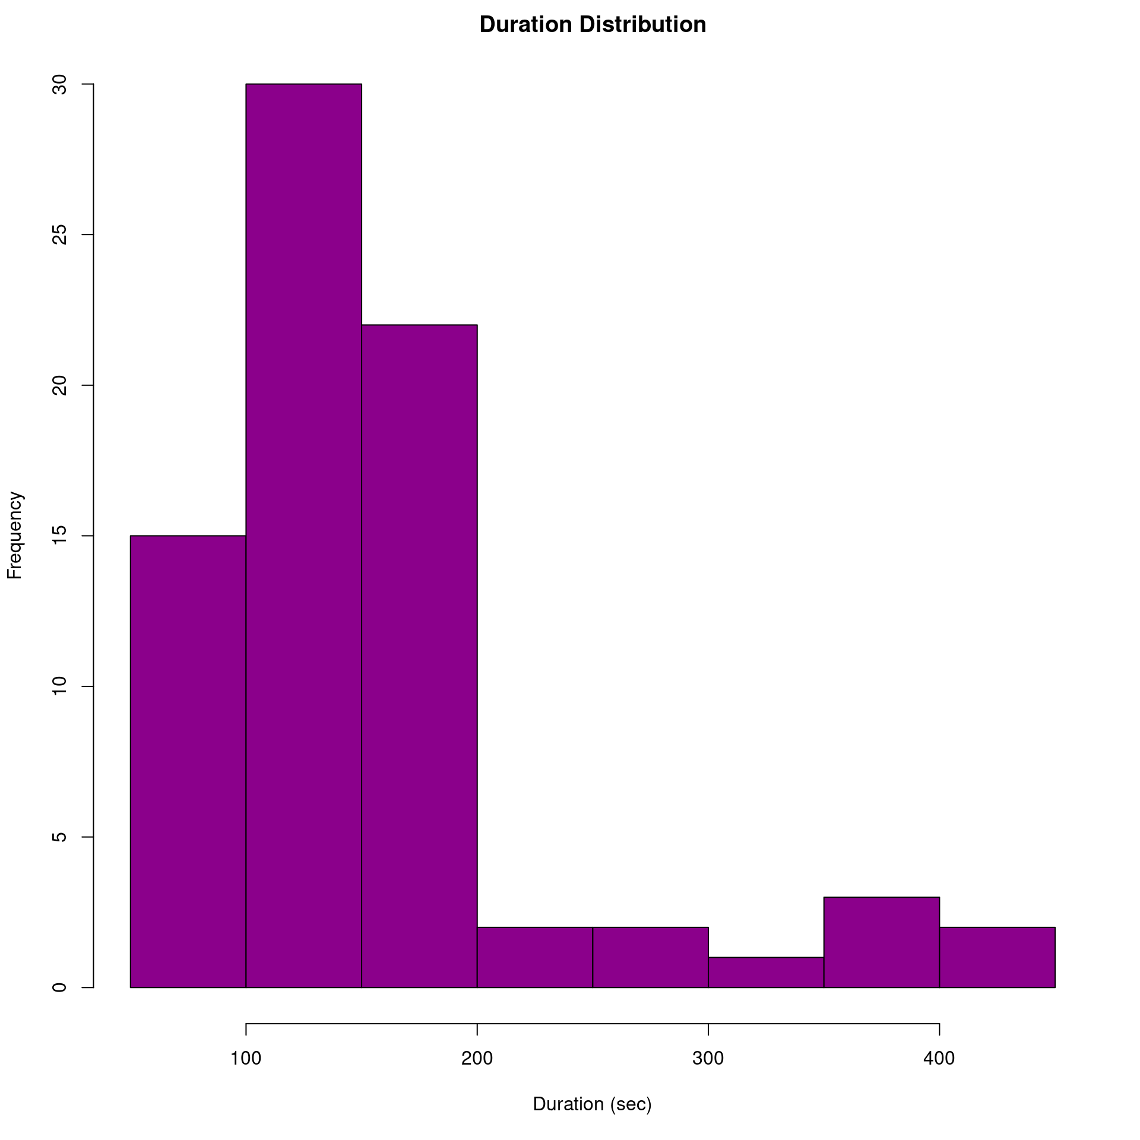
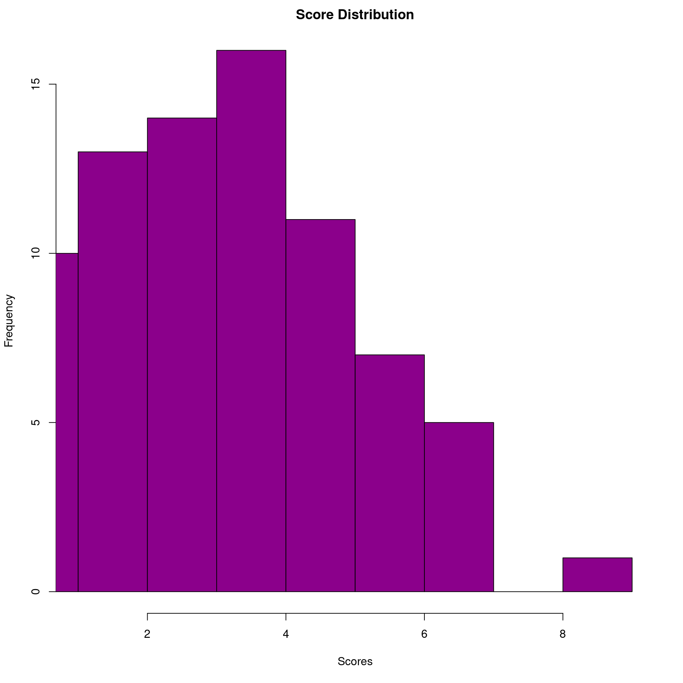
Distributions of Score and Duration
Median = 137
Median = 4

Slide 14
4
AVERAGE TREATMENT EFFECT

Slide 15
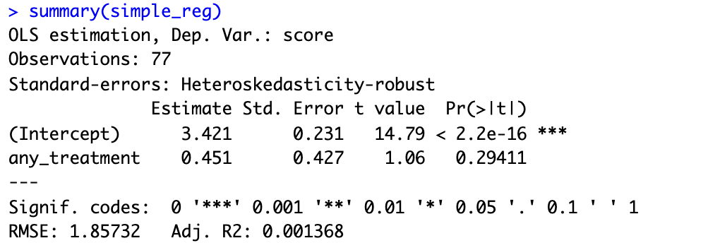
Estimate Average Treatment Effect
simple_reg <- feols(score ~ any_treatment, data=data, se='white')

Slide 16
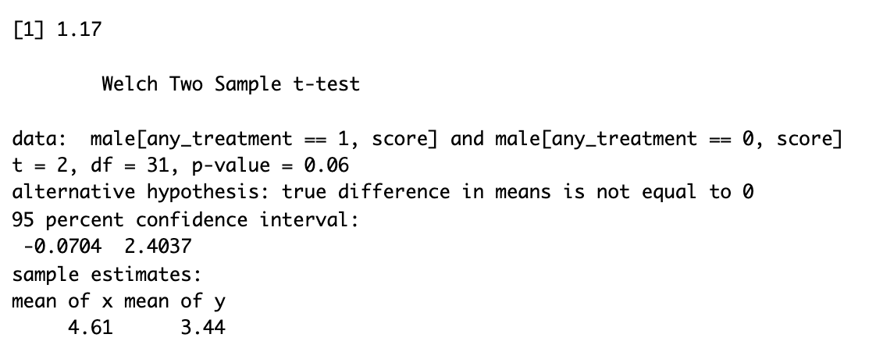
Conditional Average Treatment Effect
m_ate <- male[any_treatment == 1, mean(score)] - male[any_treatment == 0, mean(score)]
t.test(male[any_treatment==1, score], male[any_treatment==0, score])

Slide 17
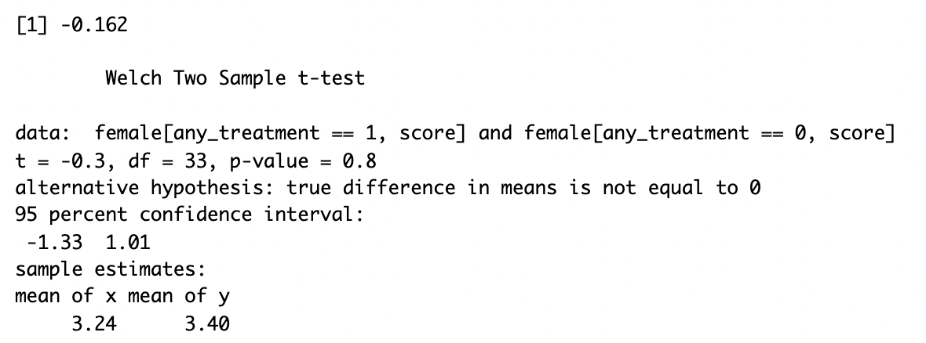
Conditional Average Treatment Effect
f_ate <- female[any_treatment == 1, mean(score)] - female[any_treatment == 0, mean(score)]
t.test(female[any_treatment==1, score], female[any_treatment==0, score])

Slide 18
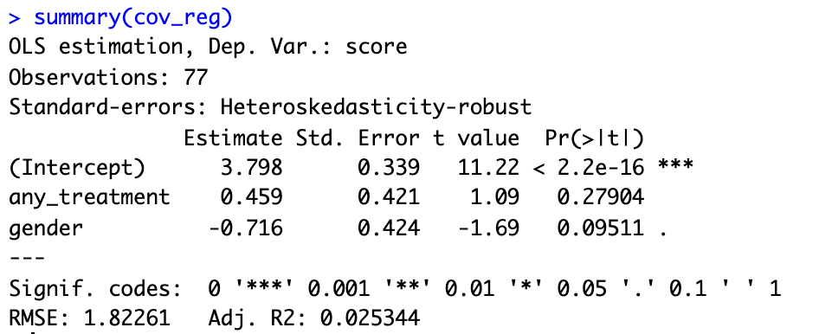
Control Covariate in Regression
cov_reg <- feols(score ~ any_treatment + gender, data=data, se='white')
Estimate: 0.451 → 0.459
Standard Error: 0.427 → 0.421

Slide 19
5
RANDOMIZATION
CHECK

Slide 20
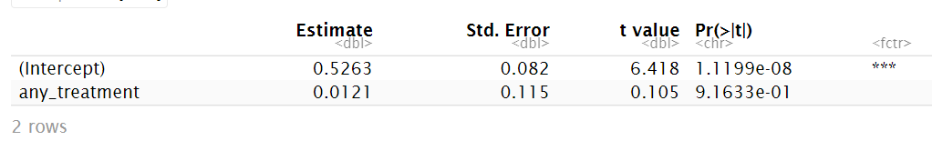
Randomization Check Part 1
regression_pre_effects_gender <- feols(gender ~ any_treatment, data = data)
Gender is a control variable that is not affected by treatment
The estimate of any_treatment is not significant
It proves that no substantial differences in before experiment variables

Slide 21
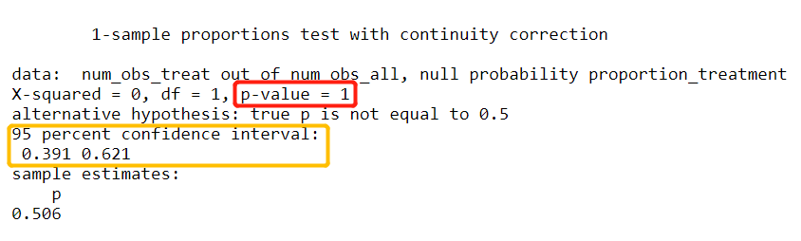
Randomization Check Part 2
P-value =1 >0.05 ---> can’t reject the null
The randomization proportion was done properly
Prop.test (num_obs_treat, num_obs_all, p = proportion_treatment)
Notes:
Second, we want to check it the proportion of people treated is what we would expect.
The test below shows that 50% of people were randomized if 39 out of 77people are treated. We see that the confidence interval does include 0.5, and we failed to reject the null. So the randomization is done properly.

Slide 22
6
STATISTICAL POWER

Slide 23
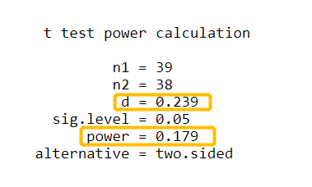
Statistical Power
The Cohen's D of 0.239 -> small effect
The power of 0.179 -> less likely to detect the effect
pwr.t2n.test(n1 = num_obs_treat, n2 = num_control, d = cohens_d, sig.level = .05, power = NULL)
Notes:
The Cohens' D measures the effect size of the difference between the mean of treatment and the mean of control. The Cohen's D of 0.239 is a small effect.
The power is 0.179 which is a bit less, meaning that we are a bit likely to detect the effect for 77 observations. This is because we have small Cohen's D and our experiment only had about 80 observations.

Slide 24
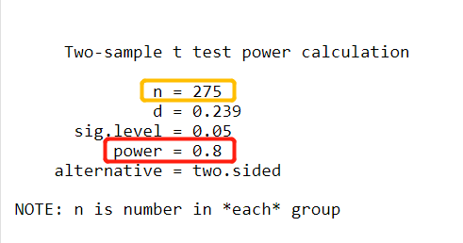
Statistical Power
need 275 observations in total
higher power of 0.8
Pwr.t.test (n = NULL, d = cohens_d, sig.level = .05, power = 0.8)
Notes:
If we want to have higher power of 0.8, we need 275 observations in total when the Cohen's D does not change.

Slide 25
7
CONCLUSION & LIMITATION

Slide 26
Conclusion
Limitations
Analyzed effect of brand names on clothing preferences
Positive effect overall but not significant
Men had higher ATE than women - more likely to choose high-end products.
Experiment was done properly based on randomization check
Need 275 observations to reach power of 0.8
Adding more product variety in the same product category
Expanding age range of respondents
Adding more brands - include mid-luxury brands
Notes:
Chris

Slide 27
Thank you!

