Slide 1

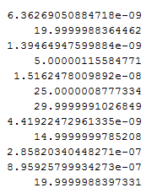
Task 3:
Interior point
X:
Result:860.00000859597
Dual simplex
X:
Result: 860

Slide 2
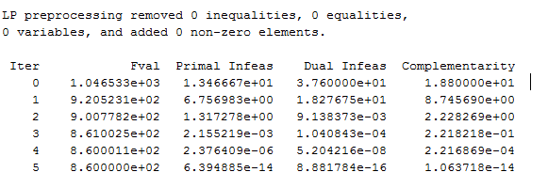
Interior point moved across the interior of the feasible region
Primal Infeas + Dual Infeas: https://www.mathworks.com/help/optim/ug/linear-programming-algorithms.html#buyrm4v-1
Complementarity: A measure of the Lagrange multipliers times distance from the bounds, which should be zero at a solution.

Slide 3
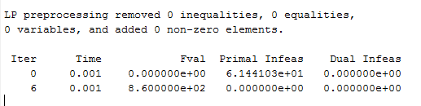
Dual Simplex

Slide 4

Task 4:

