Slide 1

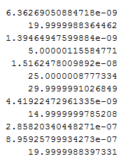
Task 3:
Interior point
X:
Result:860.00000859597
Dual simplex
X:
Result: 860

Slide 2
outline of Interior Point Method
Presolve: simplification and conversion of the problem to a standard form.
Generate an initial point
close to the central path
Predictor-corrector iterations to solve the KKT equations.
find a point where the Karush-Kuhn-Tucker (KKT) conditions hold
iterates until it reaches a feasible point :
satisfies the constraints to within tolerances
the relative step sizes are small

Slide 3
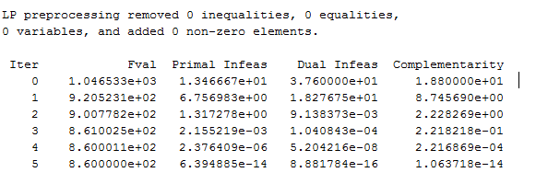
Interior point moved across the interior of the feasible region
Primal Infeas + Dual Infeas: https://www.mathworks.com/help/optim/ug/linear-programming-algorithms.html#buyrm4v-1
Complementarity: A measure of the Lagrange multipliers times distance from the bounds, which should be zero at a solution.

Slide 4
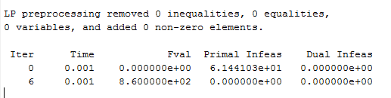
Dual Simplex

Slide 5

Task 4:

