Slide 1
GENRE CLASSIFICATION OF WORLD MUSIC
Done by,
Name: Carol Jeffri J A
Reg No: 312321205033
Under the Guidance of,
Dr. Tamizhselvi A M.E., Ph.D.,
Associate Professor

Slide 2
ABSTRACT
Music genre classification in music information retrieval (MIR) is vital for organizing vast audio collections. It entails several key steps: Firstly, feature extraction selects relevant attributes like MFCCs or rhythmic patterns. Next, feature selection identifies the most discriminative features. Then, selecting appropriate classifiers such as KNN, Random Forest is crucial. Evaluation assesses system performance using metrics like accuracy and F1-score. Post-processing techniques like ensemble learning refine results. Deep learning methods like CNNs and RNNs offer promising avenues for further improvement. By meticulously navigating these steps, effective genre classification systems can be developed, benefitting music-related businesses and users alike.

Slide 3
OBJECTIVE
1. Expand genre coverage: Extend the classification system to encompass a broader spectrum of music genres, including niche and emerging styles, to provide users with a more comprehensive and inclusive music browsing experience.
2. Enhance accuracy: Develop and refine music genre classification algorithms to achieve higher accuracy rates through advanced feature extraction techniques, classifier optimization, and ensemble learning methods.

Slide 4
LITRATURE REVIEW
S.NO | Author(s) | Key Findings | Approach | Pros & Cons
1. | Sung-Hyun Cho et al. (2022) | Achieved 92.6% accuracy on GTZAN dataset | Late fusion CNN with melspectrograms, chroma features, spectral contrast | Effective, learns complementary representations, but complex architecture
2. | M Sambath et al. (2022) | Achieved 93.8% accuracy on GTZAN dataset using InceptionV3 | CNN with mel-spectrogram features | High accuracy, learns discriminative features, limited to audio data
3. | Yagya Raj Pandeya et al. (2021) | Achieved state-of-the-art performance on Million Song Dataset (multi-modal, multi-task) | Mel-spectrograms (audio), word embeddings (lyrics) | Captures complex relationships, more complex to implement
4. | Anirudh Ghildiyal et al. (2021) | Achieved 89.3% accuracy on 10-genre dataset using SVM | Machine learning with data filtering | Improves performance of ML algorithms, limited to traditional ML techniques
5. | H.A. Hanafiah et al. (2017) | MFCC best performing feature (77.8% accuracy) | Feature extraction with SVM (mel-frequency cepstral coefficients) | Effective feature, lower accuracy compared to deep learning
6. | K. Han et al. (2017) | Achieved 84.4% accuracy on 10-genre dataset using CNN | Deep learning with convolutional neural networks | High accuracy, requires significant computational resources
7. | T. Zhang & J. Kuo (2001) | 90% accuracy in audio classification | Audio content analysis for segmentation and classification | Efficient, limited to basic audio classification
8. | L. Lu et al. (2001) | KNN and LSP-VQ for speech/non-speech discrimination | Audio content analysis for classification and segmentation | Robust, complex to implement for real-time applications
9. | S. Sugianto & S. Suyanto (2000) | Voting scheme with CNN improved accuracy (71.87%) | Mel-spectrogram and convolutional neural network | More information captured compared to MFCC, lower accuracy
10. | Q. H. Nguyen et al. (2000) | 71.7% accuracy on Vietnamese music dataset | Residual Attention Network (RAN) | Efficient, lower accuracy compared to other deep learning methods

Slide 5
DRAWBACKS OF EXIXTING SYSTEM
1. Limited genre coverage: Current systems often overlook or underrepresent various music genres, limiting their ability to accurately categorize diverse musical styles.
2. Bias in training data: Imbalanced datasets may skew classification results, favoring overrepresented genres and neglecting underrepresented ones.
3. Ambiguous genre definitions: Subjectivity in defining music genres poses challenges for classification accuracy, as genre boundaries can be unclear and open to interpretation.
4. Intra-genre variation: Significant variation within genres, including differences in style, instrumentation, and tempo, complicates accurate classification.
5. Complexity of music compositions: Music's multifaceted nature, including layering, dynamics, and cultural influences, presents challenges for classification systems in capturing genre characteristics accurately.

Slide 6


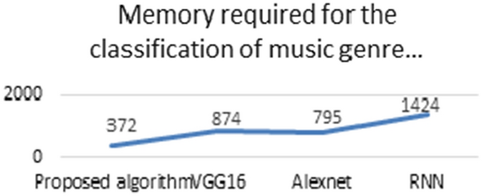

Slide 7
PROPOSED WORK
1. Develop a music genre classification system for world music, integrating audio, textual, and visual features.
2. World music encompasses diverse styles like folk, traditional, and indigenous music.
3. Extract audio features using advanced methods like Mel-frequency cepstral coefficients (MFCCs) and pitch contours.
4. Utilize natural language processing to analyze lyrics, extracting sentiment and topic information for textual features.
5. Employ computer vision techniques to analyze album cover images, extracting color and texture information for visual features.

Slide 8
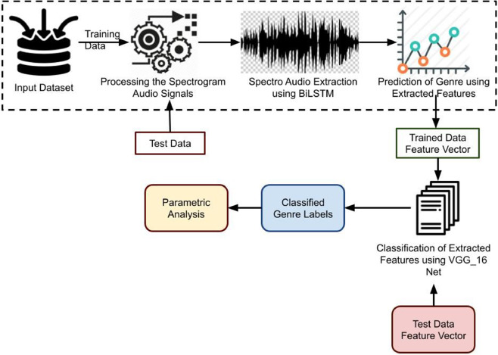
ARCHITECTURE

Slide 9
HARDWARE & SOFTWARE
HARDWARE REQUIREMENTS
Processor - minimum 8 cores for larger datasets
Minimum of 16 GB of RAM
GPU of 4 GB memory
SOFTWARE REQUIREMENTS Programming language - Python
Machine learning libraries - Tensorflow, Keras, PyTorch, Scikit- Learn
Audio Processing Libraries - Librosa, pydub, audioread
Data Visualization - Matplotlib, Seaborn, Plotly
Integrated Development Environment - Jupyter Notebook

Slide 10
PROGRAM IMPLEMENTATION
IMPORT LIBRARIES
Pandas: To import files/datasets.
Matplotlib: To visualize the data frame.
Numpy: To perform operations like scaling and correlation.
Seaborn: To visualize the data frame.
Librosa: To visualize the audio data. Install this library by “pip install librosa” command

Slide 11
PROGRAM IMPLEMENTATION
DATA PREPROCESSING
DATA EXPLORATION
Read the CSV file using Pandas
Check the Dataset with head()
Study the Dataset by using shape,info() etc.,
Then display the statistical summary using Describe()
Handling Missing Data.

Slide 12
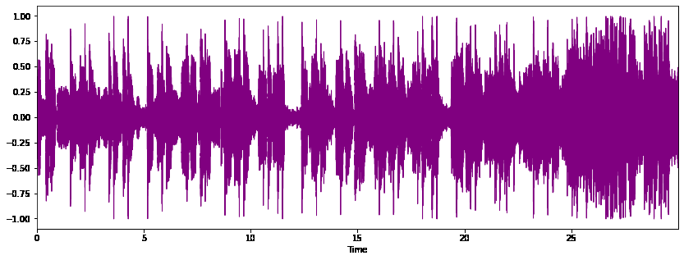
PROGRAM IMPLEMENTATION
VISUALIZE THE WAVEPLOT
Using the Librosa Audio Library we can visualize the waveplot for the [.wav] files
POP WAVEPLOT

Slide 13
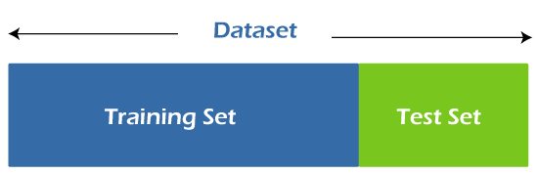
PROGRAM IMPLEMENTATION
SPLIT TRAIN & TEST SETS
Split the model using train_test_split module from sklearn.model_selection.
Training data is the subset of the original data that is used to train the machine learning model.
Testing data is used to check the accuracy of the model.

Slide 14
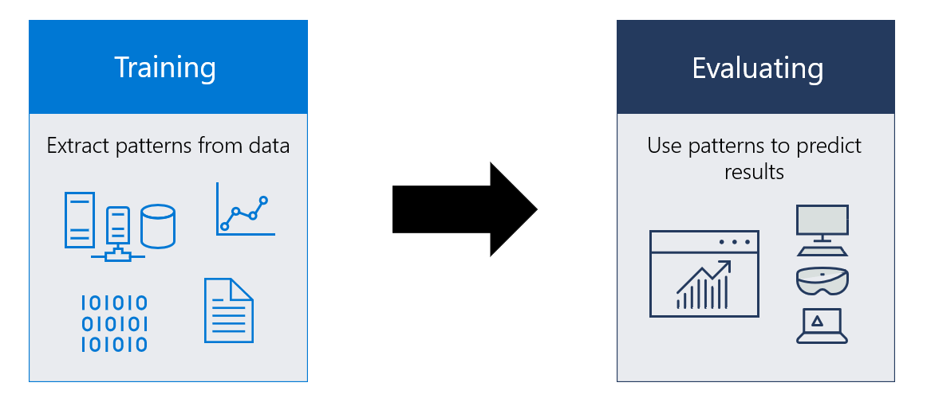
PROGRAM IMPLEMENTATION
MODEL BUILDING
Building a model in machine learning used to new data to do predictions and obtain result.

Slide 15

PROGRAM IMPLEMENTATION
RANDOM FOREST ALGORITHM
Random Forest is a supervised machine learning algorithm made up of decision trees.
Used both for classification and regression

Slide 16
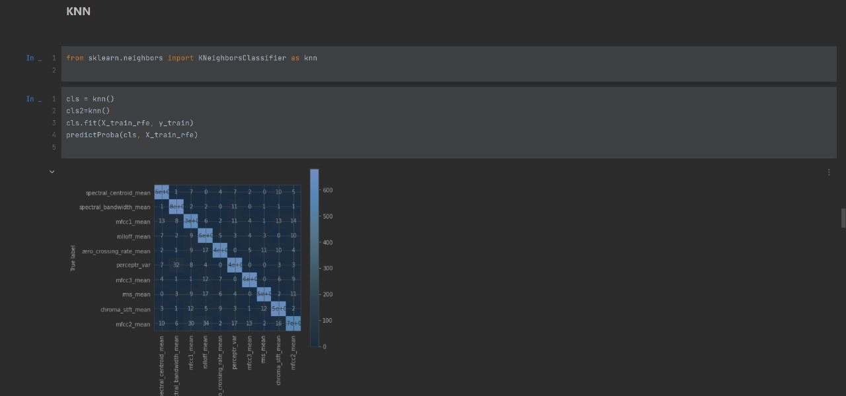
PROGRAM IMPLEMENTATION
KNN ALGORITHM
KNN is a supervised learning algorithm.
Used for classification or prediction about the group of an individual data point

Slide 17
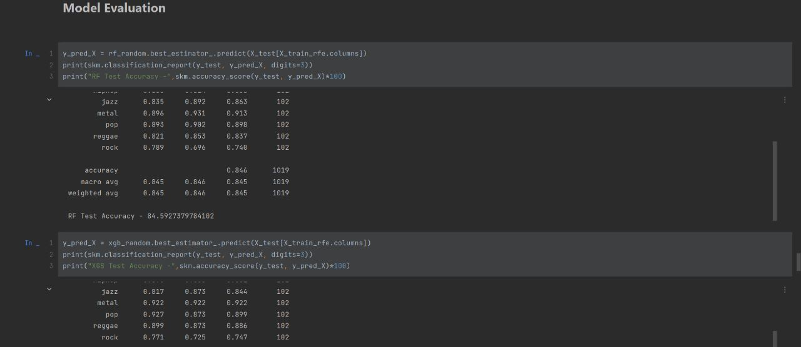
PROGRAM IMPLEMENTATION
MODEL EVALUATION
Model evaluation is a process of using different evaluation metrics to understand a machine learning model’s performance as well as its strength and weakness

Slide 18

OUTPUT

Slide 19
ACCURACY RATE
84%
RANDOM FOREST
88%
K- NEAREST
NEIGHBOUR

Slide 20
CONCLUSION
In conclusion, music genre classification is an important task that involves the use of machine learning algorithms to classify audio recordings into different music genres. This task can be broken down into several modules, including feature extraction, feature selection, classifier, evaluation, post-processing, and integration. The accuracy rate of each machine learning algorithms is as follows KNN algorithm as training accuracy of 93% and the test accuracy of 88%, RF algorithm as training accuracy of 90% and the test accuracy of 84%.This was our accuracy rate for music genre classification.

Slide 21
FUTURE WORKS
1. Genre expansion: Incorporate a wider range of genres, including niche and emerging styles, to offer users a more comprehensive selection of world music.
2. Seamless integration: Integrate the classification system with a user-friendly web front end, allowing easy navigation and exploration of diverse musical genres.
3. Interactive features: Implement interactive elements such as genre-based playlists, personalized recommendations, and user-contributed content to enhance user engagement and satisfaction.
4. Continuous development: Commit to ongoing updates and improvements, including refining classification algorithms, expanding genre databases, and enhancing user interface functionality, to ensure the platform remains relevant and valuable to users over time.

Slide 22
Reference Papers
1. Sung-Hyun Cho, Yechan Park, Jaesung Lee, “Effective Music Genre Classification using Late Fusion Convolutional Neural Network with Multiple Spectral Features” - 2022 IEEE International Conference on Consumer Electronics-Asia (ICCE-Asia). 2. M Sambath, R. Lokesh Kumar, S.M. Vishnu Reddy, V.Prakash Reddy, Linda Joseph, M. Kathiravan, “Identification and Classification of Music Genre using Deep Learning”, 2022 Second International Conference on Computer Science, Engineering and Applications (ICCSEA). 3. Yagya Raj Pandeya, Jie You, Bhuwan Bhattarai, Joonwhoan Lee, “Multi-modal, Multi-task and Multi-label for Music Genre Classification and Emotion Regression”, 2021 International Conference on Information and Communication Technology Convergence (ICTC).
4. Anirudh Ghildiyal, Sachin Sharma, “Music Genre Classification Using Data Filtering Algorithm: An Artificial Intelligence Approach”, 2021 Third International Conference on Inventive Research in Computing Applications (ICIRCA).
5. H.A. Hanafiah, M.A.Aziz,”A comparative study of music genre classification using feature extraction techniques”, 2017 IEEE International Conference on Control System, Computing and Engineering

Slide 23
Reference Papers
6. K. Han, K. Lee, J. Lee,”Music genre classification using deep learning with convolutional neural networks”, 2017 IEEE International Conference on Multimedia and Expo
7. T. Zhang and J. Kuo, “Audio content analysis for online audiovisual data segmentation and classification”, Trans. Speech Audio Processing, May 2001.
8. L. Lu, H.-J. Zhang and H. Jiang, “Content analysis for audio classification and segmentation”,2001 Speech and Audio Processing IEEE Transactions.
9. S. Sugianto and S. Suyanto, “Voting-based music genre classification using melspectogram and convolutional neural network”, 2000 International Seminar on Research of Information Technology and Intelligent Systems (ISRITI), 2000.
10. Q. H. Nguyen et al.,”Music Genre Classification using Residual Attention Network”, Proceedings of 2000 International Conference on System Science and Engineering ICSSE 2000.

Slide 24
THANKYOU

