Slide 1
RPI Events Bringing the community together through shared events
Developed by
Trulee Hersh
Carolyn Zhang
Harman Singh
Jon-Luke Williams

Slide 2

Presentation Overview
Backend
Development
Project
description
Frontend
Development
Future
Plans
Demo

Slide 3
Problem Statement
No centralized platform for non-official RPI events
RPI students are not aware of most events that occur on campus
Need for a tighter-knit community

Slide 4

Solution
Sports
Concerts
Rush
RPI Events is a web application that serves the RPI community by providing students, staff, and faculty with a centralized platform.
RPI Events
Tabling
Volunteer
Study groups
Food
Dance

Slide 5

Stakeholders
Serves the RPI community by providing students/staff/faculty with a centralized platform on which they can post and browse for any events that are relevant to the RPI community in an organized manner.
The site will generate value for those seeking to advertise/promote their events, as well as for those looking for events to attend.

Slide 6





Features
Create account
View upcoming events
Search existing events
Create new events
Save interested events

Slide 7
Demo

Slide 8
Frontend
Trulee Hersh
Harman Singh

Slide 9
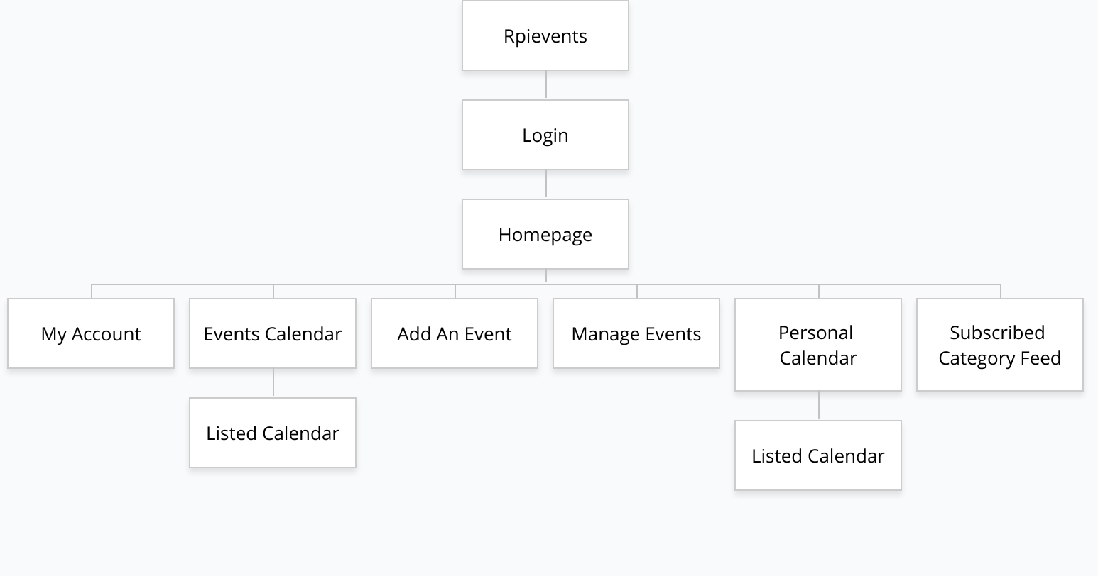
Site Map

Slide 10



Technologies
Used to give the HTML5 pages some personality. Users react strongly to a visually stunning page rather than a pure black and white page full of text.
Used to allow generic users an interface to access our website. The pages will be created in a way such that they allow the user to intuitively know where the locations of various links to different pages are located.
Used to add interactivity to the web page and dynamically load in data.

Slide 11
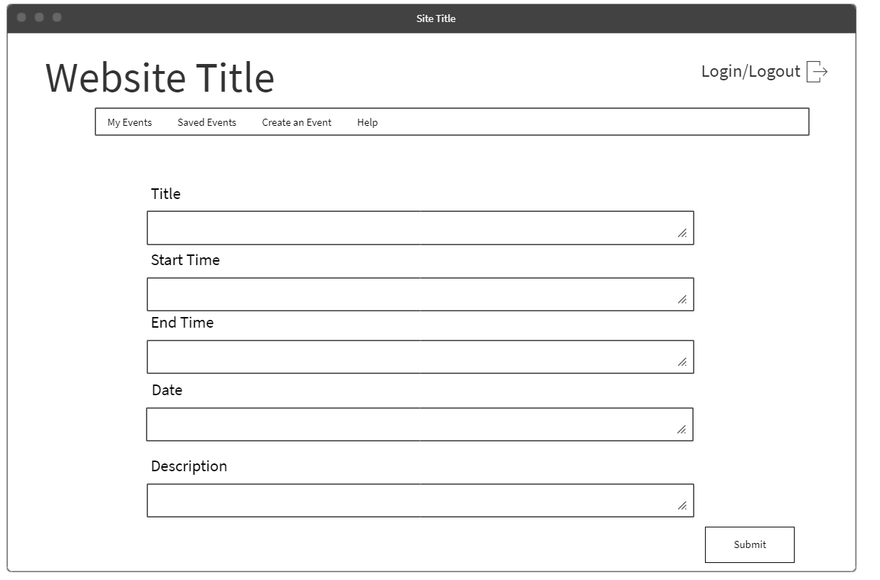
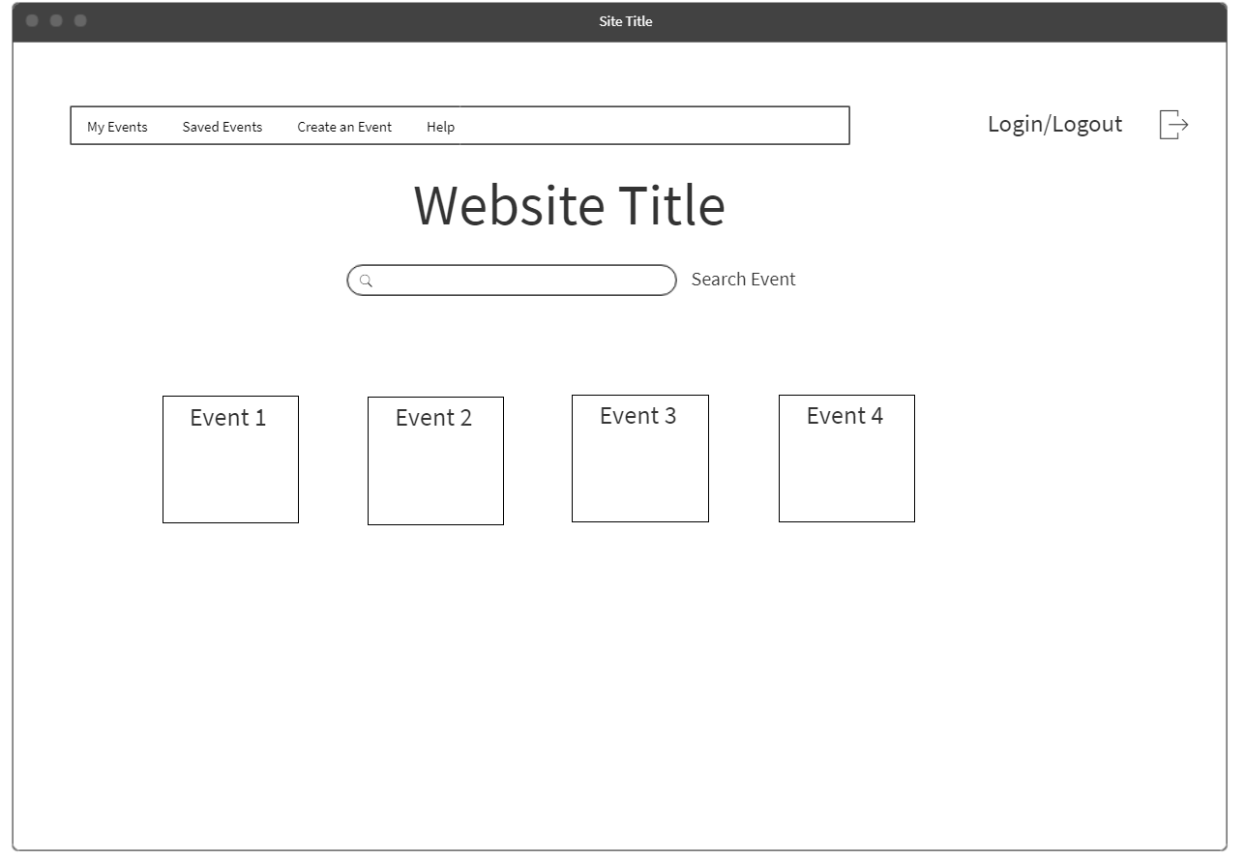
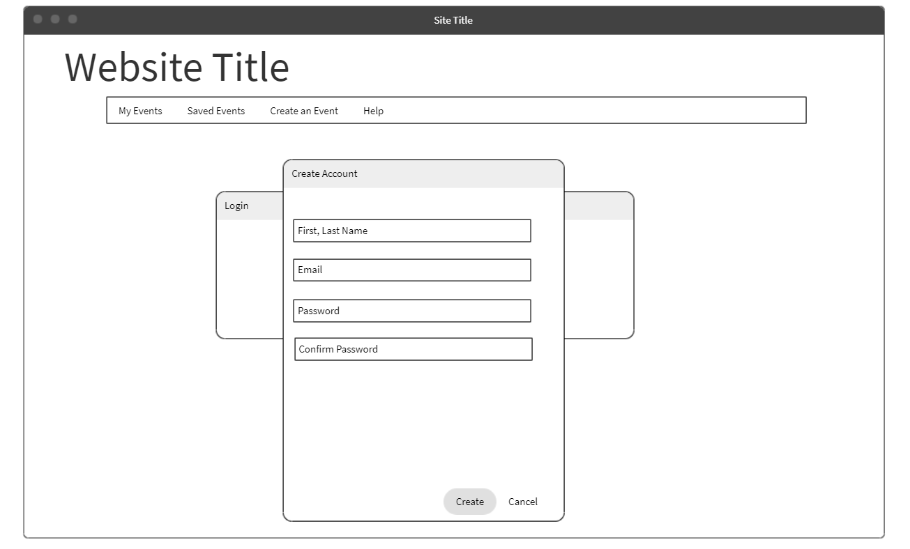
Wireframes

Slide 12
Backend Design
Carolyn Zhang
Jon-Luke Williams

Slide 13


Technologies
Used to store the data of different users’ login information and store the different events.
Used to display data from MYSQL onto events and profile pages.

Slide 14
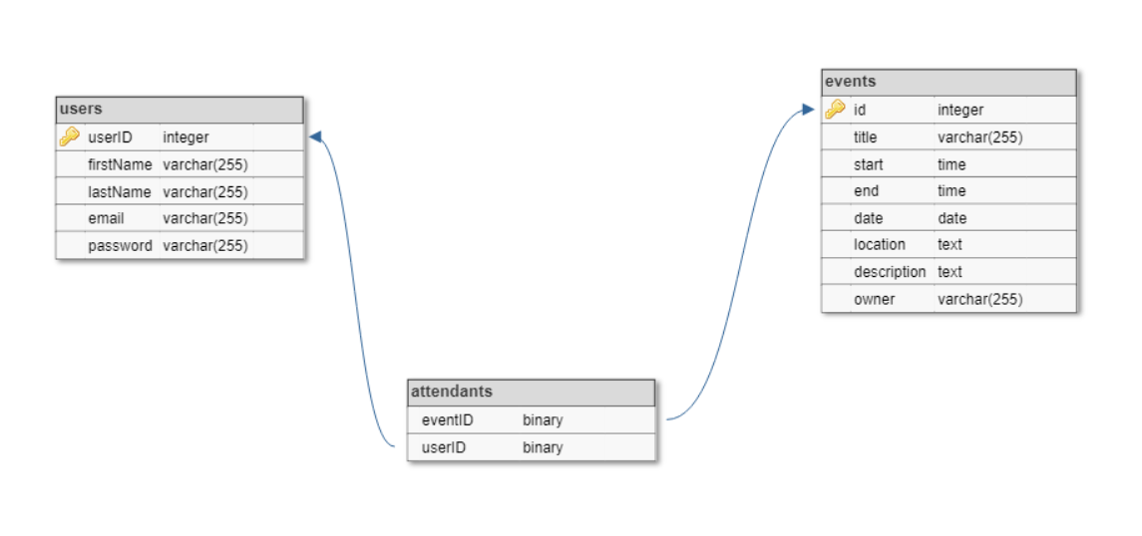
Database Tables

Slide 15

Future Plans
Develop algorithm to detect inappropriate events
Incorporate advertisement for better hosting of server
Extend search function to allow broader keywords

Slide 16
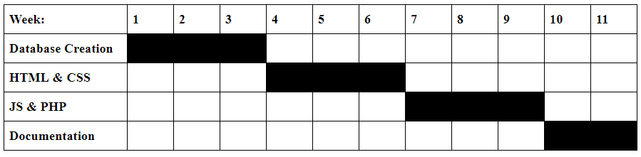
Progress Chart and Contributions
Trulee: set up project template and implemented front end with JavaScript calls to backend.
Carolyn: set up the database and implemented login authentication and user creation, helped with form validation
Harman: implemented my events and saved events using php, helped with form validation
Jon-Luke: created search functionality and helped with documentation

Slide 17
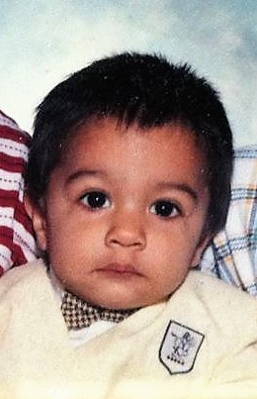

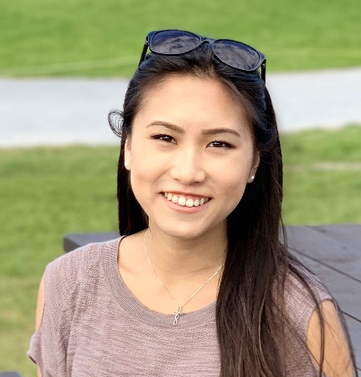
Lessons Learned
“I learned how to use Git, how to apply technologies to a project, and StackOverflow is life”
“I learned how to use PHP and MySQL more in depth. I also learned how to use Git”

Slide 18
Questions

