Slide 1
Designing and Testing Point Symbols
carolyn fish
fish@psu.edu
@cartofish
Notes:
What is a point symbol?

Slide 2
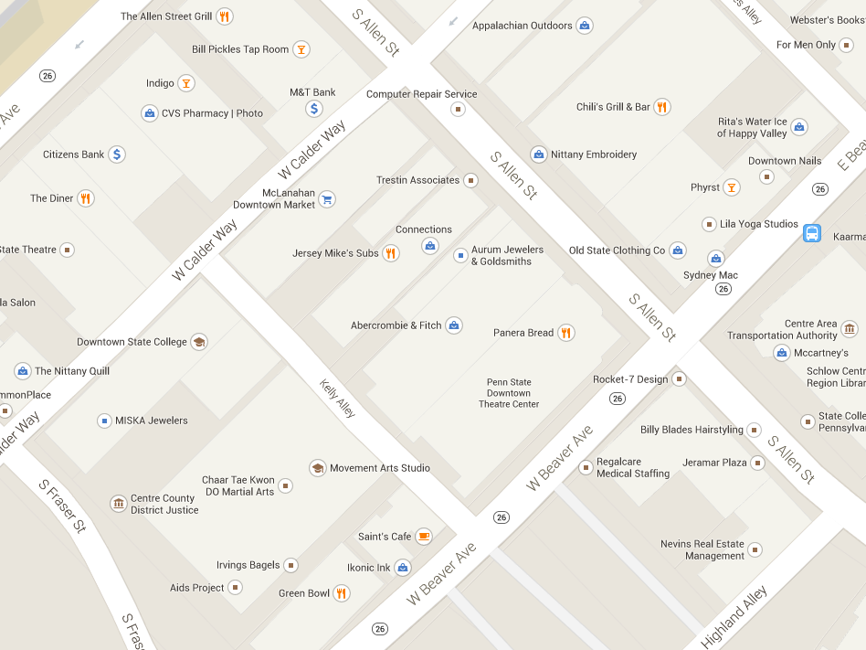
Notes:
Stuff on google

Slide 4

Notes:
I went about designing symbols similar to this. What does this look like to you?

Slide 5

Notes:
Now what is this?

Slide 7

Notes:
Had to go from blank slate…

Slide 8
Notes:
To something that means something

Slide 9
Brainstorm
Notes:
What symbols do you have to make?

Slide 10
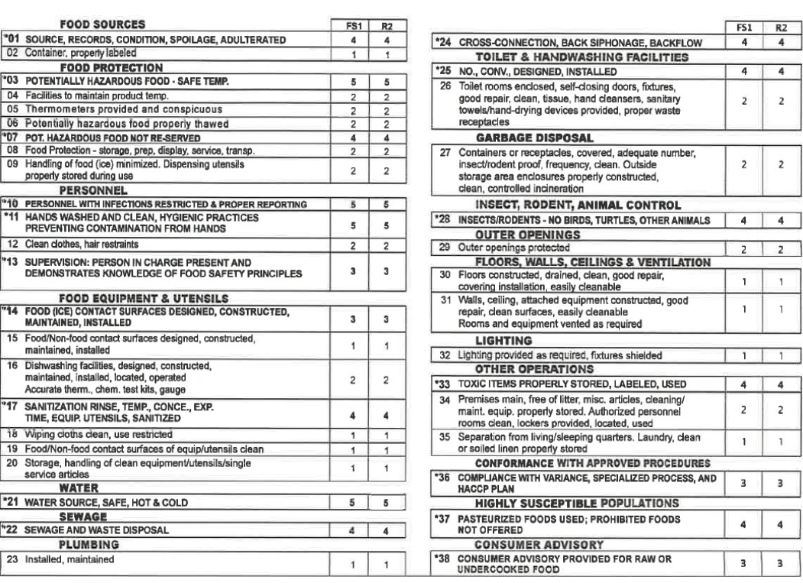

Slide 11
Iterative Design and Collaboration

Slide 12
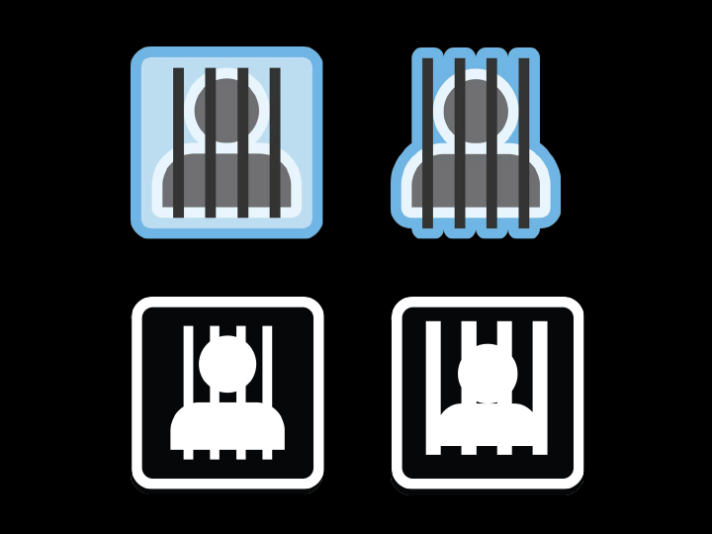
Notes:
First iteration

Slide 13
Notes:
Second iteration

Slide 14
Notes:
Third iteration. Took the stuff from graphics and worked on it alone

Slide 15
Notes:
Tested it and determined that this was easier to see

Slide 16
Research
Google Images
The Noun Project
Symbol Store
ArcGIS Fonts

Slide 17
Develop
Adobe Illustrator

Slide 18
Evaluate
Put points on a map
2. Test Symbols

Slide 19
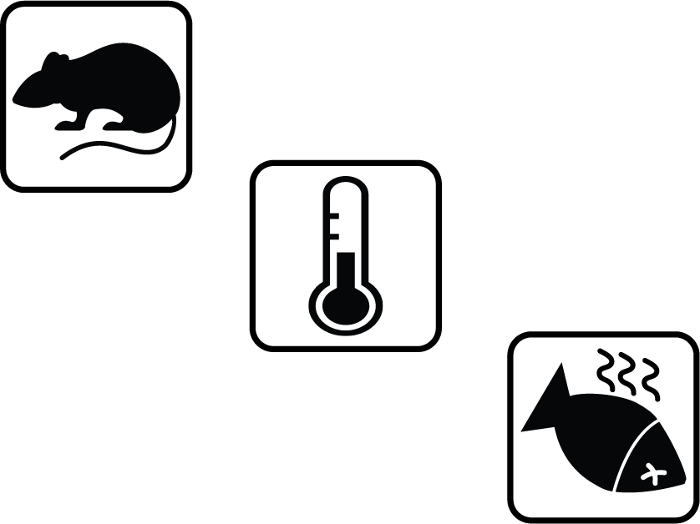

Slide 20
Thanks!
fish@psu.edu
@cartofish

