Slide 1

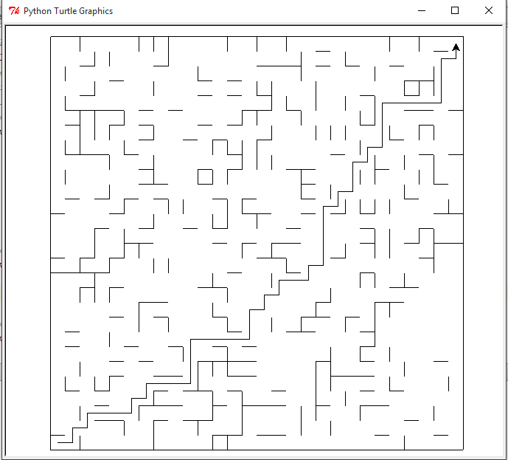
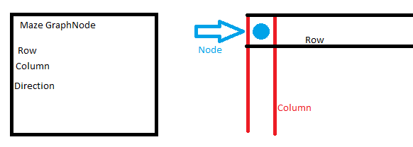
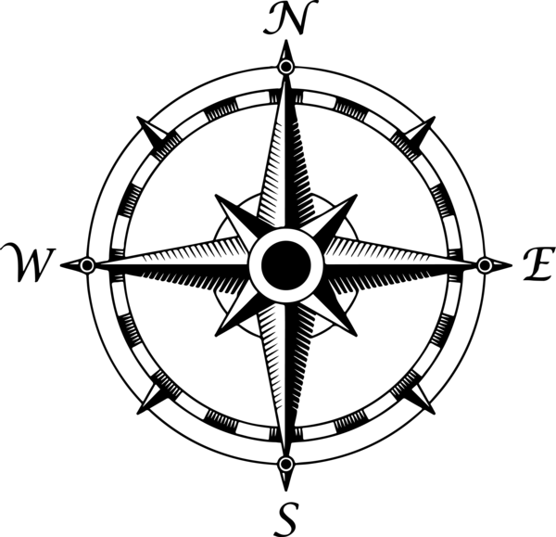

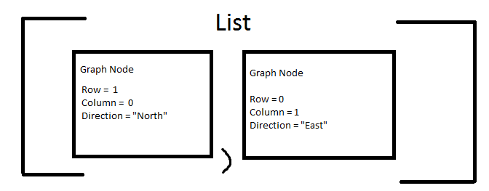
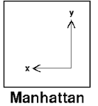

A* Maze Path Finder
William Carr
Description of the Problem
State Representation
Solution
How A* Search is used to solve the problem
The state space includes the row and column coordinates of the turtle, and the direction in which the turtle needs to move in order to traverse the maze. The turtle can only move in the four cardinal directions.
The A* search takes use of an undirected tree search. The head of the tree is initialized with a node containing the row and column coordinates of where the turtle begins it’s journey, and the direction it will move in. The first node in the tree contains an empty direction, because it is stationary at this time. In this case, point (0,0) is the starting row and column coordinates. The search will then compare if this node is equal to the goal state of (27,27), and if it not the goal state, it will continue to the expand function.
The expand function will first call a function to check if there are walls surrounding the cell the turtle is currently in. For each wall in the 4 cardinal directions, if there is not a wall, a new node will be created with the coordinates of the cell in that direction. The direction in which it will move is also saved to the node, so that at the end of the search, the path can be properly drawn on the maze. These new nodes will then be appended to a list, which will be returned to the search for further examination.
The search will now test if any of these nodes are exactly the same, as in having the same row and column coordinates. If the new node is the same as another, it will then be ignored. The search will now calculate the heuristic. This is where the search determines which of node in the list is closest to the goal state. The heuristic uses the Manhattan distance and adds that number to the cost. Since a turtle can only move the length of a cell wall, which in this case is 20 pixels long, the cost of a move is equal to 20.
The search will now decided to choose the node with the lowest heuristic and move the turtle to the new cell. The A* search will now continue this process of equality checking, expanding and heuristic calculating until it finds a path with the lowest total cost to the goal. Once the goal test is passed, which is determined by calling a function that checks if the current node has the same row and column coordinates as the goal, the search will return the list of all the nodes that were used to find the goal state. The pretty print function is then used to print the row and column coordinates to the console, and by using the moveTurtleToCell function included in the maze library, is able to draw the path of the turtle through the maze.
Given a randomly generated maze, use A* search to find the fastest route from point (0,0) to the end point (27,27)
Actions
Heuristic
In order to expand a node, the search needs to figure out where the walls are located in the given cell. If there is not a wall, the turtle is able to move into the adjacent cell in that direction. Once all the possible, unique, legal moves have been calculated, these nodes are appended to a list. This list is then returned to the search, and the heuristic is used to determine which node should be acted upon next.
The distance from the current node to the goal node is calculated by using the Manhattan Distance. The Manhattan Distance is the distance between two points on a grid, based on the horizontal and vertical path between these points.
The Formula is:
In this case, the turtle can only move North or east.
This would be the list of graph nodes returned
Notes:
Copyright Colin Purrington (http://colinpurrington.com/tips/academic/posterdesign).

Slide 2
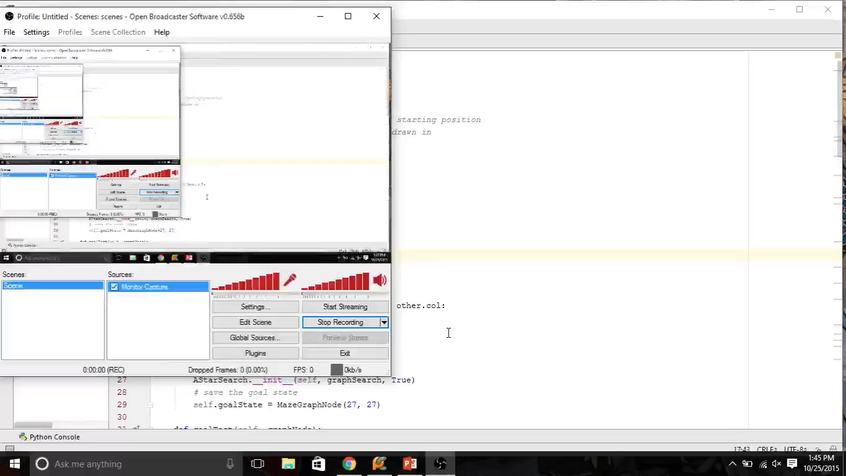
Maze Search Video

