Slide 1

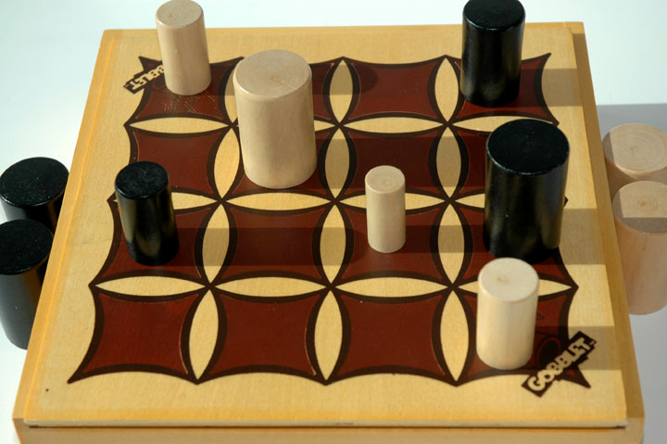
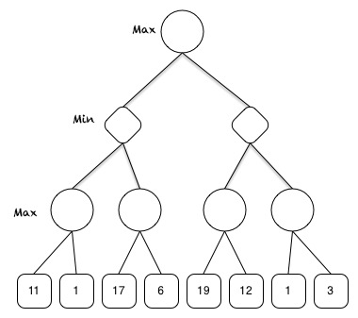
Adversarial Search
William Carr
Description of the Problem
Solution
Max
1000
Evaluation Function
Create an evaluation function for the alpha-beta search, which will be used by minimax.
L L M M
You
Opponent
Min
1000
400
L L
MiniMax & Alpha-Beta Pruning
3 in a row = + 500
Side Control = + 20
More larger Pieces = + 210 -70
More moveable pieces = + 160
Kill move = + 700
State value = + 1520
Mini Max Evaluates a board state. It saves a copy of the board, and then performs a move and checks the value. It than saves this value, reverts back to the original board, and checks a new move. It does this until the depth limit or a terminal state is reached.
Using alpha-beta pruning, the search is able to prune braches of the tree that are not worth perusing, based on weather it is checking for a max or min value.
11
11
3
11
17
19
3
1500
1000
1100
400
Notes:
Copyright Colin Purrington (http://colinpurrington.com/tips/academic/posterdesign).

