Slide 1

MICROCONTROLLER EEC-3710 PROJECT: ULTRASONIC RANGE FINDER
SUBMITTED TO – DR. ADIL SARWAR.
DATED – 03/02/2022

Slide 2

Team Members
Mohd Ali Shamsi – 19EEB119
Shahrukh – 19EEB137
M. Bilal – 19EEB169
Mohd Juned Ansari 19EEB226

Slide 3

CONTENT
ULTRASNOC RANGE FINDER
DIFFERENT COMPONENTS USED
HC-SR04
8051 MICROCONTROLLER
7-SEGMENT LED DISPLAY
CIRCUIT USED
WORKING OF CIRCUIT
APPLICATIONS

Slide 4
ULTRASONIC RANGE FINDER
This ultrasonic range finder measures up the distance up to 2.5 meters at an accuracy of 1 centimeter.
8051/AT89s51 Microcontroller and the Ultrasonic Module HC-SR04 form the basis of this circuit.
HC-SR04 is used to calculate the distance of the object from the sensor.
The information of the distance is then displayed through the 3-segment LED display.

Slide 5
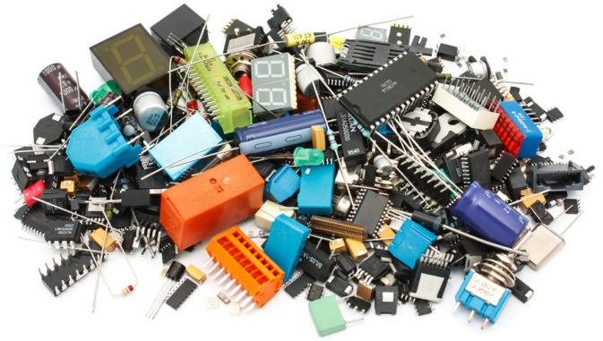
DIFFERENT COMPONENTS USED
8051/AT89S51 microcontroller.
HC-SR04
3-digits 7 segments Display.
2N2222 NPN BJT.
100ohm resistor.
8.2Kohm resistor
11.0592MHz crystal
33pF & 10uF capacitor.

Slide 6
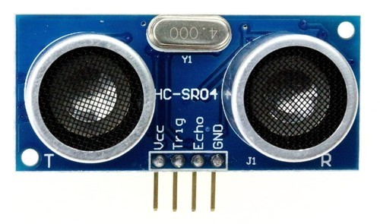
HC-SR04
Its is an ultrasonic ranging module designed for the embedded circuitry application like this one.
It has the resolution of 0.3 cm
Range : 2cm to 500cm.
Operates on 5V DC supply & Standby current > 2mA.

Slide 7
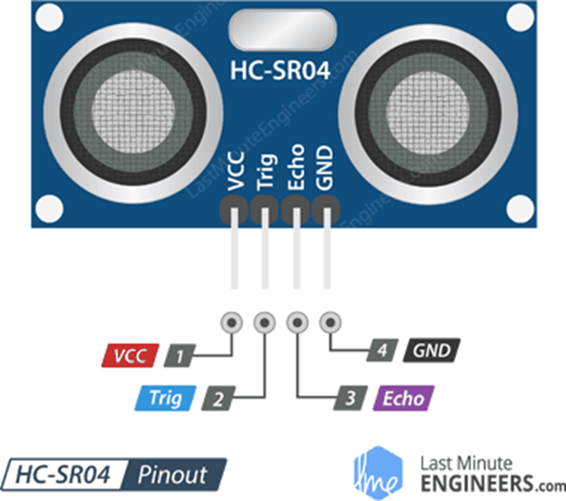
Continued…..
Vcc: 5V DC supply voltage is connected to this pin
Trigger: A triggering signal is given through this pin for the commencement of the transmission signal is given.
Triggering pulse should be 10uS high time
After Receiving triggering signal it issues 8 pulses 40kHz ultrasonic sound from the transmitter.
Echo: The echo of the transmission signal is received and a output waveform with high time proportional to signal is outputted from sensor through this pin
GND: Ground is connected to this pin.

Slide 8
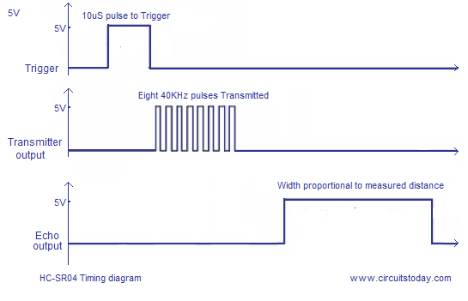
Distance in cm = echo pulse width in uS/ 58
***The cycle period for HC-SR04 must not be below 50mS.

Slide 9
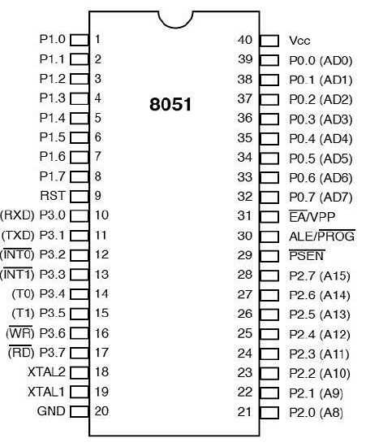
ABOUT 8051 MICROCONTROLLER
Designed by intel in 1981.
40 pins.
RAM-128 bytes, ROM-4kB.
Two 16bit timers.
It includes addressable & programmable 4 – parallel 8-bit ports
The microcontroller comprises of 8-bit accumulator & an 8-bit processing unit.

Slide 10
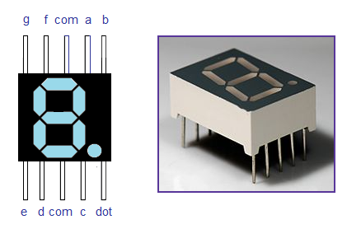
7-Segment LED Display
7-segment LED is quite popular it can ve used to display numbers from 0-9 and quite a few characters like A, B, C, d, E, etc.
A seven-segment LED has seven LEDs arranged in squarish ‘8’ form.
Seven segment displays are of two types :
1.) Common Cathode
2.) Common Anode.

Slide 11
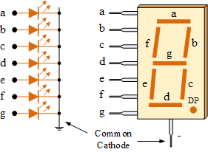
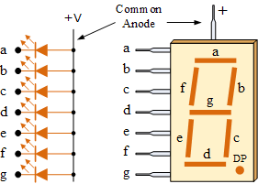
Continued……
In common cathode type, all the cathode connections of the LED segments are joined to Logic “0” or GROUND.
The individual segments are illuminated by the application of a “HIGH”, or logic “1”.
In common anode type, all the anode connections of the LED segments are joined together to logic “0” or ‘LOW’ signal.
The com pin of the LED is used to set the mode that is the common cathode (connected to GROUND) or common anode (Connected to the source.)

Slide 12
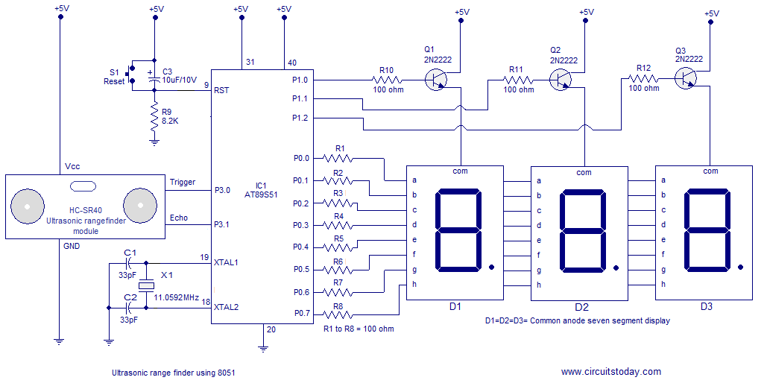
CIRCUIT USED

Slide 13
WORKING OF THE CIRCUIT
TMOD register of the microcontroller is loaded in such a manner that Timer 1 operates in Mode 2 (8-bit auto-reload mode.)
Timer 0 is not used here.
TL1 and TH1registers of the Timer1 are loaded with initial values.
TL1 is loaded with the initial count value and TH1 is loaded with reload value.
Meanwhile when echo is high the Timer1 starts and it counts from the initial value to 255 ie: 255-207= 48 counts.
From the datasheet it is clear that 58uS width is equal to 1cm.
The Timer1 counts to 48 to counter the delay produced by the branching instruction to check the status of P3.0 and P3.1 pins.

Slide 14
CONTINUED….
A triggering pulse is provided to the HC-SR04 through Pin P3.0.
The Triggering Pulse should be 10uS long, which generates 8 pulses of 40kHz.
The pulses obstructed by the object return back and the echo is caught by the HC-SR04, in this duration, the eco pin is at high for a time proportional to the distance of the object from the sensor.
Thus, the distance can be calculated using the formula:
distance of object = echo pulse width in uS /58.

Slide 15
CONTINUED….
Port 0 is used for transmitting the 8-bit display data to the display and port pins P1.0, P1.1, and P1.2 are used for transmitting display drive signals for the corresponding display units D1, D2, D3.
Push-button Switch S1, capacitor C3, and pull-down resistor R1 are used to create a debouncing reset circuitry.
Capacitor C1, C2 and crystal X1 are associated with the clock circuit.

Slide 16
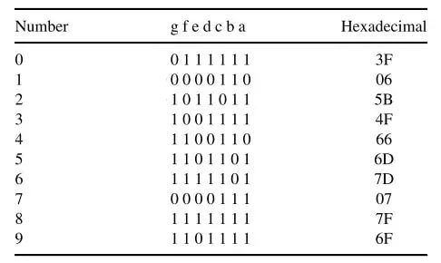
CONTINUED….
The recorded data of the distance is then displayed using a 3-bit 7-segment LED display which is configured to 8051 with current limiting resistors in series accommodating Port 0 of the 8051.
Digit Drive Pattern for the LED display is fetched using LUT: Look-Up Table.

Slide 17
APPLICATIONS
Automotive Parking System.
Obstacle Warning System.
Terrain Monitoring Robots
Industrial Distance Measurements.

Slide 18
Thank You

