Slide 1
HUBOT

Slide 2
What is HUBOT ?
A Chatbot application aims to provide assistance to students in various aspects of their university days and provide relevant and personalized support, help, information.

Slide 3
Motivation behind HUBOT :
Easy to use UI
Personalized and general assistance
What’s new?
- Not only chatbot

Slide 4
Problems after project 1:
ChatBot : Data, BackEnd
Navigation map : Data, Money
Personalized academic assistance

Slide 5
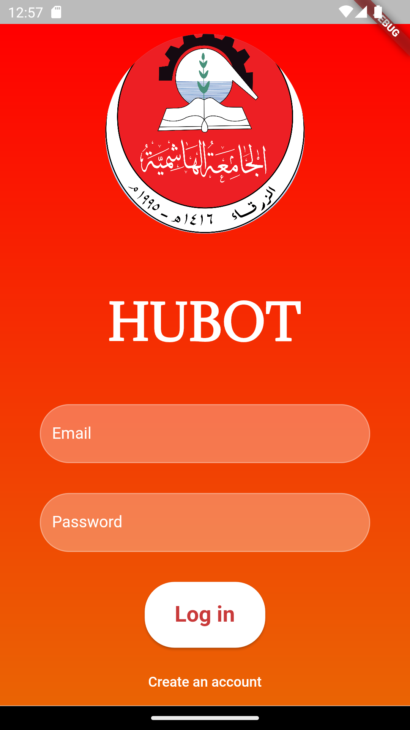

Slide 6
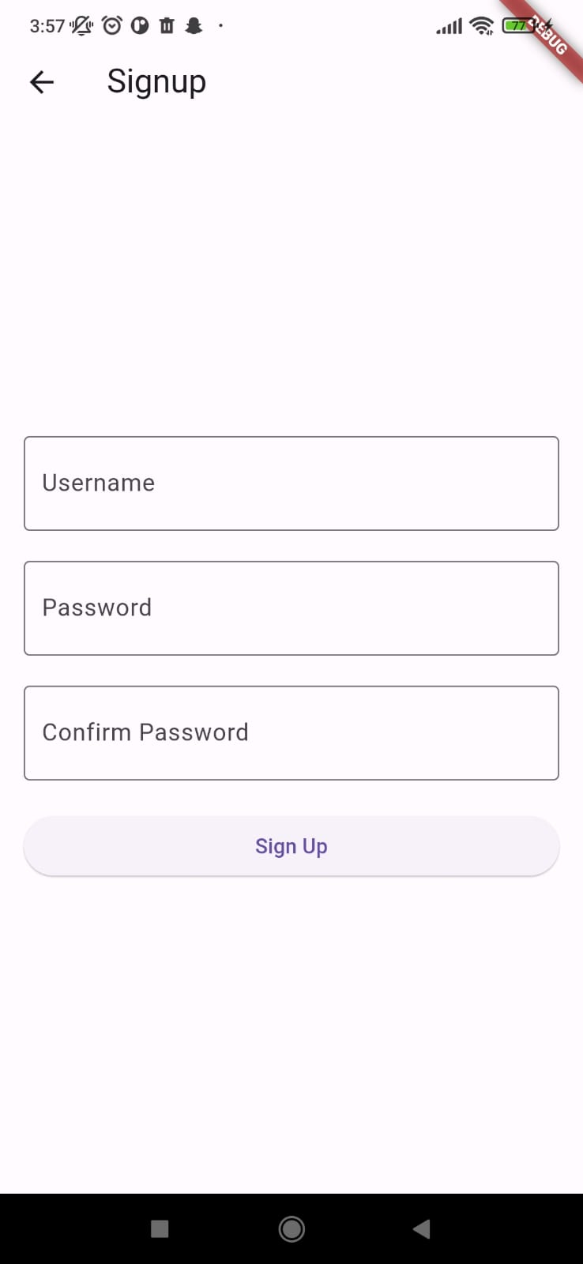
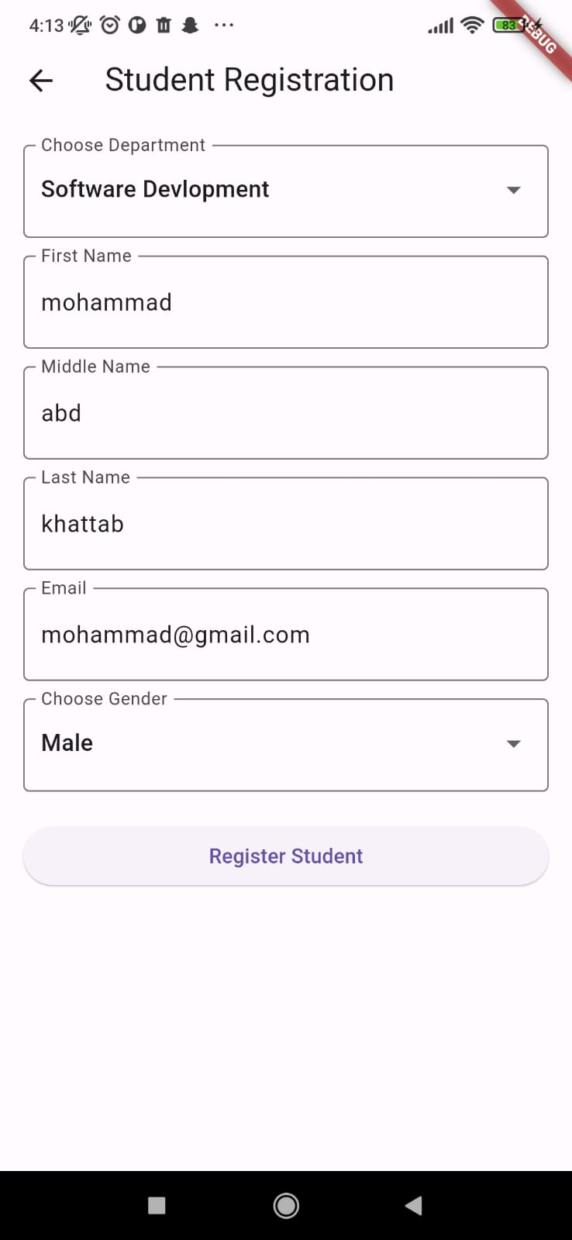

Slide 7
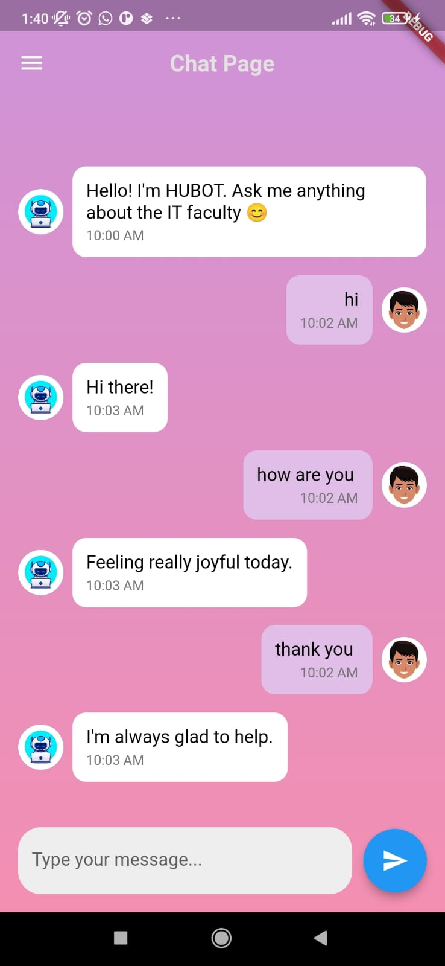
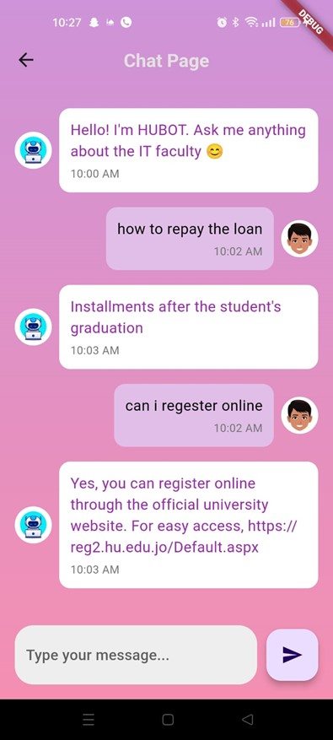

Slide 8
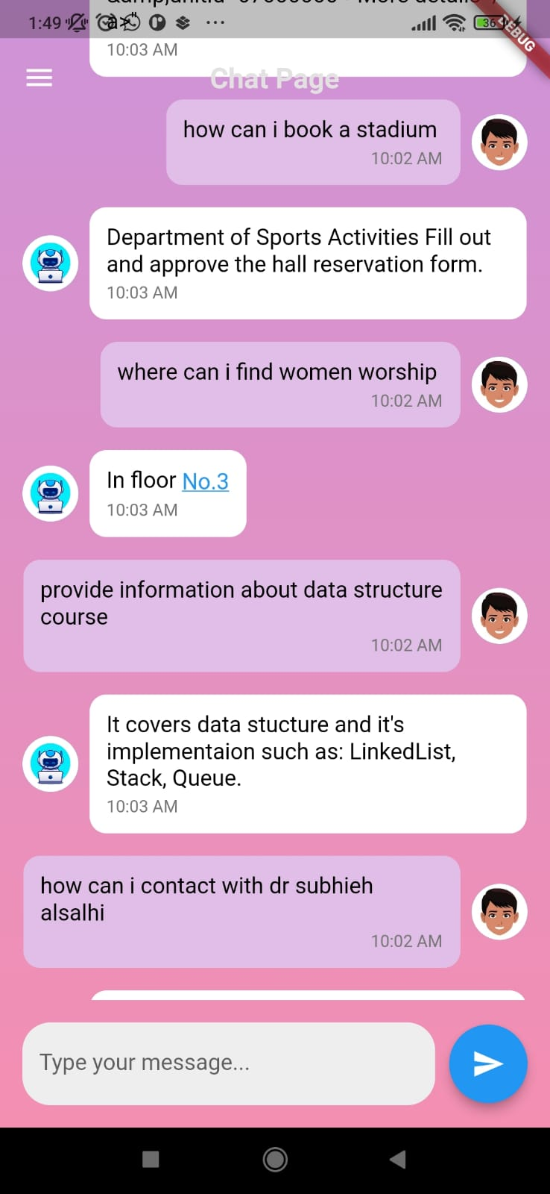
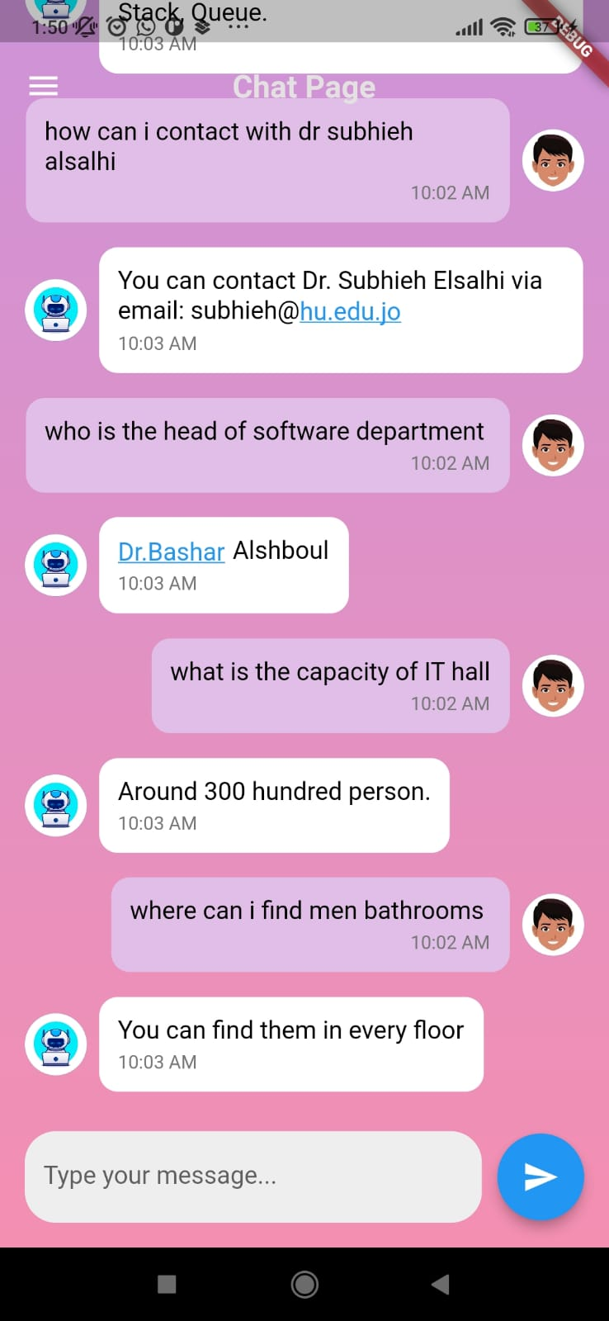

Slide 9
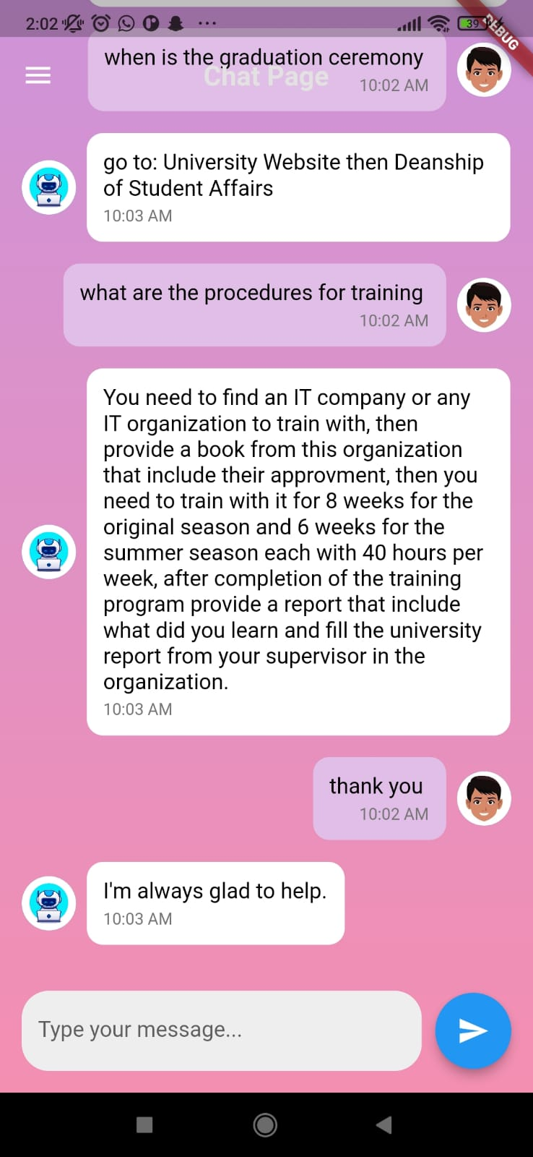
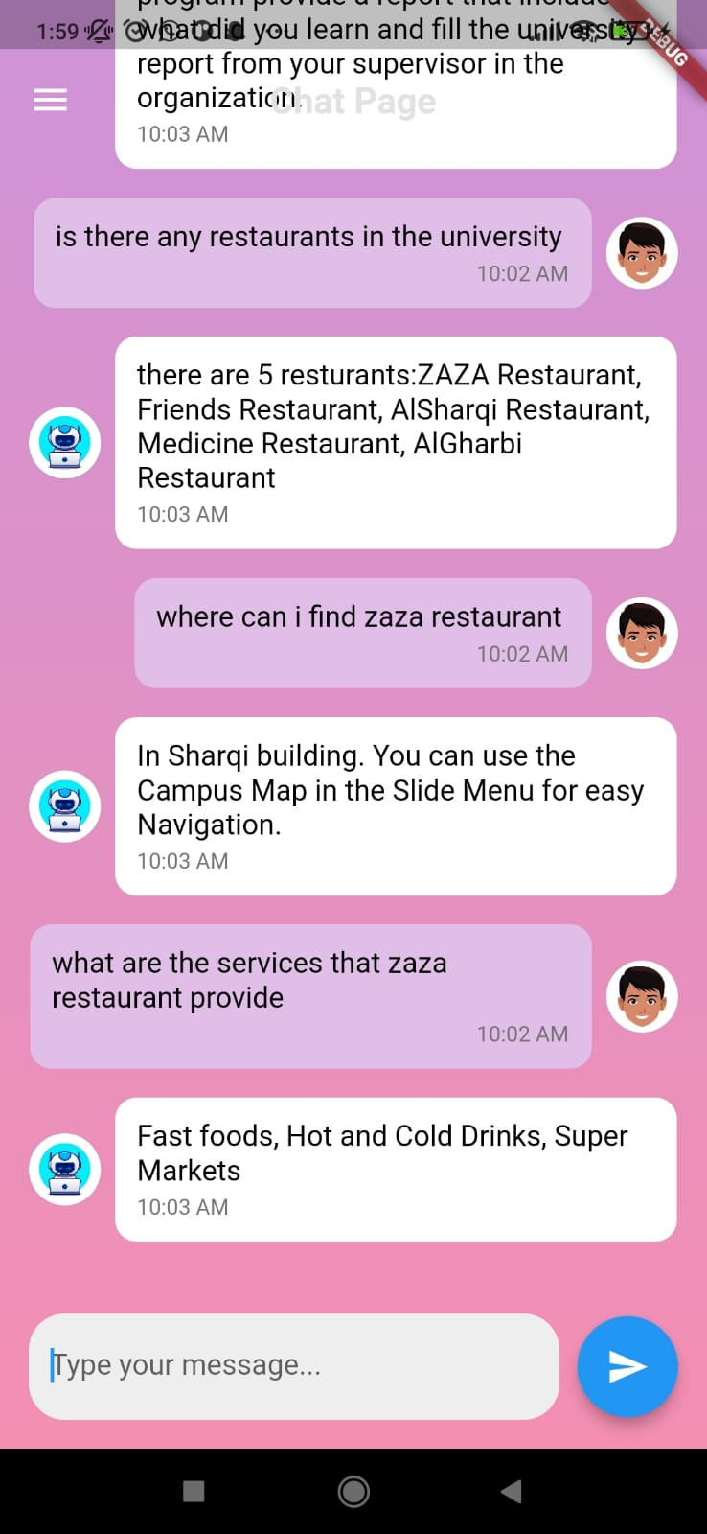

Slide 10
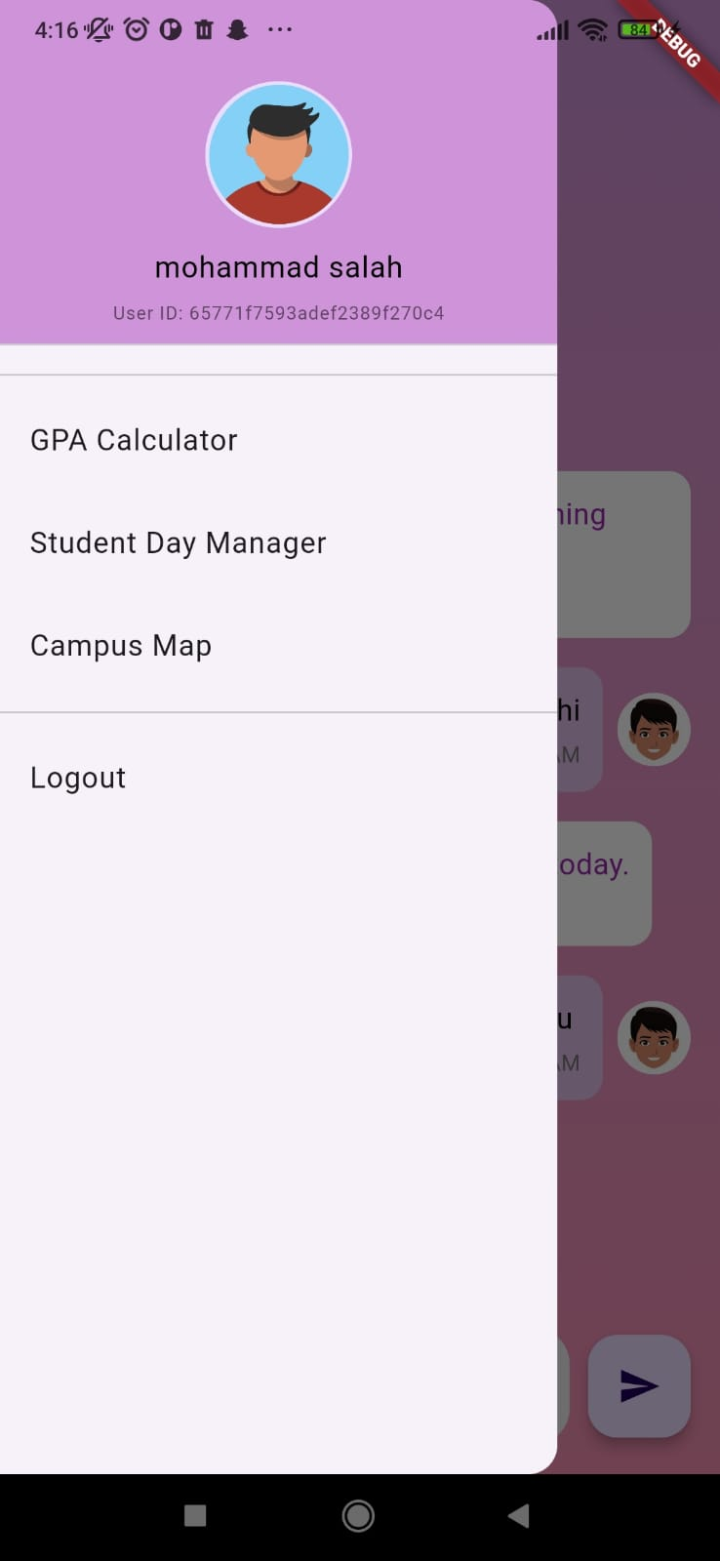

Slide 11
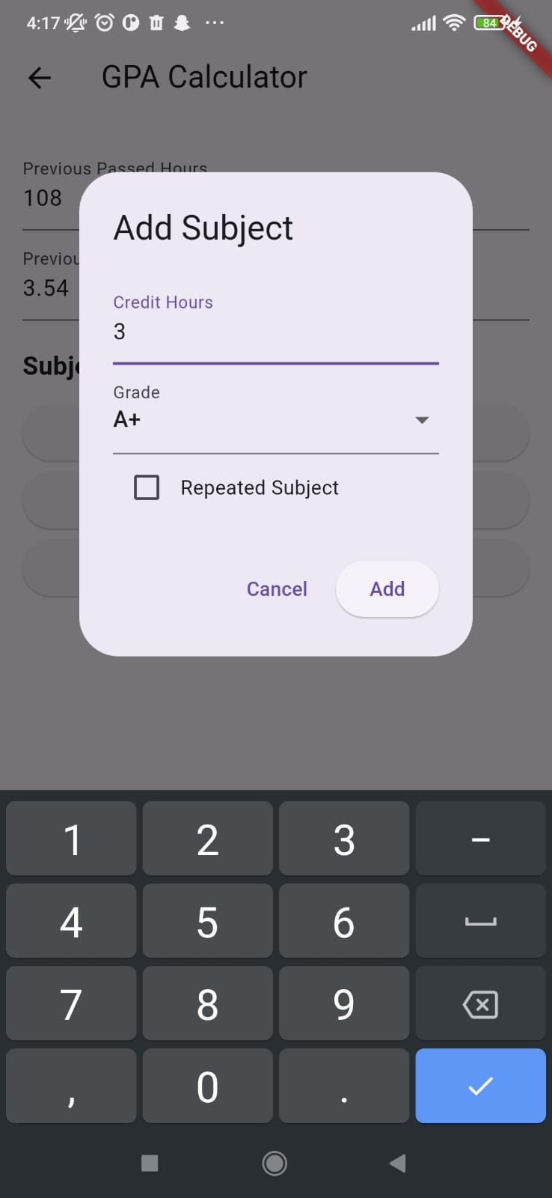
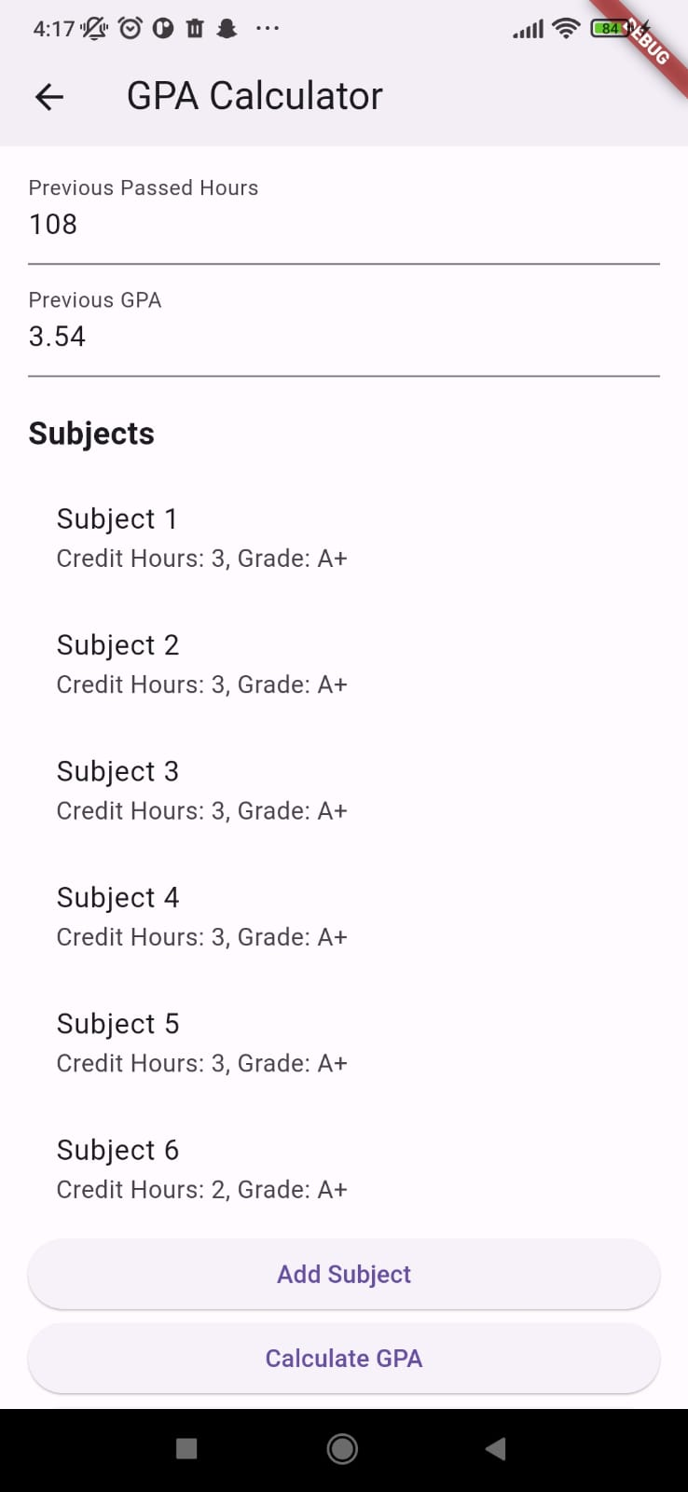
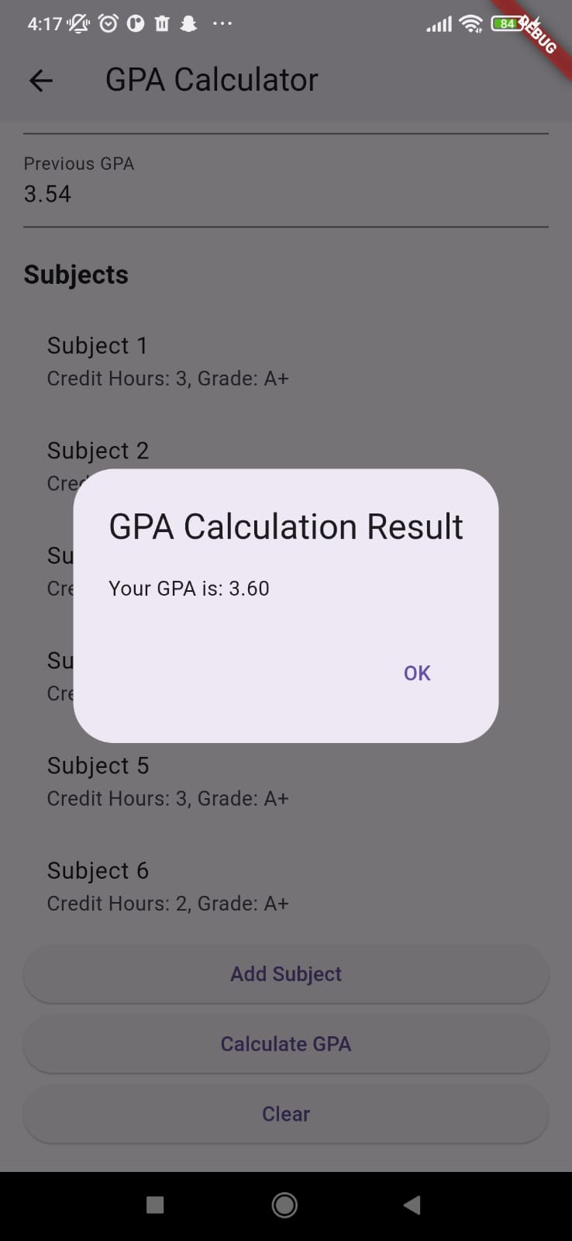

Slide 12
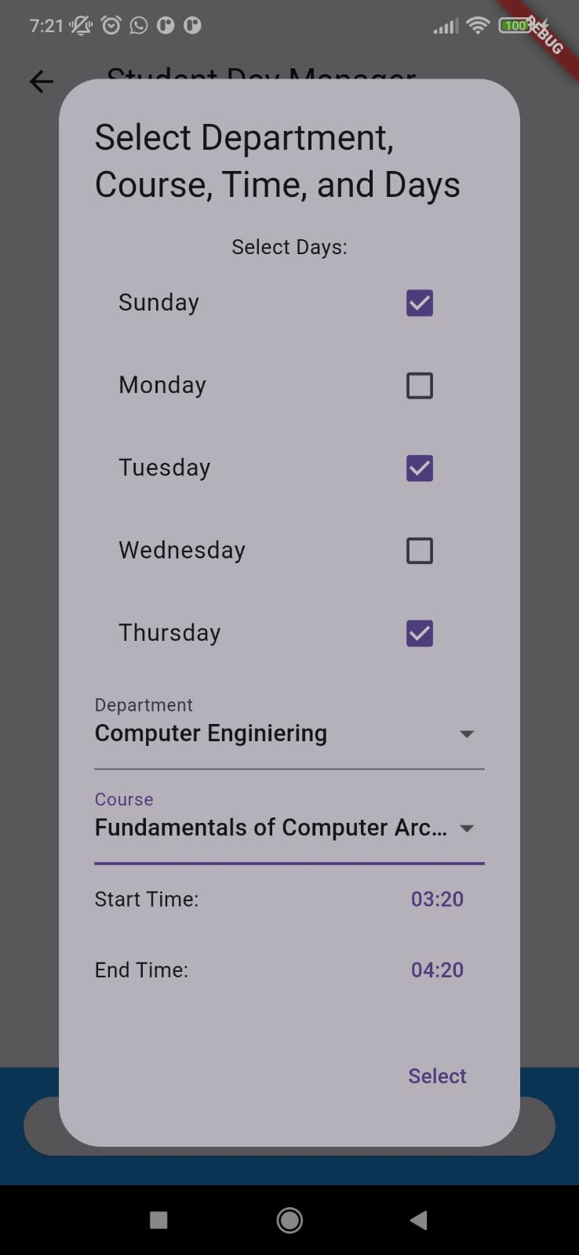
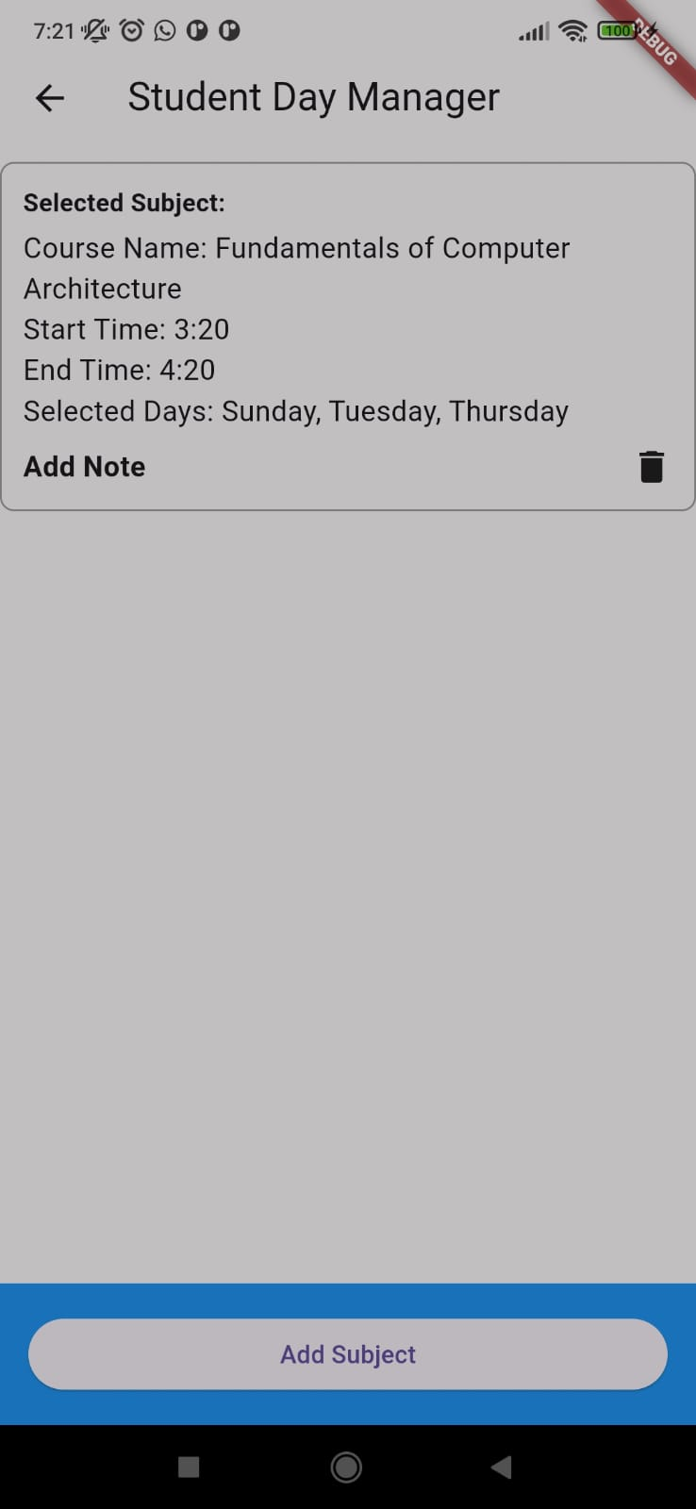

Slide 13
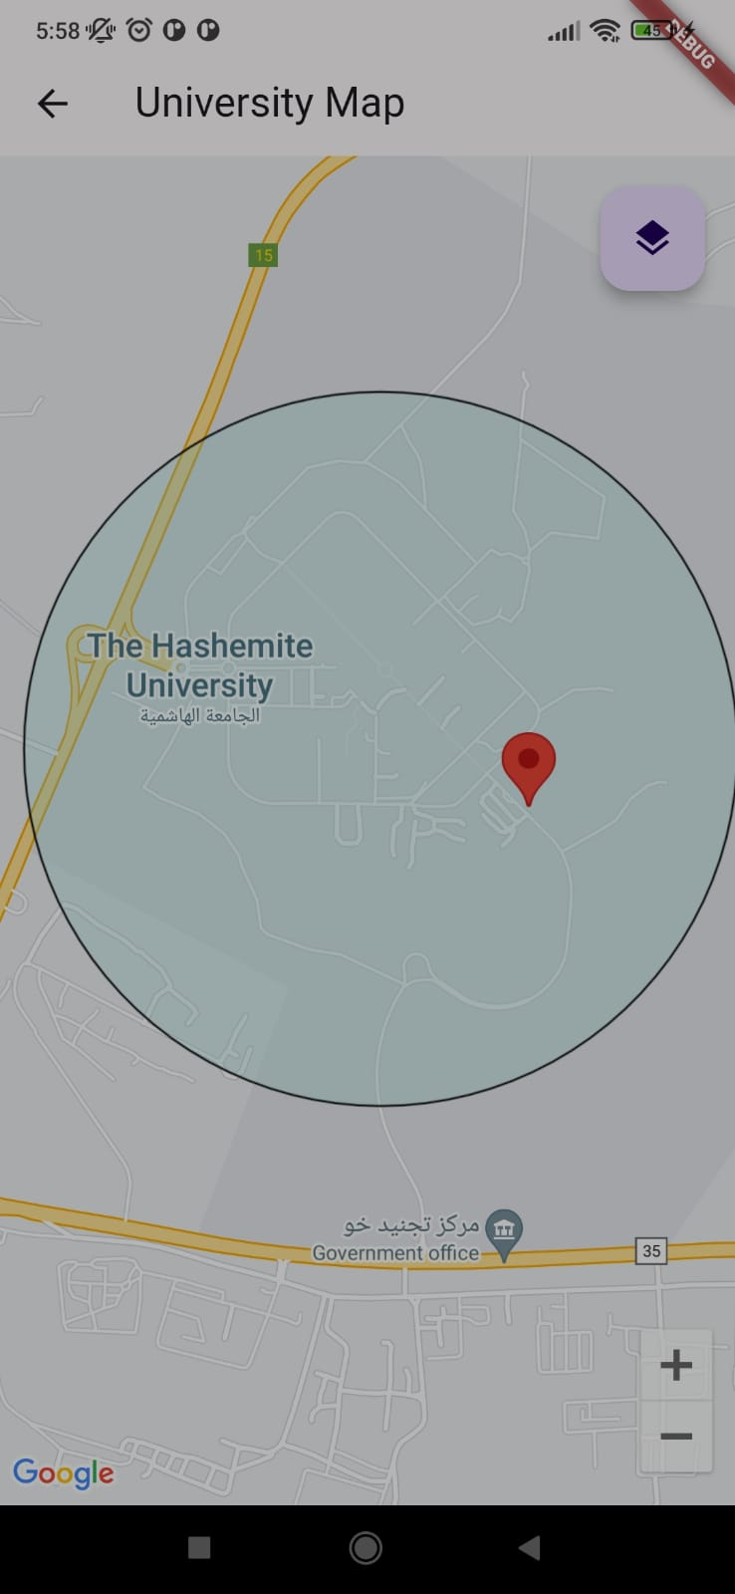
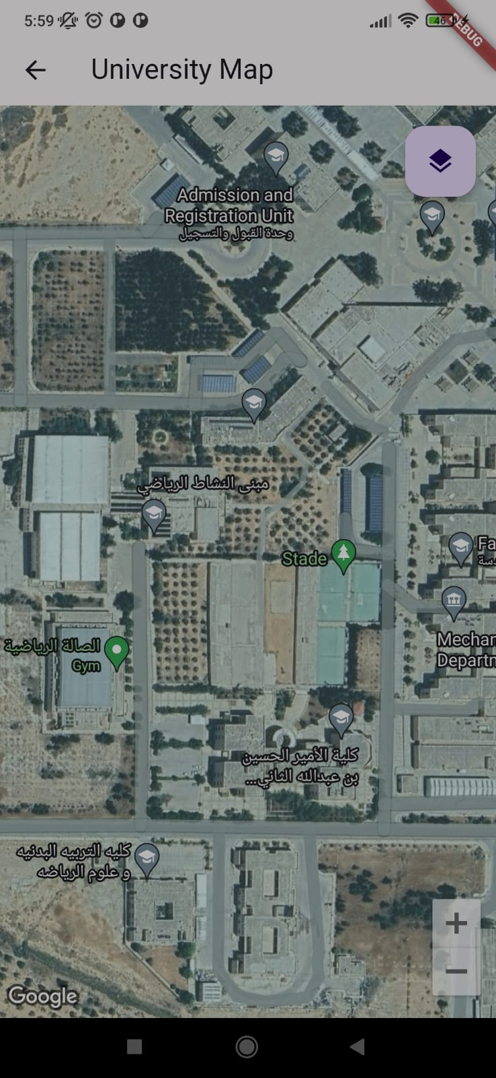

Slide 14
Used Technology :
Programming Language (JAVA)
IDE (Intellij, VS code, android studio)
Framework (Flutter , Srping boot)
API (REST API)
DataBase (Mongo DB)

Slide 15
THE END.

