Slide 1
Chat Server
Cloud Computing WS18/19
Adrian Schwab
Maximilian Waiblinger

Slide 2
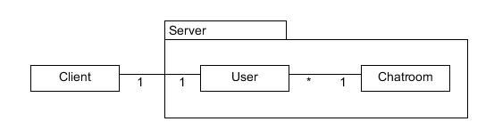
Component Diagram
Started with client and server
Added user to display the cardinality
Cloud Computing WS18/19 (Marcus Schöller) 2
Adrian Schwab; Maximilian Waiblinger

Slide 3
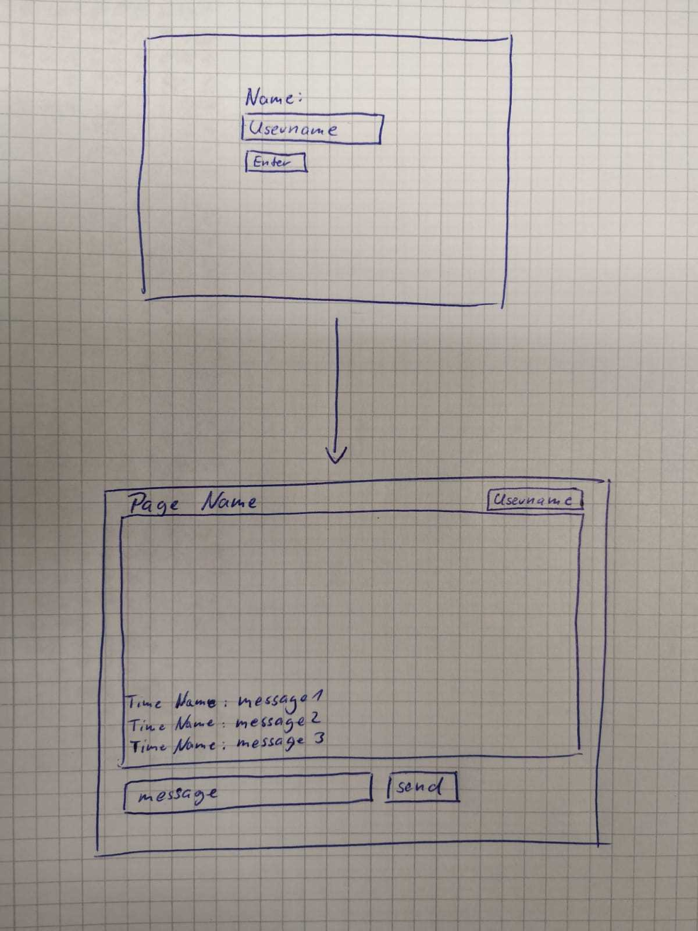
Mockup
simple
structure given by the socket.io
Cloud Computing WS18/19 (Marcus Schöller) 3
Adrian Schwab; Maximilian Waiblinger

Slide 4
Scrapped Ideas
Global Chat
Private Chat

Slide 5
Scrapped Ideas
Global Chat
Private Chat

Slide 6
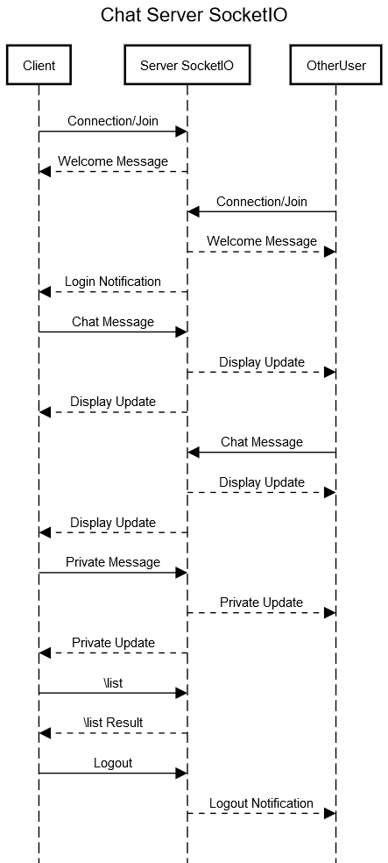
Sequence Diagram
Login
Messaging
Other interactions
Cloud Computing WS18/19 (Marcus Schöller) 4
Adrian Schwab; Maximilian Waiblinger

Slide 7
Lesson-Learnt
Node modules are awesome.

