Slide 1
JEOPARDY

Slide 2
MEDICAL ABBREVIATIONS | FAMOUS CATS | CHEMISTRY | INVENTORS | FAMOUS WOMEN
$10 | $10 | $10 | $10 | $10
$20 | $20 | $20 | $20 | $20
$30 | $30 | $30 | $30 | $30
$40 | $40 | $40 | $40 | $40
$50 | $50 | $50 | $50 | $50

Slide 3
HEART

Slide 4
WHAT IS CARDIO?

Slide 5
t.i.d.

Slide 6
WHAT IS THREE TIMES A DAY?

Slide 7
PRN

Slide 8
WHAT IS AS NEEDED?

Slide 9
HTN

Slide 10
WHAT IS HYPERTENSION?

Slide 11
ICU

Slide 12
WHAT IS INTENSIVE CARE UNIT?

Slide 13
Comic strip cat created by Jim Davis known for his cynical sadistic nature, laziness, obsessive eating, who hated Mondays and diets.

Slide 14

WHO IS GARFIELD?

Slide 15
Also known as Tardar Sauce, a cat internet celebrity known for her permanently "grumpy" facial appearance, which is caused by an underbite and feline dwarfism.

Slide 16
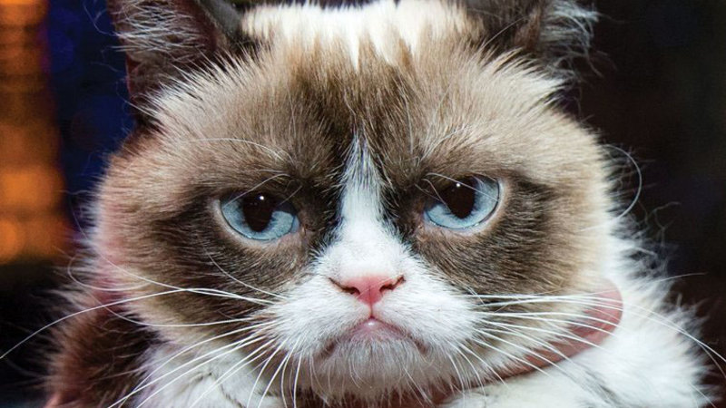
WHO IS GRUMPY CAT?

Slide 17
The advertising mascot for 9Lives brand cat food, appearing on its packaging and in many of its television commercials.

Slide 18
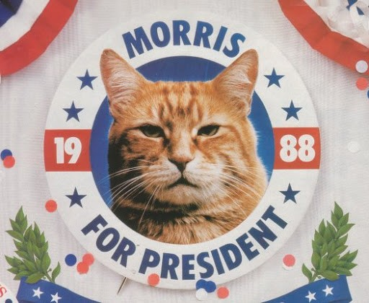
WHO IS MORRIS THE CAT?

Slide 19
A fictional character originally introduced in A. A. Milne's book The House at Pooh Corner.

Slide 20

WHO IS TIGGER?

Slide 21
A fictional cat popularized by Lewis Carroll in Alice's Adventures in Wonderland and known for its distinctive mischievous grin

Slide 22
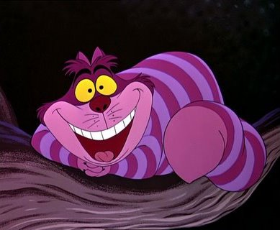
WHO IS THE CHESHIRE CAT?

Slide 23
H₂O

Slide 24

WHAT IS WATER?

Slide 25
CO₂

Slide 26
WHAT IS CARBON DIOXIDE?

Slide 27
H₂O₂

Slide 28
WHAT IS HYDROGEN PEROXIDE?

Slide 29
NaCl

Slide 30
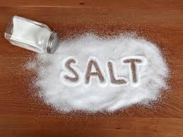
What is Sodium Chloride? (Table Salt)

Slide 31


Slide 32
C₆H₁₂O₆

Slide 33
WHAT IS A GLUCOSE MOLECULE?

Slide 34
A prominent American scientist and inventor in the early 1900s who developed hundreds of products using the peanut, sweet potatoes and soybeans. He also was a champion of crop rotation and agricultural education

Slide 35
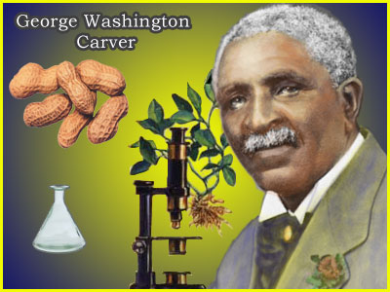
Who was George Washington Carver?

Slide 36
Successfully designed, built and flew the first powered aircraft, showing that man could fly.

Slide 37
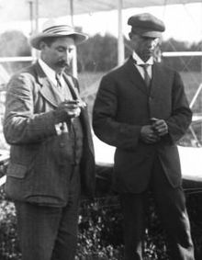
Who were the Wright Brothers?

Slide 38
Polymath who discovered electricity and invented the Franklin stove.

Slide 39
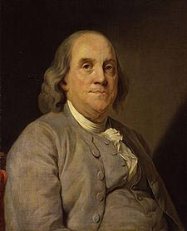
Who was Benjamin Franklin?

Slide 40


Slide 41
Serbian-born scientist who emigrated to the US who played a key role in the development of AC electricity, through the AC induction motor, transformer, and Tesla coil.

Slide 42
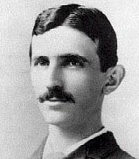
Who was Nikola Tesla?

Slide 43
Credited with inventing the first practical telephone. Also worked on optical telecommunications, aeronautics and hydrofoils.

Slide 44
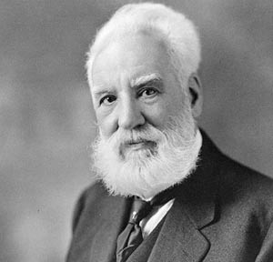
Who was Alexander Graham Bell?

Slide 45
American civil rights activist whose refusal to give up her bus seat in Montgomery, Alabama, indirectly led to some of the most significant civil rights legislation of American history.

Slide 46
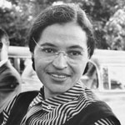
Who was Rosa Parks?

Slide 47
American jazz singer aka “First Lady of the Blues” was widely considered to be the greatest and most expressive jazz singer of all time.

Slide 48
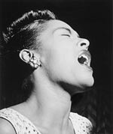
Who was Billie Holiday?

Slide 49
A Dutch Jewish author whose diary is one of the most widely read books in the world. It reveals the thoughts of a young, yet surprisingly mature 13-year-old girl, confined to a secret hiding place. “Despite everything, I believe that people are really good at heart.”

Slide 50
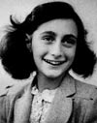
Who was Anne Frank?

Slide 51
American talk show host and businesswoman who was the first woman to own her own talk show. Her show and book club are very influential, focusing on issues facing American women.

Slide 52
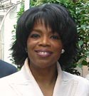
Who is Oprah Winfrey?

Slide 53
Pakistani schoolgirl who defied threats of the Taliban to campaign for the right to education. She survived being shot in the head by the Taliban and has become a global advocate for women’s rights, especially the right to education.

Slide 54
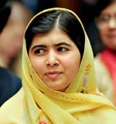
Who is Malala Yousafzai?

Slide 55
REFERENCES http://villainstournament.wikia.com/wiki/Garfield https://www.wikipedia.org/ http://www.lovemeow.com/morris-the-cat-first-feline-presidential-candidate-1608003702.html http://parody.wikia.com/wiki/Tigger http://gameshows.wikia.com/wiki/File:Daily_Double_-28.png http://www.biographyonline.net/scientists/top-10-inventors.html http://www.biographyonline.net/people/women-who-changed-world.html

