Slide 1
.Net Core

Slide 2
Agenda
Day One
Introduction Visual Studio
.Net Core Overview Getting started fundamentals Host, Startup
Dependence Injection
Create Api With Mongodb and Ef Core
Serilog/Application
Swagger
Day Two
Postman Testing
Configure Key Vault
Identity Server
Add Unit Testing
Migration from .Net Core 2.2 to .Net Core 3.1
Linq
$cert = New-SelfSignedCertificate -CertStoreLocation "Cert:\CurrentUser\My" -Subject "CN=ResApiCert" -KeySpec KeyExchange

Slide 3
Why Core?
ASP.NET Core provides the following benefits:
A unified story for building web UI and web APIs.
Architected for testability.
Razor Pages makes coding page-focused scenarios easier and more productive.
Blazor lets you use C# in the browser alongside JavaScript. Share server-side and client-side app logic all written with .NET.
Ability to develop and run on Windows, macOS, and Linux.
Open-source and community-focused.
Integration of modern, client-side frameworks and development workflows.
Support for hosting Remote Procedure Call (RPC) services using gRPC.
A cloud-ready, environment-based configuration system.
Built-in dependency injection.
A lightweight, high-performance, and modular HTTP request pipeline.
Ability to host on the following:
Kestrel
IIS ``
HTTP.sys
Nginx
Apache
Docker
Side-by-side versioning.
Tooling that simplifies modern web development.

Slide 4
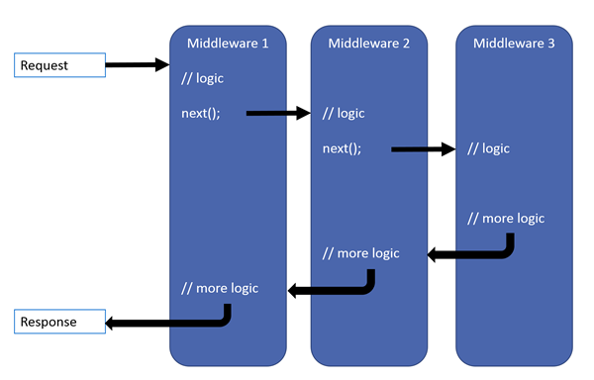
Request, Response Picture

