Slide 2
Import Collection
Import Collection with OpenApi spcecification
1. In PostMan click File Import
2. Choose Import From Link from the Import Window
3. With the Api Running click link to /swagger/v1/swagger.json copy the url https://localhost:44370/swagger/v1/swagger.json then click import leave settings

Slide 3

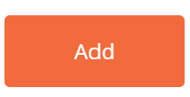
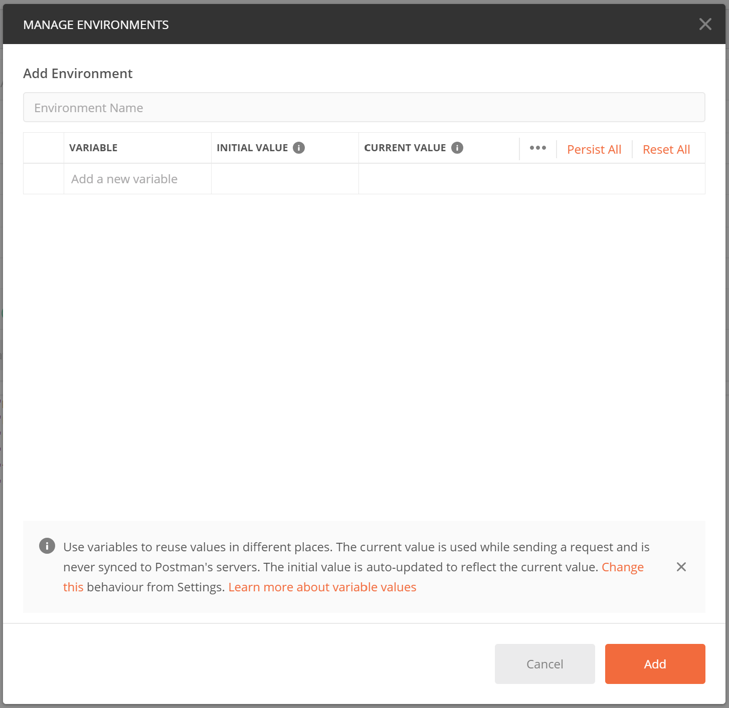
Environments
Environment
1. Click on cog the Environment Manager click Add
2. Add the Name in the Environment Name field
3. Under Variable type baseUrl and in Initial Value Type or paste https://localhost:44370/

Slide 4
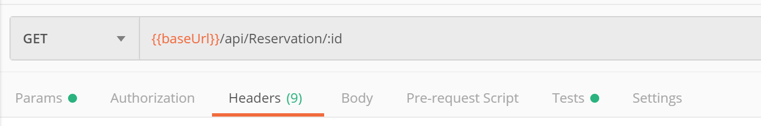

Test
Setup First Test
1. Click on Test Tab
2. From the SNIPPETS on the right side select Status code: Code is 200
3. Pm is Postmans Api the below test has 2 parameters first parameter is the test name the second parameter is the assertion.
pm.test("Status code is 200", function () { pm.response.to.have.status(200);});
4. Send Request to see if the test past you can get additional information from the Postman Console Ctrl + Alt + C or click in the bottom left
5. Now add this code to the Get an author by Id
pm.test("Get Reservation by Id", function() { var jsonData = pm.response.json(); pm.expect(jsonData.Id).to.equal("5e13fc628a38764d44f15e02");});

Slide 5
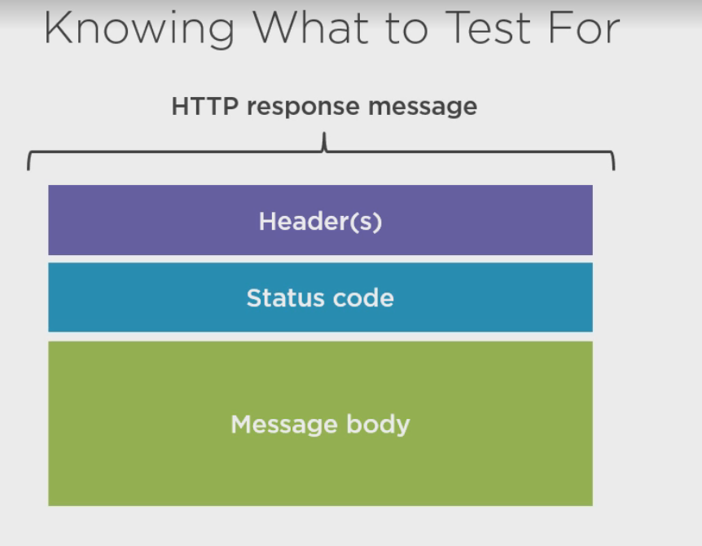
What to Test
HTTP response message
Header(s)
Status code
Message body

Slide 6
Testing for Updating an Reservation with a Put Request
Test for success
Are the correct response header (values) included?
Is the response status code as expected (200/204)
Was the correct Reservation updated?
Are all fields correct updated?
Are non-submitted fields set to their default values
Test for Failure
Does a request to an nonexisting Reservation fail with a 404 Not Found?
Does not included a Content-Type header fail with a 415 Unsupported Media Type?
Does including an unsupported Content-Type header value fail with a 415/406 Unsupported Media Type
Does sending an empty request body fail with a 400 Bad request
Do validation errors fail with a 422 UnProcessable Entity

Slide 7
Test for
Test for what should succeed and also test for what an go wrong
Test Validation like field only allows a length of 24 characters
Vary your input like pass wrong parameters and include when not required

Slide 8
Test Function
Test Function
Test Name
Function that contains the assertion
pm.test(
“* Name of the test * “,
Function ()
{
* assertion *
});

Slide 9
Response Object
Accessible via pm.response
pm.response.code( returns a number: the status code)
pm.response.reason() (function returning a string: the reason associated with the status code)
pm.response.headers(returns a HeaderList object)
pm.response.text() (function returning a string representation of the message body)
pm.response.json() (function returning an object resprestation of the message body)

Slide 10
Asserting
Testing Status Code
pm.test(
“Status code is 200”,
function() {
pm.response.to.have.status(200)});
Or
pm.test(
“Status code is 200”,
function() {
pm.expect(pm.response.code).to.equal(200)});
pm.expect is a generic assertion function
Notes:
pm.response.code is code property of the response object

Slide 11
Assertion Inclusion in an Array
https://www.chaijs.com/api/bdd/
pm.test(
“Status code is 200”,
function() {
pm.expect([200,204]).to.include(pm.response.code)});

Slide 12
Asserting Content-Type
Test if a Content-Type header is included
pm.test(
“Status code is 200”,
function() {
pm.response.to.have.header(“Content-Type”);});

Slide 13
Test if a Content-Type header is included with a specific value
pm.test(
“Status code is 200”,
function() {
pm.response.to.have.header(
‘Content-Type’,
‘application/json; charset=utf-8’);});

Slide 14
Shortcuts for Common Rules
Status code is in the 2xx range
pm.test(
“Status code is successful”,
function() {
pm.response.to.be.succes;});
Status code is in the 4xx range
pm.test(
“Request results in a client error”,
function() {
pm.response.to.be.clientError;});

Slide 15
Shortcuts for Common Rules
Status code is 404 Not Found
pm.test(
“Request results in a client error”,
function() {
pm.response.to.be.notFound;});

Slide 16
Asserting the Response Body
pm.response.text() results in a string
pm.test(
“Response has a non-empty body”,
function() {
pm.expect(pm.response.text()).not.empty;});
Or
pm.response.json() results in an object
pm.test(
“Response has a non-empty body”,
function() {
pm.expect(pm.response.json()).not.empty;});

Slide 17
Assert the Response Body(Shortcuts)
pm.test(
“Response has a non-empty body”,
function() {
pm.response.to.have.body();});
OR
pm.test(
“Response has a non-empty body”,
function() {
pm.response.to.have.jsonBody();});

Slide 18
Asserting Parts of the Response Body
Tests can contain multiple assertions
Regular JavaScript syntax can be used when writing scripts
pm.test(
var updatedReservation = pm.response.json();
“Reservation properties have been updated”,
function() {
pm.expect(updatedReservation.name).to.equal(“Tim Oleson”);
pm.expect(updatedReservation.price).to.equal(“1200”);});

Slide 19
Sending Request
pm.sendRequest(
getReservationRequest,
Function (error, respons) {
if(error) {console.log(error); }
var returnedReservation = response.json();
pm.test(“Author properties have been updated”,
function() {pm.expect(returnedReservation.name).to.equal(Tim Oleson);
pm.expect(returnedReservation.price).to.equal(1200);});})
}

Slide 20
Test Get Reservation By Id
Open Postman Select Get method that requires an Id
Select the Tests tab
Add pm.test("Response time must be below 300m", function(){ pm.expect(pm.response.responseTime).to.be.below(300);})
Click Save

Slide 21
Globals and environment var
Achieve reuse of common test across all Endpoints in your collection
pm.globals.set(key, value)
Takes and key and a value pair as shown below
var responseTimeTest = () => pm.test("Response time must be below 300m", function(){ pm.expect(pm.response.responseTime).to.be.below(300);})
pm.globals.set("responseTimeTest", responseTimeTest.toString())
pm.environment(key, value)
Takes and key and a value pair as shown below
For current environment
Use eval to run the global variable function
eval(pm.globals.get("responseTimeTest"))();
Place this in the test tab
Place the created var responseTimeTest and the pm.globals.set() in Pre-requestScript Tab

Slide 22
Collection Runner
Click Runner button on the top left side of the screen
Choose the Collection you want to run
Select the Environment to obtain the environment variables
Click Run Collection name button
All request will be run and we will see a summary with status Code and you will what test passed or failed

Slide 23
Newman
npm install -g newman
If you don’t have node https://nodejs.org/en/
Now we need to export the Collecton
Find the collection you want to export click … a menu will pop up select export
Now we need to export the Environment also got to the cog in the up right or the screen select the Environment you want to export and click the download button save in the same folder you saved the collecton
In Open command prompt cd into folder where collections are located and run this command
newman run "MicrosoftDemo API.postman_collection.json" --environment "MicrosoftDemo Api.postman_environment.json" --insecure

