Slide 1



Project Week 3
Data Preparation
Bank Deposit
Zijing Xue
Ouykhy Quach
JAN, 3rd | PARIS

Slide 2


Dataset description
Banks are looking to sell term deposits i.e. cash investment held at a financial institution. This is a major source of income for them.
The money is invested for an agreed rate of interest over a fixed amount of time, or term.
For this dataset we are looking at telephonic marketing campaigns the bank uses to outreach to its clients.
It remain an effective way to reach out however it is a huge investment through call centers . Hence, it is crucial to identify the customers most likely to subscribe so that they can be targeted.
The data is related to direct marketing campaigns of a Portuguese banking institution. The classification goal is to predict if the client will subscribe to a term deposit.
This dataset is publicly available for research. It has been picked up from the UCI Machine Learning

Slide 3
Challenges
A/ Getting a clear understanding of the 16 columns dataset as the goal is to determine which one has an influence on the decision to subscribe to a term deposit
B/ Figuring out which categorical column to encode
C/ Identify correlation
Info related to the client: | Info related to the last contact : | Info from a previous campaign:
job marital status Education average yearly balance housing loan personal loan has subscribed a term deposit | contact communication type last contact (day and month) last contact duration number of contacts performed during this campaign. | number of days since the client was last contacted number of contacts performed before this campaign outcome of the previous marketing campaign

Slide 4
Process
Identify the data issues:
duplicates: were dropped
average yearly balance:
For negative balance: we decided to drop rows of balance less than -1000
number of contacts performed during this campaign:
When campaign call > 10 and outcome result = unknow : drop those rows
last contact duration : we interpreted “0” as the client didn't pick up the call, worth targeting the client again, we decided to keep this
Numeric columns: | Non-numeric columns:
Missing data: replacing none value with mean value Outliers: checked and dropped Decided to drop column “number of contacts performed before this campaign” since very low variance | Missing data: replacing none value with the mode value Data inconsistency : updated the data accordingly

Slide 5
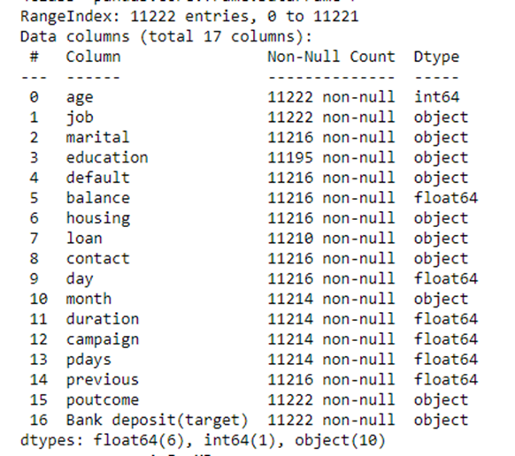
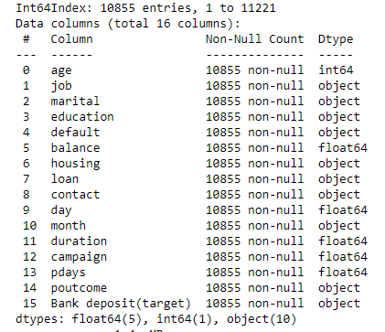
Comparison of the initial and final datasets
Initial dataset | Final dataset

Slide 6
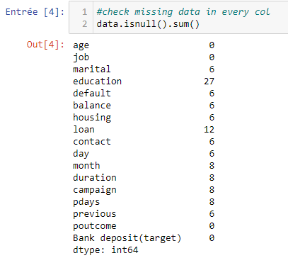
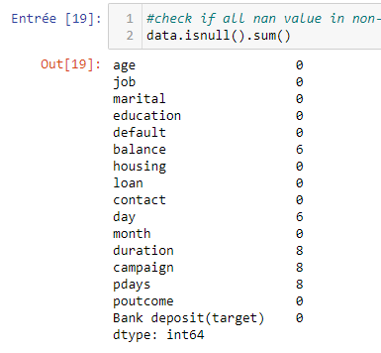
Comparison of the initial and final datasets
Prior to cleaning | After cleaning

Slide 7
Learnings
Encoded some columns in order to calculate the corrolation
(eg between “Bank deposit” and age, average balance)
Made some assumptions and calculate the corrolation :
success in “previous campaign” => could buy term deposit again
✓ Correlation 0.17
no “loan” => more possibility to buy term deposit
✗ Correlation 0.09
no “housing” => more possibility to buy term deposit
✓ Correlation 0.15

Slide 8
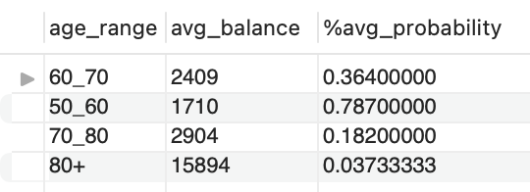
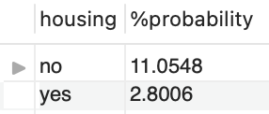
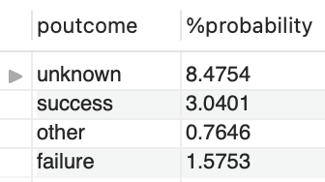
Highlights
Based on our queries results,
The age range with higher probability to subscribe is the 50-60 years old followed by the 60-70 years old
Clients without a housing loan show more probability to subscribe to a term deposit
During a previous campaign call, the outcome was captured as “unknown” meaning hesitant / undecided. The query shows there is a good probability that the client subscribe to a term deposit

Slide 9

Improvements
Each of the 16 columns might have an impact so a deep review of client related columns (non-numeric) could be relevant to identify more correlation (job, marital status, education…)
Past Usage
The full dataset was described and analyzed in:
S. Moro, R. Laureano and P. Cortez. Using Data Mining for Bank Direct Marketing: An Application of the CRISP-DM Methodology.
In P. Novais et al. (Eds.), Proceedings of the European Simulation and Modelling Conference - ESM'2011, pp. 117-121, Guimarães, Portugal, October, 2011. EUROSIS.

Slide 10
Q&A

