Slide 1
Interventions
Like the others this is a first draft designed for information not presentation and being better formatted than a word doc!

Slide 2
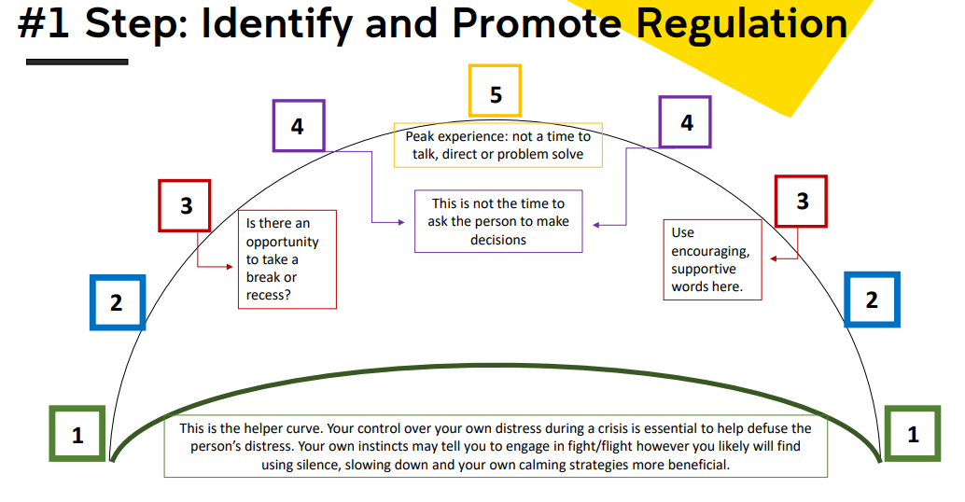
Window of tolerance
To provide an intervention we our we must think about not only the 1-5 scaling Cyndi provided (right) but also how it maps to a person’s window of tolerance (next slide)

Slide 3
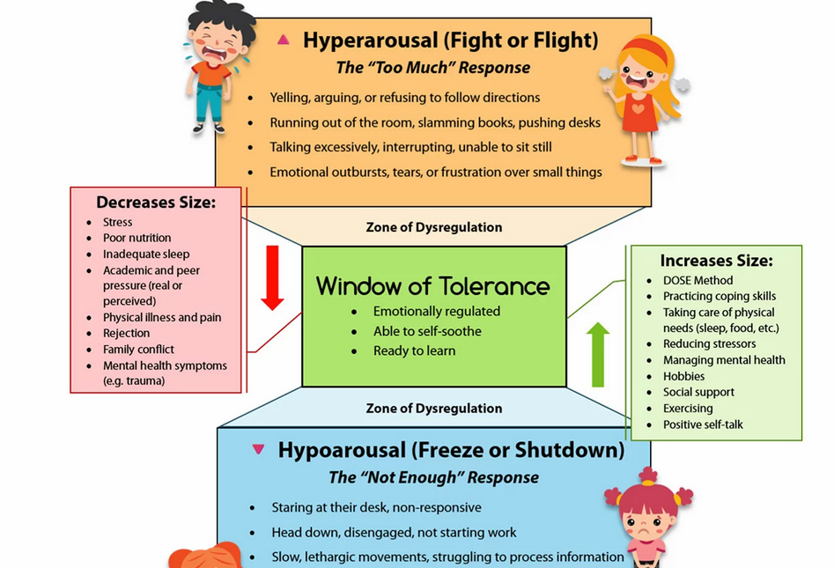
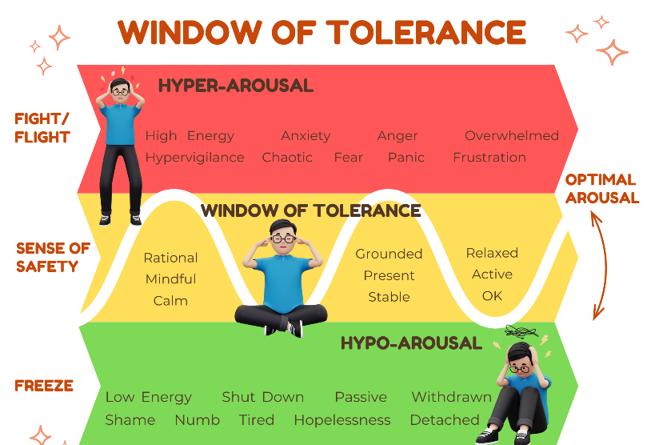
Window of tolerance cont.
We want to eventually get our students to a window of tolerance (may take 20 minutes, may take years!)
Be aware of fawning in hypoarousal and careful not to confuse submission with agreeance to interventions you try!
Be aware of certain physiological states that may confuse tolerance state (always compare to baseline)

Slide 4
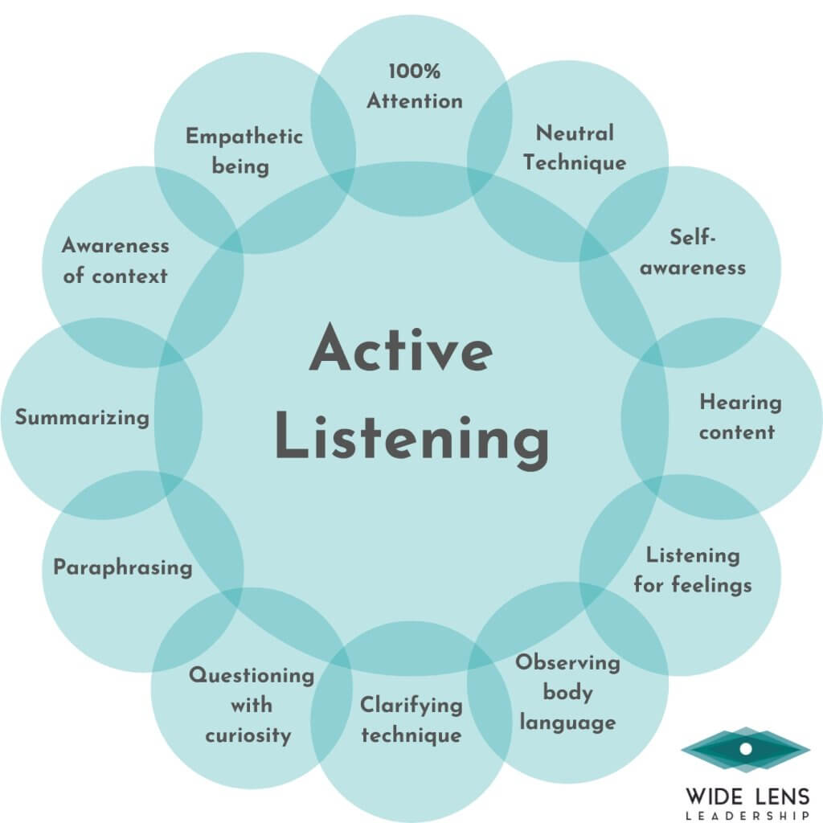
Verbal interventions – active listening
A few nuances with the picture on active listening doesn’t cover
Be culturally aware (all cultures)
EG. Some cultures see suffering as a sign of strength
Eye contact
Maintain good but not 100% eye contact
Some cultures and neurodivergent persons prefer no eye contact

Slide 5
Verbal techniques (communication and deescalation)
Accepting: Indicates you have received the information given without judgement.
Affective questions: Affective questions ask the respondent to relate their feelings, referring to the subjective emotional state of the individual as opposed to the objective interpretation of facts. We may guide a student carefully to acknowledge and articulate their feelings, which can at times be difficult to access “How about you, how are you feeling about it all?”
Broad Openings: This allows the consumer to take the lead in deciding what will be discussed at the beginning of a conversation.
Clarifying: Checking with the consumer that you have understood what was said.
Closed-ended questions: (much more niche use than open-ended) requiring "yes/no" or brief answers, are used to quickly gather specific data, manage time-limited sessions, or reduce anxiety for inarticulate/overwhelmed clients. They are effective for safety assessments (e.g., suicide risk) and clarifying specific details but should be balanced with open-ended questions to avoid an interrogating tone.
Empathising: To try and gain an understanding of another’s situation, how that person thinks and feels and the meaning of the situation. It also involves communicating that understanding back to the person to check if your understanding is accurate and to enable the consumer to offer further information.
Engagement and Rapport building: Making a connection with and showing interest in the person, getting to know them, and conveying trustworthiness to facilitate honest communication. It often involves offering some information about yourself.

Slide 6
Verbal techniques (communication and deescalation) cont.
Open-ended questions: These are questions that facilitate communication and rather than questions that elicit a yes or no response only and do not facilitate further communication about the subject matter. An example of open-ended questions: ‘What did you find most helpful when this previously occurred’? Could you tell me more about your experiences of coping with this in the past’?
Some tips (not set in stone rules)
Frame questions impersonally: Try this contrast in challenging a belief by speaking these phrases out loud.
“That doesn’t make sense.”
“Some people would have a hard time following that.”
Depersonalising your approach will reduce conflict, and this will allow more rapport and a better therapeutic alliance to be formed. When asking sensitive questions, you should frame them with permission. Try this contrast in asking a delicate question by speaking these phrases out loud:
“Tell me about your suicide attempt.”
“Can I ask you some questions about when you tried to end your life?”
Couching questions: By couching the question in a consent phrasing we allow the person to refuse to answer, which shows greater respect for them, and again addressed the power relationship. If a topic is likely to be really sensitive, it is worth flagging before even starting to explore it. The best lead-in here is:
“I'd like to ask you a few difficult questions. Is that okay?”
Gaining consent: Again, we are asking consent to explore tricky territory. The person knows if they have the emotional resilience to handle the questions, and we do not. By allowing them to decide we are more likely to build trust and a relationship.

Slide 7
Verbal techniques (communication and deescalation) cont.
Exploring: Examining a point/issue in-depth. This also demonstrates that you are listening and focused on what is being said. Facilitating problem solving: Enabling the consumer to identify and the consider the merits of potential solutions.
Focusing: Concentrating on a single point or issue for discussion.
Informing: Giving information or directing to sources of information. Making observations: Verbalising what you have heard and noticed.
Probing questions: This type of question encourages expansion on previously made points. Probing questions may help in clarifying a problem and in eliciting examples of specific issues: ‘Can you give an example of what might trigger off the vomiting?
Restating: Stating what the consumer has expressed, including their feelings and thoughts. It demonstrates that you have been listening and gives the consumer an opportunity to clarify anything that has been misunderstood.
Redirection: Also, a big deescalation technique. By redirecting the conversation gently (which can be done by restating the problem in a positive light – e.g. The video that planned on redirected missing the trip to what sort of fun do you plan on having on the trip).
Rhetorical questions (use sparingly and respectfully): Rhetorical questions are not asked with the intention of receiving an answer; indeed, at times the questioner may go on to provide the answer themselves, or use the question as a summary, before moving the student on by asking a further question. EG. “So, you haven’t been successful in losing weight before (rhetorical question), and now you are concerned for your and your baby’s health? (closed question)”
Self-disclosure: The degree of self-disclosure by the professional is determined by the consumer’s needs and overall benefits.
Summarising: Summing up what has been stated by the consumer: verbalising the most salient points and can be used to close a therapeutic interaction. Validating: Affirming the consumer’s experiences as real.

Slide 8
Verbal techniques (communication and deescalation) cont.
Silence (Used by staff): Used to allow the consumer time to think, respond and react. Active listening is maintained by the professional during periods of silence.
Silence (used by student):
Passive
Active
Creative
Destructive
Positive silences, characterized by intimacy and harmony, feel comfortable and they encourage the staff/student to become more aware of their inner worlds and of each other. In this sense the silence is active and creative.
Negative silences are less comfortable and are associated with a tension that suggests animosity or hostility. The nature of a silence can be checked through a simple question.
A simple ‘What’s happening?’ or ‘What are you feeling at this moment?’ offers the student the opportunity to say as much or as little about the silence as they feel able to.
Alternatively, you might ask: ‘Are you finding it difficult to put something into words?’

Slide 9
Motivational interviewing (Basic version) (EXPERT LEVEL REQUIREMENT)
MI is an extremely hard skill to master, Richard (maybe without realising) may be the first person I have met who can do it well (or maybe I am biased).
Without going into too much detail its name is self-explanatory, you are talking to someone with the intent to motivate change. So, I will keep it to main points
I only briefly mention it here as the relevance we are looking for to motivate someone distressed is “change talk”. These included phrases from the student like:
express desire (“I want to...”)
ability (“I can...”)
reasons to change (“I want...”)
need (“I have to...”)

Slide 10
Motivational interviewing cont.
Stages of change
Precontemplation (not ready): Not even considering change
Contemplation (getting ready): Ambivalent about making a change
Preparation (ready): Taking steps toward implementing change
Action (ready): Actively involved in the change process
Maintenance (sticking to it): Sustaining the target behaviour
Relapse (learning): Cycle restarter (but often faster than the first cycle)

Slide 11
Motivational interviewing techniques (in short)
You are more than welcome to try but I assure you this is an ARTFUL skill to master
MI is about motivating them to make their own changes
OARS
Open questions that lead to more explanation and further contemplation.
Affirmations that promote positive feelings in the exchange.
Reflections to prove the we’ve heard and truly understood the student.
Summaries, which build on simple reflections to foster momentum or generate interest in making changes
Ask – listen – ask
Ask (Open, neutral question) – goal is invite them to speak, reduce pressure, avoid assumptions
Examples “How are things going for you at the moment”, “What’s making today difficult?”
Listen (actively, do not fix or correct what they say) – this is the most important step, use OARS and resist the urge to correct
Example behaviours – nodding/open posture, validating (“that makes sense given what you’re dealing with), paraphrasing what they said (“it sounds like you’re feeling overwhelmed”)
Do NOT – rush to solve, jump to advice, correct them
Ask (Follow up / deepen understanding) – ask a second question that builds on what they say, supports autonomy
Examples “What do you think would help right now?” “What’s worked for you before?” “What do you feel you need at the moment?”

Slide 12
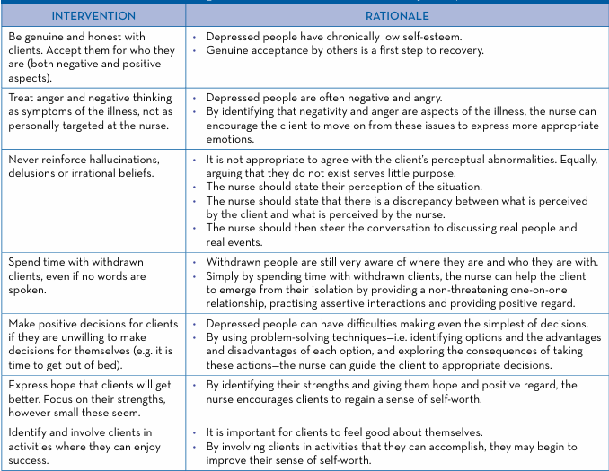
Some verbal techniques for low mood/depression/anxiety/stress (somewhat advanced but good to know)

Slide 13
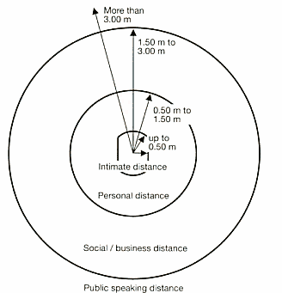
Nonverbal techniques (communication and deescalation)
Distance from student: This is also a deescalation technique. Maintain appropriate personal space depending on context and safety. It not only shows respect but keeps you safe in cases of escalating behaviour.
Relaxed Demeanour: Avoid fidgeting, which can signal boredom; maintain a relaxed, calm posture.
Uncrossed Limbs: Keep arms and legs uncrossed (legs uncrossed is for extreme cases of heightened distress) to signal that you are open to the message and not defensive.

Slide 14

Nonverbal techniques cont.
Eye Contact: Maintain comfortable eye contact (roughly 50–70% of the time) to show you are present and focused.
Eye level: This also falls into the category of deescalation techniques. Being at the same eye level can feel less intimidating.
Face the Speaker: Sit or stand squarely facing the person to show they have your full attention.
Head Nods & Mirroring (Minimal encouragers): Use occasional nodding and subtle mirroring of the speaker's posture to build rapport. The same technique can be implemented using words like ‘uh huh’ ‘mm’ ‘yeah’. These are forms of showing you are listening
Lean In: A slight forward lean demonstrates interest and engagement in the conversation.
Open palms above waste level where student can see them: This falls into the category of deescalation techniques as well. A closed fist or hidden palms can be perceived quite easily during distress as a threat.

Slide 15
Techniques to avoid
Becoming Defensive or Argumentative: If you notice that you start doing this, then its time to take a step back and reflect on your own stress levels. Common mistake statements “you’re wrong” “that’s not what happened”.
Blaming or Accusing Language
Giving Unsolicited Advice Too Early: Remember the horse and card model I taught at the start. The core idea is that interventions (interventions as small as moving 1CM closer or asking how are you rather than being quiet) are to be lightly tested to see if they are accepted or avoided. If accepted great, test with stronger interventions after some rapport is built. But always remember the slightest hint of resistance means no more interventions other than focussing on the relationship!
Interrupting or Talking Over the Person
Loaded questions: for similar reasons to leading, although great for investigation, loaded questions show task orientation rather than person centred communication, and will likely escalate the student.

Slide 16
Techniques to avoid cont.
Leading questions (BAD For deescalation, can be good if expertly used for motivating): Where leading questions are used the question itself usually points to the preferred answer. Four types of leading questions:
Simple leads: A direct question that clearly suggests the “correct” or preferred answer, often through wording that pressures agreement. “You are calm now, aren’t you?”
These can make the person feel pushed into agreement rather than heard.
Conversational leads: A more casual or natural‑sounding question that still subtly directs the answer, often framed as part of a conversation. “Wouldn’t it help if you just took a step back?”
These feel friendly but still steer the response, which can limit honest expression.
Implication leads: A question that suggests a conclusion by implying something about the person’s behaviour, feelings, or situation. “Why were you so upset earlier?” (implies they were overreacting).
These can trigger defensiveness, escalate conflict, or make the person feel blamed
Subtle leads: A less obvious form of leading question where the bias is built into wording or assumptions within the question. “What made you act that way?” “How did you end up in this situation?”
These can shape the response or unintentionally assign fault

Slide 17
Techniques to avoid cont.
Minimising or Dismissing Feelings: You have no idea what current/past stressors someone has been through and it doesn’t matter what your scale of bad is, the distressed student is currently having a bad time. Common mistake statements “its not a big deal” or “you’re overthinking it”.
Overloading with Information or Logic: Avoid long explanations, trying to “Reason them out” of emotions. Long explanations are fine once rapport is solidly built, and you are in chain intervention mode! But only if the interventions are well received genuinely, not just submissively!
Showing Impatience (Verbal or Non-Verbal): Eg. Sighing, checking watch, rushing responses. It is perfectly fine to set boundaries as we spoke about in the workshop. Say you had a strict leaving time, inform the student you need to check your watch as you have a meeting you cannot miss, even better if you set your boundaries if very time limited early. This will show the student that you dedicated maximum possible time to them. Imagine not telling them, always checking your watch, then abruptly leaving, how will they feel? How would you feel?
Talking about the news or world events: Especially considering all the wars going on, small talk surrounding news serves no purpose and has a decently high risk of escalating someone with no real benefit other than filling social gaps. It’s better to just be silent than talk news.
The urge of the “Righting Reflex”: Being right or correcting only serves your needs, the focus should be listening for what the student says. Often incorrect information they produce can be highly valuable side channel information about their distress.
Using Threats or Authority to Control: Eg “If you don’t calm down, I’ll…”
Vibing the situation/Acting on gut feeling alone: Relying purely on “vibes” or gut feelings is not a safe or professional basis for decision-making. While intuition can alert us that something may be wrong, actions should be guided by observable changes, context, and clear risk indicators rather than assumptions. Acting without evidence can unintentionally stigmatise a student or escalate a situation unnecessarily, whereas failing to act when genuine risk is present can have serious consequences. The aim is to balance awareness with professionalism - if there is credible risk, act immediately, if there is only uncertainty, observe, seek clarity, and gather more information. In practice, professional judgement is not about being right, it is about being safe, fair, and responsive to what can be clearly observed.

