Slide 1
SECTION
2
Inheritance & Polymorphism
How classes relate, extend, and become many things at once.
Inheritance
extend and specialize
Overriding
redefine inherited behavior
Polymorphism
one type, many forms
↓
↻
◆
Notes:
This should be the end for lecture 1
Section transition — take 30 seconds here. Remind students we just built the Dog class. Now ask: what if we wanted a GoldenRetriever that does everything a Dog does plus more? That question is exactly what inheritance solves.

Slide 2
Why We Need Organization
Real software spans millions of lines of code and thousands of classes. Without structure, it becomes unmaintainable.
THE PROBLEM
THE SOLUTION
• Thousands of classes with no relationship
• Duplicate code in every file
• One bug fix requires changes everywhere
• No way to group related behavior
• Inheritance — group classes into hierarchies
• Packages — group classes into logical units
• Both work simultaneously in real projects
• Fix once, benefit everywhere
Our Dog class works but what if we needed a GoldenRetriever, a Poodle, and a Labrador?
Notes:
Bridge from the Dog class we just wrote. Emphasize that real systems have thousands of classes, and without inheritance and packages the code becomes unmaintainable. Don't rush this slide — the motivation matters more than the mechanics.

Slide 3
Inheritance: Extend and Specialize
Inheritance lets a new class absorb the fields and methods of an existing class
Animal
fields: name, age
methods: eat(), sleep()
↑
IS-A RELATIONSHIP
+
CODE REUSE
A GoldenRetriever IS-A Dog. A Dog IS-AN Animal. The subclass can do everything the parent can, and more.
Write eat() once in Animal. Every subclass gets it free.
extends
Dog
inherits everything from Animal
adds: breed / bark()
↻
OVERRIDE WHEN NEEDED
!
CONSTRUCTORS NOT INHERITED
extends
GoldenRetriever
inherits everything from Dog
adds: isFriendly / fetch()
Subclasses can redefine inherited methods to specialize them.
Use super() to call the parent constructor from a subclass.
The keyword in Java is extends: public class Dog extends Animal { ... }
Notes:
Draw the hierarchy on the board as you go. Walk up the chain: a GoldenRetriever's total fields are name and age (from Animal), breed (from Dog), and isFriendly (its own). Stress that constructors are NOTinherited — you call super() to reuse the parent's constructor.

Slide 4
The super Keyword
super gives a subclass access to its parent's constructor and methods.
WITHOUT super — BROKEN
WITH super — CORRECT
class GoldenRetriever extends Dog {
GoldenRetriever(String name, int age) {
this.name = name; // name is private
this.age = age; // not visible here
}
}
// let Dog set name & age
class GoldenRetriever extends Dog {
GoldenRetriever() {
super("Buddy", 3); // must be first line
}
}
1
CALLS THE PARENT CONSTRUCTOR
2
CALL AN OVERRIDDEN METHOD
3
INSERTED AUTOMATICALLY
super() runs the parent constructor — and must be the first line.
super.eat() calls a parent method that the subclass has overridden.
Skip it and Java adds a no-arg super() — which crashes if none exists.
super is how the inheritance chain stays connected
Notes:
Without super every subclass would have to rewrite every constructor from scratch

Slide 5
Inheritance In Code
Here is what the Animal → Dog → GoldenRetriever hierarchy actually looks like in Java.
Animal
Dog extends Animal
GoldenRetriever extends Dog
public class Animal {
private String name;
private int age;
public Animal(String name, int age) {
this.name = name;
this.age = age;
}
public String getName() { return name; }
public int getAge() { return age; }
}
public class Dog extends Animal {
private String breed;
public Dog(String name, int age, String breed) {
super(name, age); // Animal sets name & age
this.breed = breed;
}
public String getBreed() { return breed; }
public void bark() {
System.out.println("Woof!");
}
}
public class GoldenRetriever extends Dog {
private boolean isFriendly;
public GoldenRetriever(String name, int age,
boolean isFriendly) {
super(name, age, "Golden Retriever");
this.isFriendly = isFriendly;
}
public void fetch() {
System.out.println("Fetching!");
}
}
GoldenRetriever buddy = new GoldenRetriever("Buddy", 3, true);
buddy has: name (from Animal) age (from Animal) breed (from Dog) isFriendly (its own)
Inherited fields travel the full chain — buddy carries all four fields even though it only declared one.
Notes:
Walk students through each panel left to right. Animal is the base — plain fields, plain constructor. Dog extends it: the first line of Dog's constructor is super(name, age) which calls Animal's constructor to set those private fields. GoldenRetriever does the same — super() calls Dog's constructor, which in turn calls Animal's. The bottom callout is the payoff: ask students how many fields a GoldenRetriever has. They might guess two. The answer is four — the whole chain contributes. This is the moment inheritance becomes concrete rather than abstract.

Slide 6
The Inheritance Tree
In Java, every class has exactly one direct parent — and every class ultimately traces back to Object.
Object
root of every Java inheritance tree
Animal
String
Integer
[YourClass]
any class you write
Dog
GoldenRetriever
1
SINGLE INHERITANCE ONLY
↑
IMPLICIT ROOT
≡
OBJECT'S METHODS
A class can extend exactly ONE other class at a time. No multiple parents.
Any class that does not explicitly extend another automatically extends Object.
toString() — text representation
equals() — content comparison
hashCode() — hash identity
This is why every Java object has a toString()
Notes:
Point out that even our Dog class implicitly extends Object, even though we never wrote 'extends'. That's why every object already has toString(), equals(), and hashCode(). Remind them Java allows only single inheritance — exactly one direct parent per class.

Slide 7
Overriding, Redefine What You Inherit
Overriding replaces an inherited method with a new implementation tailored to the subclass.
Default toString() from Object
Overriding toString() in Dog
Dog rex = new Dog("Rex");
System.out.println(rex);
// Output: Dog@3764951d
// ⚠ Not useful for debugging
@Override
public String toString() {
return "Dog{name=" + name +
", breed=" + breed + "}";
}
System.out.println(rex);
// Output: Dog{name=Rex, breed=Boxer}
// ✓ Readable and useful
The default prints a class name + memory address. Meaningless to a human.
The @Override annotation tells the compiler you intend to replace the parent method — it will catch typos.
@
@OVERRIDE ANNOTATION
=
SAME SIGNATURE
↻
ANY INHERITED METHOD
Not required, but always use it. The compiler will error if you accidentally mis-spell the method name.
The overriding method must match the parent method's name and parameter list exactly.
toString(), equals(), and any method from a parent class can be overridden.
Rule of thumb: if the default behavior from a parent class doesn't fit your class, override it.
Notes:
Live-code this one if you can. Print a Dog before overriding toString() to show the Dog@3764951d garbage output, then add the @Override version and print again. The contrast makes the point far better than any slide.

Slide 8
Polymorphism
Polymorphism — the ability of different objects to respond uniquely to the same method call.
Compile-Time Polymorphism
Runtime Polymorphism
Static binding(resolved at compile time)
Same method name, different parameter lists
The compiler decides which method runs
Uses dynamic method dispatch(Resolved at Runtime)
Overridden method resolved at runtime
Behavior depends on the actual object type
Method Overloading
Operator Overloading
Method Overriding

Slide 9
Polymorphism — One Type, Many Forms
Polymorphism lets one variable hold objects of different types — as long as they share a common parent.
THE SETUP
HOW IT WORKS: DYNAMIC DISPATCH
Animal references, any subclass
STEP 1 · At compile time
Java only checks that speak() exists on Animal.
Animal a1 = new Dog("Rex");
Animal a2 = new Cat("Whiskers");
Animal a3 = new GoldenRetriever("Buddy");
a1.speak(); // "Woof!"
a2.speak(); // "Meow!"
a3.speak(); // "Woof woof!"
STEP 2 · At runtime
Java looks at the actual object type — Dog, Cat, or GoldenRetriever.
STEP 3 · Calls the right version
The overridden speak() in the real class runs — not Animal's.
• The variable type is Animal (parent)
• The actual object can be any subclass
This is dynamic dispatch.
↑
IS-A IS REQUIRED
◆
FLEXIBLE, REUSABLE CODE
▶
RUNTIME, NOT COMPILE TIME
Works only because Dog IS-AN Animal. The is-a relationship must hold.
Write one method that accepts Animal — it works on every current and future subclass.
The method to call is chosen when the program runs, not when it compiles.
Polymorphism is the payoff of the last four slides — inheritance, the tree, and overriding all make it possible.
Notes:
This is the hardest concept in the section — give it time. Walk through dynamic dispatch slowly: the variable type is checked at compile time, but the actual object's method runs at runtime. Tie it back to inheritance, the tree, and overriding — polymorphism is the payoff.

Slide 10
Setting Up Polymorphism — Defining speak()
Before polymorphism can work, the parent class must declare the method — and each subclass must override it.
Animal declares speak()
Dog overrides speak()
Cat overrides speak()
public class Animal {
private String name;
private int age;
public Animal(String name, int age) {
this.name = name;
this.age = age;
}
public void speak() {
System.out.println("..."); // generic
}
}
public class Dog extends Animal {
private String breed;
public Dog(String name, int age, String breed) {
super(name, age);
this.breed = breed;
}
@Override
public void speak() {
System.out.println("Woof!");
}
}
public class Cat extends Animal {
public Cat(String name, int age) {
super(name, age);
}
@Override
public void speak() {
System.out.println("Meow!");
}
}
Animal provides a default — subclasses will replace it with their own version.
Now when we call speak() on any Animal reference, Java runs the correct version for whatever object is actually stored there. That is the next slide.
Notes:
This slide exists solely to show students where speak() comes from before the polymorphism slide uses it. Without this, the next slide's code calls a method that appeared from nowhere. Walk through each panel quickly — 90 seconds max. The key observation is that all three classes have speak(), but they each do something different. Ask: what do you think happens when we store a Dog inside an Animal variable and call speak()? Let them guess before flipping to the next slide.

Slide 11
The instanceof Operator
instanceof checks whether an object is an instance of a specific class or any of its parents at runtime.
LIVE TYPE CHECKS
Animal a1 = new Dog("Rex");
a1 instanceof Dog // true
a1 instanceof Animal // true
a1 instanceof Cat // false
WHY IT MATTERS
SAFE CASTING PATTERN
Polymorphism lets you hold mixed types in a single Animal reference — but instanceof lets you safely identify the real type before you cast.
if (a1 instanceof Dog) {
Dog d = (Dog) a1;
}
Cast without a check and Java throws a ClassCastException at runtime.
Rule of thumb — frequent instanceof may signal your polymorphism design needs revisiting; occasional use for type-safe casting is perfectly valid.

Slide 12
SECTION
3
Packages
Organizing your classes so they can grow, scale, and work together.
What is a package
grouping related classes
Creating a package
the package keyword
Importing
using packages from elsewhere
◆
+
↓
Notes:
Section transition. Ask students: we just wrote the Dog class — where does that file live? What if we had 50 classes? How do we find anything? That organizational problem is exactly what packages solve.

Slide 13
Packages — What and Why
A package is a named group of related classes — think of it as a folder that gives your code structure and prevents naming collisions.
WITHOUT PACKAGES
WITH PACKAGES
flat project — all files together
grouped into named packages
Dog.java
Cat.java
Animal.java
Dog.java ✗ name conflict!
Manager.java
Dog.java ✗ another one
animals/
Dog.java
Cat.java
Animal.java
management/
Dog.java ✓ no conflict
Manager.java
✗ No way to have two classes named Dog
✗ No logical grouping — everything is flat
✓ Classes can share a name across packages
✓ Related code lives together
✓ Each package compiles independently
Two classes CAN share a name if they are in different packages — they CANNOT share a name within the same package.
Notes:
Use the file explorer analogy — packages are like folders on your computer. You can have two files both named 'resume.pdf' as long as they are in different folders. Same idea. Ask: can you think of a real Java package you have already used? Lead them to java.util or java.lang.
Packages are how we import and use code elsewhere in our code base. We saw this whenever we import java libraries or using python pip to import math or whatnot

Slide 14
Creating and Importing a Package
Declaring a package is one line — the very first line of your Java file. Importing lets you reach classes from other packages.
DECLARING A PACKAGE
IMPORTING A PACKAGE
Dog.java
Main.java
package animals; // must be line 1
public class Dog {
private String name;
public Dog(String name) {
this.name = name;
}
public String getName() {
return name;
}
}
import animals.Dog; // specific class
import animals.*; // entire package
public class Main {
public static void main(String[] a) {
Dog rex = new Dog("Rex");
System.out.println(rex.getName());
}
}
animals.Dog
Imports exactly one class. Preferred — explicit.
· Must be the first non-comment, non-blank line
· Use lowercase naming: animals, not Animals
· Reverse-domain for large projects: edu.carrollu.cs226.animals
animals.*
Wildcard — imports every class. Hides what you use.
java.lang is the one package Java imports automatically — that is why you never write import java.lang.String.
Notes:
Live-code this. Create an animals/ folder, drop Dog.java in it with the package declaration, then write Main.java in a separate folder and import it. Show the compile-time error when the import is missing — then fix it. The wildcard vs specific import debate is worth 30 seconds: in industry, explicit imports are almost always preferred because they document exactly what your class depends on.

Slide 15
SECTION
4
A Jaunt Down Memory Lane
How objects stored in memory
How our system interacts with memory
Direct Addressing
Indirect Accessing
⇄
→
↪
Notes:
Section transition. Ask students: has anyone ever seen their program crash with a red error message? That is an unhandled exception. This section teaches you how to see them coming — and what to do when they arrive.

Slide 16
Memory
How a primitive value and an object reference are laid out in memory
CONTIGUOUS MEMORY
Memory.java
addr ↓
1
2
3
4
5
6
class Memory {
int x = 5;
Dog rex =
new Dog("Rex");
}
0x3A10
x = 5
Primitive
The value lives directly in x’s memory word.
⋮
0x2C44
rex = 0x4F2A
Reference
rex holds an address — a pointer, not the object itself.
⋮
0x4F2A
Dog {
Heap object
The Dog’s fields occupy contiguous words at 0x4F2A.
0x4F2E
name = "Rex"
0x4F32
age = 0
CSC 226 · DATA STRUCTURES
16
Notes:
All programs and data are held in memory
At the most basic level memory consists of contiguous sequences of addressable words
Contiguous: to share a common border
When we assign a variable, it corresponds to a specific region of memory
When we reference this variable after assignment, the compiler ensures we use the same memory location
When we access variables, we can do so in two ways:
Direct Access
Access the variable by name or position in memory
Example: accessing a local variable in a function
Indirect Access
Access the variable through a reference, pointer
Example: accessing a value via a pointer or object reference

Slide 17
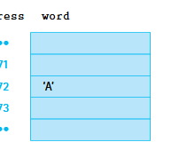
Direct Addressing
Most common in higher-level languages.
Accesses variables by their name.
Example: x = 5 or print(name).
The compiler or interpreter maps names to memory locations.

Slide 18
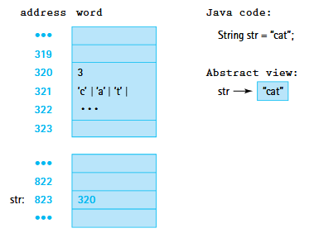
Indirect Accessing
The variable does not hold the actual value but instead holds the address of the location where the value is stored.
This adds a level of indirection
the program must first look up the address, then retrieve the value from that location.
Common in pointers (e.g., in C/C++) and references
Java objects

Slide 19
Why do we bother with indirect accessing?
Objects in java and other languages can be complex
We often use simple examples, but think of a class with many fields and methods
If we stored the whole object directly in variables
We'd need to move large chunks of memory when passing objects to methods
Even simple operations would become slow and inefficient
This would compound over time
When we pass values by reference
Instead of copying the whole object, we just pass a memory address
Reduces memory usage and avoids unnecessary duplication
Enables Advanced Features
Polymorphism
The method receives a reference to the actual object, Java can determine the real type of the object at runtime.
Shared access (multiple variables pointing to the same object)

Slide 20
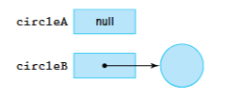
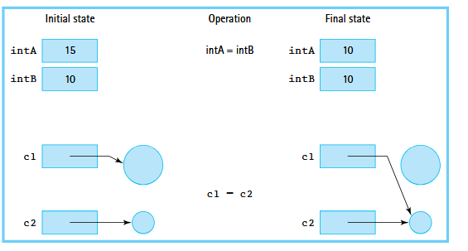
References
Variables of an object class hold references to objects
This is an example of indirect addressing
Let’s walk through two like statements
Circle circleA;
Circle circleB = new Circle(8);
Aliases
When we have two names for the same object
Notes:
Prompt students on what
This.xxx means in our constructor, now go into visualizations

Slide 21
Comparing Objects
== compares references (identity). .equals() compares values (content).
Dog a = new Dog("Rex", "Labrador");
Dog b = new Dog("Rex", "Labrador"); // same data, new object
Dog c = a; // c is an alias of a
a == b // false — different objects in memory
a == c // true — c points to the same object
a.equals(b) // false — default equals() checks identity!
== Reference equality
True only when both variables point to the exact same object.
.equals() Value equality
Compares content — but only once you override it (see below).
The payoff: override equals() to compare name and breed, and a.equals(b) becomes true — same data now counts as equal.
Notes:
This is the single most common object-comparison bug beginners hit, so slow down here. Start with the code card. We make two Dog objects, a and b, with the exact same data — "Rex" the Labrador — but with two separate new calls, so they live at two different addresses in memory. Then c = a creates an alias: c is just a second name for the very same object a points to. Now walk the three comparisons. a == b is false: == compares references (the memory addresses), and a and b are different objects even though their contents match. a == c is true: c holds the same reference as a, so they are literally the same object. Then the surprise: a.equals(b) is also false. Students expect equals() to compare content, but the default equals() inherited from Object does exactly what == does — it checks identity. That is the whole point of the left and right cards: == is reference equality, and .equals() is value equality only once you override it. Land the green payoff: if we override equals() in the Dog class to compare name and breed, then a.equals(b) finally becomes true, because now two dogs with the same data count as equal. Preview that this is exactly why String.equals() works the way they expect — the String class already overrode equals() for them.

Slide 22
Comparing Algorithms

Slide 23
What is an Algorithm?
Program
A step by step procedure for solving a computational problem
Algorithm
A step by step procedure for solving a computational problem
What is the difference between an algorithm and a program?
Timing, and purpose
Notes:
An algorithm typically comes into the picture during the design phase
Analize the environment we plan to operate in, find the best solution, planning
A blueprint
A program arises in the implementation phase, in which we are typically writing the code to facilitate the algorithm we developed

Slide 24
Characteristics of an Algorithm
Input
0 or more
Output
We must generate some result
No ambiguity
Every statement and decision should be clear
Both in logic and decision making
Finite
We must have a base case or ending condition
Think about recursive functions
Effectiveness
We must accomplish our task under some constraints
Notes:
Effectiveness
Limited time
Limited memory
Example algorithm
Making scrambled eggs
What’s our input
What’s our output
We have to follow the instructions: putting the egg in the pan
Whats our ending condition
Whats our effectivenes

Slide 25
I am thinking of a number
Why is the idea of effectiveness so important in computing?
Guess the number between 1 and 1,000
I will say higher or lower
Sequential search
This comes easy to programmers
For loops, while loops, linked list traversals
Sequential operation is how computers operate
It works
but do we see anything wrong with where this might go?
Notes:
1
Higher
2
Higher
3
Higher
Sequential search
When we talk algorithms and what makes an algorithm good, we are typically concerned about efficiency

Slide 26
Complexity of Algorithms
The analysis of algorithms is foundational to computer science
We classify efficiency of algorithms in two main ways
Space efficiency
The amount of memory required to execute the algorithm
Time complexity
How fast an algorithm can perform the required actions

Slide 27
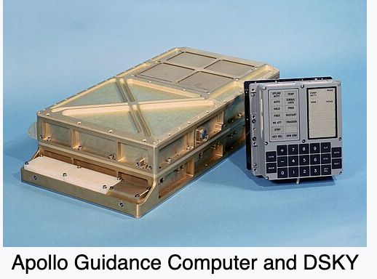
Space Efficiency
When do we care about how much space we have available?
What are some constrained environments?
Notes:
Pacemaker
Environments with limited compute
The Nasa Space shuttle used the Apollo Guidance Computer
Ran using 2,048 words of erasable memory, equivalent to about 4 kilobytes of ram
The majority of it’s software was actually made using core rope memory, where wires were physically woven through and around small magnetic cores
The pattern represented zero’s and ones
This whole process included an extra 72KB of data

Slide 28
Time Complexity
How do we access how fast a solution is?
Run the same program
Use a stopwatch to calculate the time required
What problems may arise?
Varies between implementation
Varies between hardware
Small sample sets are not indicative of performance on large sets of information
Notes:
Run the same program 1000 times, find the average time it takes to run
The program with the shorter execution time is clearly the best
This can happen due to
CPU speed
Available RAM
Storage Speed
Peripheral interactions
The list goes on

Slide 29
Measuring an Algorithm’s Time Efficiency
We know execution times very depending on external variables
So how do we access efficiency
Isolation
We take the particular operations that are fundamental to the algorithm and count the number of times this operation takes place
Let’s draw out our sequential search algorithm for our number game
Notes:
Walk through java code to create a random number, increment by 1, terminate when we guess correct
Walk through the code with students, identify characteristics of an algorithm
Input
The random number
Output
Higher, lower, correct or not correct
No ambiguity
Finite
Effectiveness
What determines how long our program runs for in this case?
Transition: let’s work on this idea of effectiveness in programs

Slide 30
That seemed to work?
Sequential search gets the job done
It works on my machine
When we consider local scale, the emphasis on algorithms feels silly
Sorting problem took a fraction of a second to produce an answer
Let’s talk about pages on the internet
Google’s search algorithm index’s well over 30 trillion pages
What would happen?
Pick a problem
The modern data sets grow so rapidly
Even as computers speed up, we still need to consider efficiency
Notes:
This is the same way our infrastructure operates
Pick a fault tolerance that is magnitudes greater than the expected load, then add more

Slide 31
Complexity Cases
Best case complexity
Tells us the complexity when we are very lucky
Represents the fewest number of steps that an algorithm can take
Question: Do we think this is useful as a measurement of complexity?
Average case complexity
Represents the average number of steps required, considering all possible inputs
What do we think about this being useful as a measurement of complexity
Worst case complexity:
Represents the highest number of steps that an algorithm would require
What do we think about worst case?
Notes:
Take a step back and talk about how our number guessing game worked, where I can guess a random value, not following sequential sort
Walk through each of these with students, don’t get to the idea of worst case being the best yet

Slide 32
The BIG picture idea
We care about the highest order term in a formula
It dominates performance as input size grows
Separate out the choice of implementation and algorithm
How hard is the algorithm, not can we shave seconds off compute
Why?
An algorithm that calls for a certain action should not be judged based on implementation details
Iterative vs recursive
Using a While or a For loop
Separate the hardware limitations that some system might have
We express efficiency based on the size of input

Slide 33
Let’s guess the number again
Let’s think of a number between 1 and N
Sequential searching
Sequential search algorithm
1…2…3…4...N
This idea of N input is exactly how we evaluate how effective particular solutions may be
Notes:
- Remember – Higher/lower based on our guess
Vastly large number could requires vastly large number of steps in the worst case
Only when we abstract inputs out can we really understand how they are likely to act under load

Slide 34
Order of Growth
We want to express the growth of a programs runtime as input grows
Not exact, but an abstract generalization
What is the relationship between increasing the size of the input and the amount of time required to execute some algorithm
We are going to put an upper bound on the growth
Don’t worry about precision
Order of, rather than exact
Thus, we want to consider:
Look for an upper bound of the growth as a function of the input in the worst case

Slide 35
Big O notation
Big O notation is a way to describe the performance or complexity of an algorithm.
It is a measure of how long an algorithm takes to complete, relative to the size of the input.
Why is Big O important?
Big O notation is important because it helps us understand how an algorithm will perform as the size of the input increases.
This is crucial in software development, as it allows us to:
Predict performance
Compare algorithms
Identify bottlenecks

Slide 36
Let’s guess the number again(again)
Let’s think of a number between 1 and N
Sequential searching
Sequential search algorithm
1…2…3…4...N
If we think of our solution
How does it’s behavior change as our N value get’s larger?
Say, N*2
Or how about N*N?
What happens to our number of steps required in the worst case?
Notes:
- Remember – Higher/lower based on our guess
- Vastly large number could requires vastly large number of steps in the worst case

Slide 37
Common Orders of Growth
0(1) – Bounded time
The amount of work is bounded by a constant and is not dependent on the size of the problem
0(log₂N) – Logarithmic time
The amount of work depends on the logarithm in base 2, of the size of the problem
These algorithms successively cut the amount of data to be processed in half at each step
0(N) – Linear time
The amount of work is some constant times the size of the problem
Algorithms that work through all the data to arrive at a conclusion
(N log₂N) - Log-Linear Complexity
The amount of work is some constant times the size of the problem
Algorithms that apply logarithmic algorithms N times
0(N²) – Quadratic time
Algorithms typically involve applying a linear algorithm N times
O(2^{N}) – Exponential time
Costly, point to point algorithms that must check multiple relationships
Notes:
Primer before diving into bunch more examples
Remind: Ideally, we would like our algorithms to be as close to the top of this order of growth as possible.
We have looked over a couple examples
Now let’s fill in the gaps

Slide 38
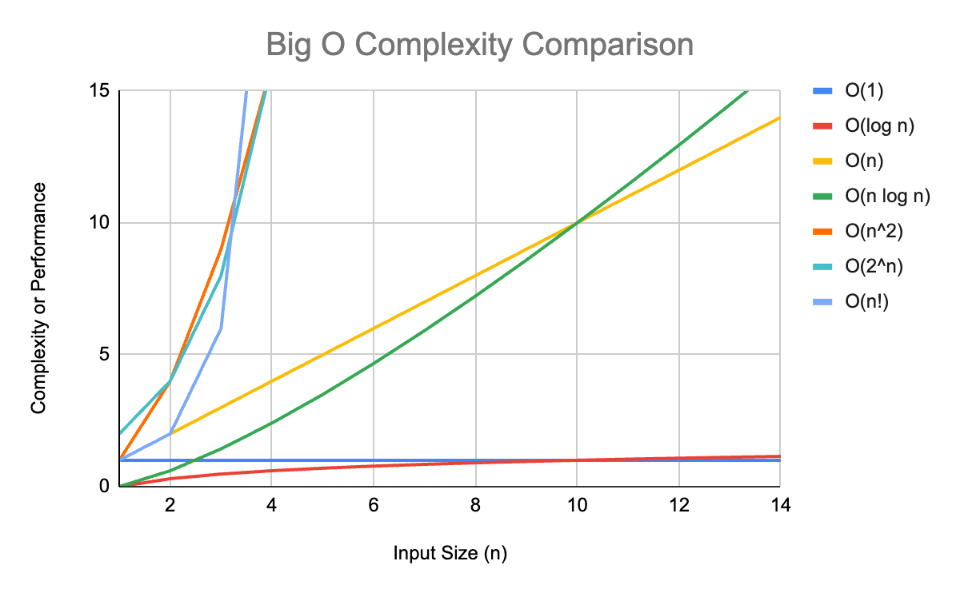

Slide 39
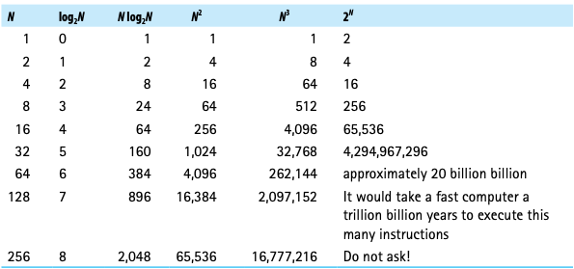

Slide 40
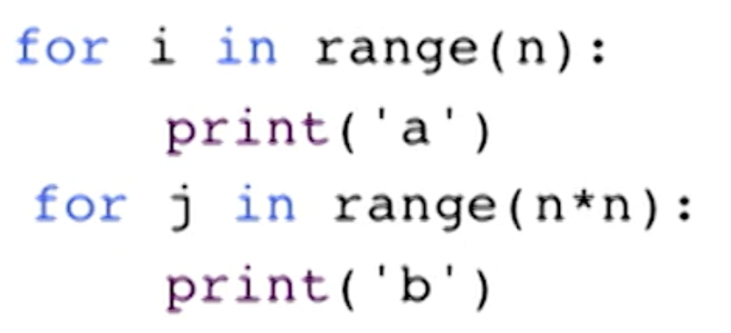
So how do we evaluate algorithms?
Evaluate each line of code separately
Focus on the dominant statements
law of Addition
For sequential statements:
We use the combination of the order of growth
What order growth was our number guessing sequential algorithm?
O(N)
The number of steps directly corelated to the value of N
What about the code snippet above?
O(N) + O(n²) = O(N²)
Notes:
Walk students through why our sequential search is O(N)
The amount of work is some constant times the size of the problem
Algorithms that work through all the data to arrive at a conclusion
Snippet:
Algorithms typically involve applying a linear algorithm N times

Slide 41
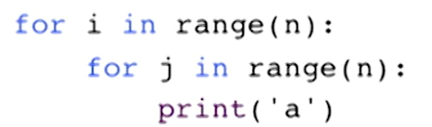
So how do we evaluate algorithms(cont)?
Law of multiplication
Applies for Nested statements
The order of growth is a combination of:
Inner part
Outer part
In the example here, what happens for each of these loops, in the worst case
O(N*N)
O(N²)

Slide 42
Common Orders of Growth - Recap
0(1) – Bounded time
The amount of work is bounded by a constant and is not dependent on the size of the problem
0(log₂N) – Logarithmic time
The amount of work depends on the logarithm in base 2, of the size of the problem
These algorithms successively cut the amount of data to be processed in half at each step
0(N) – Linear time
The amount of work is some constant times the size of the problem
Algorithms that work through all the data to arrive at a conclusion
(N log₂N) - Log-Linear Complexity
The amount of work is some constant times the size of the problem
Algorithms that apply logarithmic algorithms N times
0(N²) – Quadratic time
Algorithms typically involve applying a linear algorithm N times
O(2^{N}) – Exponential time
Costly, point to point algorithms that must check multiple relationships
Notes:
Primer before diving into bunch more examples
Remind: Ideally, we would like our algorithms to be as close to the top of this order of growth as possible.
We have looked over a couple examples
Now let’s fill in the gaps

Slide 43
Binary Search
Divide-and-conquer algorithm
The idea
Divide the problem into smaller subproblems
Conquer each subproblem
Combine (if needed) the solutions
If we think about our sorted list of numbers, what do we know?
What does a list being sorted mean in this case?
Numerical values, from base to some upper bound
If we think about number comparison
What are some of the possible outcomes we can have when we compare two numbers

Slide 44
Binary Search – Continued
Pick an index that divides our list in half
Did we find the number!
What complexity case would this be
If we did not find the number, ask if our guess is higher or lower than the number we are looking for
Depending on the answer, search left or right
Let’s see what this looks like
Notes:
Next slide

Slide 45
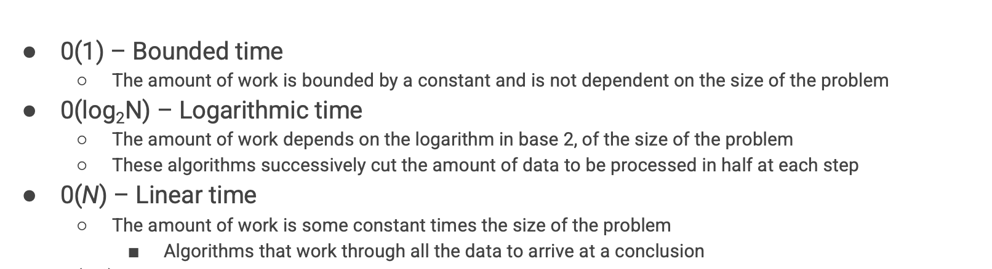
Let’s guess the number again(again)(again)
Remember: Our goal is to get higher up the BigO notation chain
Our old solution was linear – O(N)
We have two options
Bounded Time
Logarithmic Time
Binary Search – Logarithmic
Choose some middle range of numbers
Rather than sequential guessing
First guess is N/2
Second guess is ( (N/2) /2)
Notes:
We change the way we guess
N=9 0,1,2,3,4,5,6,7,8,9 10/2 = 5 - higher, split and focus on right, repeat

Slide 46
Exercise
Program it ☺
Notes:
Give students 5 minutes then walk through it on the board
We can see the solution halves the input each time, it’s no longer completely based on the input size itself, thus it’s logarithmic

Slide 47
Recap

Slide 48
Common Orders of Growth - Recap
0(1) – Bounded time
The amount of work is bounded by a constant and is not dependent on the size of the problem
0(log₂N) – Logarithmic time
The amount of work depends on the logarithm in base 2, of the size of the problem
These algorithms successively cut the amount of data to be processed in half at each step
0(N) – Linear time
The amount of work is some constant times the size of the problem
Algorithms that work through all the data to arrive at a conclusion
(N log₂N) - Log-Linear Complexity
The amount of work is some constant times the size of the problem
Algorithms that apply logarithmic algorithms N times
0(N²) – Quadratic time
Algorithms typically involve applying a linear algorithm N times
O(2^{N}) – Exponential time
Costly, point to point algorithms that must check multiple relationships
Notes:
Primer before diving into bunch more examples
Remind: Ideally, we would like our algorithms to be as close to the top of this order of growth as possible.
We have looked over a couple examples
Now let’s fill in the gaps

Slide 49
Bounded Time – O(1)
Let’s think about our guessing problem again
Complexity is independent of input
O(1) operations are those who’s runtime does not depend on the size of the input(N)
Typically arise as part of larger programs
Not whole algorithms on their own
Loops or recursive calls must be bounded independently of N
Loops
The terminating condition must not depend on N
Recursion
The base case must not depend on N
O(1) recursion cases are rare
Why is this?
Notes:
Draw out a simple for loop with a bounded range i<10
Recursion functions aim to solve problems by breaking them down into smaller subproblems, which inherently changes their time complexity.

Slide 50
Logarithmic time – 0(log₂N)
Complexity is not independent of input
O(N) operations runtime is directly related to the size of the input
Loops are often bound by the value of N
Example:
Let’s say we have some unsorted array
How do we find a number?
What if the array is sorted?
Might be able to terminate early, but worst case is still O(N)
With a sorted array, can we do better?
yes
Notes:
Write the binary sort solution

Slide 51
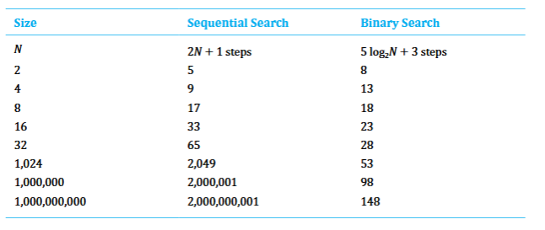
Binary Search vs Sequential Search
Binary Search
Requires more computation
More complex
Sequential Search
Simpler
requires less computation
Remember our goal:
The power of algorithms is in the scale in which we operate

Slide 52
Logarithmic time – 0(logN) – Example 2
Let’s say we have some number N
Out goal is to sum the individual digits of N
1234 = 10
1+2+3+4
How do we do it?
Notes:
Let’s look at another example, we have talked about logarithmic examples with a base of 2
Logarithmic can include any method of cutting our operational steps down by a constant factor
Even through our input is N -> 100, the program only runs 3 times
% to get the last number / to drop it

Slide 53
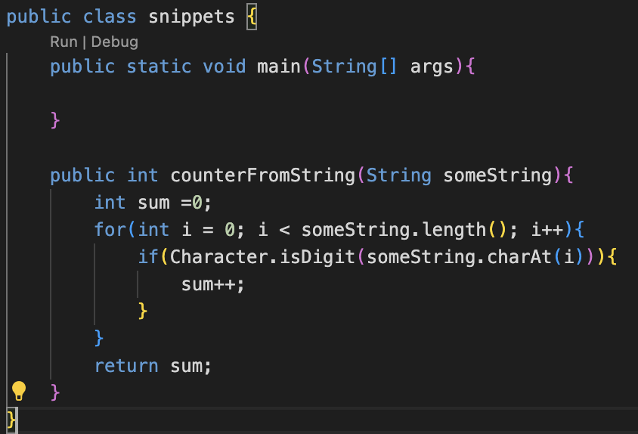
Linear Time – O(N)
The amount of work is some constant times the size of the problem
Worst case requires us to do all the work
Reducing the size of the problem by 1
Indicative of Linear complexity

Slide 54
(N log₂N) - Log-Linear Complexity
Merge sort
We will revisit this later

Slide 55
Quadratic time – O(N²)
Algorithms of this type typically involve applying a linear algorithm N times
We see this typically with nested loops
Remember our example from ealier?

Slide 56
Selection Sort
What if we didn’t have a sorted list?
Would Linear still work?
Would Binary sort still work?
Let’s say we have an array of N numbers
Our goal is to sort this into numerical order
0,1,2,3, …N
What are our options?
And no, we cannot use built in operations
Notes:
1. Find the smallest number
2. Swap it into the correct position
3. Repeat Draw out how we walk through the array and swap value
only after writing the code
What is fundamental to this algorithm?
What is the algorithm that is executed the most, what powers the algorithm
Each time we go through the loop, we must look at the remaining elements
We have a nested loop
Outer loop goes to N
Inner loop goes to N-1..N-2…N-3 n * (n-1) – distribute – N2

Slide 57
Exponential Complexity
These algorithms are extremely costly and require more time for large problems than any of the polynomial time algorithms
We typically see these when dealing with multiple relationship interactions
We often see this when there is a recursive function with more than one recursive call in the function

Slide 58
The Power Set
Let’s assume we have a set of integers
No repeats
1,2,3,…N
Our goal is to generate the collection of all possible subsets
If our set was: {1,2,3,4}
What are the possible subsets?
Order doesn’t matter
{}{1}{2}{3}{4}{1,2}{1,3}{1,4}{2,3}{2,4}{3,4}{1,2,3}{1,2,4}{1,3,4}{2,3,4}{1,2,3,4}
Notes:
How would we go about solving this?
If we wanted to, we could write a massive tangled web of nested loops that basically goes one by one and says: hey, do I add N to this or not
Using recursion, the solution is far more elegant
When we think recursively, we say: let's assume I can solve a smaller sized problem
If I want to generate the power set from 1 to N, I can assume it's also possible to generate the power set from 1 to N-1, and so on
If we have this solution, we can solve the bigger problem
All of the things that were in that solution to the smaller problem, must be part of the solution to the bigger problem, there all subsets of 1 to n, because their subsets of n-1
Add all those in, then add N to each of the subsets
We have all the ways to find the solution without N, so we just add N in and were good to go

Slide 59
PowerSet: Example
Initial set = {1,2,3,4}
{}
{1}
{2}
{1,2}
{3}
{1,3}
{2,3}
{1,2,3}
{4}
{1,4}
{2,4}
{1,2,4}{3,4}{2,3,4}{1,2,3,4}
Notes:
We want to generate the power set of integers from 1 to n
The best solution for this is recursive, we will look at how to program this at a later point, for now it’s enough to assume we can generate the power set of integers from 1 to n-1
We generate the sets excluding N
Remember order doesn’t matter

Slide 60
Big O notation
Big O notation is a way to describe the performance or complexity of an algorithm.
It is a measure of how long an algorithm takes to complete, relative to the size of the input.
Why is Big O important?
Big O notation is important because it helps us understand how an algorithm will perform as the size of the input increases.
This is crucial in software development, as it allows us to:
Predict performance
Compare algorithms
Identify bottlenecks
Notes:
So, as a summary, we have Big 0 Notation
This is the way in which we talk about comparing the efficiency of algorithms
We should be able to begin to reason about what is the cost of an algorithm by recognizing the common patterns
You should be able to start to work in the opposite direction
Given some algorithm, how do we move up our tree
How do we stay away from exponential algorithms
Not always possible

