Slide 1
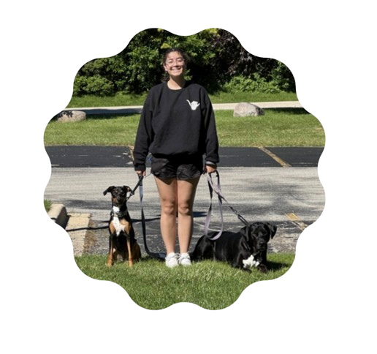
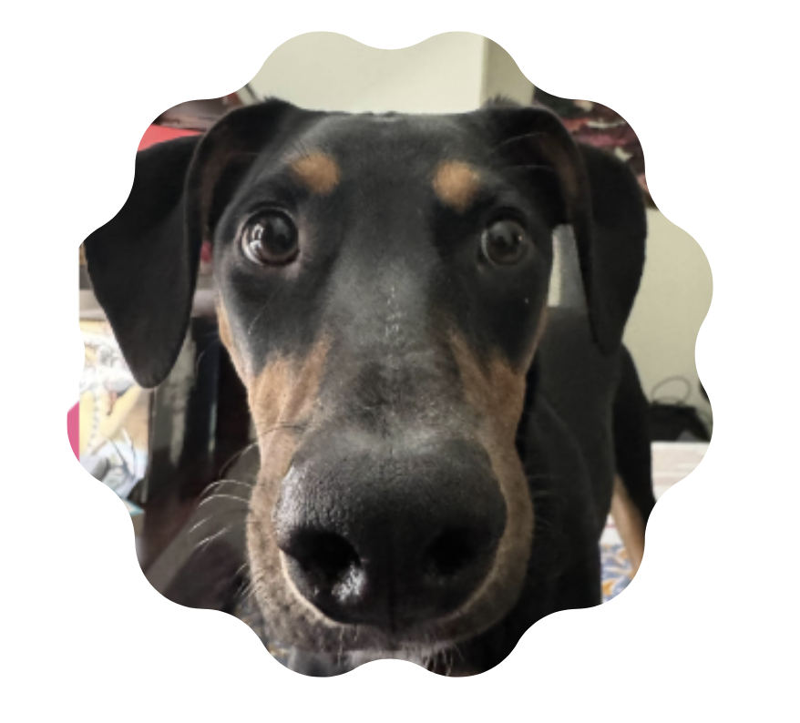

Who Am I?
Jack Forden
Marquette alumni ‘22, -> Graduate Program: ‘25
Focus Areas:
CS-Education, Student Retention, Languages, CS History, OS, Compilers
Outside of Academics
Competitive Games +++
CS2
Tarkov
Chillies aficionado
Favorite things:
FMAB
Wilder Woods(FEVER/Sky, Patience)
Toes in the water
Game Design
Tournament organizing for Broken Arrow
https://www.ba-hub.net/
Extreme couponing
Notes:
Keep this light and quick — it sets the tone, so don't linger.
Marquette alum '22, now in the '25 grad program — mention your focus on CS education and student retention.
Drop a couple of hobbies (competitive games, CS2, Tarkov, chili cooking) to come across as approachable.
If time allows, have a few students introduce themselves back.

Slide 2
Course Logistics
Where and how we meet this semester.
L
B
LECTURES
Mon · Wed · Fri
2:40 – 3:50 PM
TEXTBOOK
Object-Oriented Data Structures Using Java
4th Edition · Nell Dale
Bring questions — every lecture leaves time for them.
Notes:
MWF 2:40–3:50 — state attendance expectations and that every lecture leaves time for questions.
Textbook: Nell Dale, Object-Oriented Data Structures Using Java (4th ed.) — clarify required vs. reference.
Point them to where slides and materials get posted.
Reinforce: bring questions to every session.
Changes

Slide 3
Grading Scale
How your final grade breaks down.
Projects
45%
Midterm Exam
25%
Final Exam
25%
Participation
10%
Academic honesty is non-negotiable. Do your own work — when in doubt, ask first.
Notes:
Projects are 45% — the grade is hands-on; encourage starting early instead of cramming.
Midterm and Final are 25% each — clarify whether the final is cumulative.
Participation is 10% — showing up and engaging counts; these are easy points.
Academic honesty: say it plainly — do your own work, and when in doubt, ask first.

Slide 4
I want you to be successful
But I also need to be honest — here's what actually makes the difference.
AN INCOMPLETE LIST OF QUALITIES FOR SUCCESS
1
2
3
Learn by Doing
Willing to jump in and build.
Experiment
Willing to make mistakes.
Ask for Help
Willing to reach out.
THE #1 CHARACTERISTIC THAT WILL MAKE YOU SUCCESSFUL
Perseverance
Notes:
Frame this as honest advice, not just a pep talk.
Learn by doing / experiment / ask for help — give a quick personal example of each.
Land hard on Perseverance — the #1 trait; struggling is a normal part of learning, not a sign you can't do it.

Slide 5
How to Get Help
Four ways to reach me — use whichever is easiest.
Ask early. Ask often.
If you're confused, someone else probably is too — be the voice that says it.
H
D
@
L
Office Hours
Held often — don't let me get bored!
Discord
discord.gg/P7vC7Pdy4h
Email
Drop me a note anytime.
In Lecture
Just raise your hand.
Notes:
Talking points (say these out loud, don't put on the slide):
- Recognize there are times when you don't know the answer - and that's okay. I often don't know the answer either; you don't get a PhD by knowing everything. It's perseverance and desire to learn.
- I often forget the little things, big things, medium things. It's okay to google, ask, question.
- Office hours: I plan to hold a lot this semester - don't let me get bored!
- Nobody knows what's going on - be the voice that helps vocalize this. Ask in lecture, via Discord, email, office hours, or via...

Slide 6
Today's Agenda – Warming back into things
Five stops from a single class to full data structures — here's the path we'll take today.
1
Classes & Objects
Primitive vs reference types, fields, constructors, this keyword, null, access modifiers, methods & objects in memory
2
Inheritance & Polymorphism
Extending classes, overriding methods & one type, many forms
3
Packages
Organizing code, creating a package & importing what you need
4
Exceptions
try / catch / finally, throwing errors & the three major parts
5
Data Structures
Arrays, linked lists, stacks, queues, maps, trees & graphs
Notes:
Preview the five stops; stress that it's one continuous thread built around the Dog class.
Flag the natural break after the Dog code slide (slide 14).
Set expectations: today is a re-warm-up, not brand-new material.
Call out where they are on this roadmap as you move through the lecture.

Slide 7
Remember How To Write Code?
Warm-up discussion — think back to the code you've already written.
Let’s talk.
No wrong answers here — just think out loud with me.
?
?
QUESTION 01
QUESTION 02
What languages have you written code in — Java, Python, or anything else?
What are the main differences between those languages?
Open floor — shout them out.
Hold that thought — we’ll build on it as we dig into classes.
Notes:
Open floor — let them shout out languages; jot them on the board.
Draw out the differences (typing, syntax, use cases) to surface what they already know.
Bridge forward: "hold that thought — we'll build on it as we get into Java classes."
Keep it light, about 5 minutes; don't let it stall.

Slide 8
Java's Two Kinds of Types
Every value in Java is either a primitive or a reference — the difference shapes how it is stored and compared.
Primitive Types
Reference Types
Type | Description
boolean | true or false (1 bit)
char | single character, 16-bit Unicode
byte | integer, 8-bit (-128 to 127)
short | integer, 16-bit
int | integer, 32-bit (most common)
long | integer, 64-bit
float | decimal, 32-bit
double | decimal, 64-bit (most common)
Dog d = new Dog();
· Store a memory address, not a value directly
· Examples: String, Dog, Circle, any class you define
· Default value when uninitialized: null
· Passed by reference, not by value
Rule of thumb — if it starts with a lowercase letter (int, double), it is primitive. If it starts uppercase (String, Dog), it is a reference type.
Notes:
This distinction matters all semester — primitives store values directly, reference types store addresses. The == operator behaves differently for each, which we will revisit when we compare objects.

Slide 9
A brief re-introduction to classes
A class is a blueprint that bundles data and behavior — so we can classify and reuse.
Dog
WHY CLASSES?
Classify like objects
Group similar things under one shared type.
1
FIELDS (data)
– name : String
– breed : String
– age : int
Write behavior once
Methods operate over any object of the class.
2
Less duplication
Reuse structure instead of repeating code.
3
METHODS (behavior)
+ bark() : void
+ fetch() : void
Easier debugging
Fix and update logic in a single place.
4
A class: name · fields · methods

Slide 10
Classes – terminology
The core members that build, read, and change an object's data.
Constructor
Getter · accessor
Setter · mutator
Builds and initializes a new object when new is called.
Reads a private field's value for outside code to use.
Updates a private field's value in a controlled way.
new Dog("Rex", 4)
getName() → "Rex"
setAge(5)
· Same name as the class
· Sets up the initial state
· Read-only — never changes data
· e.g. getAge(), getBreed()
· The safe way to write a field
· e.g. setName("Bella")
Getters and setters guard private fields — the encapsulation we formalize with access modifiers next.
Notes:
Page 2 remarkable, write a basic class on the board, add a constructor for the class
Add getters and setters for the class
Page 2 and 3
Don’t go into the idea of this. In memory yet
Show how we import and call this new class in main
Import packagename.classname
Classname objectname = new classconstructor(arguments)
Terminology detail (the three cards):
Constructor — a special method that builds and initializes a new object; runs when the new keyword is used. It has the same name as the class and sets up the object's initial state, usually taking parameters (e.g. new Dog("Rex", 4) sets name and age).
Getter (observer / accessor) — retrieves the value of a private field so outside code can safely read it without modifying it. Read-only; e.g. getName(), getAge(), getBreed().
Setter (transformer / mutator) — updates or modifies the value of a private field in a controlled way; the safe path for writing a field, e.g. setAge(5), setName("Bella").
Getters and setters guard private fields — this is the encapsulation we formalize with access modifiers on the next slide.

Slide 11



The 'this' Keyword
this refers to the current object — the instance the method or constructor is running on.
Without this (ambiguous)
With this (correct)
public Dog(String name) {
name = name;
⚠ assigns param to itself
}
public Dog(String name) {
this.name = name;
✓ field = parameter
}
Disambiguates fields
Lives in constructors
Calls sibling constructors
When a parameter and a field share the same name, this.fieldName refers to the field.
Most commonly seen in constructors to initialize instance variables.
this() can call another constructor in the same class (covered later).
You saw this.name = name on the Dog class slide — now you know exactly why it is there.
Notes:
Walk students through the broken version first — ask them what they think name = name does. Let them realize the parameter shadows the field. Then show the fix with this. This is one of the most common constructor bugs beginners write.

Slide 12
Access Modifiers
Where your code can be reached — access narrows as you move down the list.
MODIFIER
Same Class
Same Package
Subclasses
Everywhere
public
✓
✓
✓
✓
protected
✓
✓
✓
package
✓
✓
private
✓
Encapsulation tip — keep fields private, expose behavior through public methods.
Notes:
The access table (from Table 1.1) is on the slide — walk the four modifiers top to bottom:
public — accessible from anywhere: any class, any package.
protected — same class, subclasses (even in other packages), and other classes in the same package; outside classes that are NOT subclasses can't reach it directly.
package (default, no keyword) — same package only.
private — only within the same class; enforces encapsulation, so outside code goes through getters and setters.
Point out the staircase — access narrows as you read down the table.

Slide 13
Objects
One class is a blueprint — each object is a live instance with its own data.
class Dog
rex : Dog
BLUEPRINT
name = "Rex"
breed = "Boxer"
age = 4
FIELDS
String name
String breed
int age
new Dog()
bella : Dog
METHODS
bark()
fetch()
name = "Bella"
breed = "Poodle"
age = 2
A class is a custom type — it extends the language's built-in types (int, String, char) with your own.
Notes:
Objects are some collection of properties that can be expressed as variables and functions
Things it knows
Things it can do
Fields in objects are instance variables and functions are called methods
Methods discussed on next slide

Slide 14
null and NullPointerException
null means a reference variable exists but points to no object.
The setup
The danger
Dog rex; // declared — no Dog created
rex = null; // explicitly nothing
Dog bella = new Dog("Bella"); // real object
Dog rex;
System.out.println(rex.getName());
// 💥 NullPointerException!
IN MEMORY
⚠ Calling a method on null crashes at runtime
rex
null (no object)
⚠ It compiles fine — the error only appears when run
bella
Dog name = "Bella"
⚠ Most common beginner bug in Java
Always ask: has this variable been assigned a real object before I call a method on it?
Notes:
NullPointerException will be the most common error message they see this semester. Spend 2–3 minutes here. Emphasize that the compiler does not catch this — it is a runtime crash. Show them what the error message looks like in an IDE so they recognize it immediately.

Slide 15
Methods
Functions that live inside a class and act on an object's data.
ANATOMY OF A METHOD CALL
dot operator
dog
.
bark()
the object — which instance
the method — behavior to run
●
Work with fields
Read and change the object's data (fields).
●
Use class logic
Run the internal behavior defined in the class.
METHODS OBEY ACCESS MODIFIERS TOO
public
private
protected
same rules as fields — control who can call them

Slide 16
Objects In Memory
Each object gets its own variables in memory — while static and final data live in one shared place.
CLASS-LEVEL MEMORY · ONE COPY
static int dogCount = 2
static & final live here
final int LEGS = 4
One copy — shared by every instance.
PER-INSTANCE MEMORY
rex : Dog
@heap 0x1A3F
bella : Dog
@heap 0x2B77
INSTANCE VARIABLES
INSTANCE VARIABLES
name = "Rex"
breed = "Labrador"
age = 4
name = "Bella"
breed = "Poodle"
age = 2
Instance variables differ per object — static and final give the whole class one shared, constant copy.
Notes:
Walk through an example of classes and objects being created,
SKIP AHEAD TO – JAUNT DOWN MEMORY LANE –
Don’t get into writing out visualizations yet

Slide 17
Putting It Together: The Dog Class
Fields, a constructor, a getter, and a method — the last few slides, in real Java.
Dog.java
JAVA
1
2
3
4
5
6
7
8
9
10
11
12
13
14
// Dog.java — fields, a constructor, and methods
public class Dog {
private String name; // instance field
static int dogCount = 0; // shared by all
final int LEGS = 4; // constant
public Dog(String name) { // constructor
this.name = name;
dogCount++;
}
public String getName() { return name; } // getter
public void bark() { // method
System.out.println(name + " says woof!");
}
}
Notes:
Walk the class top to bottom: fields, then the constructor, then the getter and the bark() method.
static int vs final int — when to reach for each:
Use static int when you want ONE value shared across every object of the class, and it can still change. dogCount is the classic case: there's a single counter for all dogs, and we bump it in the constructor each time a new Dog is made. Any instance (or the class itself) reads the same, up-to-date number.
Use final int when the value must NEVER change after it's set — a constant. LEGS = 4 is fixed; the compiler will reject any attempt to reassign it. This documents intent and protects the value.
The two are independent axes: static is about WHERE the value lives (one shared copy vs. one per object); final is about WHETHER it can change (constant vs. reassignable).
You can combine them: static final int is the usual pattern for a true shared constant (e.g. static final int MAX_AGE = 20) — one copy, never changes. Plain final (non-static), like LEGS here, gives each object its own value that's locked once the constructor sets it.
Quick gut-check to offer students: "Should every dog share this number?" → static. "Should this value ever change?" → if no, final.

Slide 18
Overloaded Constructors & Method Signatures
A class can have multiple constructors — each with a different parameter list. Java tells them apart by their signature: the method name + parameter types + parameter count.
Dog.java — two constructors
JAVA
1
2
3
4
5
6
7
8
9
10
11
12
13
14
public class Dog {
private String name;
private int age;
// Constructor 1 — name only
public Dog(String name) {
this.name = name;
this.age = 0; // default age
}
// Constructor 2 — name and age
public Dog(String name, int age) {
this.name = name;
this.age = age;
}
}
Dog a = new Dog("Rex");
// calls Constructor 1 — age defaults to 0
Dog b = new Dog("Bella", 3);
// calls Constructor 2 — age set to 3
Dog c = new Dog();
// 💥 compile error — no zero-arg constructor defined
The signature is the name + parameter types. Return type is NOT part of the signature — two methods cannot differ only by return type.
Notes:
Ask students: how does Java know which constructor to call? Walk them to the answer: it matches on the number and types of arguments. Then ask what happens with new Dog() — no match, compile error. This is the moment to introduce the term 'method signature' which they will use all semester.

Slide 19
SECTION
2
Inheritance & Polymorphism
How classes relate, extend, and become many things at once.
Inheritance
extend and specialize
Overriding
redefine inherited behavior
Polymorphism
one type, many forms
↓
↻
◆
Notes:
This should be the end for lecture 1
Section transition — take 30 seconds here. Remind students we just built the Dog class. Now ask: what if we wanted a GoldenRetriever that does everything a Dog does plus more? That question is exactly what inheritance solves.

