Slide 1


Othniel Carr

Slide 2
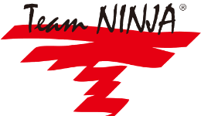
Beginning
Team Ninja was founded in 1995.
Tomonobu Itagaki.

Slide 3
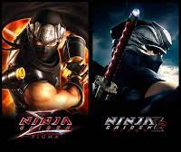
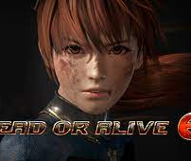
Top Games
Ninja Gaiden
Dead or Alive

Slide 4
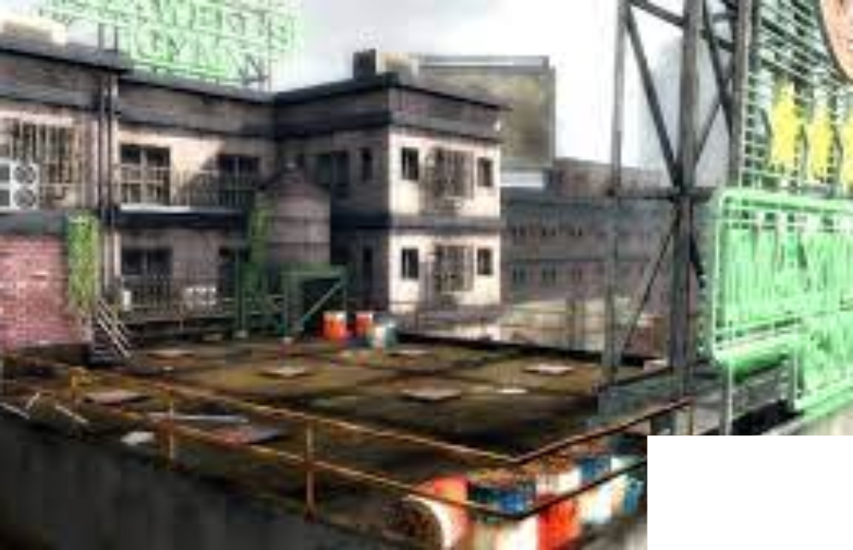
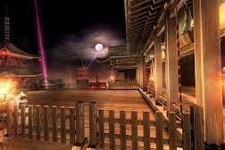
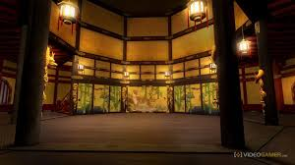

Slide 5
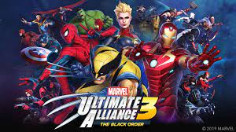
Ultimate Alliance 3
Nintendo Switch Exclusive
Made 10 years after second one was made
Very different from previous Team Ninja Games

Slide 6
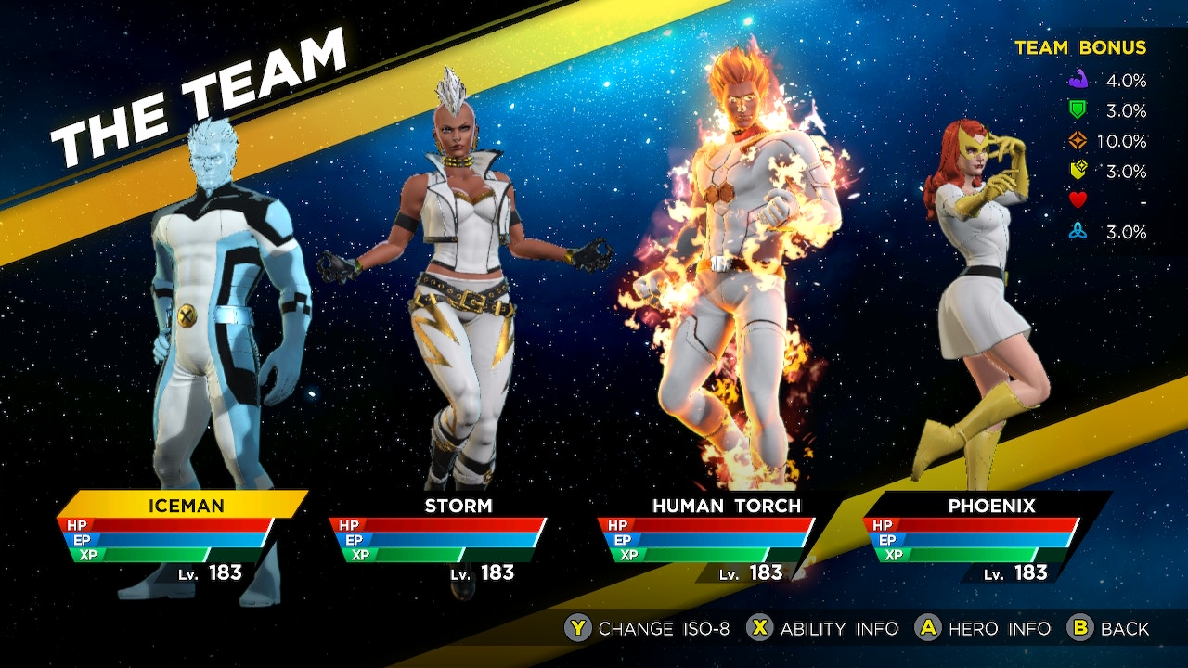

Slide 7
Sources
https://www.gamerevolution.com/features/501293-team-ninja-best-games
https://bleacherreport.com/articles/2846694-marvel-ultimate-alliance-3-review-gameplay-impressions-and-speedrunning-tips
https://www.giantbomb.com/team-ninja/3010-1764/

