Slide 1

Drivers Scheduling Problem in Utrecht

Slide 2
Introduction - The Crisis: A Systemic Failure
Driver Shortage:
Critical labor gaps identified by U-OV (2026).
Systemic Fragility:
Rigid schedules trigger a "domino effect" of cancellations.
Vicious Cycle:
Declining service reliability leads to increased passenger aggression and deteriorating working conditions.
Human Cost:
25% stress-related sick-leave rate further depleting the workforce.
Driver Shortage
Cancellation
Stress & Sick-leave
Passenger Aggression

Slide 3
Introduction
The Crisis: A Systemic Failure
Driver Shortage:
Critical labor gaps identified by U-OV (2026).
Systemic Fragility:
Rigid schedules trigger a "domino effect" of cancellations.
Human Cost:
25% stress-related sick-leave rate further depleting the workforce.
Vicious Cycle:
Declining service reliability leads to increased passenger aggression and deteriorating working conditions.

Slide 4
Common Terms
Trip: A scheduled bus run from a start to an end station.
Duty: The full sequence of trips plus breaks assigned to a driver in a day.
Shift: The start-end time window during which a driver performs their duty.

Slide 5
Related Work - The Driver Scheduling Problem
Definition
Objective
Assigning daily driver duties to cover all bus trips.
Traditionally focused on cost minimization
Complexity
Gap
Strict labor laws and temporal coupling.
Mathematical "optimums" are often too rigid for real-world shortages or delays.

Slide 6
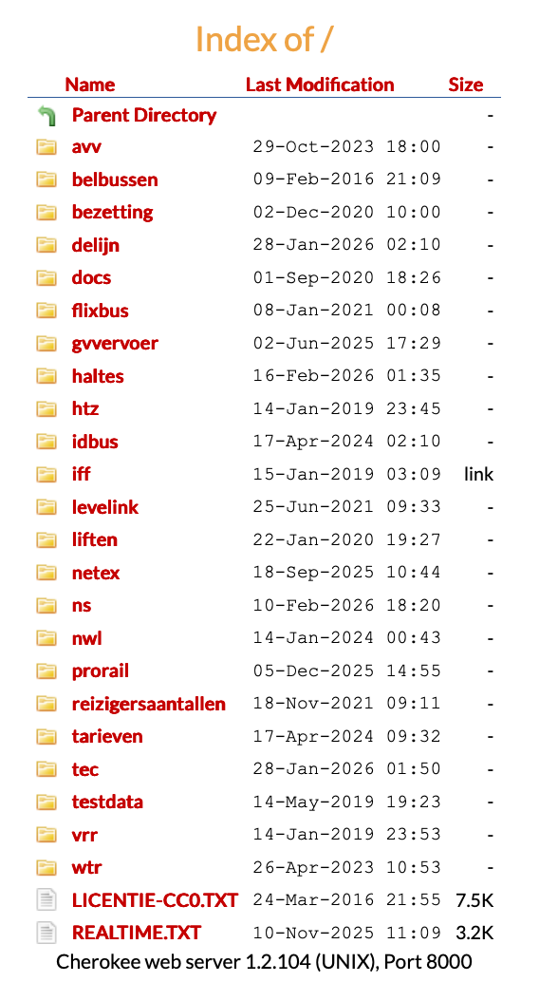
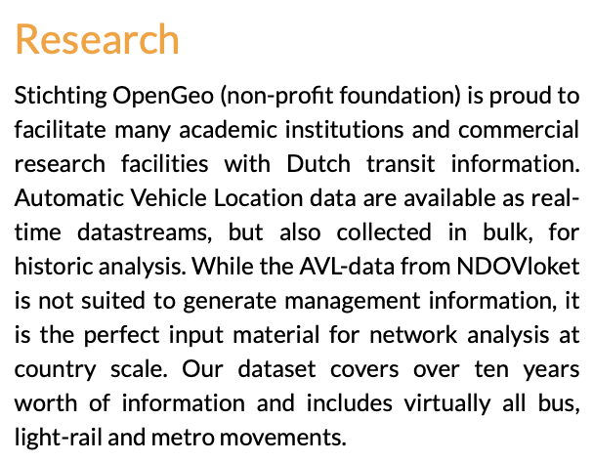
Data Description
Primary Source: https://data.ndovloket.nl/
`bezetting`： Crowding level inside the vehicle (occupancy rate).
`haltes`： All percise location of bus stopping spot.
`netex`： Newest timetable for buses in whole Netherlands.
Validation Data: Stichting OpenGeo (AVL)
Notes:
Our primary data is sourced from NDOV, which provides comprehensive transit information for the Netherlands
We utilize three key datasets from this source
First one contains historical occupancy rates, showing the crowding levels inside vehicles.
Second one gives us the precise geographic locations of every bus stop.
Third one provides the latest scheduled timetables for buses.
For model validation, we use AVL logs from Stichting OpenGeo. This dataset covering over ten years of actual vehicle movements.

Slide 7
From Problem Description to Problem Modeling
Problem: Driver shortages → some trips must be canceled.
Model decisions: 1) Which trips to run/cancel. 2) How to structure each driver’s shift.
Goal: 1) Maximize passengers served. 2) Guarantee minimum coverage per area.
Constraints: Legal and Operational.

Slide 8
Approach and Benchmarking
What will we will do?
Create realistic driver-shortage scenarios.
Generate a daily operating plan.
How will we do it?
Compare Exact vs Heuristic algorithms on the same metrics.
What will we learn?
Trade-off: solution quality vs execution speed.

Slide 9
Exact Method: Integer Linear Programming Model
ILP model selects best set of Shifts
(objective+constraints)
Timetable (Trips)
Rules
Driver Count
Generate pool of Shift Candidates
Driver Schedule
& Metrics
-Solution is a set of all the valid trips executed in a day.

Slide 10
Heuristic Method
Framework: A two-phase iterative metaheuristic (Construction + Local Search).
Adaptive Construction: Uses a Restricted Candidate List (RCL) governed by a threshold α.
Employs probabilistic sampling to explore diverse solution spaces.
Refinement: Local search phase eliminates redundant duties to maximize workforce efficiency.
Advantages | Disadvantages
High Computational Efficiency | Sub-optimal Solutions
Escaping Local Optima | Parameter Sensitivity
Notes:
[Framework] This method uses a two-phase iterative framework. It starts with a Construction phase to build a solution and follows with a Local Search to refine it.
[Adaptive Construction] During construction, we use a Restricted Candidate List controlled by a threshold alpha. By using probabilistic sampling, the algorithm can explore different solution spaces rather than just picking the single best local option.
[Refinement] In the refinement phase, the method apply a local search to eliminate any redundant duties. This ensures we maximize our workforce efficiency.
The main advantages are its high computational efficiency and its ability to escape local optima.
The disadvantages are that it may produce sub-optimal solutions compared to exact methods, and it is sensitive to the parameters we set.
High Computational Efficiency: Ideal for real-time service recovery and rapid re-scheduling.
Escaping Local Optima: Randomization allows the algorithm to "jump out" of stagnant, low-quality solutions.
Sub-optimal Solutions: As an approximation method, it does not guarantee the global optimum.
Parameter Sensitivity: Performance depends heavily on the tuning of $\alpha$ and the number of iterations.

Slide 11
Evaluation
Service Continuity and Reliability
Total cancelled trips: To measure how many scheduled services were not operated.
Cancellation rate: To indicate the proportion of trips that failed to run as planned.
Average delay per route: To capture the overall punctuality performance of each route.
Delay distribution: To show the variability and severity of delays across trips.
Service Regularity
Departure interval deviation: To measure how stable departure intervals are compared to the planned schedule.

Slide 12
Expected Contributions
Demonstrates how a bus driver scheduling system can manage driver shortages under fixed routes and timetables.
Optimizes bus driver reallocation decisions and duty assignments to maximize total passengers served.
Guarantees a minimum service level across all areas, preventing complete service cut-offs.
Supports more resilient and predictable public transport services.

Slide 13
Future Work
Incorporate additional objectives
Operating cost minimization
Driver-focused criteria (fairness, preferred shifts)
Develop a multi-objective optimization framework
Passenger demand
Coverage guarantees

Slide 14
Data Migration Project Proposal
Here is where your presentation begins

Slide 15
Contents of this template
You can delete this slide when you’re done editing the presentation
Fonts | To view this template correctly in PowerPoint, download and install the fonts we used
Used and alternative resources | An assortment of graphic resources that are suitable for use in this presentation
Thanks slide | You must keep it so that proper credits for our design are given
Colors | All the colors used in this presentation
Icons and infographic resources | These can be used in the template, and their size and color can be edited
Editable presentation theme | You can edit the master slides easily. For more info, click here
For more info: Slidesgo | Blog | FAQs
You can visit our sister projects: Freepik | Flaticon | Storyset | Wepik | Videvo

Slide 16
Table of contents
01
02
03
04
05
06
Objectives
Resources
Budget
Solutions
Communication plan
Conclusion

Slide 17

How to create a project proposal
Creating a project proposal can be done in five steps:
Define the project objectives and timeline
Identify resources needed to complete the project
Develop a budget for the project and estimate any potential risks associated with it
Write down your proposed solution and provide supporting documents or evidence that prove its feasibility if necessary
Develop a communication plan to ensure key stakeholders are kept informed of progress throughout the entire process

Slide 18
01
Objectives
of the project

Slide 19
Objectives
Our aim
The goal
An aim in a corporate context is a goal or desired result that the organization seeks to achieve. The aim should be clear and achievable, and often serves as the basis for further planning actions inside the organization
Goals inside a company are usually specific and measurable, with clearly defined deadlines and outcomes. The company’s goals help focus the actions of the organization and ensure resources are used effectively

Slide 20
Resources
Human
resources
Financial resources
Physical resources
The project team is responsible for the successful execution of the project. Our team is composed of experienced professionals with the necessary skills and expertise to complete the project on time and within budget
Our project budget is $100,000. This budget includes all expenses associated with the project, including salaries and equipment. We have allocated these resources to ensure that we are able to complete the project within budget
Our project requires a number of specialized pieces of equipment. We will be using [insert equipment and their functions]. All equipment is in good working condition and has been tested and calibrated prior to use

Slide 21
Budget
Sources of funding
Personnel costs
Funding for a company can come from personal savings or investments, bank loans and other loan options, venture capital and angel investors, grants, competitions or programs, crowdfunding…
Personnel costs refer to the expenses incurred in hiring, training and retaining staff for a company. This can include salaries, bonuses, benefits and other payroll-related costs
Equipment and materials
Travel and miscellaneous
Equipment and materials costs refer to all the expenses related to the purchasing, maintenance and upkeep of any physical items used in production or other business processes inside the company
Travel and miscellaneous costs refer to expenses related to any travel-related activities, such as conferences, trainings or business trips. It may also include office supplies, communications services, licenses and other miscellaneous expenses

Slide 22
Solutions
Solution 1
Solution 2
Solution 3
Implementing a new CRM (Customer Relationship Management) system to improve customer data management and
sales tracking
Outsourcing specific business functions (such as accounting or IT) to a third-party provider to reduce some costs and increase time efficiency
Launching an e-commerce platform to expand the reach of the business and increase online sales
Solution 4
Solution 5
Solution 6
Developing a new product or service to diversify the business and increase revenue streams
Implementing a cost-saving initiative, such as energy-efficient practices or process automation, to reduce expenses
Establishing strategic partnerships with other businesses to gain access to new markets or
innovative technologies

Slide 23
$500,000
200 units
25%
Net profit of the project
Break-even point
Market share in the industry

Slide 24
10 million
First-year revenue of the project

Slide 25
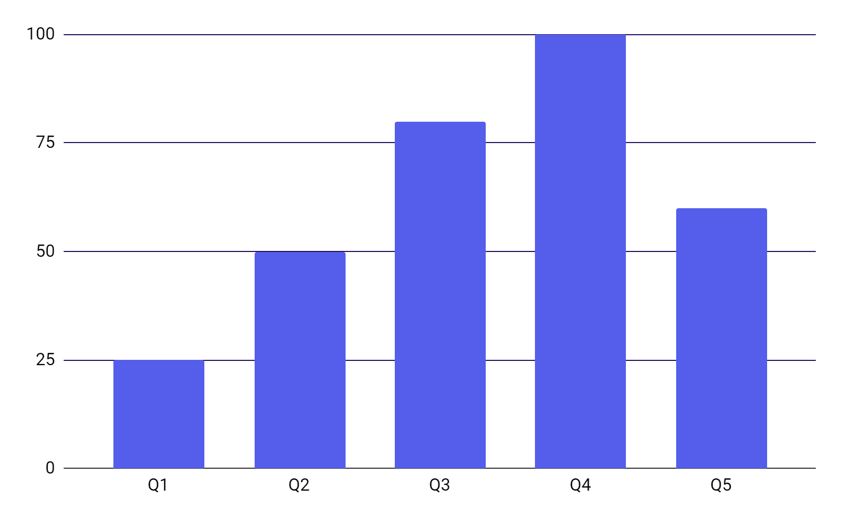
Project data
Benefits of using graphs
Graphs in project proposals offer visual organization, enabling clear presentation of information in a structured format. They enhance the visual appeal, facilitate data comparison and improve overall clarity and professionalism of your project proposal
Follow the link in the graph to modify its data and then paste the new one here. For more info, click here

Slide 26
Project activities
Activity | Start date | End date | Resource | Cost | Revenue
Market research | 1/1/20XX | 1/15/20XX | Market research firm | $20,000
Product development | 1/16/20XX | 6/30/20XX | R&D team | $200,000
Beta testing | 7/1/20XX | 8/15/20XX | Beta testers | $10,000
Marketing campaign | 1/1/20XX | 1/15/20XX | Advertising agency | $100,000
Product launch | 1/16/20XX | 6/30/20XX | Sales team | $50,000 | $500,000
Post-launch support | 7/1/20XX | 8/15/20XX | Support team | $50,000 | $800,000

Slide 27

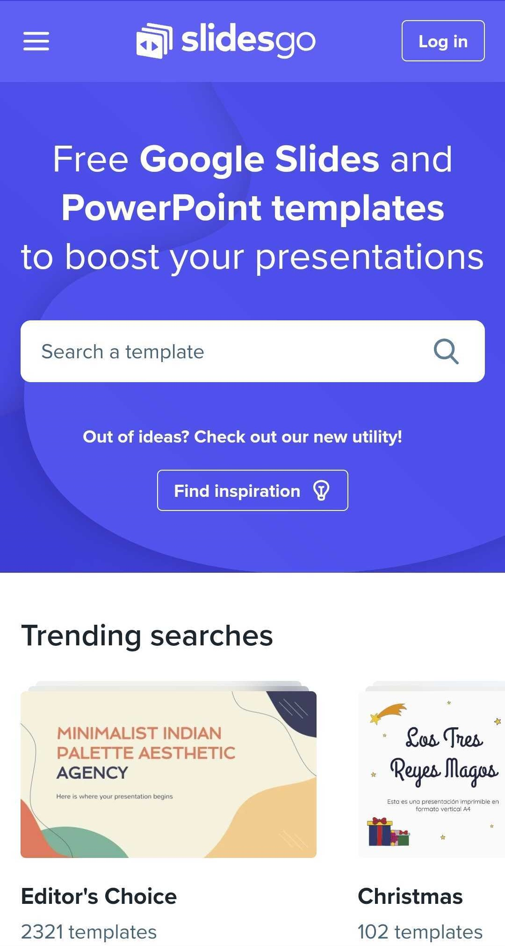
What to show in a mockup
Product/website description: A brief overview of the product/website, including its key features, dimensions, and materials used
Features and benefits: A detailed explanation of the product's/website's features and how they will benefit the user
Technical specifications: A list of the product's/website's technical specifications, such as dimensions, weight, power requirements, connectivity options and hosting platform

Slide 28
Project timeline
Conduct market research and analyze the target audience to identify opportunities
Create the product or service by defining features, design, and functionality
Test the product with a group of users to receive feedback and improve the product
Execute a marketing campaign to promote the product to the target audience
Release the product or service to the market with a comprehensive launch plan
Provide customer support to ensure customer satisfaction
Explore opportunities for growth and expansion of the product or service
Continuously improve the product based on customer feedback and market trends

Slide 29
Project roadmap
Initiative | Objective | Jan | Feb | Mar | Apr | May | Jun | Jul | Aug | Sep | Oct | Nov | Dec
Market research | Increase brand awareness by 30% within the first year
Product development | Achieve a customer satisfaction rate of 90%
Marketing campaign | Increase revenue by 20% within the first year
Product launch | Achieve a customer satisfaction rate of 90% within the first year
Expansion | Reduce costs by 15% within the first year by expanding the product
Partnership | Reach profitability within 18 months of launch

Slide 30




Photo showcase
A photo showcase can be a useful addition to a business project proposal as it can help to visually communicate the concept or idea being proposed

Slide 31
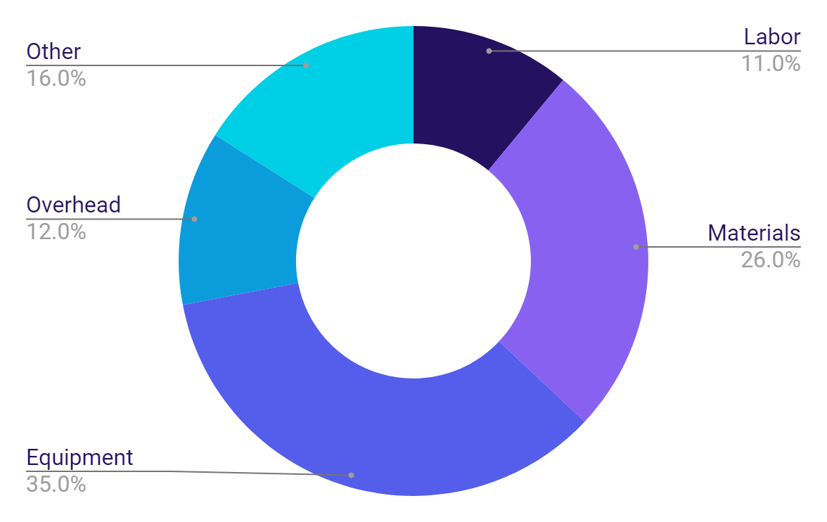
Project expenses
Labor
Materials
Equipment
Overhead
Other
Follow the link in the graph to modify its data and then paste the new one here. For more info, click here

Slide 32
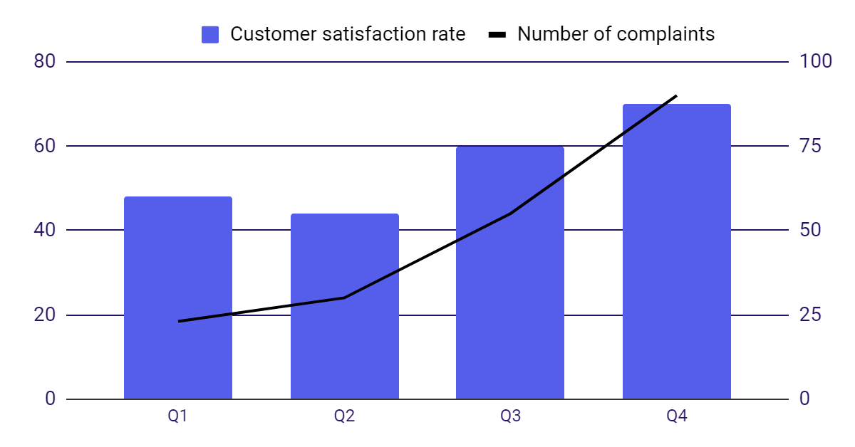
KPI dashboard
Resource | Utilization rate | Cost per unit
Labor | 85% | $50
Equipment | 70% | $100
Materials | 95% | $20
Rent | 90% | $1,000
Energy | 80% | $80
Software licenses | 80% | $200
Advertising | 60% | $500
120 u/day
2h
Output per worker
Time to complete a task
Follow the link in the graph to modify its data and then paste the new one here. For more info, click here

Slide 33
Thanks!
Do you have any questions?
youremail@freepik.com
+34 654 321 432
yourwebsite.com
Please keep this slide for attribution

Slide 34



Alternative resources
Here’s an assortment of alternative resources whose style fits that of this template:
Vectors
Abstract landing page
Abstract lineal shapes landing page template

Slide 35
Resources
Did you like the resources in this template? Get them at our other websites:
Vectors
Abstract landing page
Photos
Modern and equipped computer lab
Modern and equipped computer lab (I)
Young network engineers with a laptop medium shot
Black man working with a computer
People working as a team company

Slide 36
Instructions for use
If you have a free account, in order to use this template, you must credit Slidesgo by keeping the Thanks slide. Please refer to the next slide to read the instructions for premium users.
As a Free user, you are allowed to:
Modify this template.
Use it for both personal and commercial projects.
You are not allowed to:
Sublicense, sell or rent any of Slidesgo Content (or a modified version of Slidesgo Content).
Distribute Slidesgo Content unless it has been expressly authorized by Slidesgo.
Include Slidesgo Content in an online or offline database or file.
Offer Slidesgo templates (or modified versions of Slidesgo templates) for download.
Acquire the copyright of Slidesgo Content.
For more information about editing slides, please read our FAQs or visit our blog:
https://slidesgo.com/faqs and https://slidesgo.com/slidesgo-school

Slide 37
Instructions for use (premium users)
As a Premium user, you can use this template without attributing Slidesgo or keeping the Thanks slide.
You are allowed to:
Modify this template.
Use it for both personal and commercial purposes.
Hide or delete the “Thanks” slide and the mention to Slidesgo in the credits.
Share this template in an editable format with people who are not part of your team.
You are not allowed to:
Sublicense, sell or rent this Slidesgo Template (or a modified version of this Slidesgo Template).
Distribute this Slidesgo Template (or a modified version of this Slidesgo Template) or include it in a database or in any other product or service that offers downloadable images, icons or presentations that may be subject to distribution or resale.
Use any of the elements that are part of this Slidesgo Template in an isolated and separated way from this Template.
Register any of the elements that are part of this template as a trademark or logo, or register it as a work in an intellectual property registry or similar.
For more information about editing slides, please read our FAQs or visit our blog:
https://slidesgo.com/faqs and https://slidesgo.com/slidesgo-school

Slide 38
Fonts & colors used
This presentation has been made using the following fonts:
Space Grotesk
(https://fonts.google.com/specimen/Space+Grotesk)
Cairo
(https://fonts.google.com/specimen/Cairo)
#241160
#ffffff
#e2e4fc
#8861f1
#545eea
#0b9cdc
#01cfe6

Slide 39





Storyset
Create your Story with our illustrated concepts. Choose the style you like the most, edit its colors, pick the background and layers you want to show and bring them to life with the animator panel! It will boost your presentation. Check out how it works.
Pana
Amico
Bro
Rafiki
Cuate

Slide 40
Use our editable graphic resources...
You can easily resize these resources without losing quality. To change the color, just ungroup the resource and click on the object you want to change. Then, click on the paint bucket and select the color you want. Group the resource again when you’re done. You can also look for more infographics on Slidesgo.

Slide 43
JANUARY
FEBRUARY
MARCH
APRIL
MAY
JUNE
PHASE 1
Task 1
Task 2
PHASE 2
Task 1
Task 2
JANUARY
FEBRUARY
MARCH
APRIL
PHASE 1
Task 1
Task 2

Slide 46
...and our sets of editable icons
You can resize these icons without losing quality.
You can change the stroke and fill color; just select the icon and click on the paint bucket/pen.
In Google Slides, you can also use Flaticon’s extension, allowing you to customize and add even more icons.

Slide 47
Educational Icons
Medical Icons

Slide 48
Business Icons
Teamwork Icons

Slide 49
Help & Support Icons
Avatar Icons

Slide 50
Creative Process Icons
Performing Arts Icons

Slide 51
Nature Icons

Slide 52
SEO & Marketing Icons

Slide 53


