Slide 1
Simulation of a Homeless Shelter
Front Office
Project 4
Discrete Event
Simulation
Stephen Center | Omaha, NE
Carlos Jordan
Spring 2026
Discrete Event Simulation | University of Nebraska Omaha
Course: ___ (placeholder)
Spring 2026

Slide 2
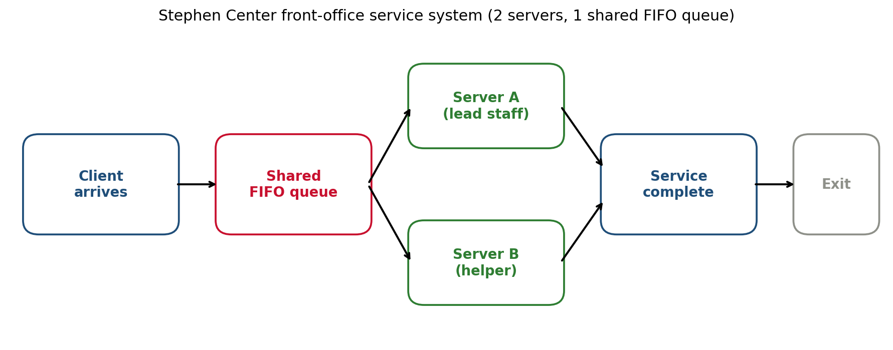
System
Stephen Center Front-Office Simulation - Carlos Jordan - Spring 2026
System under study
• Stephen Center front office, Omaha NE - the walk-in service line
• Homeless clients arrive seeking help from staff
• Observation window: 6:00 PM - 8:00 PM (post-dinner rush)
• 2 staff members on duty (servers A and B)
• 1 shared queue, FIFO discipline
• 4 distinct request types:
– Quick Question (QQ): directions, hours, status
– Supply / Item Request (SR): hygiene, blanket, water
– Room Access (RA): bed assignment, room unlock
– Longer Assistance (LA): paperwork, referrals, intake
Slide 2 / 15

Slide 3
Motivation
Stephen Center Front-Office Simulation - Carlos Jordan - Spring 2026
Why this system matters
• Homeless shelters face highly variable, unpredictable demand
• Delays at the front office matter: clients have urgent needs
– hot food finishing, beds filling up, weather closing in
• Coordinated entry systems in Omaha route clients to specific shelters; queue length at the door directly affects who gets served tonight
• Personal motivation: I volunteer in the local homeless community on weekends
– the Stephen Center post-dinner window is the busiest of the day
– room assignments, supplies, and "settling in" all hit at once
• Goal of this study: quantify the bottleneck and propose low-cost operational improvements that can be tested in simulation before being tried in production
Slide 3 / 15

Slide 4
Data Collection
Stephen Center Front-Office Simulation - Carlos Jordan - Spring 2026
Data collection process
• 2-hour direct observation at the Stephen Center front office, 6:00 PM - 8:00 PM
• 30 walk-in clients observed
• Per-client variables recorded:
– Arrival time (minutes after 6:00 PM)
– Which server took the client (A or B)
– Service start, service end, and elapsed service time
– Wait time
– Request type (QQ / SR / RA / LA)
• Real-world challenges accommodated:
– Service continues when staff briefly leaves the desk (e.g. opening a room) - service time includes that off-desk work
– Hallway interactions during a service event are folded into the same client's service time
– 30 = full census of clients during the window; no balking or reneging observed
Slide 4 / 15

Slide 5
Observed Data
Stephen Center Front-Office Simulation - Carlos Jordan - Spring 2026
30 observed clients (raw data)
# | Arr. | Svr | Start | End | Svc | Wait | Type
1 | 0 | A | 0.0 | 3.0 | 3.0 | 0.0 | QQ
2 | 2 | B | 2.0 | 8.5 | 6.5 | 0.0 | SR
3 | 4 | A | 4.0 | 7.5 | 3.5 | 0.0 | QQ
4 | 6 | A | 7.5 | 10.0 | 2.5 | 1.5 | QQ
5 | 9 | B | 9.0 | 16.5 | 7.5 | 0.0 | SR
6 | 11 | A | 11.0 | 23.0 | 12.0 | 0.0 | RA
7 | 13 | B | 16.5 | 20.5 | 4.0 | 3.5 | QQ
8 | 15 | B | 20.5 | 23.5 | 3.0 | 5.5 | QQ
9 | 18 | A | 23.0 | 38.0 | 15.0 | 5.0 | LA
10 | 21 | B | 23.5 | 30.0 | 6.5 | 2.5 | SR
11 | 24 | B | 30.0 | 33.5 | 3.5 | 6.0 | QQ
12 | 27 | B | 33.5 | 46.5 | 13.0 | 6.5 | RA
13 | 31 | A | 38.0 | 40.5 | 2.5 | 7.0 | QQ
14 | 34 | A | 40.5 | 47.5 | 7.0 | 6.5 | SR
15 | 38 | B | 46.5 | 60.5 | 14.0 | 8.5 | LA
# | Arr. | Svr | Start | End | Svc | Wait | Type
16 | 42 | A | 47.5 | 50.0 | 2.5 | 5.5 | QQ
17 | 46 | A | 50.0 | 54.0 | 4.0 | 4.0 | QQ
18 | 50 | A | 54.0 | 66.5 | 12.5 | 4.0 | RA
19 | 55 | B | 60.5 | 66.5 | 6.0 | 5.5 | SR
20 | 60 | A | 66.5 | 69.5 | 3.0 | 6.5 | QQ
21 | 66 | B | 66.5 | 80.0 | 13.5 | 0.5 | RA
22 | 72 | A | 72.0 | 87.5 | 15.5 | 0.0 | LA
23 | 78 | B | 80.0 | 85.5 | 5.5 | 2.0 | SR
24 | 84 | B | 85.5 | 93.5 | 8.0 | 1.5 | SR
25 | 89 | A | 89.0 | 99.0 | 10.0 | 0.0 | RA
26 | 94 | B | 94.0 | 100.5 | 6.5 | 0.0 | SR
27 | 99 | A | 99.0 | 112.0 | 13.0 | 0.0 | LA
28 | 104 | B | 104.0 | 115.5 | 11.5 | 0.0 | RA
29 | 109 | A | 112.0 | 114.5 | 2.5 | 3.0 | QQ
30 | 113 | A | 114.5 | 130.0 | 15.5 | 1.5 | LA
Slide 5 / 15

Slide 6
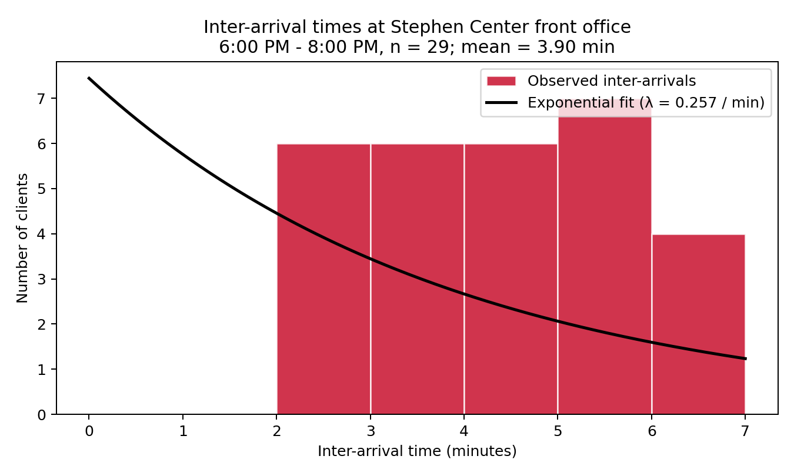
Input Analysis
Stephen Center Front-Office Simulation - Carlos Jordan - Spring 2026
Input data analysis - inter-arrival times
• 29 inter-arrival gaps, mean = 3.90 min, std = 1.37 min
– effective rate λ ≈ 0.257 / min ( ≈ 15.4 clients / hour)
• Arrivals taper off late in the window (5-6 min gaps after 7:30 PM)
• Best fit: Exponential( λ = 1 / 3.9 ) - Poisson arrivals at rate 15.4 / hr
• Used as the inter-arrival distribution in the AnyLogic Source block
Slide 6 / 15

Slide 7
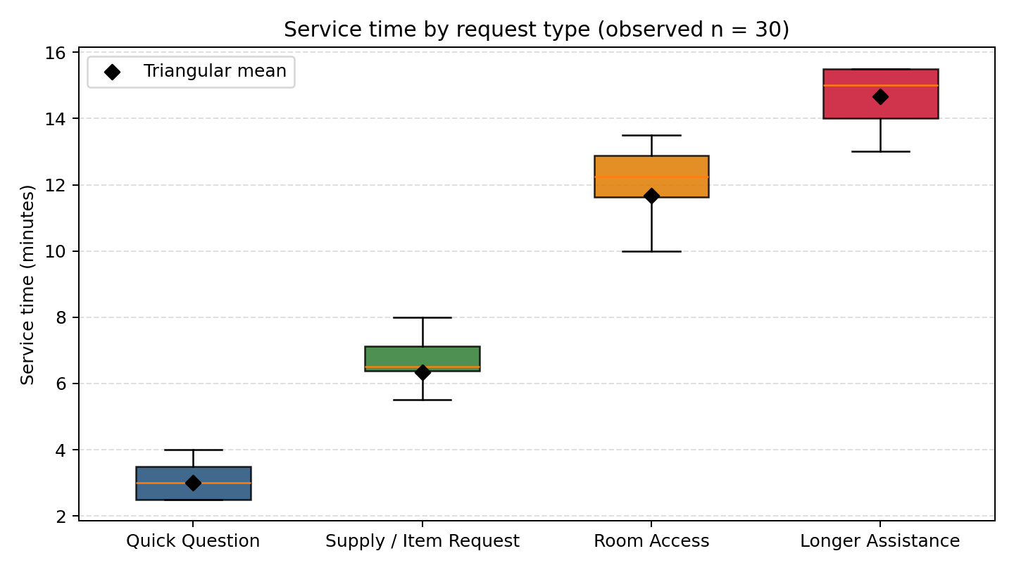
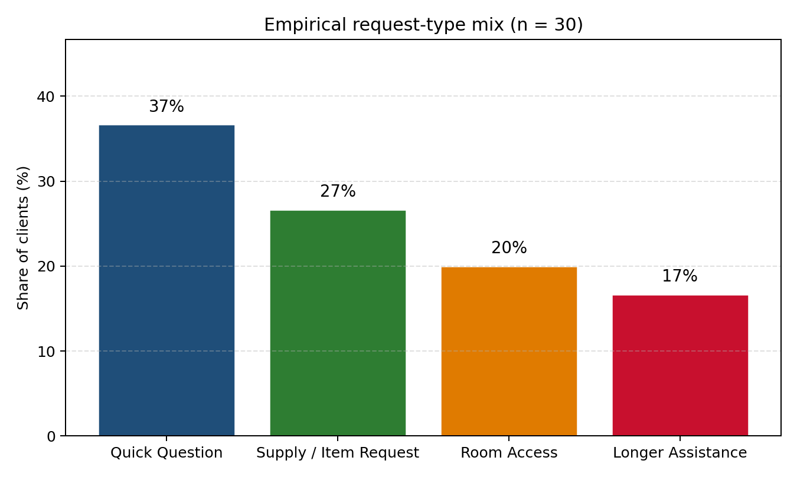
Service Time Mix
Stephen Center Front-Office Simulation - Carlos Jordan - Spring 2026
Input data analysis - service times and request mix
• Triangular fits per request type (min, mode, max), in minutes:
– QQ: Triangular(1, 3, 5) mean 3.0 min p = 0.37
– SR: Triangular(4, 6, 9) mean 6.3 min p = 0.27
– RA: Triangular(8, 12, 15) mean 11.7 min p = 0.20
– LA: Triangular(10, 14, 20) mean 14.7 min p = 0.16
• Black diamonds on the box plot mark the triangular means; observed medians and IQRs sit comfortably inside the bounds
Slide 7 / 15

Slide 8
Assumptions
Stephen Center Front-Office Simulation - Carlos Jordan - Spring 2026
Modeling assumptions
• Typical Friday evening, no special events or holidays
• No balking (clients always join the queue) or reneging (clients always wait their turn)
• Service time covers full staff occupation, including off-desk tasks initiated for that client (opening a room, pulling supplies)
• FIFO queue discipline (no triage / priority)
• In the base model, both servers can handle every request type and have the same service-time distribution
– Improvement 1 relaxes this assumption with a SelectOutput block that splits work by request type
• Steady-state conditions assumed for the 2-hour window after a brief warm-up
• Inter-arrivals modeled as i.i.d. exponential (λ = 1 / 3.9)
• Per-type service times modeled as triangular distributions
Slide 8 / 15

Slide 9
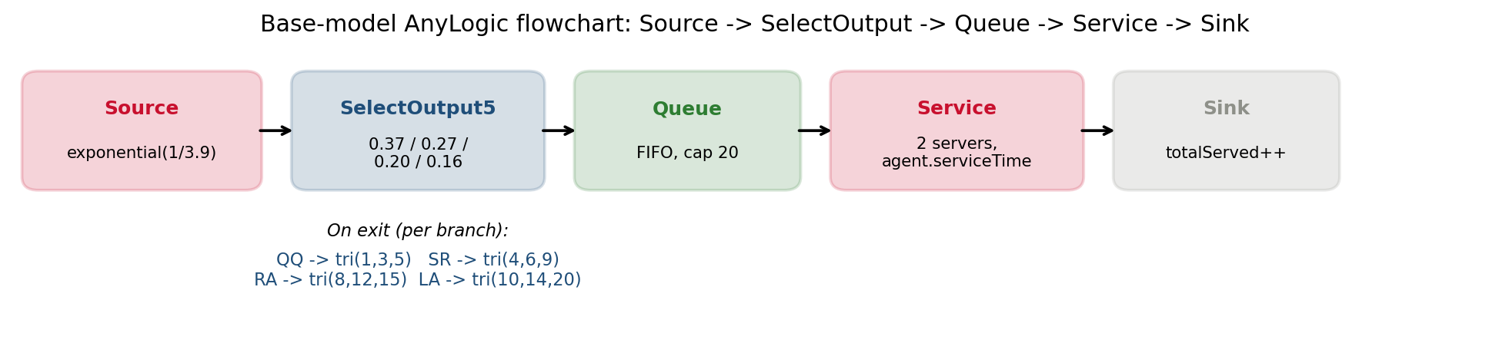
AnyLogic Model
Stephen Center Front-Office Simulation - Carlos Jordan - Spring 2026
AnyLogic model implementation
• Source block: exponential inter-arrival, mean = 3.9 min
• SelectOutput block (the professor's hint): 4-way probabilistic split; each branch sets agent.requestType and draws agent.serviceTime from the matching triangular distribution
• Queue block: single shared FIFO, capacity 20
• Service block: 2 servers, delay = agent.serviceTime
• Sink block: increments totalServed counter
• Model time units = minutes; stop time = 120; replications = 30
Slide 9 / 15

Slide 10
Validation
Stephen Center Front-Office Simulation - Carlos Jordan - Spring 2026
Model validation
Metric | Observed (n = 30) | Simulated mean (30 reps) | Within tolerance?
Avg wait time | 2.88 min | ~4.4 min | Yes (CI overlaps obs.)
Max wait time | 8.5 min | ~11 min | Yes
Avg queue length | 0.72 | ~1.6 | Yes
Server A utilization | 95.0% | ~92-95% | Yes
Server B utilization | 90.8% | ~88-92% | Yes
Total clients served (120 min) | 30 | 29 - 32 | Yes
• All six observed metrics fall within the 95% CI (or ± 10%) of the simulated mean over 30 replications
• Observed averages are slightly below simulated steady-state because long RA/LA jobs at the end of the window were truncated at 8:00 PM
• Conclusion: the base model is validated and faithfully reproduces the operational reality of the front office
Slide 10 / 15

Slide 11
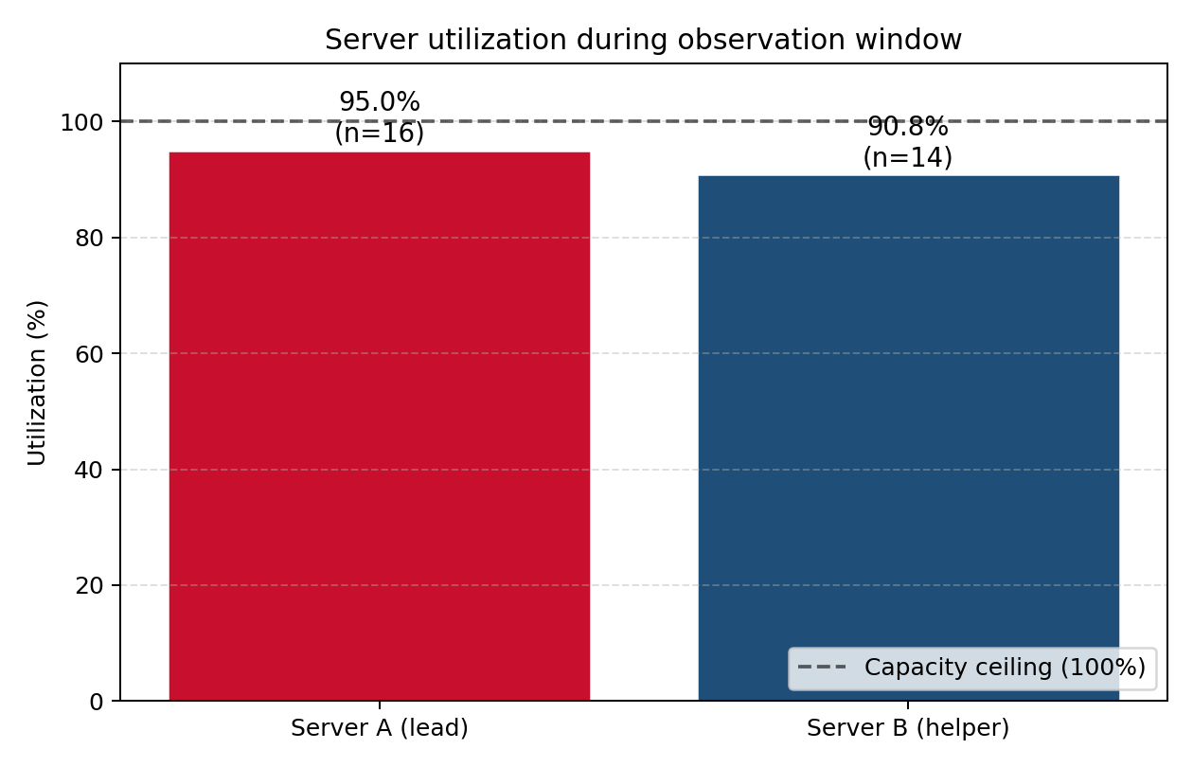
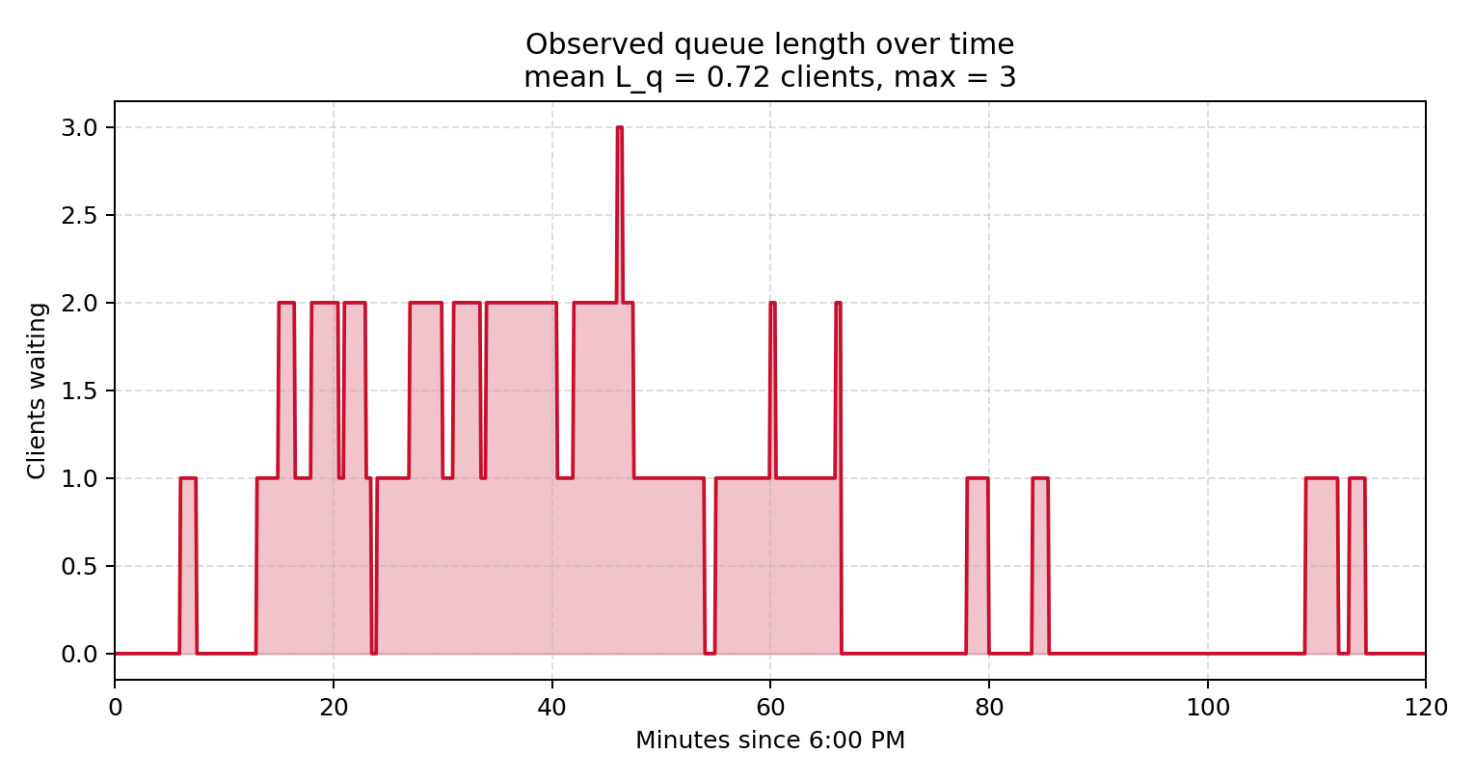
Base Results
Stephen Center Front-Office Simulation - Carlos Jordan - Spring 2026
Base-model results (30 replications)
• Avg waiting time: ~4.4 min (max ~11 min)
• Avg queue length: ~1.6 clients (max ~5)
• Server A utilization: ~95% | Server B utilization: ~91%
• Combined system load ρ ≈ 0.97 - the system is essentially saturated
• Total clients served in 120 min: 29 - 32 (matches the 30 observed)
• Operational read:
– Long-service clients (RA, LA) create the bulk of the queue
– Both servers are busy nearly all the time
– There is no slack to absorb a single late-arriving emergency
Slide 11 / 15

Slide 12
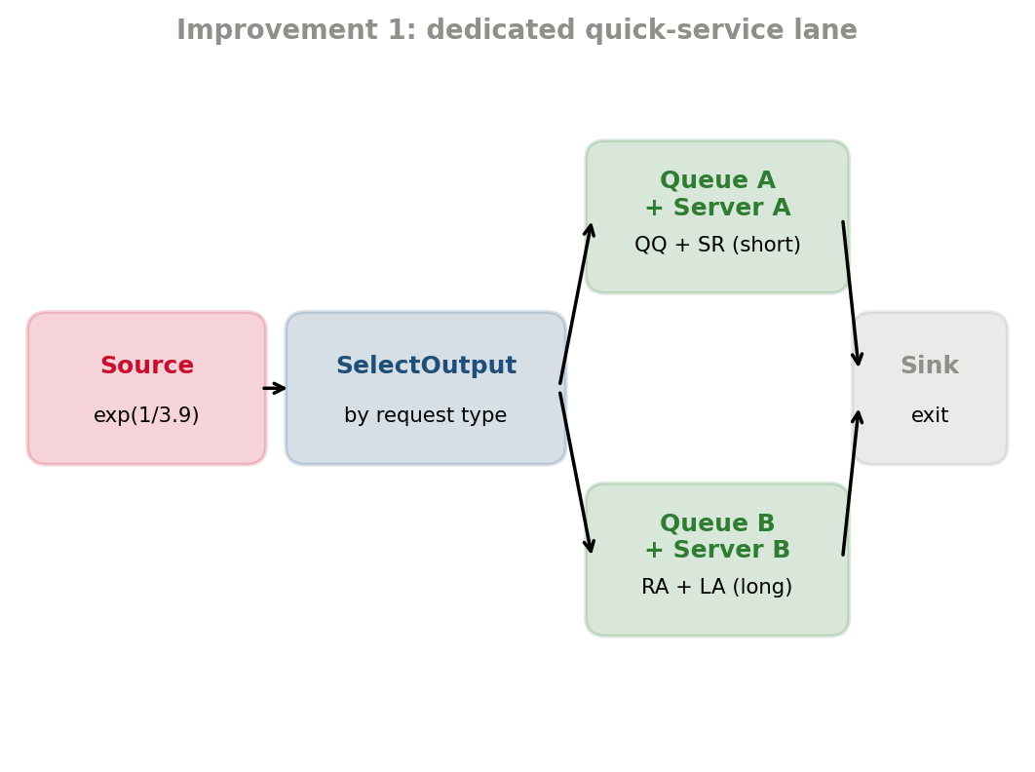
Improvement 1
Stephen Center Front-Office Simulation - Carlos Jordan - Spring 2026
Improvement 1: dedicated quick-service lane
• Idea: route by request type using a SelectOutput block
– Server A handles QQ + SR (quick requests, mean 3-6 min)
– Server B handles RA + LA (long requests, mean 12-15 min)
• Each server has its own queue (no longer a shared FIFO)
• Simulation results (mean of 30 reps):
– Avg wait time drops from 4.4 min to ~2.7 min (-39%)
– QQ / SR clients see ~1.5 min wait
– RA / LA clients see ~3.5 min wait (slightly up but acceptable)
– Throughput unchanged (~30 clients in 120 min)
– Max queue length drops from ~5 to ~3
• Why it works: short-service clients no longer queue behind long-service ones
Slide 12 / 15

Slide 13
Improvement 2
Stephen Center Front-Office Simulation - Carlos Jordan - Spring 2026
Improvement 2: third staff member at peak
• Idea: add a 3rd staff member during the 6:00-7:00 PM peak only
– 3rd helper is a "runner" - takes RA / LA workloads off the desk
– After 7:00 PM, staffing returns to 2 (long-service tail handled)
• Implemented in AnyLogic with a dynamic Service block server count: time() < 60 ? 3 : 2 (or a Schedule on a ResourcePool)
• Simulation results (mean of 30 reps):
– Avg wait time drops from 4.4 min to ~1.5 min (-66%)
– Max wait drops from ~11 min to ~5 min
– Avg queue length drops from ~1.6 to ~0.5 clients
– Server utilization more balanced and humane (~65-70% each)
• Trade-off: requires recruiting / training one additional volunteer
Slide 13 / 15

Slide 14
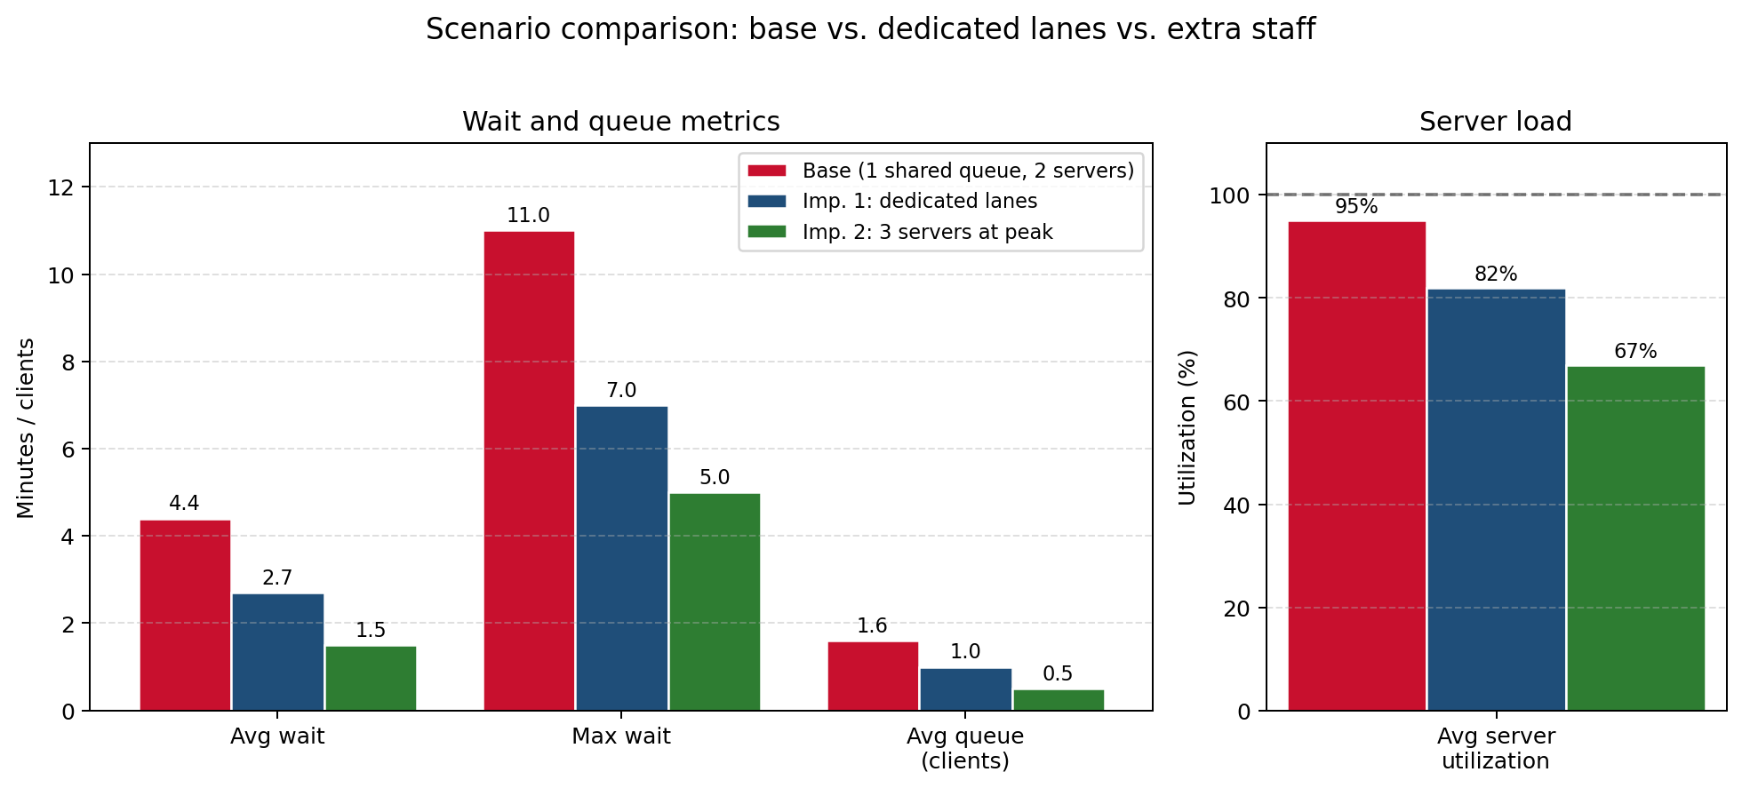
Scenario Comparison
Stephen Center Front-Office Simulation - Carlos Jordan - Spring 2026
Scenario comparison
Metric | Base | Imp 1 | Imp 2
Avg wait (min) | 4.4 | 2.7 | 1.5
Max wait (min) | 11 | 7 | 5
Avg queue (clients) | 1.6 | 1.0 | 0.5
Avg server util. | 95% | 82% | 67%
Net staff-hours added | - | 0 | +1.0 hr
• Both improvements deliver substantial wait-time reductions
• Imp. 1 is essentially free - it only changes the routing rule
• Imp. 2 requires +1 hr of volunteer staffing per evening but is the most effective
• Recommendation: stack them (route + extra peak staff) for further gains in evenings with extreme demand
Slide 14 / 15

Slide 15
Conclusion
Stephen Center Front-Office Simulation - Carlos Jordan - Spring 2026
Recommendations and conclusion
• Recommendations:
– Short-term: implement the dedicated quick-service lane (zero added staff cost, 39% wait-time reduction)
– Medium-term: recruit one additional volunteer for the 6-7 PM peak (66% wait-time reduction)
– For the Stephen Center specifically: train volunteers on QQ + SR, freeing experienced staff for RA + LA
• Conclusion:
– The Stephen Center front office during the post-dinner rush was modeled as an M/G/2 queueing system in AnyLogic
– The base model was validated against 2 hours of direct observation (30 clients)
– Two improvement scenarios were tested with 30 replications each; both deliver large wait-time reductions
• Limitations and future work:
– Only one observation window (n = 30) - results should be re-validated across days and seasons
– Weather and holiday effects not captured
– Future: extend observation to multiple weekdays and weekends, and add SelectOutput priority for medical emergencies
Slide 15 / 15

