Slide 1
A study of Ant Colony Optimization on TSP
Yuchen Wang & Ruofan Li

Slide 2
TSP (Travelling salesman problem)
Given a list of cities and the distances between each pair of cities, what is the shortest possible route that visits each city exactly once and returns to the origin city?" It is an NP-hard problem in combinatorial optimization, important in theoretical computer science and operations research.
The travelling purchaser problem and the vehicle routing problem are both generalizations of TSP.

Slide 3
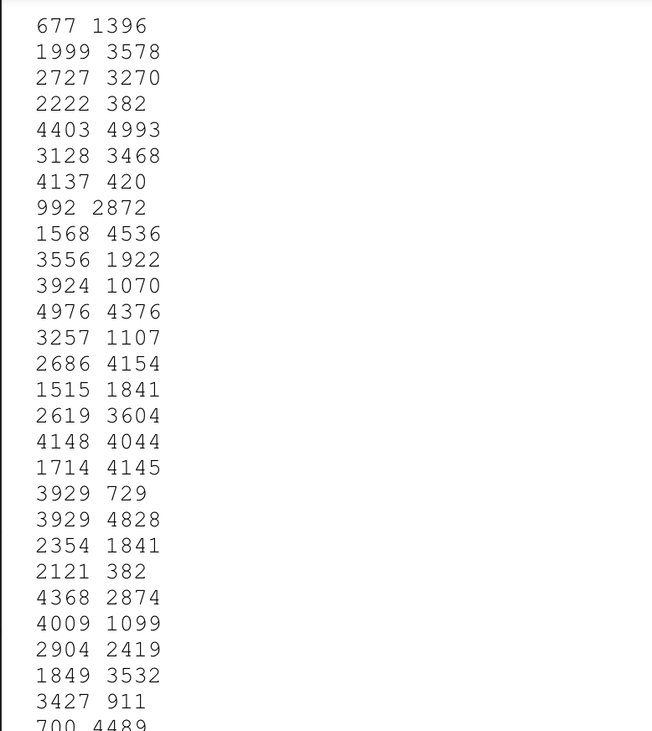
Data Description
The data we use is the Coordinates of cities. The first column represents the x-value of the city coordinates and the second column represents the y-value.
We randomly generate 100 cities.

Slide 4
ACO (Ant Colony Optimization)
Ant colony optimization (ACO), also known as ant algorithm, is a bionic algorithm that simulates the path finding of ants in nature, and is a probabilistic algorithm used to find the optimal path in a graph.
The higher the concentration of pheromone, the more likely the path is to be chosen by later ants, thus forming a positive feedback phenomenon.

Slide 5
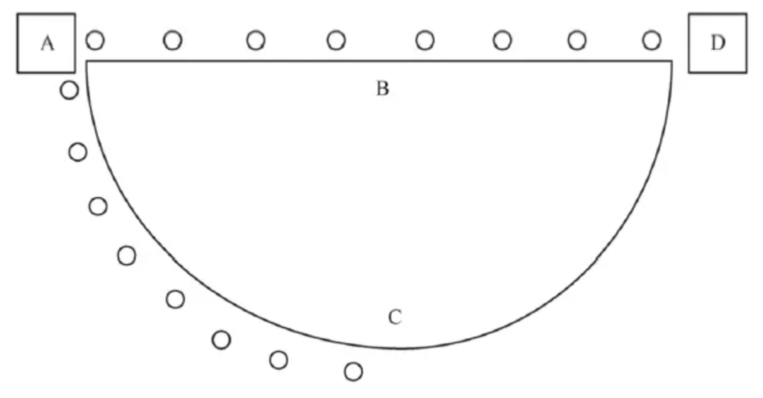
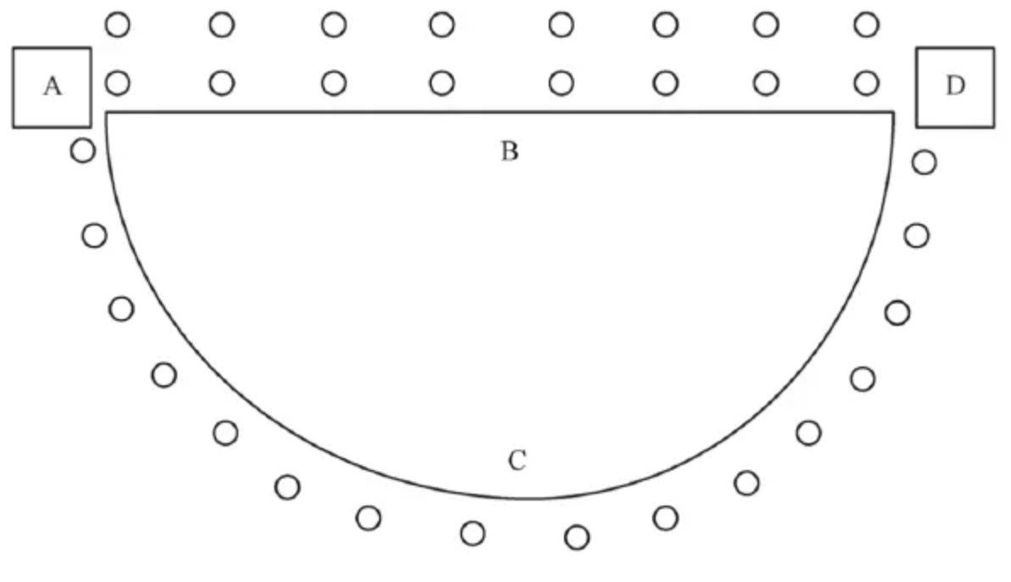
The pheromone is updated in two ways: first, by volatilization, which means that the pheromone on all paths decreases at a certain rate, simulating the process of natural ant colony pheromones over time; second, by augmentation, which adds pheromones to the edges with "good" values (ants walking through them).

Slide 6
Evaluation
General Performance
To see how solutions evolve during the runtime of ACO
Performance with various parameters
To see how ACO perform with different parameter settings
Comparison with GA and PSO
To see the overall performance differences between ACO, GA and PSO on TSP

Slide 7
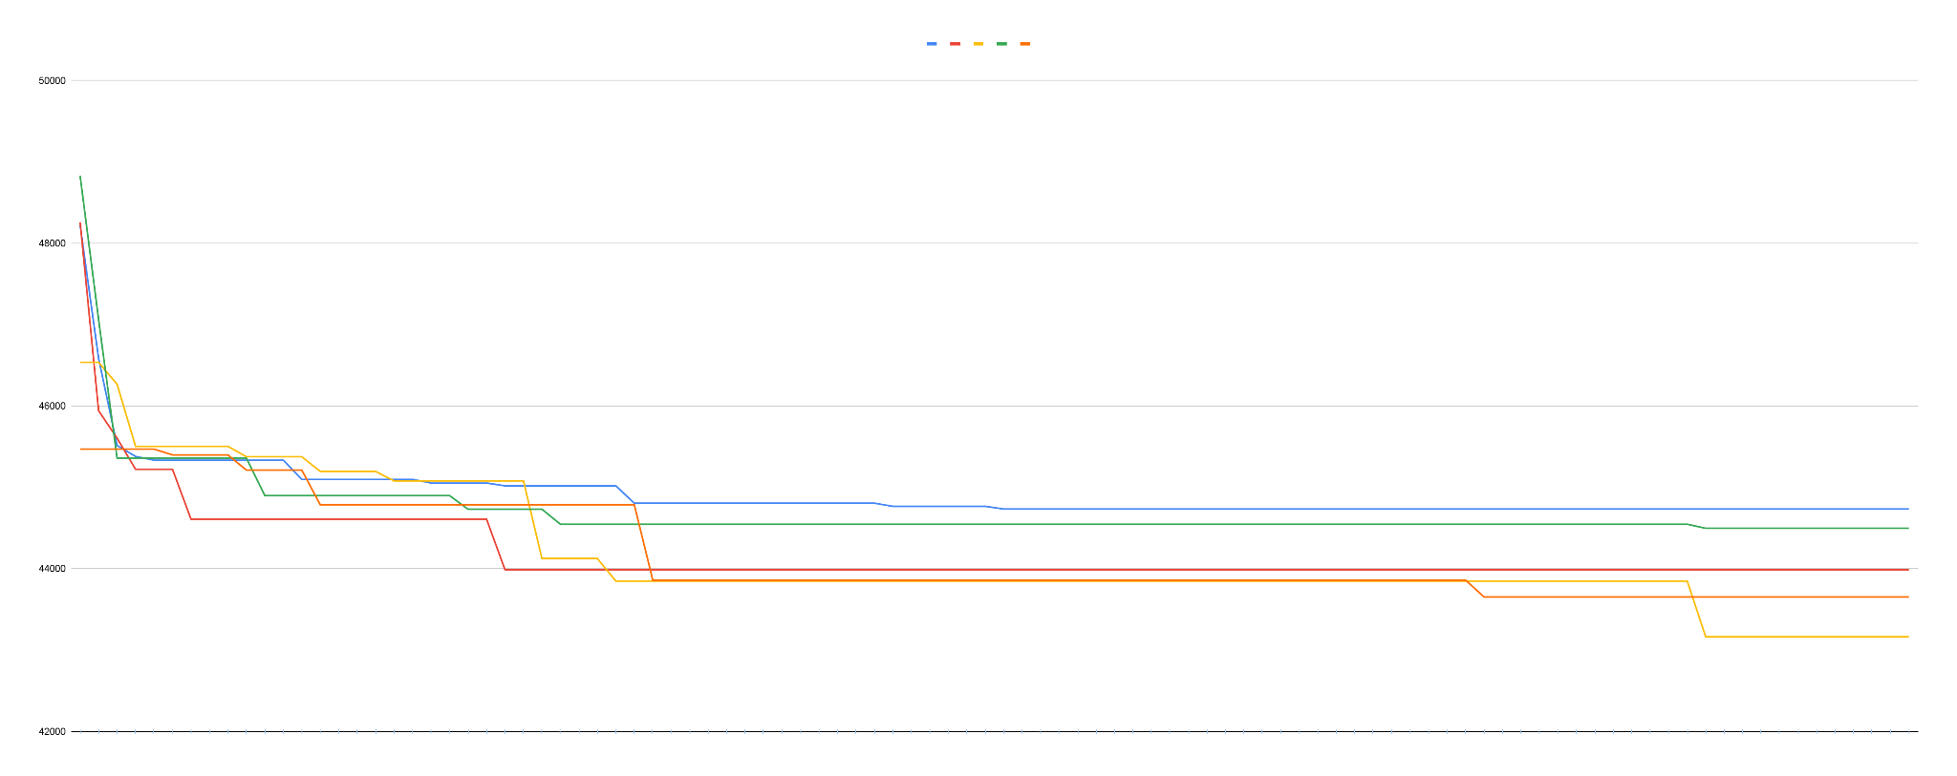
Results: General Performance
Evolution of solutions throughout generations

Slide 8
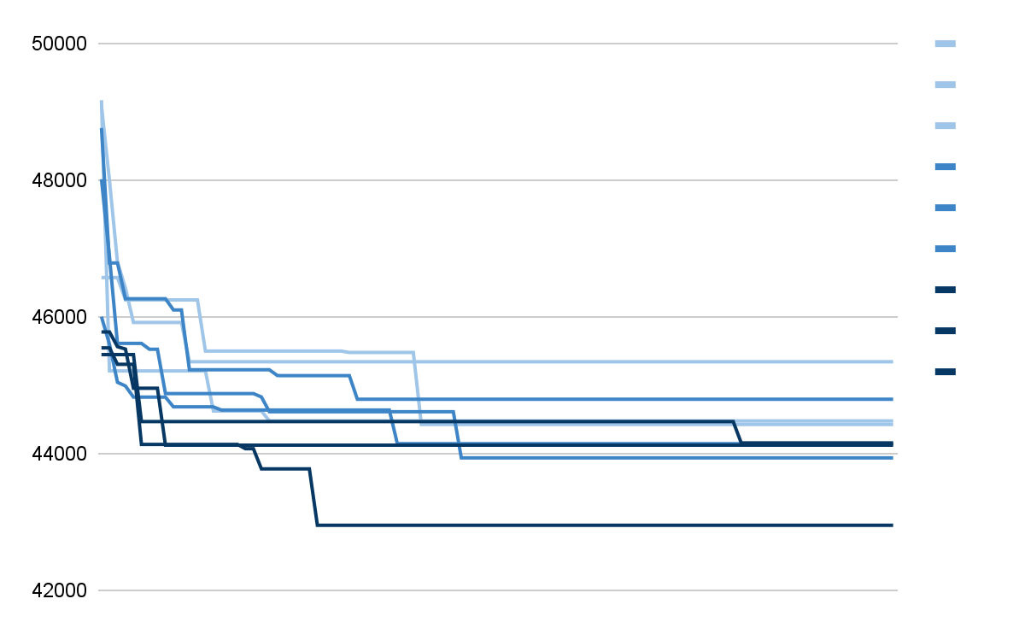
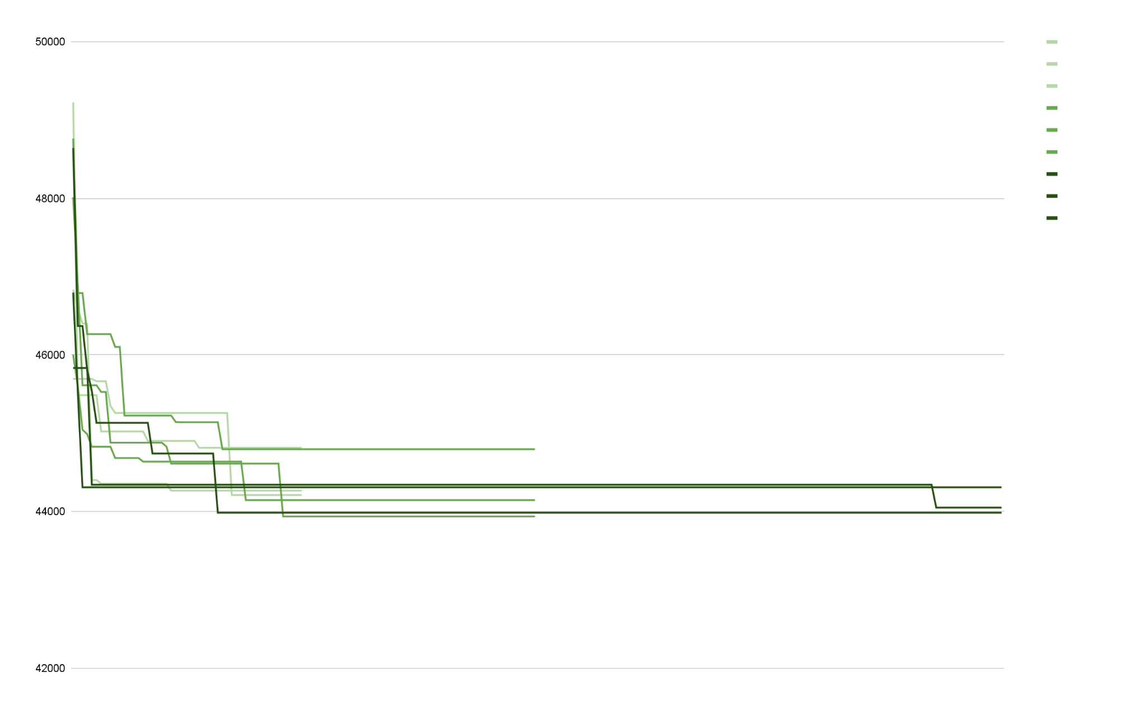
Results: Performance with various parameters
Different parameter settings lead different results
Ant count: 10, 20, 40
More likely to find better solutions with larger ant count
Generation count: 50, 100, 200
More likely to find better solutions within more generations

Slide 9
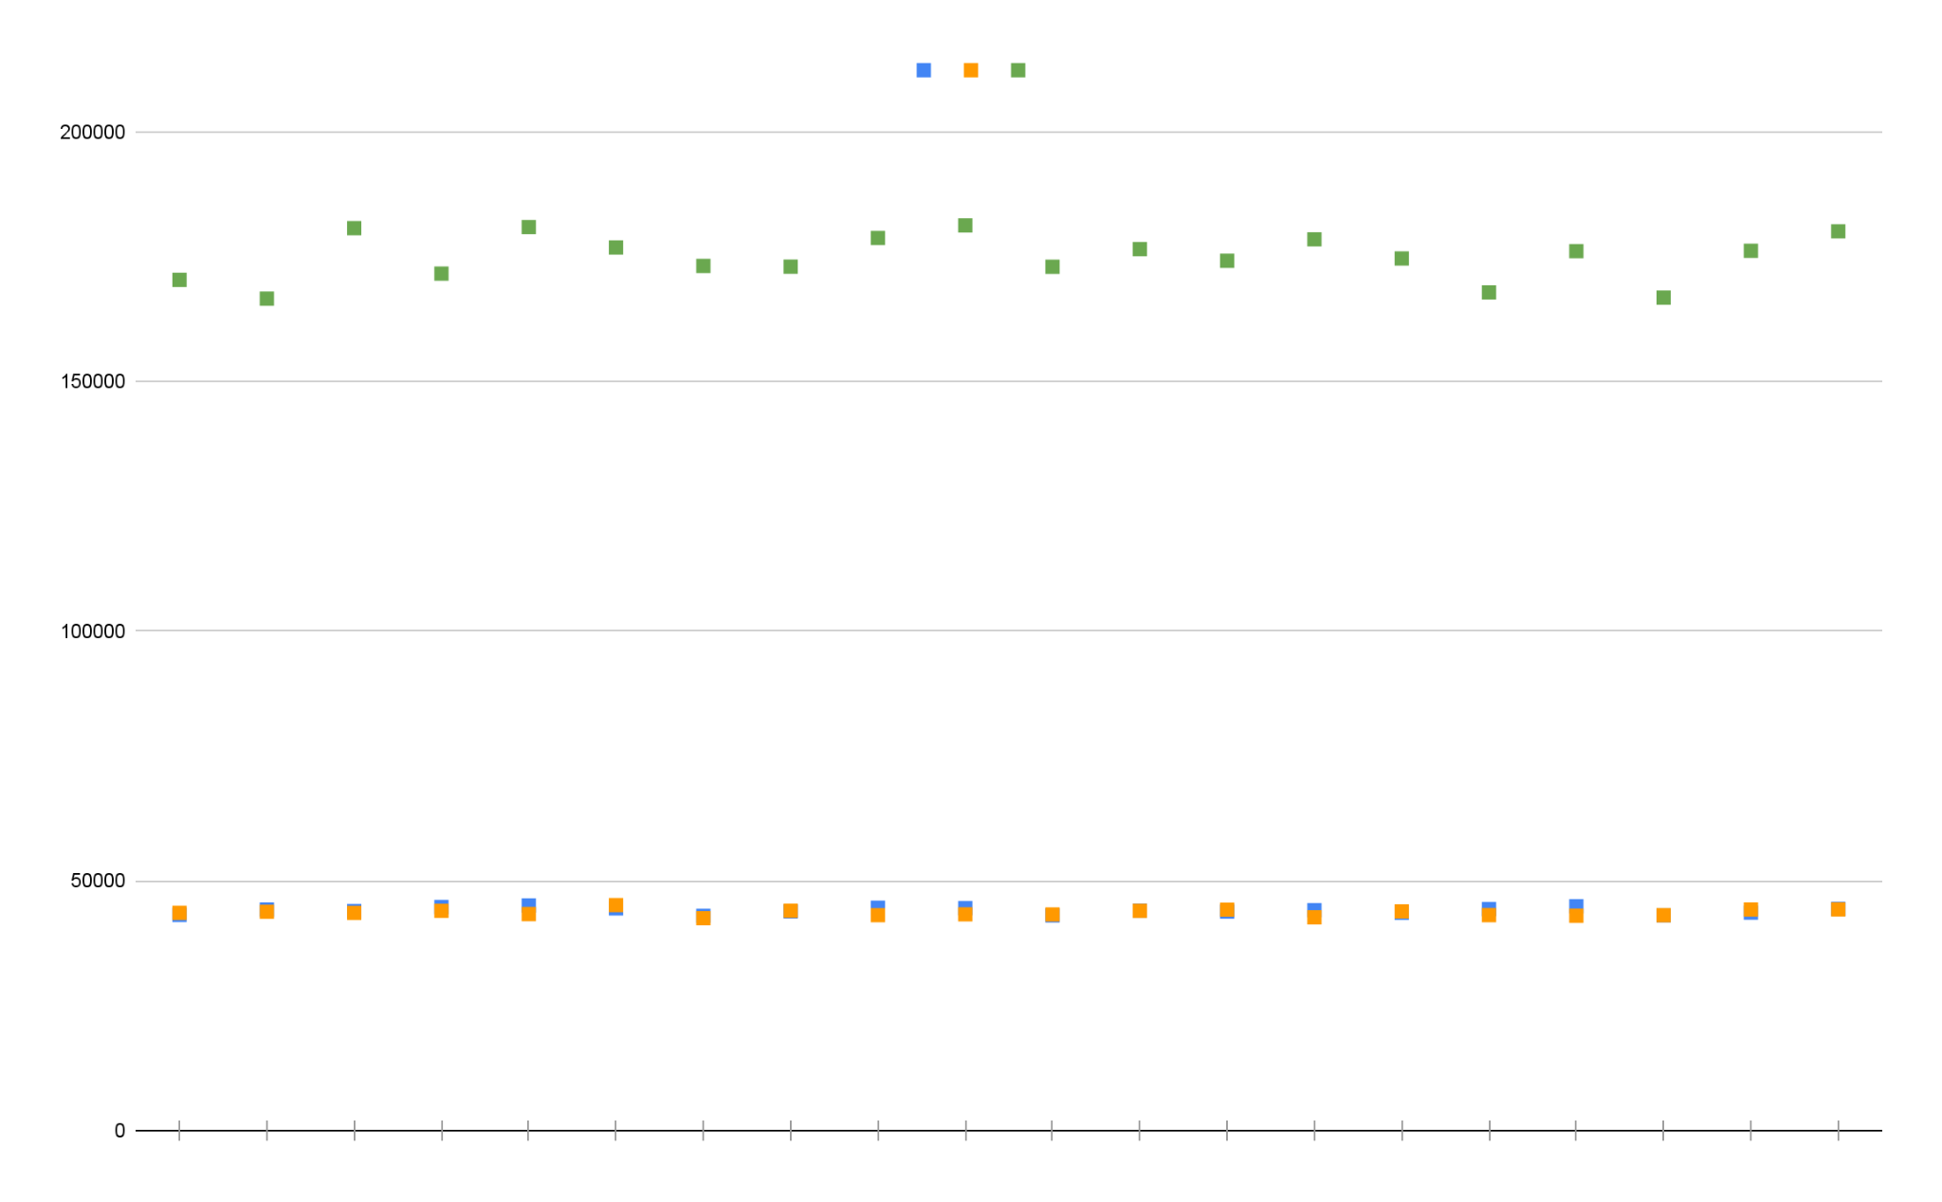
Results: Compare with GA and PSO
Stability (Standard Deviation)
ACO: 625.25; PSO: 630.97; GA: 4596.25
Quality of solutions (Solution Average)
ACO: 44021.49; PSO: 43598.79; GA: 174902.46

Slide 10
Conclusion:
Evolution of the solutions produced by ACO mostly occurs in early generations of ACO runs
Larger ant group and generation count leads better solutions
ACO and PSO are both relatively stable, and are much more stable than GA on resolving TSP
ACO and PSO both perform well on producing high quality solutions for TSP. GA perform worse comparing with the other two
Overall, ACO is a relatively good algorithm on resolving Travel Salesman Problem

Slide 11
Thank you :D

