Slide 1

Website Lab Book
Carson

Slide 2
Problem
People(me) have a hard time organizing their time efficiently
Mission
Help people(me) organize their time

Slide 3
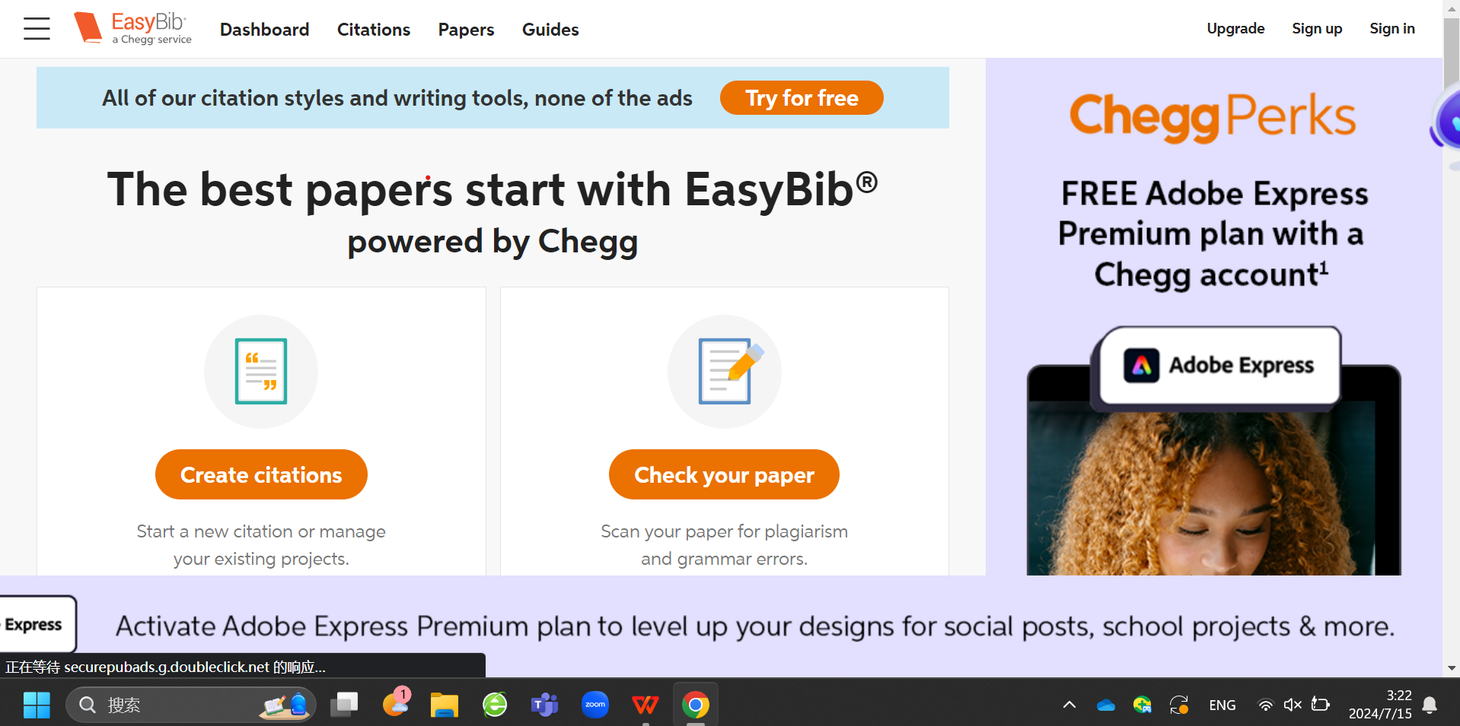

Slide 4

Manage your time wisely with
TimeMaster Zote

Slide 5
Home
Create
Look at Zote
Your stuff
Info

