Slide 1
Dostar Marketing Employee Optimization
Objectives:
Identify employees’ areas of specialization
Define linear programming model object function and constraints
Review Excel solver solution
Draw insights from solution

Slide 2
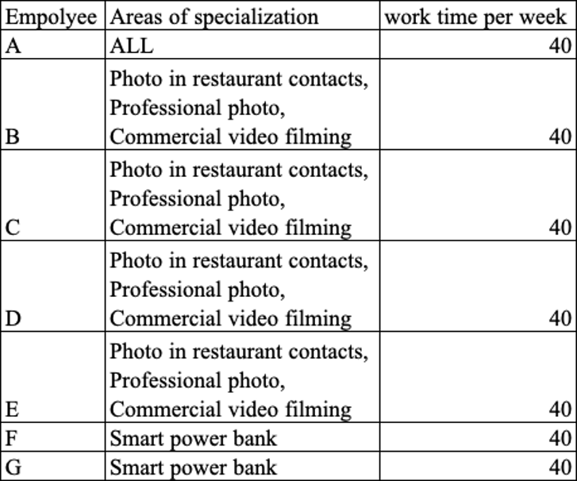
Employee Areas of Specialization

Slide 3
Employee Areas of Specialization
Employees B, C, D, and E all share the same 4 areas of specialization.
Employees F and G share the same 1 area of specialization.
Employee A can do all areas of specialization.
Employees F and G are the least diverse.
All workers have the same 40 hours per week.
Overlapping specializations could allow for a reduction in employees.

Slide 4
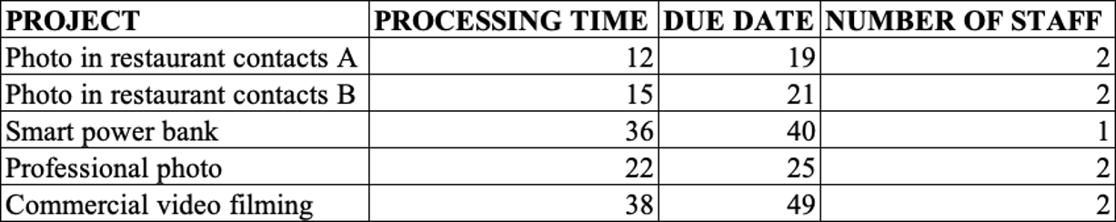
Data for Linear Programming Model

Slide 5
Linear Programming Model
The objective is to reduce costs by reducing the number of employees.
Y = Project & X = Employee
Objective function : Y = X1 + X2 + X3 + X4 + X5 + X6 +X7
Decision variables :
P1 & P2 : X1 + X2 + X3 + X4 + X5 = 2
P3 : X1 + X6 + X7 = 1
P4 & P5 : X1 + X2 + X3 + X4 +X5 = 2
X6 & X7 != P1 or P2 or P4 or P5
X2 & X3 & X4 &X5 != P3

Slide 6
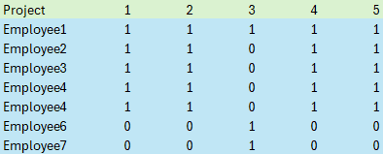
Project Capabilities Array
This Array determines which employees can work on each project
The values are binary: 1 equals capable and 0 equals not.

Slide 7
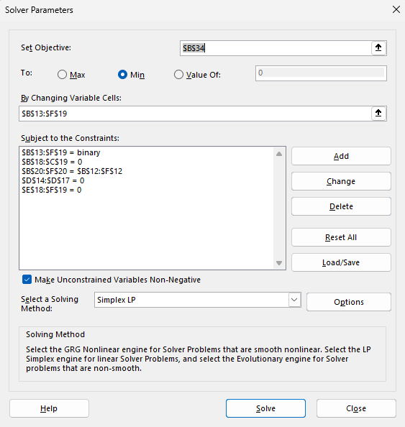
Excel Solver Menu

Slide 8
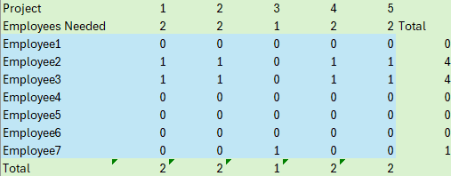
Excel Solver Result
To minimize the number of employees, the manager would fire all employees except 2, 3, and 7.
All projects would be completed with 3 employees.

Slide 9
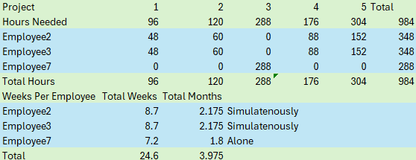
Implications of Solver result
All projects would require an estimated 4 months to complete.
Employee2 and Employee3 working on the same project dramatically reduces project time.
Employee7’s project is a bottleneck requiring almost 2 months to complete.
Employee7’s salary may be higher due to workload.
Employee2 and Employee3’s salary cost is most likely high due to multiple specializations.
Higher salary wages may offset money saved from fewer employees.

