Slide 1
ELEC S212 (Sept. 2018)
Network
Programming and Design
Surgery 5
(Introduction to network application development)
Course Coordinator : Dr. Steven Choy
Tutor : Mr. Joe Lee
URL of my teaching website : http://learn.ouhk.edu.hk/~t441051/s212
P.<number>
Notes:
CT212 (02/03)-Network Programming and design
27 April, 2002
School of Science & Technology

Slide 2
Agenda for Surgery 5
C programming basics
Flowchart of C programming
Framework of C program
Compile C program in Linux/UNIX
Execution sequence of C program
Variable, data type, Operator, Flow control building block
Array & pointer
Function, structure and I/O
Discussion
P.<number>
Notes:
CT212 (02/03)-Network Programming and design
27 April, 2002
School of Science & Technology

Slide 3
Objective of Unit 5
Describe the basic steps in creating C programs
Analyze simple C program
Describe different data structures in C
Describe variables, types and type declaration in C
Discuss the basic input and output (i.e. I/O) functionalities in C
Demonstrate the basic conditional-testing statement, looping mechanism in C
Describe arithmetic operations in C
Demonstrate the capability on using arrays and pointers in C
Demonstrate a basic understanding of application development and write applications using C
P.<number>
Notes:
CT212 (02/03)-Network Programming and design
27 April, 2002
School of Science & Technology

Slide 4
C programming basic (1)
Why C programming?
  Portability : from one platform to another
  Standard library concept and rich library set
  Middle level language
    High level language syntax
    Low level language function and approximate speed
  Structural and modular
  Free format language (study unit 5, P.19)
  Easy to learn
P.<number>
Notes:
CT212 (02/03)-Network Programming and design
27 April, 2002
School of Science & Technology

Slide 5
C programming basic (2)
What C program can do:
  Input data (from keyboard or file)
  Process input data based on requirement specification
  Output processed result (to monitor or file)
  “C program with Socket system call” + HTML + javascript => One type of Network programming
2 types of programming bugs :
  Syntax bug
  Logical bug
P.<number>
Notes:
CT212 (02/03)-Network Programming and design
27 April, 2002
School of Science & Technology

Slide 6
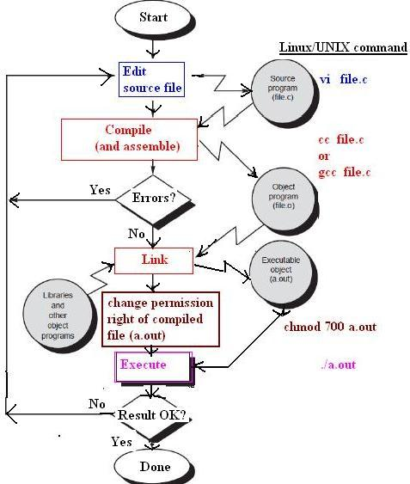
Flowchart of C programming (1)
P.<number>
Notes:
CT212 (02/03)-Network Programming and design
27 April, 2002
School of Science & Technology

Slide 7
Flowchart of C programming (2)
C Programming process:
  Design and (optional) write down your programming specification using any pseudo-code
  Edit source code (*.c) of your program using any editor such as pico or vi
  Compile and link source code by gcc or cc
    Compile your source with C compiler (gcc) to object code (*.o)
    Link your object code with library with gcc to machine code
  chmod your machine code to executable in unix environment
  As you may need to change your source code several times for debugging, it is more efficient to automat steps 3 , 4, 5 using makefile.
Please read the workshop for C beginner at URL: http://learn.ouhk.edu.hk/~t441051/ct212/workshop/c_program_beginner_workshop/index.html
P.<number>
Notes:
CT212 (02/03)-Network Programming and design
27 April, 2002
School of Science & Technology

Slide 8
Framework of C program (1)
Each C program (source code) is a text file.
Extension of filename of the source code MUST be *.c.
Content of C source code is a combination of followings:
  Preprocessor directive:
    #include, #define, #undef, #ifdef, #else, #endif
  Statement for declaration of global or local variable
  One or more user-defined functions
    Function declaration declares “name of function” and “parameters (parameter name and data type) of function”
    Function definition includes
      Local variable declaration statements
      C statements for the function.
      Statement for calling another user-defined function or C library function.
      (cont’d)
P.<number>
Notes:
CT212 (02/03)-Network Programming and design
27 April, 2002
School of Science & Technology

Slide 9
Framework of C program (2)
  One or more user-defined functions (cont’d):
    main() function is a special function which
      MUST be existed
      DOES NOT require function declaration.
  Comment in either one of 2 forms:
    //comment in one line
    /*
    comment in one or multiple lines
    */
P.<number>
Notes:
CT212 (02/03)-Network Programming and design
27 April, 2002
School of Science & Technology

Slide 10
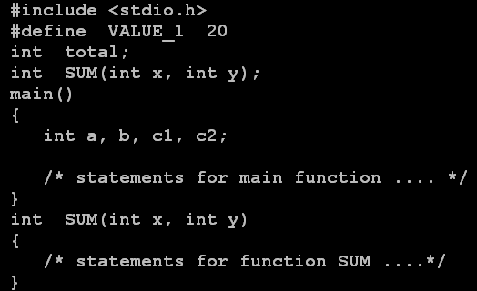
#include a header file
#define a constant
global variable declaration. All functions can access global variables.
Function declaration, if any
Every C program must include a main function. The main function includes variable declarations, C statements, function calling statements.
Local variable is accessible within the function only
C statements for main function.
Function definition, if any
P.<number>

Slide 11
Compile C program in Linux/UNIX (1)
Function of c compilation :
  check for syntax error in source code
  source code (*.c) -> object code (*.o) -> executable machine code
C compilation model :
  4 components – preprocessor, compiler, assembler, linker)
Available c compiler :
  gcc (better, more ansi-compatible)
P.<number>

Slide 12
Compile C program in Linux/UNIX (2)
How to compile :
  For single source file :
    compile to executable code :
      gcc *.c
      a.out is default filename for executable code
    compile up to object code file but no linking :
      gcc –c *.c
      *.o will be output
    compile to executable code but specify filename for executable code :
      gcc –o out_exe *.c
      out_exe but NOT a.out will be executable code
P.<number>

Slide 13
Compile C program in Linux/UNIX (3)
  For multiple source files :
    make utility + makefile (or Makefile) file
    makefile file syntax :
      Maintarget: requirements1
      instructions1
      target1: requirements2
      instructions2
      target2: requirements3
      instructions3
Try “make” with makefile and c programs downloadable from Joe’s web site -> Tutorial page
P.<number>

Slide 14
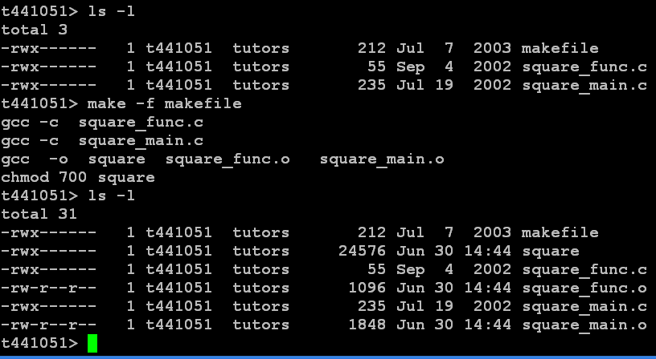
P.<number>

Slide 15
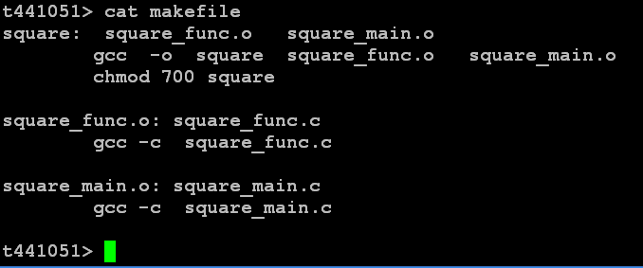
P.<number>

Slide 16
Execution sequence of C program
Execution sequence of a binary C program :
  It starts executing function main().
  Variable declaration statement allocates memory for storing corresponding variable.
  The C statements within main() are executed from top to down unless
    When a conditional flow statement is executed, its execution sequence is based on “value of condition” and “logic of the conditional flow statement”.
    When a user-defined “calling function” statement is executed, the statements in the corresponding “function definition” are executed.
    When an exit() statement is executed, the C program terminates.
P.<number>
Notes:
CT212 (02/03)-Network Programming and design
27 April, 2002
School of Science & Technology

Slide 17
Variable & constant
Variable :
  A memory location is reserved for storing value
  Value can be changed as program executes
  Need declaration :
    data type
    variable name (study unit 5, P.21, 22): used to identify the variable
    Initial value of variable can be assigned in declaration but NOT a MUST.
  Value assigned to the variable must match with its data type
    Eg. int var;
    var = 1 + 2; (OK)
    var = 1.1 + 2.2; (Wrong, type mismatch)
Constant :
  Value is fixed
  Type can be integer, floating-point, character, string, etc;
  Eg. #define CONST 123
P.<number>
Notes:
CT212 (02/03)-Network Programming and design
27 April, 2002
School of Science & Technology

Slide 18
Data type of variable (1)
Type | description | example | Value range
char | Character (1 byte) | char var1; char var1, var2; | A to Z; a to z
int | Integer (2 byte) | int var, var2; | -32768 to 32767
float | Floating point number (4 byte) | float var1, var2; | -3.4E+38, 1.2, 3.4E+38
double | Higher range floating point number | Double var1, var2; | -1.7E+308 to 1.7E+308
FILE | For file pointer | FILE file1_ptr; | (to be discussed)
P.<number>
Notes:
CT212 (02/03)-Network Programming and design
27 April, 2002
School of Science & Technology

Slide 19
Data type of variable (2)
String type is just an array of char, end with ‘\0’
long modifier : range is doubled
  Eg int is 2 byte, long int is 4 byte (but depending of system)
P.<number>
Notes:
CT212 (02/03)-Network Programming and design
27 April, 2002
School of Science & Technology

Slide 20
C statement
Each C statement ends with semi-colon
C statement can be:
  Assignment statement
  Arithmetic statement
  Relational & Logical operation
    Used as “condition” for flow-control statement
  Flow control statement
    If-else
    Switch
    While loop, Do while loop
    for loop
P.<number>
Notes:
CT212 (02/03)-Network Programming and design
27 April, 2002
School of Science & Technology

Slide 21
Assignment statement
operator | description | Statement example
= | Left side variable takes value of right side expression | i = 10;
+= | i = i + 10 | i += 10;
-= | i = i - 10 | i -= 10;
*= | i = i * 10 | i *= 10;
/= | i = i / 10 | i /= 10;
%= | i = i % 10 | i %= 10;
++ | i = i + 1 | i ++;
-- | i = i - 1 | i --;
P.<number>
Notes:
CT212 (02/03)-Network Programming and design
27 April, 2002
School of Science & Technology

Slide 22
Arithmetic statement
Operator | description | Statement example
+ | addition | a= 1 + 2;
- | subtraction | a= 80 - 35;
* | multiplication | a= 5*7;
/ | Division (integral quotient) | a=21/5;
% | remainder | a=11%2;
P.<number>
Notes:
CT212 (02/03)-Network Programming and design
27 April, 2002
School of Science & Technology

Slide 23
Relational & logical operation
Operator | description | example
> | Larger than | x > y
>= | Larger than or equal to | x >= y
< | Less than | x < y
<= | Less than or equal to | x <= y
== | Equal to | x == y
!= | Not equal to | x != y
&& | AND | (x>y) AND (a < z)
|| | OR | (x>y) OR (a < z)
! | NOT | !(a < z)
(10 < x < 100) (wrong statement)
(10 < x) && (x < 100) (correct statement)
Result of each expression is either “True” or “False”
P.<number>
Notes:
CT212 (02/03)-Network Programming and design
27 April, 2002
School of Science & Technology

Slide 24
Flow control statements (1) – “if-else”
Syntax :
  if (condition1)
  { statement block1}
  else if (condition2)
  { statement block2 }
  else
  { statement block3}
Execute this block of statements when “value of condition1” is true
Execute this block of statements when “value of condition1” is false AND “value of condition2” is true.
block of statements is enclosed by {}.
Condition expression is enclosed by ().
Execute this block of statements when “value of condition1” is false AND “value of condition2” is false.
P.<number>
Notes:
CT212 (02/03)-Network Programming and design
27 April, 2002
School of Science & Technology

Slide 25
Flow control statements (2) - switch
Execute statement block1 when “value of expression” equals to constant1
Syntax :
switch(expression)
{ case constant1: statement block1; break;
case constant2: statement block2; break;
case constant3: statement block3; break;
. . .
default: statement blockn; break; }
Execute statement block2 when “value of expression” equals to constant2
Execute statement blockn when “value of expression” DOES NOT equal to any constanti
Execute statement block3 when “value of expression” equals to constant3
P.<number>
Notes:
CT212 (02/03)-Network Programming and design
27 April, 2002
School of Science & Technology

Slide 26
Flow control statements (3) – while loop
Syntax :
while (condition)
{ statement block}
Repeat execution of statement block whenever “value of condition” is true.
Check value of condition before execution of statement block.
After n-time repeat execution of statement block, value of condition will change to false. The loop then ends. Value n can be 0 but cannot be estimated.
P.<number>
Notes:
CT212 (02/03)-Network Programming and design
27 April, 2002
School of Science & Technology

Slide 27
Flow control statements (4) – Do while loop
Do while loop , (do then check condition)
Syntax :
Do {statement block}
While (condition)
Similar to while loop except:
  Execution of statement block once. Then check value of condition.
Repeat execution of statement block whenever “value of condition” is true.
P.<number>
Notes:
CT212 (02/03)-Network Programming and design
27 April, 2002
School of Science & Technology

Slide 28
Flow control statements (5) – for loop
Similar to while loop. Number of iteration to repeat is known before or can be determined by some variable
Syntax :
for (counter=start_value; counter=finish_value; counter_increment)
{ statement block }
Counter is a variable
Start_value, finish_value can be either constant or variable
Counter_increment can be :
  ++counter
  Counter = counter + 1;
  Counter = counter +3; etc.
Refer to for_loop.c
P.<number>
Notes:
CT212 (02/03)-Network Programming and design
27 April, 2002
School of Science & Technology

Slide 29
Array (1)
Array :
  A group of related variables, with same data type
    Eg. Use an array of integer to represent telephone number of students
  All elements are stored continuously in memory space
  Number of members is explicitly specified
    eg. int a[5];
      a is an array of integers, with 5 members ( a[0], a[1], a[2], a[3], a[4] )
      a is also memory address of element a[0]
    Eg. char b[3];
      b is an array of char, with 3 members ( b[0], b[1], b[2] )
  Index start at zero , not one
  Index can be a variable of int type
    Eg. int i, a;
    a[i] = 10;
P.<number>
Notes:
CT212 (02/03)-Network Programming and design
27 April, 2002
School of Science & Technology

Slide 30
Array (2)
How to initialize :
  initialize in declaration statement
    int a[5] = {1, 2, 3, 4, 5};
    char b[3] =“abc”;
  Initialize in separate statement
    int a[5]; a = {1, 2, 3, 4, 5};
    char b[3]; b = “abc”;
How to access or assign individual element:
  a[0] = 3; a[3]=5; ….
  b[0]=‘A’; b[1]=‘B’; b[2]=‘C’; (note each element is a char , not string)
Multi-dimension array is possible
  Eg. int z[5][3];
  Totally 15 members, z[0][0],……, z[4][2]
P.<number>
Notes:
CT212 (02/03)-Network Programming and design
27 April, 2002
School of Science & Technology

Slide 31
Pointer (1)
Pointer is a variable that holds the memory address of another variable of any data type
Declaration : int *p; int a=2; int b;
  p is a pointer to another variable *p. *p is of type int
Why pointer ?
  Call by reference in function - parameters must be pointers
  Very useful in dynamic memory allocation such as link list.
**after declaring a pointer:
  Only memory for the pointer is allocate
  There are no memory allocated to the variable pointed to by the pointer
  You may need to allocate memory for the variable pointed to by pointer using “malloc() function”. Or memory segmentation results.
P.<number>
Notes:
CT212 (02/03)-Network Programming and design
27 April, 2002
School of Science & Technology

Slide 32
Pointer (2)
How to associate a pointer with another variable ?
  p = &a ;
  Now *p=a=2
  &a means to retrieve memory address of variable a
How to access content of variable that a pointer points to ?
  b = *p;
  Now, b=*p=a=2
*p + 1 is different from *(p+1)
P.<number>
Notes:
CT212 (02/03)-Network Programming and design
27 April, 2002
School of Science & Technology

Slide 33
Pointer (3)
Operation that can be done with arrays can also be done with pointers
In programmer’s point of view,
  Eg. int x[10]; int *p;
    assume size of int is 1 byte
    p = &x[0]; or p=x;
    Now, *(p+1) is x[1], *(p+2) is x[2], ….. *(p+9) is x[9]
    *p + 1 is x[0] +1, *(p+1) is X[1]
  Eg. float y[10]; float *q;
    Assume size of float is 4 byte
    q = &y[0];
    Now *(q + 1) is y[1], *(q+2) is y[2], ….*(q+9) is y[9]
P.<number>
Notes:
CT212 (02/03)-Network Programming and design
27 April, 2002
School of Science & Technology

Slide 34
Pointer (4)
However, in terms of memory address (i.e. what actually happens in memory address), it is quite different.
  Eg. int x[10]; int *p;
    assume size of int is 1 byte
    p = &x[0]; or p=x;
      “content of p” is the memory address x[0],
      (“content of p” +1) is the memory address of x[1],
      (“content of p” +2) is memory address of x[2],
      …..
      (“content of p” + 9) is memory address of x[9]
P.<number>
Notes:
CT212 (02/03)-Network Programming and design
27 April, 2002
School of Science & Technology

Slide 35
Pointer (5)
However, in terms of memory address (i.e. what actually happens in memory address), it is quite different (cont’d)
  Eg. float y[10]; float *q;
    Assume size of float is 4 byte
    q = &y[0];
      “content of q” is the memory address of y[0],
      (“content of q” + 4) is the memory address of y[1],
      (“content of q” +8) is the memory address of y[2],
      ….
      (“content of q” +36) is the memory address of y[9]
The difference with slide P.33 is handled by compiler and is transparent to programmer.
When programming, you should follow slide P.33
Refer to pointer.c, 5th reference in my teaching website.
P.<number>
Notes:
CT212 (02/03)-Network Programming and design
27 April, 2002
School of Science & Technology

Slide 36
String
String :
  Header files to include : #include <string.h>
  Just array of char, ended with ‘\0’
  String manipulation libraries:
    strcpy(), strcmp(), strcat(), strlen(), strchr(), strstr(), strtok(),……
P.<number>
Notes:
CT212 (02/03)-Network Programming and design
27 April, 2002
School of Science & Technology

Slide 37
Function (1)
Why function?
  More readable
  Easier to debug , especially for large size program
  Distribute jobs to team members
Calling function only need to know followings of called function :
  Input to called function
  What called function can do.
  Output from called function
Calling function does not need to know how called function to do its processing
Main() is the first function which executes when a program starts to run
P.<number>
Notes:
CT212 (02/03)-Network Programming and design
27 April, 2002
School of Science & Technology

Slide 38
Function (2)
2 types of parameters passing :
  Call by value
    Actual parameters and formal parameters are of different memory locations. Values of actual parameters are copied to formal parameters
    If values of formal parameters change, values of actual parameters does not change
    refer to func_by_value.c
  Call by reference
    Actual parameters and formal parameters are same memory locations. Only pointers are copied.
    If values of formal parameters change, values of actual parameters change
    refer to func_by_reference.c
P.<number>
Notes:
CT212 (02/03)-Network Programming and design
27 April, 2002
School of Science & Technology

Slide 39
Function (3)
Declaration of function must exist before main() and specified with key word “extern” if function definition is stored in separate file
  extern function_name(parameter_list with datatype)
  Refer to external.c
Recurrsion
  Function call itself
  Simple in programming but hard to debug
P.<number>
Notes:
CT212 (02/03)-Network Programming and design
27 April, 2002
School of Science & Technology

Slide 40
I/O (1) – command line argument
Command line :
  cmd_name arg1 arg2 arg3
Use 2 arguments in main function
  main (int argc, char * [])
  (argc - 1) equals number argv of arguments
  argv is an array of string, which stores arguments
  argv[0] is cmd_name
  argv[1] is 1st argument (i.e. arg1)
  argv[argc-1] is last argument (i.e. arg3)
Refer to inout_cmd.c
P.<number>
Notes:
CT212 (02/03)-Network Programming and design
27 April, 2002
School of Science & Technology

Slide 41
I/O (2) – Std. I/O library
Library for any std. I/O operation
Header file to include :
  #include stdio.h
Std. I/O functions :
  Input from keyboard
    getchar(), gets(), scanf(), ….
  output to monitor
    printf(), putchar(), puts(),…..
All input functions take argument as either string or char (eg. 123 is viewed as string “123”, not number 123)
Refer to inout_std.c
P.<number>
Notes:
CT212 (02/03)-Network Programming and design
27 April, 2002
School of Science & Technology

Slide 42
I/O (3) – Conversion library
Library for utility functions such as memory allocation, random number generator, string conversion, process control, etc
Header files to include :
  #include stdlib.h
Convert input data from type char or string to other type such as int, float, long, etc & then process
  Convert from type char or string : atoi(), atof(), atol(), etc
  Convert from type string to long or integer : strtol(), strtod,
  Convert case of a char or string : tolower(), toupper()
P.<number>
Notes:
CT212 (02/03)-Network Programming and design
27 April, 2002
School of Science & Technology

Slide 43
I/O (4) – text file I/O
Text File I/O functions :
  Input from text file :
    fgetchar(),fgets(),fscanf()…..
  output to text file :
    fprintf(),fputchar(),fputs(),….
Text file I/O programming involves 4 steps :
  1. Declare a file pointer
    File *infp, *outfp;
  2. Associate filename to a file pointer and open for operation
    infp=fopen(“INFILENAME”, “x”);
    outfp=fopen(OUTFILENAME”, ”x”);
        x = r => open existed file to read only
        x = w => create file to write
        x = a => append to existed file
        …..
P.<number>
Notes:
CT212 (02/03)-Network Programming and design
27 April, 2002
School of Science & Technology

Slide 44
I/O (5) – text file I/O
  3. Read or write content of file for processing
    fgets(char *str, int maxlen, FILE *infp);
    fprintf(FILE *outfp, const char *format, ….);
  4. Close file after all file accesses are done
    fclose(infp);
    fclose(outfp);
Refer to inout_file.c
P.<number>
Notes:
CT212 (02/03)-Network Programming and design
27 April, 2002
School of Science & Technology

Slide 45
I/O (6) – printf() vs scanf()
printf(const char *format, var1, var2,….);
  A very useful library function for formatting output
  For how to use printf(), refer to URL :
    http://www.nextdawn.nl/sub/c_language/format-conversion-printf-in-c.php
Scanf()
  A very useful library function for reading formatted input
  For how to use scanf(), refer to URL :
    http://www.java2s.com/Tutorial/C/0080__printf-scanf/Readinganddiscardingcharactersfromtheinputstream.htm
P.<number>
Notes:
CT212 (02/03)-Network Programming and design
27 April, 2002
School of Science & Technology

Slide 46
Structure
A user-defined data type for a collection of variables under single name
Easier to program, debug.
Eg. A structure for a student should contain name, id, age, address, tel_num
  Typedef struct {
  char *name;
  char *id;
  char *address;
  char *tel_num
  } student_record;
  student_record student;
    “student_record” is a new user-defined data type and “student” is a variable of type student_record.
  How to assign or access value to field member
    student->name = “joe”; (or student.name=“joe”;)
P.<number>
Notes:
CT212 (02/03)-Network Programming and design
27 April, 2002
School of Science & Technology

Slide 47
Others
How to call unix command :
  system(“command_name”);
Suggestion :
  To prevent problems, always include header files <stdio.h>, <string.h>, <stdlib.h>
  Read Study unit 5, section for “common programming errors in C” (P.65 to 68)
  For C programming, practice is much more important than reading.
    Write your first C program ASAP.
    When you don’t know how to use a statement or library function, write a simple test program to find it out.
  Not all libraries are fully portable to different system. Use ansi-C standard library to prevent problem.
  find a C programming reference book which includes list and description of ansi-C standard library. (eg. Kernighan, B W and Ritchie, DM (1998) The C programming Language, 2nd edition or Joe’s online reference)
P.<number>
Notes:
CT212 (02/03)-Network Programming and design
27 April, 2002
School of Science & Technology

Slide 48
Open
Discussions
P.<number>
Notes:
CT212 (02/03)-Network Programming and design
27 April, 2002
School of Science & Technology

