Slide 1
ELECS212
Network
Programming and Design
Tutorial 3 for group 1 & 2
(Lab 1.8 running in ucourse2.ouhk.edu.hk)
Course Coordinator : Dr. Steven Choy
Tutor : Mr. Lee, Bo-sing (Joe)
URL of my teaching website : http://ucourse.ouhk.edu.hk/~t441051/s212
P.<number>
Notes:
CT212 (02/03)-Network Programming and design
27 April, 2002
School of Science & Technology

Slide 2
Agenda
How to publish web page under your account in ucourse2 (Step 1 of lab 1.8)
Protect your website by password (Step 2 to 5 of lab 1.8)
P.<number>
Notes:
CT212 (02/03)-Network Programming and design
27 April, 2002
School of Science & Technology

Slide 3
Lab 1.8
To protect your website by password, you need to
  Create directories ~/public_html/ and ~/public_html/cgi-bin. Change permission mode of these 2 directories to 701 (Step 1)
  Prepare directory & web pages files to be password protected (Step 2)
  Create user password file (.myhtpasswd) and set appropriate permission right for files “.myhtpasswd” and “.htaccess” (Step 3)
  Edit content of file “.htaccess” (Step 4)
  Verify user authentication (Step 5)
P.<number>
Notes:
CT212 (02/03)-Network Programming and design
27 April, 2002
School of Science & Technology

Slide 4
Lab 1.8 – Step 1 (1)
To publish web page in system (eg. ucourse) where you have an account
Create directories “~/public_html” and “~/public_html/cgi-bin” and change their permission right to 701
    mkdir ~/public_html
    chmod 701 ~/public_html
    mkdir ~/public_html/cgi-bin
    chmod 701 ~/public_html/cgi-bin
For your web page files (*.html)
      Locate them under ~/public_html/
      Change permission mode to 704
P.<number>
Notes:
CT212 (02/03)-Network Programming and design
27 April, 2002
School of Science & Technology

Slide 5
Lab 1.8 – Step 1 (2)
  Steps of creating your web page
    cd ~/public_html/
    pico test.html
    chmod 704 test.html
Content of test.html (case-insensitive)
<html>
<header>
<title> test page </title>
</header>
<body>
<font size=5> Test Page for my web page </font>
</body>
</html>
P.<number>
Notes:
CT212 (02/03)-Network Programming and design
27 April, 2002
School of Science & Technology

Slide 6
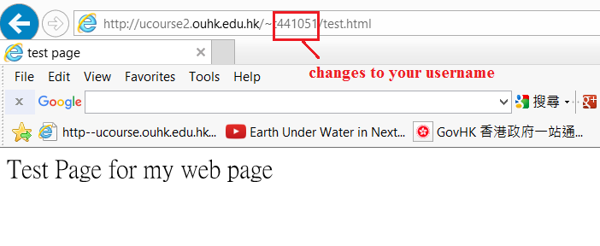
Lab 1.8 – Step 1 (3)
Access the web page file “test.html” by any browser.
URL of test.html
  http://ucourse2.ouhk.edu.hk/~s1234567/test.html (where s1234567 is username of your account in ucourse2)
P.<number>
Notes:
CT212 (02/03)-Network Programming and design
27 April, 2002
School of Science & Technology

Slide 7
Lab 1.8 – Step 1 (4)
For your cgi-script files (*.cgi)
  Locate them under ~/public_html/cgi-bin/
  Change permission mode to 705
  Steps of creating your cgi
    cd ~/public_html/cgi-bin
    pico test.cgi
    chmod 705 test.cgi
Content of test.cgi (case-sensitive for first line)
#!/usr/bin/ksh
echo "Content-type: text/html\n\n"
echo "Hello. This is shell script run by CGI"
P.<number>
Notes:
CT212 (02/03)-Network Programming and design
27 April, 2002
School of Science & Technology

Slide 8
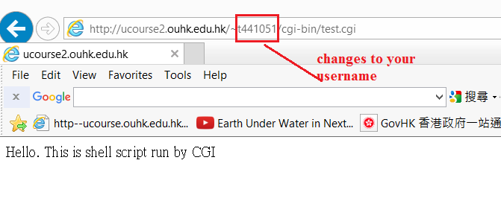
Lab 1.8 – Step 1 (5)
Access the web page file “test.cgi” by any browser.
URL of test.cgi
  http://ucourse2.ouhk.edu.hk/~s1234567/cgi-bin/test.cgi (where s1234567 is username of your account in ucourse)
P.<number>
Notes:
CT212 (02/03)-Network Programming and design
27 April, 2002
School of Science & Technology

Slide 9
Lab 1.8 – Step 2
Prepare directory & files to be password protected
mkdir ~/public_html/protect
chmod 701 ~/public_html/protect
cp ~/public_html/test.html ~/public_html/protect
P.<number>
Notes:
CT212 (02/03)-Network Programming and design
27 April, 2002
School of Science & Technology

Slide 10
Lab 1.8 – Step 3 (1)
To provide password-protection to any web page files (*.html) under ~/public_html/protect, you need to
  Create username/password file, “.myhtpasswd” (Step 3)
  Create a file, “.htaccess”, under the directory to be password-protected (Step 4)
  The file “.htaccess” must be located in the directory where password protection is required.
  Set appropriate permission right for files “.myhtpasswd” and “.htaccess”
P.<number>
Notes:
CT212 (02/03)-Network Programming and design
27 April, 2002
School of Science & Technology

Slide 11
Lab 1.8 – Step 3 (2)
Create username/password file “.myhtpasswd” with a new username “s1234567” and password “apr09” by command below.
  cd ~/public_html/protect
  /usr/local/apache/bin/htpasswd -c .myhtpasswd s1234567
      Password is apr09
  Note: if you create second username/password, you need to use option –b (/usr/local/apache/bin/htpasswd -b .myhtpasswd username password)
Verify new username/password pair is created
  cat .myhtpasswd
P.<number>
Notes:
CT212 (02/03)-Network Programming and design
27 April, 2002
School of Science & Technology

Slide 12
Lab 1.8 – Step 4 (1)
In ~/public_html/protect, create file “.htaccess” using pico
cd ~/public_html/protect
pico .htaccess
Content of file .htaccess
AuthType Basic
AuthName “Lab 1.8 Password protection”
AuthUserFile YourHomeDir/public_html/protect/.myhtpasswd
<LIMIT GET POST>
Require valid-user
</LIMIT>
Set permission right of the file “.htaccess” to 704
  chmod 704 ~/public_html/protect/.htaccess
Set permission right of the file “.myhtpasswd” to 704
    chmod 704 ~/public_html/protect/ .myhtpasswd
P.<number>
Notes:
CT212 (02/03)-Network Programming and design
27 April, 2002
School of Science & Technology

Slide 13
Lab 1.8 – Step 4 (2)
The file “.htaccess” tells APACHE server
    AuthType: Which protocol is used for authentication. (basic)
    AuthName: The message displayed in prompt window
    AuthUserFile: Location and filename of password file containing username/password.
    Require valid-user: any username in password file can be used for authentication
    ErrorDocument: Display particular web page with error message when authentication is failed (eg. Wrong username/password for 3 times).
P.<number>
Notes:
CT212 (02/03)-Network Programming and design
27 April, 2002
School of Science & Technology

Slide 14
Lab 1.8 – Step 5
Verify user authentication by IE browser.
  In any browser, type URL
  http://ucourse2.ouhk.edu.hk/~s1234567/protect/test.html
(where s1234567 is your username of account in ucourse)
    A pop-up window appears. It prompts you for username and password (Fig. 1.8.2)
  Press “cancel” button in the pop-up window
    It should redirect you to a web page with warning message (Fig. 1.8.3)
  Press “Refresh” button in IE browser.
    A pop-up window appears. It prompts you for username and password (Fig. 1.8.4)
    Enter “s1234567” as username and “apr09” as password. The authentication will be successful and greeting page comes out. (Fig. 1.8.5)
Remember to “delete all cache” if you retry after successful access
P.<number>
Notes:
CT212 (02/03)-Network Programming and design
27 April, 2002
School of Science & Technology

