Slide 1
***All references, if any, are referred to Joe’s teaching file, NOT study unit.
You can download from tutorial page of my teaching website : http://learn.ouhk.edu.hk/~t441051/s212/index.html
Password for teaching materials in my teaching website is s2122018
P.<number>
Notes:
CT212 (02/03)-Network Programming and design
27 April, 2002
School of Science & Technology

Slide 2
Course Syllabus (1)
Fundamental concepts of computer networking
  **Unit 1 – Introduction to computer networking and the Internet
  *Unit 2 – Network Infrastructure
  ***Unit 3 – TCP/IP essentials
  Unit 4 – Network operating systems
Network application development
  **Unit 5 – Introduction to network application
  **Unit 6 – Network programming
  **Unit 7 – Internet applications and network game development
  (cont’ d)
P.<number>
Notes:
CT212 (02/03)-Network Programming and design
27 April, 2002
School of Science & Technology

Slide 3
Course Syllabus (2)
Advance networking issues & network solution design
  **Unit 8 – Security in networks
  **Unit 9 – Wide area network access and wireless technologies
  **Unit 10 - Marketing of network products & services
P.<number>
Notes:
CT212 (02/03)-Network Programming and design
27 April, 2002
School of Science & Technology

Slide 4
Objectives of unit 1 (1)
Explain what a computer network is, why computer networks are used
  computers & networking devices connected by transmission media. The computers can communicate, provide or access shared resources, with the help of some networking S/W.
Explain why computer networks are used and describe the general services that computer networks provide or facilitate.
  Share resources sharing
  Enhancing communication and collaboration between people
  Remote management of network resources
Describe, compare and contrast the characteristics of client/server architecture and peer-to-peer architecture.
P.<number>
Notes:
CT212 (02/03)-Network Programming and design
27 April, 2002
School of Science & Technology

Slide 5
Objectives of unit 1 (2)
Categorize networks according to scale, and explain their differences.
  Classification by different criteria is possible. Size criteria is only one of different criteria.
    PAN, LAN, MAN, CAN, WAN
Describe the basic network topologies, and explain the benefits and uses of different topologies.
  Be aware the difference between physical topology and logical topology
Describe, compare and contrast the characteristics of circuit-switched networking and packet-switched networking.
  Internet (i.e. TCP/IP) use packet switching
  Telephone system uses circuit switching
P.<number>
Notes:
CT212 (02/03)-Network Programming and design
27 April, 2002
School of Science & Technology

Slide 6
Objectives of unit 1 (3)
Describe, compare and contrast the characteristics of connection-oriented and connectionless services.
  Connection setup before data transfer
  reliability
Identify and describe the more important LAN technologies.
  Ethernet uses CSMA/CD
  wireless LAN uses CSMA/CA
P.<number>
Notes:
CT212 (02/03)-Network Programming and design
27 April, 2002
School of Science & Technology

Slide 7
Objectives of unit 1 (4)
Outline, compare, and contrast the OSI model and the Internet reference model.
  How many layers? Name & function of layers.
  Comparison of OSI & TCP/IP model
  TCP/IP model is also named as INTERNET model.
Explain what the Internet is, and describe its infrastructure.
  H/W (routers, switches, …, transmission media) & S/W (TCP/IP, NOS, applications)
Identify and describe some of the most important services that are available on the Internet.
  WWW, Email, DNS, SSH/telnet, SFTP/FTP
Define the prevalent networking protocols and standards, and identify some of the more important standards organizations and Internet standards.
P.<number>
Notes:
CT212 (02/03)-Network Programming and design
27 April, 2002
School of Science & Technology

Slide 8
Objectives of unit 2 (1)
Identify the core elements of a network infrastructure.
  H/W: Gateway, router, bridge, switch, hub, repeater
  S/W: network protocol (unit 3), application (unit 5, 6, 7) & NOS (Unit 4)
  Transmission media: coaxial cable (obsolete), twisted pair cable (UTP or STP) or optic fiber
Explain basic network signal transmission concepts.
Choose the most appropriate transmission media in respect to different circumstances.
  Wired:
  Wireless connection : wireless LAN or Infra-red (Unit 9: Pick appropriate standard and security protocol)
Identify and describe different network topologies.
P.<number>
Notes:
CT212 (02/03)-Network Programming and design
27 April, 2002
School of Science & Technology

Slide 9
Objectives of unit 2 (2)
Explain the functionality of networking equipment including hubs, switches and routers.
  Which level does each H/W device works on in OSI/TCP model?
  What problem some device has and what problem it can solve?
Inspect and configure basic network tools.
Describe basic network design.
  avoid collision and broadcast problem
  Segmentation to improve performance
  choose appropriate network devices to solve 2 problems.
  More on Unit 8, 9 & 10
P.<number>
Notes:
CT212 (02/03)-Network Programming and design
27 April, 2002
School of Science & Technology

Slide 10
Objective of Unit 3 (1)
Describe the concept of the Internet architecture
  Layered
  Encapsulation, de-capsulation, de-multiplex, TCP & UDP port are different, MTU
Identify the different roles of IP, TCP and UDP in Internet communication
Describe the features of the IP
  Function of IP layer
  Format, structure of IP address
  Classful IP and Classless IP
  Is IP address enough? Why? How to solve?
  IPv6
  **How to subnet (“refer to another document “how_to_subnet.doc”)
P.<number>
Notes:
CT212 (02/03)-Network Programming and design
27 April, 2002
School of Science & Technology

Slide 11
Objective of Unit 3 (2)
Discuss IP naming and address translation mechanisms
  DNS: DNS name <-> IP address
  ARP: IP -> MAC address; RARP: MAC -> IP address
Demonstrate an understanding of IP routing
  Understand what default gateway means
  IP packets are routed based on destination IP address
Compare connection-oriented and connectionless communication
  Transport layer has 2 protocols only:
    TCP – connection oriented
    UDP - connectionless
P.<number>
Notes:
CT212 (02/03)-Network Programming and design
27 April, 2002
School of Science & Technology

Slide 12
Objective of Unit 3 (3)
Discuss TCP protocol mechanism
  Connection-oriented:
    connection setup before data transfer.
  Reliable & flow control by sliding window
Discuss UDP protocol mechanism
  Connectionless:
    No connection setup
  Un-reliable but better throughput
  Small & independent packet
Analyze the benefits & limitations of TCP and UDP
  A high level comparison
P.<number>
Notes:
CT212 (02/03)-Network Programming and design
27 April, 2002
School of Science & Technology

Slide 13
5 questions for communication between 2 web applications (eg. Client & server) on 2 different machines?
  How to identify a machine → IP address
  How to identity a s/w running in a machine → sokcet (i.e. IP address + transport layer protocol type + port number)
  How to transfer data from one machine to another → routing table + IP layer based on destination IP address
  How to ensure all data are correctly received by destination s/w -> TCP reliability
  What to do if there is network congestion due to :
    Transmitting host sends out data too fast;
    receiving capability of destination machine is not enough (eg. Less processing power, memory, NIC speed, etc) -> TCP flow control
P.<number>
Notes:
CT212 (02/03)-Network Programming and design
27 April, 2002
School of Science & Technology

Slide 14
Objective of Unit 5 (1)
Describe the basic steps in creating C programs
Analyze simple C program
Describe different data structures in C
Describe variables, types and type declaration in C
Discuss the basic input and output (i.e. I/O) functionalities in C
Demonstrate the basic conditional-testing statement, looping mechanism in C
Describe arithmetic operations in C
Demonstrate the capability on using arrays and pointers in C
P.<number>
Notes:
CT212 (02/03)-Network Programming and design
27 April, 2002
School of Science & Technology

Slide 15
Objective of Unit 5 (2)
Demonstrate a basic understanding of application development and write applications using C
  **Can you:
    How to compile a C source code to executable
    Understand & comment on a C source code
    Track values of variables when C program is executing.
  If you still don’t know how to write a simple C program, study this online workshop
http://learn.ouhk.edu.hk/~t441051/s212/workshop/c_program_beginner_workshop/index.html
P.<number>
Notes:
CT212 (02/03)-Network Programming and design
27 April, 2002
School of Science & Technology

Slide 16
Objective of Unit 6 (1)
Discuss client/server architecture
Discuss concepts of process
  Process definition
  What is pid, ppid, zombie process?
  How to identify pid, ppid of a process using “ps aux”, “ps –al”.?
  How to find out pid and ppid of a process?
    By Linux/UNIX command
    By system call.
  How to kill a process?
Discuss the use of sockets for inter-process communication.
Identify and describe different modes of socket communication.
  connection oriented (TCP)
  connectionless (UDP)
P.<number>
Notes:
CT212 (02/03)-Network Programming and design
27 April, 2002
School of Science & Technology

Slide 17
Objective of Unit 6 (2)
Describe the process of socket programming with TCP
Describe the process of socket programming with UDP
Develop network applications using sockets
  Integration of socket system calls (getpid(), getppid(), gethostbyname() , gethostname(), ….) into network application.
Explain the operations of Remote Procedure Calls (RPCs).
P.<number>
Notes:
CT212 (02/03)-Network Programming and design
27 April, 2002
School of Science & Technology

Slide 18
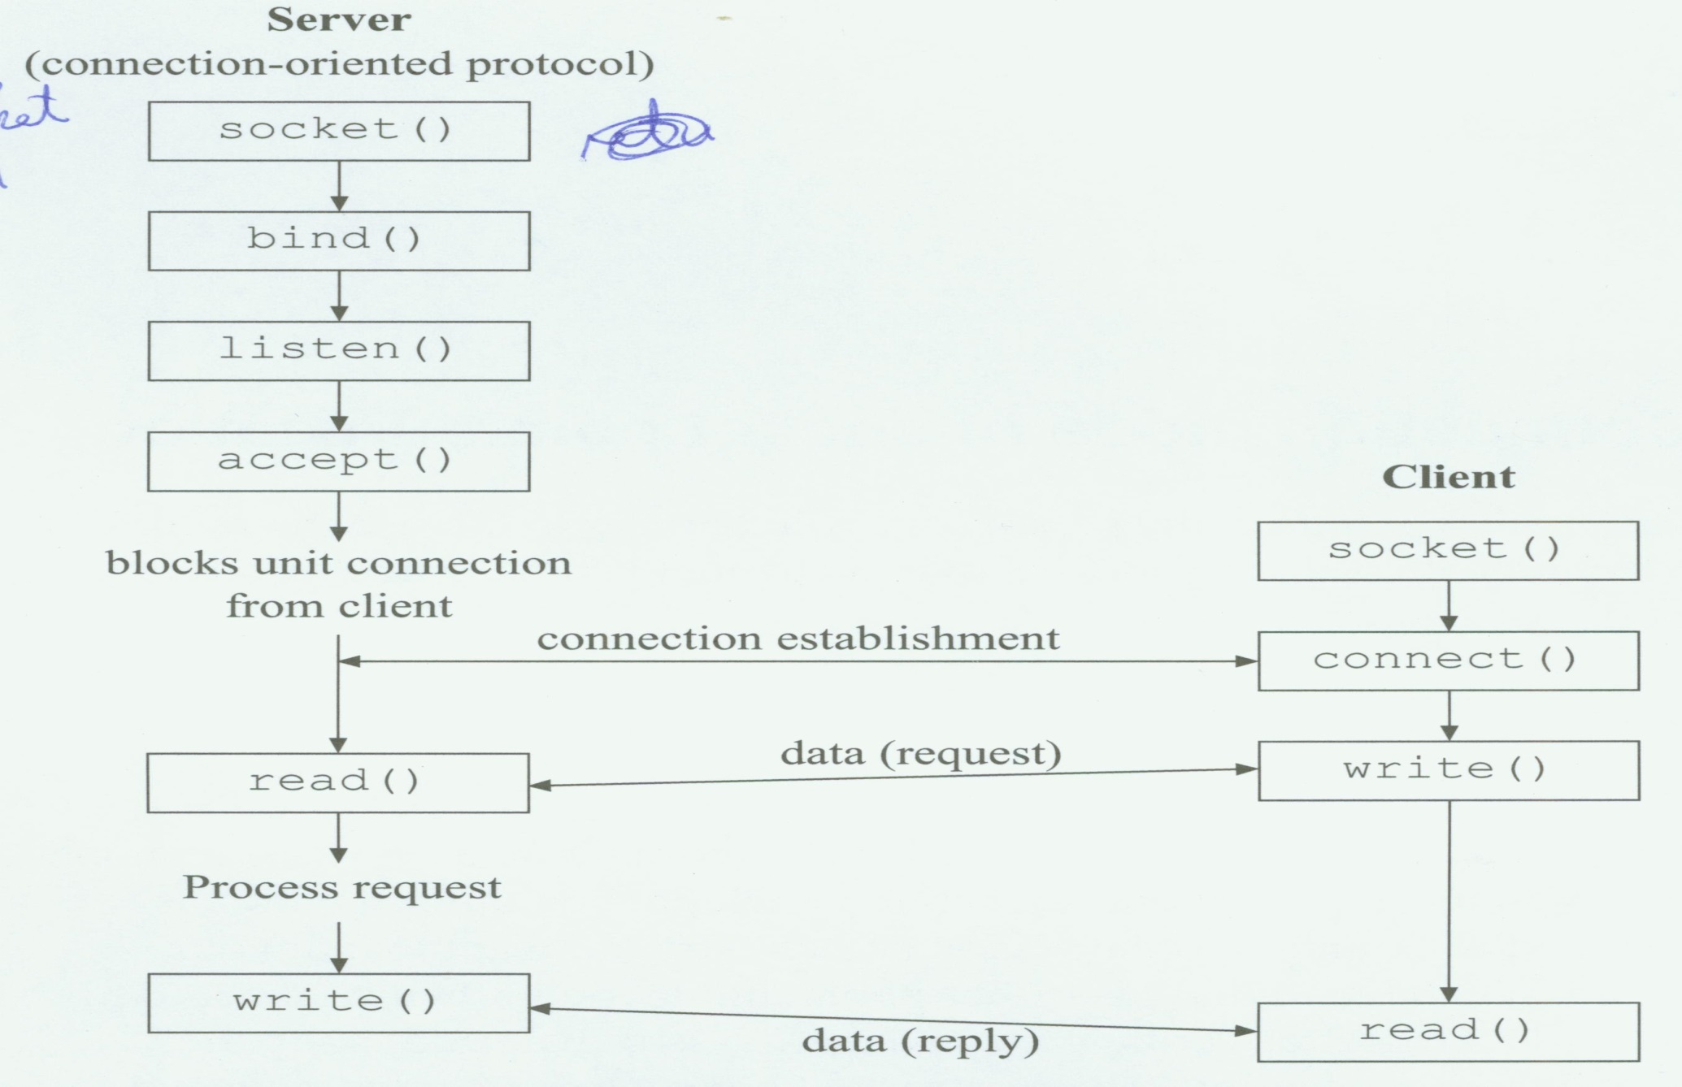
Connection-oriented
P.<number>
Notes:
CT212 (02/03)-Network Programming and design
27 April, 2002
School of Science & Technology

Slide 19
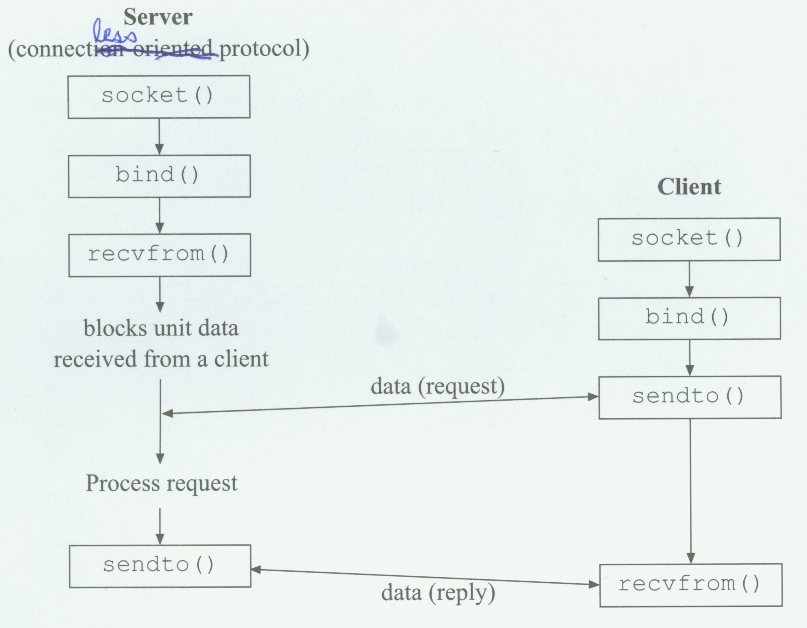
Connectionless
P.<number>
Notes:
CT212 (02/03)-Network Programming and design
27 April, 2002
School of Science & Technology

Slide 20
Objective of Unit 7 (1)
Identify the features of WWW
Write HTML documents
  http://learn.ouhk.edu.hk/~t441051/s212/workshop/HTML_workshop/index.html)
Explain the use of programs on the web
Compare & contrast server-side and client-side scripting
  TMA03 (Q1)
Discuss the several programming languages to build websites
Develop interactive homepages using Javascript
P.<number>
Notes:
CT212 (02/03)-Network Programming and design
27 April, 2002
School of Science & Technology

Slide 21
Objective of Unit 7 (2)
Understand CGI program development
  (CGI workshop in my teaching website)
    Read encoded form data from stdin
    Decoding and extract original form data
    Print html header
    Process based on programming specification and return some value back to browser in HTML format.
    Print html footer.
  Refer to my “workshop for CGI”
    CGI basic concepts
    4 steps of writing cgi POST program
P.<number>
Notes:
CT212 (02/03)-Network Programming and design
27 April, 2002
School of Science & Technology

Slide 22
Objective of Unit 8
Discuss the goals and risks in network security
  CIAA
  TMA03 (Q4)
Describe the implementation of security policies and audits.
Identify and describe common network security controls, including firewalls, IDS, anti-virus server, VPN gateway, IPSEC and SSL
  TMA03 (Q4, Q5)
Identify and describe common cryptography algorithms. Describe the mechanisms for authentication and integrity
Discuss resilient network designs and NOS security issues
Practice the use of public keys for secure remote host access
P.<number>
Notes:
CT212 (02/03)-Network Programming and design
27 April, 2002
School of Science & Technology

Slide 23
Objective of Unit 9 (1)
Identify and describe the operation and types of WAN technologies
Demonstrate awareness of local developments in WAN services
Discuss basic issues related to wireless communication
  AP (Access Point) is required for wireless LAN
  Advantages such as mobility and flexibility
  Transmission speed is much better and is approaching wired network.
  The transmitted data is through air => Everyone can capture the data => security issue is very important.
  Transmission speed (or Signal strength) is inversely proportional to distance from AP. Blocking in-between reduces signal strength.
P.<number>
Notes:
CT212 (02/03)-Network Programming and design
27 April, 2002
School of Science & Technology

Slide 24
Objective of Unit 9 (2)
Evaluate wireless network protocols and standards
  802.11a, b, g, N, WiMax
  RF frequency, transmission data rate & coverage
Describe common wireless security measure and standards
P.<number>
Notes:
CT212 (02/03)-Network Programming and design
27 April, 2002
School of Science & Technology

Slide 25
Objective of Unit 9 (3)
Practical understanding of wireless network
  Do you know AP?
  Do you know security protocols for wireless such as WEP, WPA, WPA2?
  Security is basically provided by encryption. Dynamic and random key is much more secure.
  WEP (Wired Equivalent Privacy) – static key
  WPA (Wi-Fi Protected Access) – dynamic key
  WPA2 – dynamic key and very strong encryption algorithm (AES)
  Only WPA2 is secure enough. Others are breakable
P.<number>
Notes:
CT212 (02/03)-Network Programming and design
27 April, 2002
School of Science & Technology

Slide 26
Objective of Unit 10 (1)
Discuss basic network design goals/issues
  There is always trade-off between different factors during design.
    Functionality
    Scalability
    Adaptability
    Manageability
    Satisfy user requirements
      Reliability
      Availability
      Response time
      user-friendliness
      Network security
      ….
    Cost effective
P.<number>
Notes:
CT212 (02/03)-Network Programming and design
27 April, 2002
School of Science & Technology

Slide 27
Objective of Unit 10 (2)
Outline the network solution design process
**Collect, understand and analyze network requirements of your company.
  Need communication with end user.
Identify design goals.
Choose suitable concurrent network technologies
**Design network infrastructure & NOS.
  Design fulfills, at best, network requirements and design goals. There is always trade-off among design goals and network requirements.
  You may simulate
*Documentation of your design
Review your design based on your documentation. Re-works with steps 1 to 5 if necessary
Implement based on your final design documentation
P.<number>
Notes:
CT212 (02/03)-Network Programming and design
27 April, 2002
School of Science & Technology

Slide 28
Objective of Unit 10 (3)
Analyze network requirements and existing network designs, and identify areas for improvement.
  Fully understand user-requirement – functionality, performance, security and reliabiliy
  Geographical location of networked offices
  Nature of application
  Cost
  Future expansion
P.<number>
Notes:
CT212 (02/03)-Network Programming and design
27 April, 2002
School of Science & Technology

Slide 29
Objective of Unit 10 (4)
Identify points of concerns in network design.
  Correctness of user requirement
  Correct interpretation of user requirement
  Technical skill of designer
  Cost match with budget or not
  Ease of management, maintenance and troubleshooting of network
  ….
Design network solutions that satisfy both business and technical goals.
Discuss basic issues related to network solutions implementation.
Discuss basic issues related to testing, optimizing and documenting network design solutions, and to security issues related to network solution design (Unit 8).
P.<number>
Notes:
CT212 (02/03)-Network Programming and design
27 April, 2002
School of Science & Technology

Slide 30
Objective of Unit 10 (3)
Identify the key points in network maintenance, analyze simple network problems and implement corresponding troubleshooting procedures.
Discuss basic Internet marketing and advertising principles, and develop the capacity to conduct hands-on global e-auction activities.
  What is network marketing
  **Framework of network marketing
  **Components of network marketing framework
  4 concepts/laws for network economics
  Fundamentals for network marketing
P.<number>
Notes:
CT212 (02/03)-Network Programming and design
27 April, 2002
School of Science & Technology

Slide 31
Suggestion (1)
Please read exam-related documents from C.C. (available in OLE home -> ELECS212-News -> Course News).
  Exam-Messages-to-Students from C.C. (for key topics)
  Specimen Exam paper (for exam format only)
Concentrate on topics from objectives of each unit. This file provides a highlight on it.
Review questions from TMAs
Make sure you really understand how to subnet
P.<number>
Notes:
CT212 (02/03)-Network Programming and design
27 April, 2002
School of Science & Technology

Slide 32
Suggestion (2)
Don’t be afraid of CGI programming.
  Ensure you know how to understand C source code, comment it and track values of variables when program runs
  Ensure you know how to use system call in a C program.
  Ensure you know the framework of CGI programming
  Ensure you know how to change a C program into CIA program.
  The program won’t be too difficult and too long.
Try to answer in point-form. We don’t need an essay.
Lengthy un-related answer won’t get any mark but just waste your examination time and may make script marker feel un-comfortable.
Never leave your answer blank.
P.<number>
Notes:
CT212 (02/03)-Network Programming and design
27 April, 2002
School of Science & Technology

