Slide 1
ELEC S212 (Sept. 2018) Network Programming and Design
Surgery 2
(Network Infrastructure)
Course Coordinator : Dr. Steven Choy
Tutor : Mr. Lee, Bo-sing (Joe)
URL of my teaching website : http://learn.ouhk.edu.hk/~t441051/s212

Slide 2
Agenda for Surgery 2
What is network Infrastructure
Transmission basic
Transmission medium
Physical and logical topology
Network access method (or technology)
Network equipment (or components)
2 types of network backbone
Collision problem
Broadcast problem

Slide 3
Objective of Unit 2
Describes the core elements of a network infrastructure;
Explains basic network signal transmission concepts;
Discusses the most appropriate transmission media in respect to different circumstances;
Describes different network topologies;
Describes different types of access networks, and identifies their differences;
Explains the functionality of networking equipment including hubs, switches and routers;
Outlines basic network design principles and tools.

Slide 4
What is Network Infrastructure (1)
Network infrastructure is composed of
Transmission medium
Wired or wireless
Physical and logical topology
Bus, ring, star, hybrid
Network access method (or technology)
Etherenet (CSMA/CD), wireless (CSMA/CA), Token ring (obsolete), FDDI, ATM, etc.
Network equipment
Hub (obsolete), repeater, LAN switch, bridge and router
Servers
WWW, email, DNS, etc
Protocol suit (TCP/IP) and NOS

Slide 5
What is Network Infrastructure (2)
Design of network infrastructure:
How to connect network equipment and servers
Where should be placed for those network equipment and servers
Configuration of those network equipment and servers
Configuration of NOS

Slide 6
Types of transmission signal
Transmission is the processing required to pass signal (i.e. data) from one end to the other via transmission medium
2 types of signal
Analog
Signal value is continuous
With amplitude, frequency, wavelength and phase
Signal strength decrease with transmission length => loss of signal content
Eg. Dialup networking or multiplexing
Digital
A series of pulses, with value of “0” and “1” only
Encoding series of “0” and “1” to represent signal content

Slide 7
transmission direction
Simplex
Signal can travel in one direction only
Half-duplex
Signal can travel in both direction over medium but in only one direction at a time
Full-duplex
Signal can travel in both direction over medium but in both directions at the same time
Multiplex
Multiple signal are allowed to travel at the same time over medium, with each signal assigned to a sub-channel.

Slide 8
Transmission media (1)
Wired
Coaxial cable
BNC connector
Used in obsolete Thinnet (10base2) & thicknet (10base5)
HK cable TV still use RG-6 coaxial cable
Twisted pair cable (most-commonly used)
Relatively inexpensive, easy to install, flexible
2 types:
STP - With a shielding to prevent electro-magnetic interference
UTP - cat. 1 to 7, RJ-45 connector,
Fiber optic (growing but expensive)
Resistant to electro-magnetic interference
Longer transmission distance (2 to 5km), larger bandwidth (100baseFX, 1G, 10G or above)
Better security

Slide 9
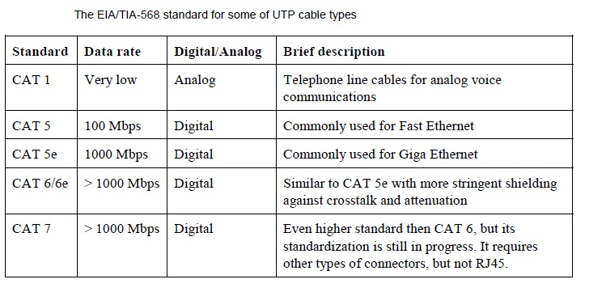
Transmission media (2)
Cat 6/6a

Slide 10
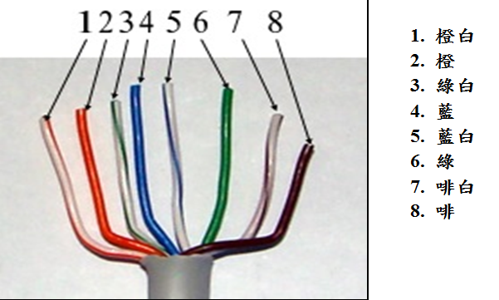
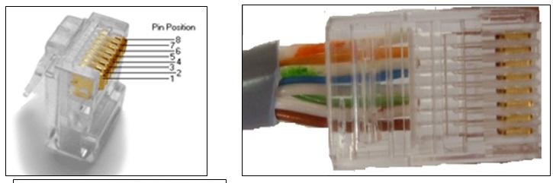
Transmission media (3)

Slide 11
Transmission media (4)
Wireless
Radio Frequency (802.11b, a, g, n)
802.11b – up to 11 Mbps, RF is 2.4 GHz
802.11a – up to 54 Mbps, RF is 4.8 GHz
802.11g – up to 54 Mbps, RF is 2.4 GHz
802.11n – up to 500 Mbps or more.
Longer distance (100 to 150m) & better data rate
Usually requires access point (AP)
Blue tooth
Version 1.x, 2.x, 3.x, 4.x, 5.x
Exchange data over short distance with less data rate
Lower power consumption & simpler configuration

Slide 12
Transmission media (5)
5 factors in choosing media
Cost
Setup cost (Installation) + continuous cost (maintenance & support)
reusing existing infrastructure,
Size & Scalability
Max. node per segment, segment length, max. network length
Throughput and bandwidth (Speed)
Speed of vertical (backbone) cable must be greater than that of horizontal (LAN) cable
Ease of installation, maintenance & support
Noise immunity
Environmental Electro-Magnetic Interference (EMI)

Slide 13
Physical Topology (1)
Physical topology :
Physical view of devices (host & cable concentrating device) and cable
The choice of the physical topology should be in alignment to the transmission media, cabling design and network type.
Different physical topologies vary in their scalability and reliability.
3 types:
Bus (coaxial cable, thinnet, thicknet)
Bad scalability
Single point of failure
Ring (FDDI)
Bad scalability
Single point of failure
Star (UTP with hub, switch or router)
Better scalability
Failure of one node/link has no effect on other nodes

Slide 14
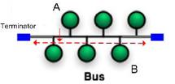
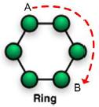
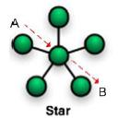
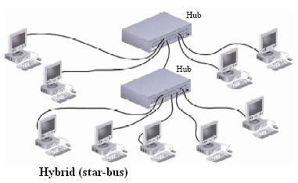
Physical Topology (2)

Slide 15
Logical Topology
Logical topology :
refers to how data is transmitted back and forth among the nodes within a network.
It is concerned with layout view in terms of signal flow
It is related to the network access technology.
2 types:
Bus (eg. in Ethernet)
Ring (eg. in Token ring)
Physical and logical topology of a network can be different.
Eg. Token ring : Physically star, logically ring
Eg. Ethernet : physically star, logically bus

Slide 16
Network access technology
Many technologies are available for network access layer:
Ethernet
Concurrent market dominant for LAN
Wireless
Emerging for LAN
Token ring
Obsolete
FDDI
Obsolete network backbone
ATM
For WAN
Frame Relay
For WAN
…..

Slide 17
Ethernet
2 types of Ethernet
Shared Ethernet
Older generation
use hub, half duplex
cannot overcome collision => bad performance especially for large network
Switched Ethernet
Concurrent generation
Use LAN switch, full duplex
overcome collision => Better performance
Ethernet uses CSMA/CD (Carrier Sense Multi-Access/Collision Detect) for accessing media.

Slide 18
CSMA/CD
Detail of CSMA/CD
Each station always listens on its segment for any signal transmission or collision
Send preamble (a sequence of 1010…bits) before actual data bits
If 2 or more stations transmit at the same time, collision occurs and is detected. All transmitting stations stop sending immediately.
After random of time, re-transmit
So, if any 2 stations transmit data at the same time, the transmitted data will collide and corrupted => collision.
Both stations need to re-transmit data after random of delay => bandwidth is wasted => network performance is degraded.

Slide 19
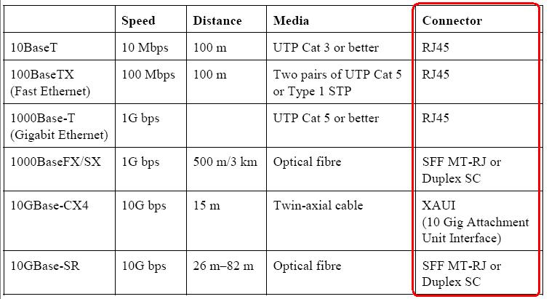
IEEE standards for Ethernet

Slide 20
Wireless
Use CSMA/CA, which is similar to CSMA/CD except that receiver sends explicit acknowledge to sender => more overhead but with better reliability
Each wireless network is named with a SSID (Service Set IDentifier).
Computer associates to the wireless network by this SSID

Slide 21
Token ring (Obsolete)
Token ring media access mechanism
When no host is sending data, a free token is traveling along the ring.
Host must capture a free token before sending data
After capturing a free token, host starts transmitting data
Downstream host repeats signal from upstream host
Transmitting host generate free token after data is received by receiver.

Slide 22
Network equipment (1)
Computers are not connected directly. They are connected to networking devices. Devices include:
Repeater & hub
Operates at OSI layer 1 or TCP/IP layer 1
What is hub (movie). Repeater regenerates electrical signal. Hub is just a multi-port repeater.
Hub cannot overcome collision (movie) and broadcast problem.
Transparent bridge
Operates at OSI layer 2 or TCP/IP layer 1
Forward frame based on destination MAC address.
Bridge operation (movie).

Slide 23
Network equipment (2)
switch
Operates at OSI layer 2 or TCP/IP layer 1
What is switch (movie). Switch is just a multi-port bridge
Switch/bridge can overcome collision problem (movie) but cannot overcome broadcast problem.
Compare hub, switch in terms of collision control (movie)

Slide 24
Network equipment (3)
Router
Operates at OSI layer 3 or TCP/IP layer 2
Forward IP packet based on destination IP address
What is router (movie)
Router can overcome broadcast (movie) & collision problem
Gateway – can work on all layers.

Slide 25
Network backbone
Classification in terms of location of backbone router:
distributed backbone -
Backbone routers are distributed over wide area
Higher cost to connect backbone routers using WAN
Hard to manage
Collapsed backbone -
Backbone components are centralized in a single location
Lower cost,
easy management
Higher adaptability
Higher scalability

Slide 26
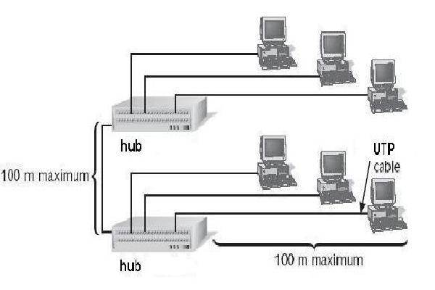
LAN - Collision problem (1)
Segmentation by hub/repeater.
All computers in same collision domain => collision problem

Slide 27
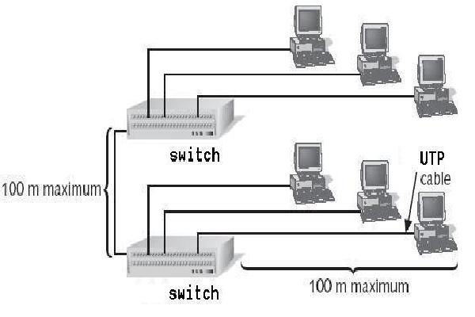
LAN - Collision problem (2)
Segmentation by switch/bridge (overcome collision problem).
Each port of switch corresponds to one segment
=> multiple small collision domains => better performance

Slide 28
LAN - Broadcast problem (1)
All hosts are connected by hub/repeater/bridge/switch & belongs to same subnet.
Broadcast sent by any host can reach all other hosts => broadcast problem

Slide 29
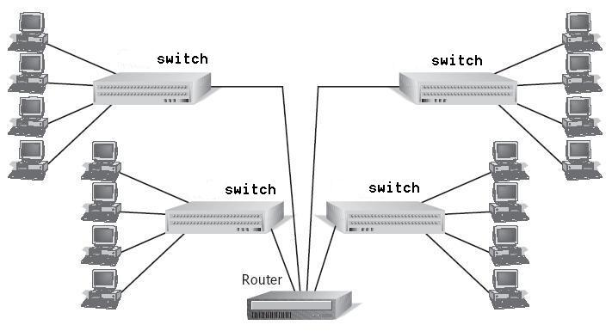
LAN - Broadcast problem (2)
router is used to connect 4 subnets.
Broadcast is limited to each subnet => broadcast domain is much less.

Slide 30
VLAN
VLAN definition:
A logical grouping of network nodes
Nodes can locate at different locations by connecting to different LAN devices.
All nodes of same VLAN forms a broadcast domain and belongs to same subnet
Currently, only switch supports VLAN.
Benefits of VLAN:
Network management: easy to migrate host to another VLAN without physical relocation
Security : communication between VLANs can be controlled.
Limit collision & broadcast traffic within one VLAN

Slide 31
Factors that Impact Network Performance
Size of collision domain
Larger collision domain => lower performance
Size of broadcast domain
Networking protocols are broadcast based
Larger broadcast domain => lower performance
Bandwidth of your network
Lower bandwidth => lower performance
Number of PCs of your network.
More PC => performance may downgrade if not properly designed
Application are data-intensive or not.

Slide 32
Open
Discussions

