Slide 1
ELEC S212 (Sept. 2018)
Network
Programming and Design
Surgery 10, 11 for all groups
(Network solution design & network marketing)
Course Coordinator : Dr. Steven Choy
Tutor : Mr. Joe Lee
URL of my teaching website : http://learn.ouhk.edu.hk/~t441051/s212
By Joe Lee
P.<number>
Notes:
CT212 (02/03)-Network Programming and design
27 April, 2002
School of Science & Technology

Slide 2
Objective of Unit 10 (1)
Outline the network solution design process.
Analyze network requirements and existing network designs, and identify areas for improvement.
Discuss basic network design issues, and identify points of concerns in network design.
Design network solutions that satisfy both business and technical goals.
Discuss basic issues related to network solutions implementation.
By Joe Lee
P.<number>
Notes:
CT212 (02/03)-Network Programming and design
27 April, 2002
School of Science & Technology

Slide 3
Objective of Unit 10 (2)
Discuss basic issues related to testing, optimizing and documenting network design solutions, and to security issues related to network solution design.
Identify the key points in network maintenance, analyze simple network problems and implement corresponding troubleshooting procedures.
Discuss basic Internet marketing and advertising principles, and develop the capacity to conduct hands-on global e-auction activities.
By Joe Lee
P.<number>
Notes:
CT212 (02/03)-Network Programming and design
27 April, 2002
School of Science & Technology

Slide 4
Agenda for Tutorial 10
Goals of network design
Analysis of network requirements of your company
Network design process
Network design
  Network infrastructure
Network implementation
Network maintenance & trouble-shooting
Network marketing
By Joe Lee
P.<number>
Notes:
CT212 (02/03)-Network Programming and design
27 April, 2002
School of Science & Technology

Slide 5
Network design
By Joe Lee
P.<number>
Notes:
CT212 (02/03)-Network Programming and design
27 April, 2002
School of Science & Technology

Slide 6
Network design goals (1)
Before design, you needs to know your design goal
No ideal design in the world
There is always trade-off between different factors during design.
  Functionality
  Scalability
  Adaptability
  Manageability
  Satisfy user requirements
    Reliability
    Availability
    Response time
    user-friendliness
    Network security
    ….
  Cost effective
By Joe Lee
P.<number>
Notes:
CT212 (02/03)-Network Programming and design
27 April, 2002
School of Science & Technology

Slide 7
Network design goals (2)
Functionality – fulfill user functional requirement
Scalability – ability to support growing number of users & applications.
Adaptability – ability to adopt future technologies. Network technology always evolves with time.
Manageability – easy administration. A perfect but complex network, that needs extra cost/man-power to manage or difficult to manage, is useless
Satisfy user requirement
  Performance – response time must be satisfied by user, especially for time-critical application
  User-friendly
  Reliability – especially for mission-critical application, Internet connection & network backbone
  Security – sensitive data over public network
Cost-effectiveness – especially concerned by your boss
By Joe Lee
P.<number>
Notes:
CT212 (02/03)-Network Programming and design
27 April, 2002
School of Science & Technology

Slide 8
Analysis of network requirements (1)
User requirement :
  Functionality
  Performance or response time (eg. Video conference)
  Reliability (eg. Mission-critical financial application)
  Security
Geographical information of offices to be connected:
  Geographical distribution of offices decide what technology to use :
    LAN or WAN or both.
    What kind of WAN or LAN?
  Number of computers in each office
By Joe Lee
P.<number>
Notes:
CT212 (02/03)-Network Programming and design
27 April, 2002
School of Science & Technology

Slide 9
Analysis of network requirements (2)
Nature of applications running on network :
  Bandwidth requirement – large amount of data passing through network
  Mission-critical (reliability) or time-critical (performance)
  Broadcast-intensive – need segmentation
Future expansion :
  Your company grows.
  New technology evolves.
    Eg. Cat 3 cable supports 10Mbps while Cat 5 cable supports 100Mpbs. Amount of data is always increasing. You must choose Cat 6e or 7 cable.
  Discuss with top management about expansion of company within “3 to 5” years and/or “5 to 10” years.
By Joe Lee
P.<number>
Notes:
CT212 (02/03)-Network Programming and design
27 April, 2002
School of Science & Technology

Slide 10
Analysis of network requirements (3)
Cost estimation :
  2 parts :
    One-time (i.e. setup cost)
    Recurring (i.e. maintenance cost)
  Different technologies may involve different cost. Eg. LAN always involves both parts while WAN involves recurring cost only (WAN link is leased from telecom provider)
Network simulation :
  Simulate network loading before implementation
  Provide a rough idea of performance of network
  Help you to predict future number of users, applications & topology.
  Correctness of result depends on correctness of your modeling and simulation data
By Joe Lee
P.<number>
Notes:
CT212 (02/03)-Network Programming and design
27 April, 2002
School of Science & Technology

Slide 11
Network design process
**Collect, understand and analyze network requirements of your company.
  Need communication with end user.
Identify design goals.
Choose suitable concurrent network technologies
**Design network infrastructure & NOS.
  Design fulfills, at best, network requirements and design goals. There is always trade-off among design goals and network requirements.
  You may simulate
*Documentation of your design
Review your design based on your documentation. Re-works with steps 1 to 5 if necessary
Implement based on your final design documentation
By Joe Lee
P.<number>
Notes:
CT212 (02/03)-Network Programming and design
27 April, 2002
School of Science & Technology

Slide 12
Network design
2 parts :
  Network infrastructure
    For small network :
      LAN only
      Flat model is enough
    For very large network :
      composed of a number of LANs & WANs
      very complicated
      require hierarchical model
  NOS (WIN2016): with virtualization technology.
By Joe Lee
P.<number>
Notes:
CT212 (02/03)-Network Programming and design
27 April, 2002
School of Science & Technology

Slide 13
Network infrastructure - definition
Infrastructure includes :
  transmission media
  Topology
  Network access technology
  LAN internetworking devices :
      LAN switch, bridge, hub, repeater & hosts
  Device connecting LAN or WAN devices : router
  WAN internetworking devices :
      frame relay, X.25, remote access device
  the architecture of the resulting network
  how and where these devices & transmission media are connected
  …….
By Joe Lee
P.<number>
Notes:
CT212 (02/03)-Network Programming and design
27 April, 2002
School of Science & Technology

Slide 14
How to design infrastructure
Usually, top-down design approach is used
  Network architecture design
    Flat or hierarchical
  Backbone design
    Distributed or collapsed
  WAN design
    WAN link bandwidth & redundancy
    Choose WAN technology & Carrier
  LAN design
    Segmentation by LAN switch
    VLAN
    Access control between different VLANs
    ….
  Cabling
  IP addressing scheme
  Wireless LAN design
  INTERNET connection
By Joe Lee
P.<number>
Notes:
CT212 (02/03)-Network Programming and design
27 April, 2002
School of Science & Technology

Slide 15
Network architecture (1)
2 possible types of architectures :
  Flat model – for small network only, easy to manage
  * 3-layered hierarchical model – for small to large network, requires expertise to manage.
By Joe Lee
P.<number>
Notes:
CT212 (02/03)-Network Programming and design
27 April, 2002
School of Science & Technology

Slide 16
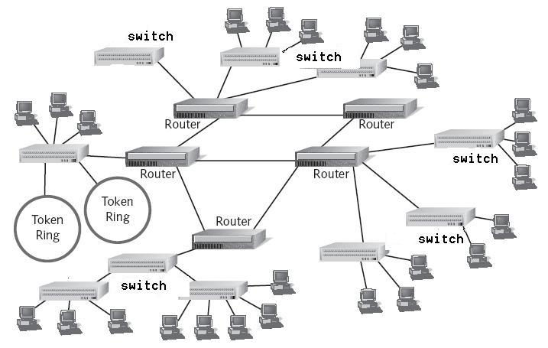
Network architecture (2) - Flat model
By Joe Lee
P.<number>

Slide 17
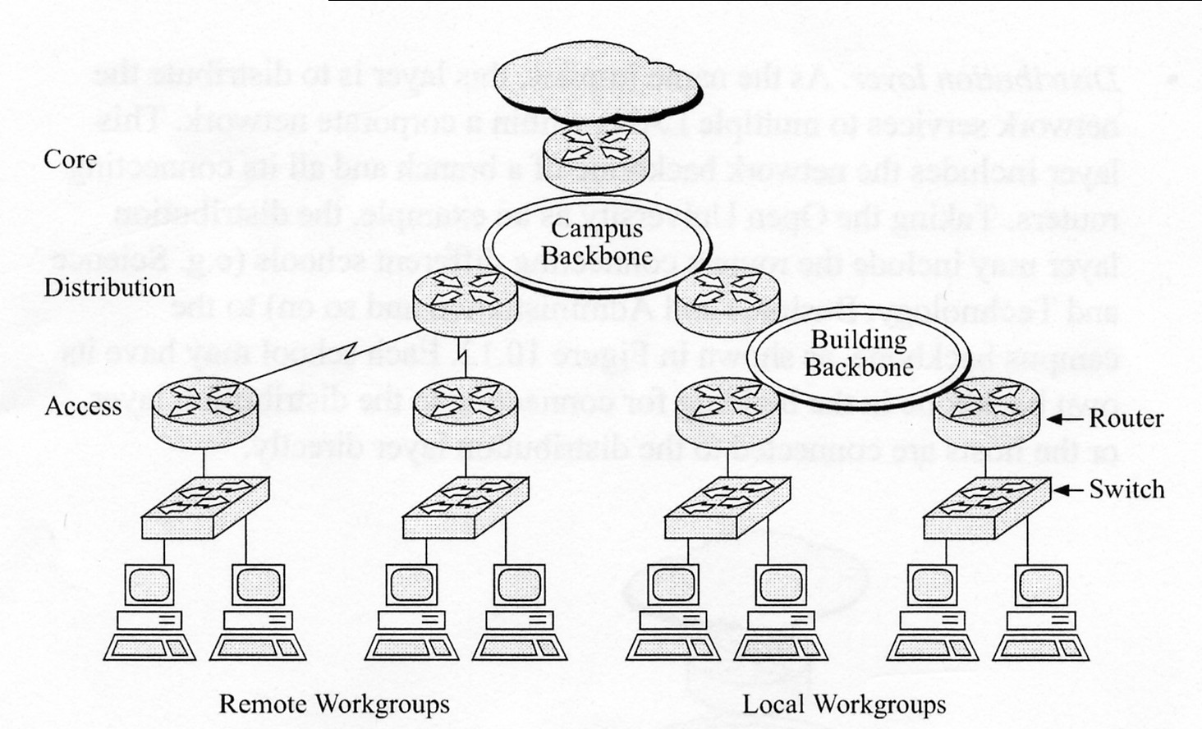
Network Architecture (3)– Hierarchical model
By Joe Lee
P.<number>
Notes:
CT212 (02/03)-Network Programming and design
27 April, 2002
School of Science & Technology

Slide 18
Network Architecture (4)
3-layered hierarchical architecture
  Core layer :
    the backbone of infrastructure
    Connect internal network to external network via FIREWALL
      INTERNET
      remote access via dialup or xDSL connection
    provide WAN connection (eg. frame-relay or X.25) to remote offices
    Server farm is usually connected to this layer.
By Joe Lee
P.<number>
Notes:
CT212 (02/03)-Network Programming and design
27 April, 2002
School of Science & Technology

Slide 19
Network Architecture (5)
3-layered hierarchical architecture
  Distribution layer :
    Distribute network services to multiple departmental LANs within a corporate network.
    Aggregation of traffic and summary of routes
    Routing policy is implemented on this layer
  Access layer :
    Directly connect to LAN SW/hub, which connects hosts
    Access control is done on this layer
By Joe Lee
P.<number>
Notes:
CT212 (02/03)-Network Programming and design
27 April, 2002
School of Science & Technology

Slide 20
Network Architecture (6)
Design issues
  Relationship of transmission speed of 3 layers :
    Core >> distribution > access
  Cable must be shielded if environment is noisy
  Core backbone must be mostly reliable, powerful & only responsible for packet forwarding
  Distribution layer is responsible for routing policy and traffic aggregation
  Access layer is responsible for traffic access control
  Failure of some part of network does not affect running of other parts of network
  Localization of traffic, if possible
  Depending on requirement & complexity of your company, 3 layers can be reduced to 2 or even 1 layer.
By Joe Lee
P.<number>
Notes:
CT212 (02/03)-Network Programming and design
27 April, 2002
School of Science & Technology

Slide 21
Network Architecture (7)
Benefits of 3-layered hierarchical architecture :
  Ease of development, management & trouble-shooting
  Scalable
  Predictability of network behavior
By Joe Lee
P.<number>
Notes:
CT212 (02/03)-Network Programming and design
27 April, 2002
School of Science & Technology

Slide 22
Network Architecture – case study 1
What is the effect to network communication?
Router 101
Router 11
Router 12
Router 1
Router 2
Router 3
Router 4
SW 1
SW 2
SW 3
SW 4
Subnet 1
Subnet 2
Subnet 3
Subnet 4
By Joe Lee
P.<number>
Notes:
CT212 (02/03)-Network Programming and design
27 April, 2002
School of Science & Technology

Slide 23
Network Architecture – case study 2
What is the effect to network communication?
Router 101
Router 11
Router 12
Router 1
Router 2
Router 3
Router 4
SW 1
SW 2
SW 3
SW 4
Subnet 1
Subnet 2
Subnet 3
Subnet 4
By Joe Lee
P.<number>
Notes:
CT212 (02/03)-Network Programming and design
27 April, 2002
School of Science & Technology

Slide 24
Network Architecture – case study 3
What is the effect to network communication?
Router 101
Router 11
Router 12
Router 1
Router 2
Router 3
Router 4
SW 1
SW 2
SW 3
SW 4
Subnet 1
Subnet 2
Subnet 3
Subnet 4
By Joe Lee
P.<number>
Notes:
CT212 (02/03)-Network Programming and design
27 April, 2002
School of Science & Technology

Slide 25
Network Architecture – case study 4
What is the effect to network communication?
Router 101
Router 11
Router 12
Router 1
Router 2
Router 3
Router 4
SW 1
SW 2
SW 3
SW 4
Subnet 1
Subnet 2
Subnet 3
Subnet 4
By Joe Lee
P.<number>
Notes:
CT212 (02/03)-Network Programming and design
27 April, 2002
School of Science & Technology

Slide 26
Network Architecture – case study 5
What is the effect to network communication?
Router 101
Router 11
Router 12
Router 1
Router 2
Router 3
Router 4
SW 1
SW 2
SW 3
SW 4
Subnet 1
Subnet 2
Subnet 3
Subnet 4
By Joe Lee
P.<number>
Notes:
CT212 (02/03)-Network Programming and design
27 April, 2002
School of Science & Technology

Slide 27
Network Architecture – case study 6
What is the effect to network communication?
Router 101
Router 11
Router 12
Router 1
Router 2
Router 3
Router 4
SW 1
SW 2
SW 3
SW 4
Subnet 1
Subnet 2
Subnet 3
Subnet 4
By Joe Lee
P.<number>
Notes:
CT212 (02/03)-Network Programming and design
27 April, 2002
School of Science & Technology

Slide 28
Network Architecture – case study 7
What is the effect to network communication?
Router 101
Router 11
Router 12
Router 1
Router 2
Router 3
Router 4
SW 1
SW 2
SW 3
SW 4
Subnet 1
Subnet 2
Subnet 3
Subnet 4
By Joe Lee
P.<number>
Notes:
CT212 (02/03)-Network Programming and design
27 April, 2002
School of Science & Technology

Slide 29
Network backbone (1)
Classification in terms of components’ location:
  distributed backbone -
    Backbone components are distributed over wide area
    Higher cost
  Collapsed backbone -
    Backbone components are centralized in a single location
    Lower cost, easy management
By Joe Lee
P.<number>
Notes:
CT212 (02/03)-Network Programming and design
27 April, 2002
School of Science & Technology

Slide 30
Network backbone (2)
Advantages of collapsed backbone:
  Ease of management & management
  Higher adaptability
  Higher scalability
  Lower cost
By Joe Lee
P.<number>
Notes:
CT212 (02/03)-Network Programming and design
27 April, 2002
School of Science & Technology

Slide 31
WAN
Mainly for connecting LAN on remote sites from core/distribution layer. Usually rent from telecom provider
Choose appropriate technology based on your requirement of reliability, bandwidth, security, scalability and cost
  Dedicated Lease line
  Leased line
    T1, …., T4
    Sonet (OC-1, OC-192)
  Frame Relay, X.25
  Broadband such as ADSL, SDSL, Cable modem,
  SONET or Metro Ethernet (cheaper than SONET)
By Joe Lee
P.<number>
Notes:
CT212 (02/03)-Network Programming and design
27 April, 2002
School of Science & Technology

Slide 32
LAN –basic concepts
LAN devices – hub/repeater, bridge/switch, router:
  All LAN devices can extend size of LAN
  Ethernet LAN is the mainstream of concurrent network. Its mechanism is broadcast-based & causes collision & broadcast problem.
  Collision and broadcast traffic will downgrade network performance
  Repeater/hub cannot solve collision & broadcast problem
  Bridge/switch can solve collision problem but cannot solve broadcast problem.
  Router can solve both collision & broadcast problem but its cost is much higher
Reduce size of collision domain by segmenting a LAN with LAN switch/bridge
Reduce size of broadcast domain by router
By Joe Lee
P.<number>
Notes:
CT212 (02/03)-Network Programming and design
27 April, 2002
School of Science & Technology

Slide 33
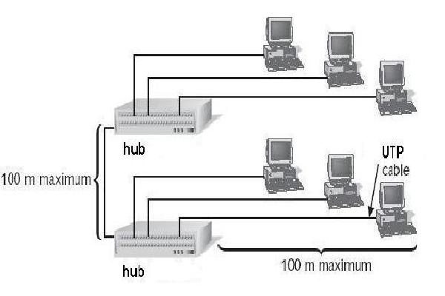
LAN - Collision problem (1)
Segmentation by hub/repeater.
All computers in same collision domain => collision problem
By Joe Lee
P.<number>

Slide 34
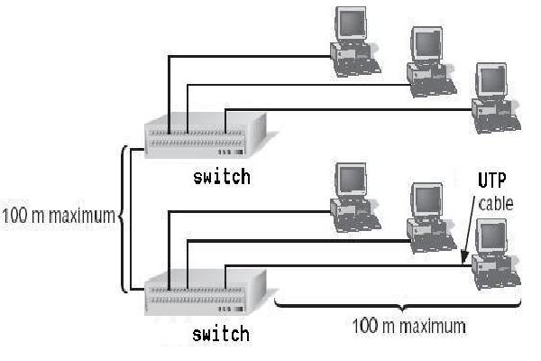
LAN - Collision problem (2)
Segmentation by switch/bridge (overcome collision problem).
Each port of switch corresponds to one segment
=> multiple small collision domains => better performance
By Joe Lee
P.<number>

Slide 35
LAN - Broadcast problem (1)
All hosts are connected by hub/repeater/bridge/switch & belongs to same subnet.
Broadcast sent by any host can reach all other hosts => broadcast problem
By Joe Lee
P.<number>

Slide 36
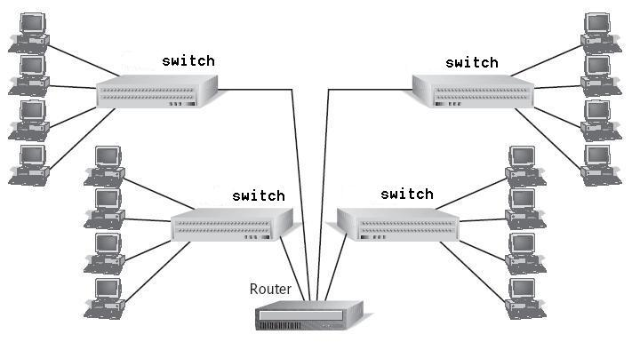
LAN - Broadcast problem (2)
router is used to connect 4 subnets.
Broadcast is limited to each subnet => broadcast domain is much less.
By Joe Lee
P.<number>

Slide 37
VLAN
VLAN definition:
  A logical grouping of network nodes at different physical locations
Nodes can locate at different locations by connecting to different LAN devices.
All nodes of same VLAN forms a broadcast domain and belongs to same subnet
Currently, only switch supports VLAN.
Benefits of VLAN:
  Network management: easy to migrate host to another VLAN without physical relocation
  Security : communication between VLANs can be controlled.
  Limit collision & broadcast traffic within one VLAN
By Joe Lee
P.<number>
Notes:
CT212 (02/03)-Network Programming and design
27 April, 2002
School of Science & Technology

Slide 38
Cabling (1)
To select cable, you should consider 4 issues:
  speed to support
  environment noisy– shielded or unshielded
  Cost
  Easy management
Based on transmission speed(100M/250M/1G), UTP can be classified as cat. 5e/6
  https://en.wikipedia.org/wiki/Twisted_pair
Based on different pin-assignment to RJ45 on both ends, UTP can be classified as straight-through or cross-over cable
  straight-through: to connect LAN device to end hosts,
  cross-over : to connected 2 LAN devices
By Joe Lee
P.<number>
Notes:
CT212 (02/03)-Network Programming and design
27 April, 2002
School of Science & Technology

Slide 39
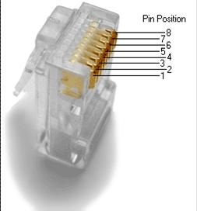
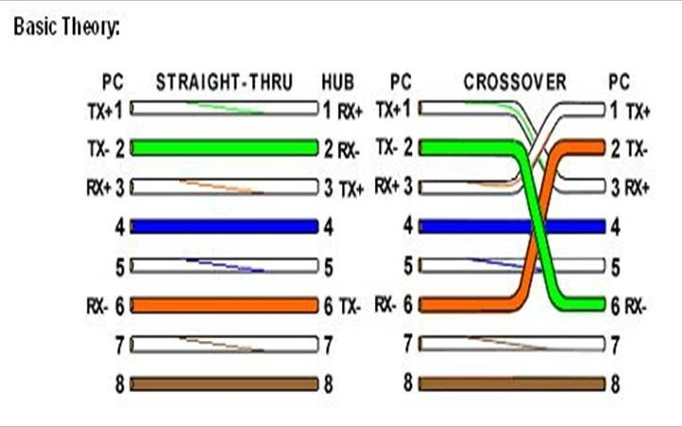
Cabling (2)
By Joe Lee
P.<number>
Notes:
CT212 (02/03)-Network Programming and design
27 April, 2002
School of Science & Technology

Slide 40
Cabling (3)
For connecting backbone or sometimes distribution layer device, higher speed cable such as fiber should be used.
  Fiber can support up to 10 Gbps or even higher
for WAN or INTERNET connection, lease line, metro-Ethernet or other WAN connection from telecom vendor is used
By Joe Lee
P.<number>
Notes:
CT212 (02/03)-Network Programming and design
27 April, 2002
School of Science & Technology

Slide 41
IP addressing (1)
For detail, refer to my tutorial 8 material “how to subnet.doc”
  Number of subnets
  Number of computers per subnet
  Subnet mask of each subnet
  …..
To connect to INTERNET, you must use public (or legal) IP address from INTERNIC or ISP.
Private address :
  Used for network not connecting to INTERNET
  Can connect to INTERNET when work with NAT
  3 ranges :
    10.0.0.0 ~ 10.255.255.255
    172.16.0.0 ~ 172.31.255.255
    192.168.0.0 ~ 192.168.255.255
By Joe Lee
P.<number>
Notes:
CT212 (02/03)-Network Programming and design
27 April, 2002
School of Science & Technology

Slide 42
IP addressing (2) - NAT
Public IP Address
Private IP Address
NAT
FW
INTERNET
Intranet
NAT and FW may be merged into single device
By Joe Lee
P.<number>
Notes:
CT212 (02/03)-Network Programming and design
27 April, 2002
School of Science & Technology

Slide 43
Wireless LAN design (1)
Key design issues:
  RF frequency & interference
  Data rate
  coverage
  Security of data.
  Cost.
Security standards
  Open - no security protocol is used. Knowing SSID can access the wireless network.
  WEP - Static key. Not safe
  WPA - Dynamic key. More safe than WEP.
  WPA2 - Most secure and recommended
By Joe Lee
P.<number>

Slide 44
Wireless LAN design (2)
Planning
  Floor plan of covered area
  Location of AP
  Degree of redundancy between APs
  Minimize overlapping of APs’ covered areas.
  Trade-off between above 2 items
Use PoE switch and AP
Install wireless gateway to filter traffic from wireless network to wired network.
By Joe Lee
P.<number>

Slide 45
INTERNET connection (1)
To connect to INTERNET, think about following issues:
  Choose network protocol – TCP/IP is the sole standard
  Public IP addresses got from ISP
    Use “NAT + private IP address” if number of public IP addresses is NOT enough
  Connection method
    Usually via ISP
    Think about different WAN technologies
  What INTERNET services will be provided to your users?
    Web Browsing & Email are basic
    Other timing critical service such as video conference
By Joe Lee
P.<number>
Notes:
CT212 (02/03)-Network Programming and design
27 April, 2002
School of Science & Technology

Slide 46
INTERNET connection (2)
  What INTERNET servers do you need to maintain
    Web, email, proxy & DNS servers
    Can ISP help to maintain these servers?
  You need security policy and devices to protect your network. Refer to P.28 ~ 68 of Surgery 8.
    Firewall and/or NAT
    VPN gateway
    IPS (Intrusion Prevention System)
    Anti-virus gateway
    Security audit
    Security policy
    ……
By Joe Lee
P.<number>
Notes:
CT212 (02/03)-Network Programming and design
27 April, 2002
School of Science & Technology

Slide 47
Network implementation (1)
Network implementation involves 5 steps:
  Planning
  Installation
  Configuration
  Pilot running to test for fulfilling of original design
  Initial production running
By Joe Lee
P.<number>
Notes:
CT212 (02/03)-Network Programming and design
27 April, 2002
School of Science & Technology

Slide 48
Network implementation (2)
Planning of ACTIVE directory
  Understand concept of active directory.
  Network protocol to use => Obviously TCP/IP
  Hardware requirement of servers
  Network services provided to users
    File, print, email, DNS, web, etc
  Administrative tools to use
  Inter-operation with computers running different OS.
Naming format of rack, switch, router & cables
Access control of data center
Power source (& backup power source)
By Joe Lee
P.<number>
Notes:
CT212 (02/03)-Network Programming and design
27 April, 2002
School of Science & Technology

Slide 49
Network implementation (3)
Installation of networking devices, servers & client machine
  Hardware installation
  connect different networking devices, servers & client using appropriate cables
  install software/application for different networking devices, servers & client.
Configuration of networking devices
  Interface configuration – IP address, speed, duplex
  Routing protocol to use
  Access control list
Configuration of servers machine
  File system to use
  Server role
  Create security measure for accounts
By Joe Lee
P.<number>
Notes:
CT212 (02/03)-Network Programming and design
27 April, 2002
School of Science & Technology

Slide 50
Network maintenance
Goals :
  Keeping network running smoothly
  Finding potential problem
  Optimization.
How :
  Backup
  Standardization
  Documentation
  Continuous monitoring for fulfilling user requirement.
By Joe Lee
P.<number>
Notes:
CT212 (02/03)-Network Programming and design
27 April, 2002
School of Science & Technology

Slide 51
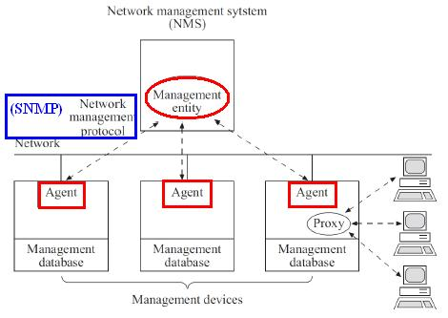
Network management (1)
By Joe Lee
(Switch, Router, AP, server, etc)
P.<number>
Notes:
CT212 (02/03)-Network Programming and design
27 April, 2002
School of Science & Technology

Slide 52
Network management (2)
2 components
  Management entity/manager
    A software which collect, display & anaylyze information from monitored devices
  Management agent installed in devices to be monitored.
    A software which monitors network traffic and behavior on the managed device and gather statistics. The data are stored in its management database.
Network management protocol running between management entity/manage and agent
  SNMP (Simple Network Management Protocol)
By Joe Lee
P.<number>
Notes:
CT212 (02/03)-Network Programming and design
27 April, 2002
School of Science & Technology

Slide 53
Network troubleshooting (1)
Use systematic approach :
  Gathering information :
    from end user or administrator of related part
    From network management tools or scan the network by yourself
  Listing possible causes
  Isolating the problem by tools discussed later :
    Scope of problem – host only or subnet-wide or whole network-wide
  Study the result and try to review step 1 to 3, if necessary.
By Joe Lee
P.<number>
Notes:
CT212 (02/03)-Network Programming and design
27 April, 2002
School of Science & Technology

Slide 54
Network troubleshooting (2)
Troubleshooting tools :
  Testing cable (or RJ45) fault by :
    TDR (Time-Domain Reflectometer) for locating open & short circuits, sharp bends & imperfection of twisted pair & coaxial cable.
    OTDR (Optical Time-Domain Reflectometer) for locating breaks, measuring the attenuation & splice or connector loss in fiber optic cable
    Cable tester for twisted pair, coaxial cable & fiber optic cable – physical connectivity
  Switch port failure:
    By color of switch port
      Green ➔ OK
      Amber ➔ speed or duplex mis-match between switch port and NC of PIC
      Off ➔ port failure
  Router port failure:
    By color of router port (similar to switch port)
By Joe Lee
P.<number>
Notes:
CT212 (02/03)-Network Programming and design
27 April, 2002
School of Science & Technology

Slide 55
Network troubleshooting (3)
  Check correctness of TCP/IP configuration of user’s PC:
    WIN/2013/2016/XP/7/10 : ipconfig /all
    Unix/Linux : ifconfig -a
  Check routing table of user’s PC :
    WIN/2013/2016/XP/7/10, UNIX/Linux : netstat –nr
  Check for path intact :
    ping IP_address_of_destination
  Check for configuration of router
By Joe Lee
P.<number>
Notes:
CT212 (02/03)-Network Programming and design
27 April, 2002
School of Science & Technology

Slide 56
Network troubleshooting (4)
Troubleshooting tools :
  Network traffic :
    Network monitor – usually for creating network traffic profile for future comparison; gather information about packet size, type, error packet, overall use but don’t decode the packet;
    Protocol analyzer such as Wireshark – capturing and decoding data packet. More in-depth analysis can be done but require sophisticated technique & knowledge.
By Joe Lee
P.<number>
Notes:
CT212 (02/03)-Network Programming and design
27 April, 2002
School of Science & Technology

Slide 57
Network marketing
By Joe Lee
P.<number>
Notes:
CT212 (02/03)-Network Programming and design
27 April, 2002
School of Science & Technology

Slide 58
Why learn marketing knowledge?
If you design a network product/service but no one buy it, what happens?
  Revenue of your company decrease
  Profit of your company decrease
  Someone (may be you) need to be fired.
  The company may be closed finally.
Does a genius MIT graduate want to be always headed by Harvard’s MBA graduates?
By Joe Lee
P.<number>
Notes:
CT212 (02/03)-Network Programming and design
27 April, 2002
School of Science & Technology

Slide 59
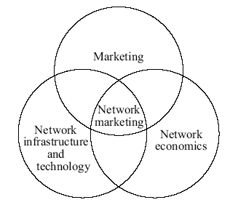
Framework of network marketing (1)
By Joe Lee
P.<number>

Slide 60
Framework of network marketing (2)
3 components of framework:
  Network infrastructure & technology (your learned from Surgery 1 to 10 and part 1 of Surgery 11)
  Network economics (part 2 of Surgery 11)
  Marketing fundamentals (part 2 of Surgery 11)
By Joe Lee
P.<number>
Notes:
CT212 (02/03)-Network Programming and design
27 April, 2002
School of Science & Technology

Slide 61
Network economics (1)
4 concepts/laws:
  Moore’s Law - capability of networking/hi-tech product doubles every 12 months or even shorter
    Eg. Number of transistors per square inch of wafer double every year
    Eg. New generation of CPU (with much higher operating speed) comes out every 12 months
    Eg. How fast new version of intelligent mobile comes out
  Metcalfe's Law - new technologies are valuable only when large number of people use it.
    Eg. Telephone system,
    Eg. INTERNET, E-banking, E-auction
    Eg. Touch screen technology
By Joe Lee
P.<number>
Notes:
CT212 (02/03)-Network Programming and design
27 April, 2002
School of Science & Technology

Slide 62
Network economics (2)
  Law of Disruption - Social, political and economic system changes incrementally (i.e. at lower pace) but technology changes exponentially (i.e. at faster pace).
    Combination of Moore’s Law & Metcalfe’s Law leads to Law of Disruption
    The exponential change of technology is due to a critical mass of users
    Once exponential change is reached, technology can affect different areas other than technologies, e.g. commerce, law, crime, living practice, etc.
    Eg. INTERNET usage leads to controversial debate on copyright LAW among countries.
By Joe Lee
P.<number>
Notes:
CT212 (02/03)-Network Programming and design
27 April, 2002
School of Science & Technology

Slide 63
Network economics (3)
  Law of Diminishing Firms : Large firm is longer dominate the market for very long time. It is gradually competed/replaced by virtual/small firm
    Cost of supporting large firm is huge (salary cost, office cost, manufacturing cost, assembly cost, communication cost, etc…)
    With INTERNET and other new technololgy, resources and assets are shared over logical network =>
      the cost of operating a firm, cost of transaction and cost of marketing are reduced dramatically.
      The market change is much faster. The market is more open & cost effective
By Joe Lee
P.<number>
Notes:
CT212 (02/03)-Network Programming and design
27 April, 2002
School of Science & Technology

Slide 64
Network economics (4)
Current situation:
  Small firm can be as powerful as large firm
  Number of small economic entities , down to level of individuals, is increasing
  Globalization is happening
Eg. With INTERNET, a U.S. firm request
  Chinese/SouthEast Asia factory for manufacturing
  Indian company to provide technical support & call center service
  Hong Kong company for promotion of product in Asia
  …..
By Joe Lee
P.<number>
Notes:
CT212 (02/03)-Network Programming and design
27 April, 2002
School of Science & Technology

Slide 65
Fundamentals for network marketing (1)
Marketing is an organizational function & a set of process for creating, communicating and delivering value to customers and for managing customer relationships in ways that benefit the organization and stakeholder.
Some terms for marketing:
  Direct marketing – communication between customers & merchandise is via telephone, mail or personal visit.
  E-mail marketing – via email
  Online marketing – INTERNET & e-mail based
  Permission marketing – centered around getting a customer’s consent to receive information from a company
  Auction
By Joe Lee
P.<number>
Notes:
CT212 (02/03)-Network Programming and design
27 April, 2002
School of Science & Technology

Slide 66
Fundamentals for network marketing (2)
Marketing of services – The product to be sold also include providing service to customer.
4 P of marketing :
  Product
  Price
  Place
  Promotion
Refers to http://www.sfu.ca/~mvolker/biz/mktintro.htm
Final goal of marketing – make my product/service known to all potential customers and they buy my product/service.
Marketing maxim : “sell your product, you must sell at the right time, in the right place to promote your product
By Joe Lee
P.<number>
Notes:
CT212 (02/03)-Network Programming and design
27 April, 2002
School of Science & Technology

Slide 67
Approaches to network marketing (1)
A question : How to make my service/product known to potential clients?
There are some ways but we concentrate on 4 approaches:
  Faxes
  Email
  E-commerce
  Mobile network
By Joe Lee
P.<number>
Notes:
CT212 (02/03)-Network Programming and design
27 April, 2002
School of Science & Technology

Slide 68
Approaches to network marketing (2)
Fax approach
  Fixed phone line monthly fee is fixed in Hong Kong => no additional cost for more fax.
  Going to be obsolete
Email approach can be sub-divided into
  Permission-based email marketing
  Non-permission-based email marketing
  Passive advertisement
    Include email address at the end of one’s response or query in a discussion forum or newsgroup
By Joe Lee
P.<number>
Notes:
CT212 (02/03)-Network Programming and design
27 April, 2002
School of Science & Technology

Slide 69
Approaches to network marketing (4)
E-commerce approach
  Penetration of Broadband usage in Hong Kong is very High
  Reasons of buying via e-commerce:
    More products & cheaper
    Convenient
  Requires
    Good Payment gateway
    Good transportation system
By Joe Lee
P.<number>
Notes:
CT212 (02/03)-Network Programming and design
27 April, 2002
School of Science & Technology

Slide 70
Payment Gateway
Payment gateway
    Alipay (https://www.alipay.com/)
    Google Wallet (wallet.google.com)
    Apple pay (https://support.apple.com/en-hk/apple-pay)
    PayPal (https://www.paypal.com/hk/home)
    PayDollar (http://www.paydollar.com/tchi/aboutus.html)
    …….
By Joe Lee
P.<number>
Notes:
CT212 (02/03)-Network Programming and design
27 April, 2002
School of Science & Technology

Slide 71
Approaches to network marketing (3)
Mobile network approach
  Penetration of mobile phone/mobile application in Hong Kong is very High
  Rate of advertising through
    SMS and
    mobile application
      The market is growing rapidly
  Do you think it is changing your life?
By Joe Lee
P.<number>
Notes:
CT212 (02/03)-Network Programming and design
27 April, 2002
School of Science & Technology

Slide 72
Open
Discussions
By Joe Lee
P.<number>
Notes:
CT212 (02/03)-Network Programming and design
27 April, 2002
School of Science & Technology

