Slide 1
ELEC S212 (AY_2018) Network Programming and Design
Surgery 1
(Introduction to computer networking & the Internet)
Course Coordinator : Dr. Steven Choy
Tutor : Mr. Lee, Bo-sing (Joe)
URL of my teaching website : http://learn.ouhk.edu.hk/~t441051/s212

Slide 2
Agenda
Objective of Tutorial 1
Tutorial 1
What is computer network
Why computer network
Basic computer networking concepts/terms
Layering network model – OSI & TCP/IP
Protocols and standards
Internet & Internet services

Slide 3
Objectives of surgery 1
Explain what a computer network is, and why computer networks are used.
Describe the general services that computer networks provide or facilitate.
Describe, compare and contrast the characteristics of client/server architecture and peer-to-peer architecture.
Categorize networks according to scale, and explain their differences.
Describe the basic network topologies, and explain the benefits and uses of different topologies.
Describe, compare and contrast the characteristics of circuit-switched networking and packet-switched networking.

Slide 4
Objectives of surgery 1
Describe, compare and contrast the characteristics of connection-oriented and connectionless services.
Identify and describe the more important LAN technologies.
Describe what a network operating system is, and identify its important features.
Outline, compare, and contrast the OSI model and the Internet reference model.
Explain what the Internet is, and describe its infrastructure.
Identify and describe some of the most important services that are available on the Internet.
Define the prevalent networking protocols and standards, and identify some of the more important standards organizations and Internet standards.

Slide 5
What is computer network?
Definition of computer network
a group of computers & networking devices (eg. Printer, fax, etc.) that are connected by some type of transmission media. The computers can communicate, provide or access shared resources, with the help of some networking S/W.
There are different resources that can be shared
Equipment such as printer, fax, scanner
Information such as data file, multimedia file, database, application program
Storage
Computational resource
…..

Slide 6
Why computer network?
Computer network provides many advantages:
Share resources sharing
Refer to previous slide
Enhancing communication and collaboration between people
Email, WWW, video conference
Entertainment (network games)
E-commerce
Online discussion forum
Remote management of network resources
Network administrator at Hong Kong can remotely configure/monitor/reboot network equipments at U.S., Europe, etc.

Slide 7
Features of a good computer network?
A good computer network should be featured with:
Meet end user’s requirements
Performance is accepted by end uesrs.
Good Reliability or High availability
Scalability
Security
Easy to manage
Within budget

Slide 8
Basic computer networking concepts
Introduction of some basic computer networking concepts/terms:
Network classification
Network topology
3 types of switching methods
Connection-oriented Vs connectionless
Network transport system
Network OS
Network security

Slide 9
Network classification
Computer network can be classified from different points of view.
Usually, we classify networks from 3 perspectives
based on size of network:
PAN, LAN, MAN, CAN & WAN
based on role of network computers:
Client/server Vs Peer-to-peer networks
Based on transmission media:
Wired network Vs wireless network

Slide 10
Network classification
Classification of networks by size of network
PAN (Personal Area Network). Eg. your home network.
LAN (Local Area Network)
Within an office or building
High transmission speed.
MAN (Metropolitan Area Network)
Larger than LAN. Multiple LANs that extend across multiple buildings.
CAN (Campus Area Network)
Larger than MAN. Multiple LANs that extend across Campus.
WAN (Wide Area Network)
Across city, country or even international
Connected through public data network provided by carrier
Transmission speed of WAN link is lower than that of LAN

Slide 11
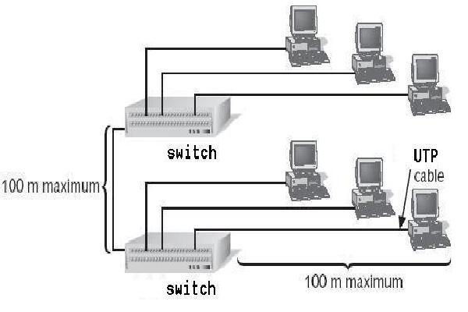
LAN

Slide 12
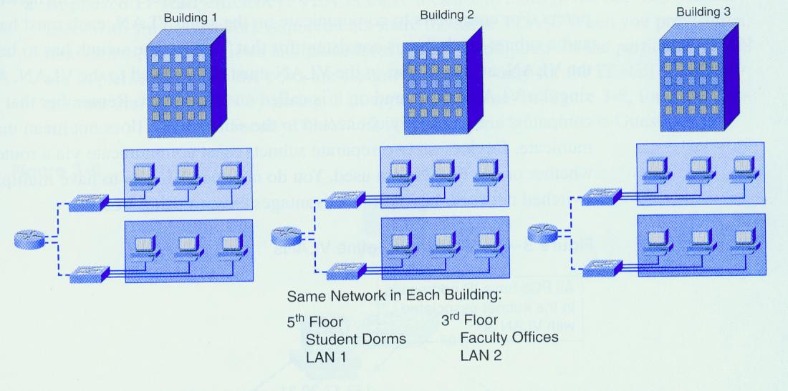
MAN/CAN

Slide 13
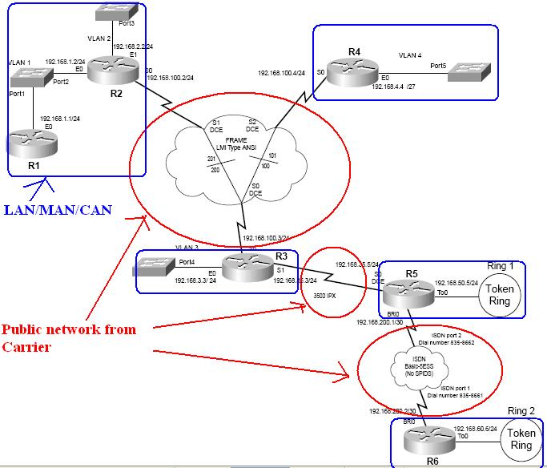
WAN

Slide 14
Network classification
Classification of networks by role of computers:
client/server network
Server
is the computer that has better processing (CPU) power and more memory.
provides services or shares its resources to clients.
Client
is the computer that has less processing (CPU) power and less memory.
requests services or uses shared resources from server.
more complex, centralized management,
Suitable for larger company
Eg. Active directory or domain
(cont’d)

Slide 15
Network classification
Classification of networks by role of computers:
peer-to-peer network
All computers has similar processing power and size of memory.
Each computer can share its file storage/printer to other computer.
Simple, decentralized management
Suitable for small company
eg. workgroup

Slide 16
Network classification
Classification of networks by transmission media:
Wired network
Transmission media is cable
Eg. Cat5/6 UTP, optic fiber, etc
Wireless network
Transmission media is through air
Eg. RF or Infrared

Slide 17
Network topology
Physical topology
The physical layout of network’s nodes.
3 basic physical topologies:
Bus, star, ring
Logical topology
The way in which a network access media and transmit signal across it.
2 basic logical topologies:
Bus, ring
A network may have different physical and logical topology.
Eg. An Ethernet network connected with a LAN switch
Physical topology is star
Logical topology is bus

Slide 18
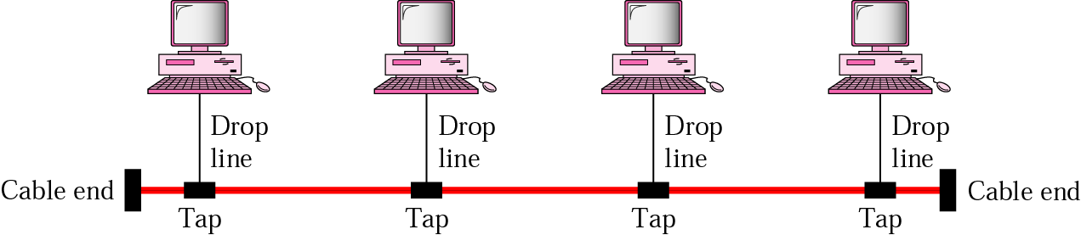
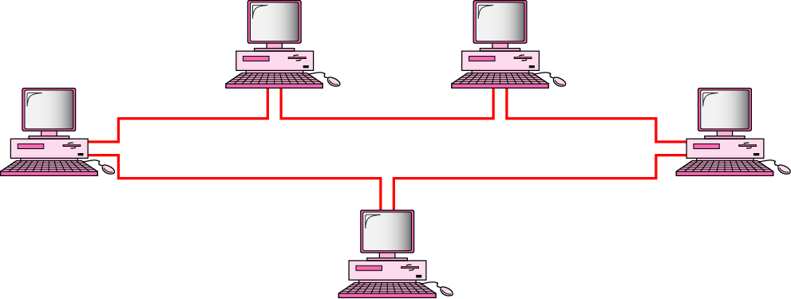
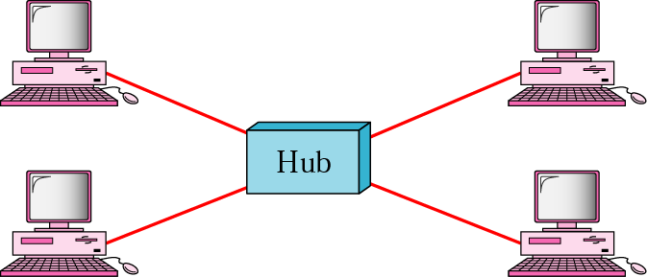
Physical topologies (1)
Bus
Ring
Star

Slide 19
Physical topologies (2)
 | Star | Bus | Ring
Advantage | Less costly than mesh, easier fault identification and isolation | Ease of installation, cost-effective for long line of devices | Better reliability than bus
Disadvantage | Hub failure causing total network breakdown | Difficult fault isolation, path break causing isolation into two groups of devices | Path break can disable the whole network unless if it is a dual ring
No. of links | n | 1+n | n
Application examples | Local area network in offices | Coaxial cable TV in households or buildings | Obsolete Token ring

Slide 20
3 types of switching methods
Switching method determines how connections are created between nodes
There are 3 types:
Circuit switching
Packet switching (TCP/IP)
Message switching

Slide 21
Circuit-switching
Circuit switching service is a telecommunication technology
by which two network nodes establish a dedicated (i.e. non-shared) communications channel (or circuit) connecting them for the duration of the communication session before the nodes may communicate.
This is done by the telephone system, using the dialed number with ordinary voice-grade lines and ISDN digital lines.
WAN technologies uses circuit switching service:
ISDN

Slide 22
Packet-switching
Packet/cell switching is a digital networking communications method that groups all transmitted data – regardless of content, type, or structure – into suitably-sized blocks, called packets/cells.
Packets/cells are then transferred in variable-bit-rate data streams (sequences of packets) over a shared WAN cloud.
When traversing network adapters, switches, routers and other network nodes, packets are buffered and queued, resulting in variable delay and throughput depending on the traffic load in the network.
The path is determined by the addressing field in each packet/cell and the routers/switches along the path => addressing overhead in frame encapsulation.
WAN technologies that uses packet/cell-switched service
Frame relay, X.25, ATM & SMDS

Slide 23
Message-switching
Message switching is precursor of packet switching.
Message is stored and routed entirely in each hop, without partitioning into packets.
First introduced in 1961.

Slide 24
Circuit-switching vs packet-switching
 | Circuit-switching | Packet-switching
cost | higher | lower
Effective usage of link bandwidth | Waste bandwidth | better
Transmission delay | Predictable & constant | un-predictable and variable
Addressing overhead in each unit of data | no | yes
Dedicate/share link | Dedicate link | Share link

Slide 25
Connection-oriented Vs Connectionless
Connection-oriented
A connection must be established between 2 communicating nodes before actual data transfer between these 2 nodes.
Often provide reliable transfer of data, in proper sequence
More transmission overhead
statful
Connectionless (datagram communication)
Transfer data to communicating party without establishing any connection.
No guarantee on the data will be received by the communicating party.
Less transmission overhead
stateless
More will be discussed in Tutorial 3.

Slide 26
Network Transport system
Network Transport system describes the logical interconnection, rather than physical interaction, between nodes.
It depends on the electrical pulses carried by physical layer of OSI model.
Currently, Ethernet and Wi-Fi are the 2 most common transport systems.
Legacy transport systems include ARCNET and Token ring.

Slide 27
Layered network model (1)
In order to allow 2 computers to communicate, exchange data, share/access resource via a network, these 2 computers must follow a number of rules. The rules are so many and complicated. These rules are called networking protocols.
We need a method/mechanism to develop & handle these rules.
So, a layered network model is required for computer networking.
There are 2 networking models – OSI & TCP/IP

Slide 28
Layered network model (2)
Logical view of a layered network model
Network is divided into a number of layers
Lowest layer is numbered as 1, higher layer is numbered with larger number
Layer N (Boss) request service, layer N-1 (employee) provide service
Each layer is ignorant about implementation of other layers
Each layer only knows the interface (SAP) to directly lower or upper layer

Slide 29
Layered network model (3)
Advantages
Simplify complexity of network design & implementation
Easy for human to discuss & analyze
Allow interoperability between products from different vendors
Change of any layer is transparent to other layers
Implementation of any layer is independent of other layers

Slide 30
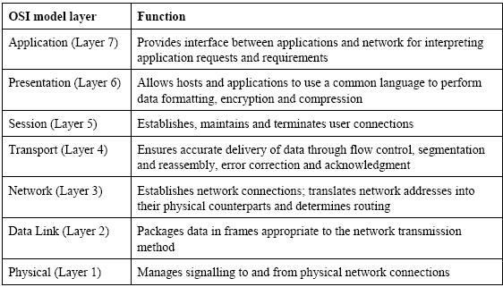
OSI model

Slide 31
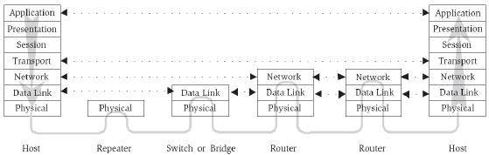
OSI model

Slide 32
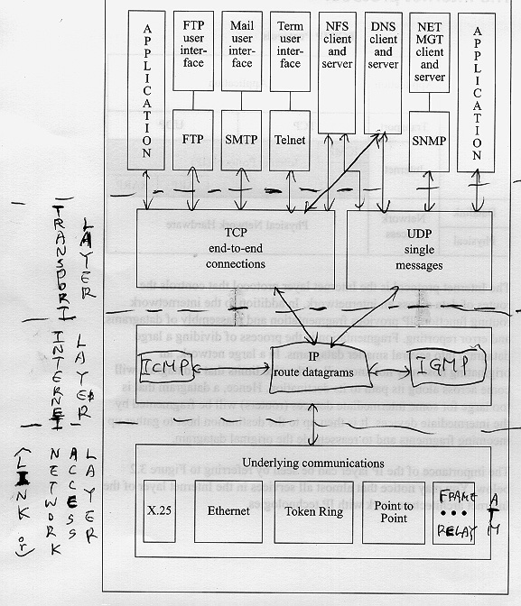
TCP/IP model

Slide 33
OSI Vs TCP/IP
Layer mapping between OSI and TCP/IP model
OSI model | Internet (TCP/IP) model
Application | application
Presentation
Session
Transport | Transport
Network | Internet
Data link | Network access
Physical

Slide 34
OSI Vs TCP/IP
OSI model
7 layers – application, presentation, session, transport, network, data link, physical layer
Well-defined
More restrictive in layering structure
Transport layer can use different protocols eg. SPX for Netware
Usually as a reference point for discussion use or academic research. Seldom implemented

Slide 35
OSI Vs TCP/IP
Internet (TCP/IP) model
4 layers,
Layer 4 (Application) – dns, ftp, smtp, http, snmp, …..
Layer 3 (Transport) – tcp, udp
Layer 2 (Internet) – ip, icmp
Layer 1 (Network access) – ethernet, token, FDDI , ATM
De-facto and only standard for INTERNET
Transport layer is dominated by TCP and UDP
Development based on experiment & practice
Less restrictive in layering structure

Slide 36
More on protocol
What is protocol
Protocol is a standard method or format for communication between network devices.
Protocols ensure that data are
transferred whole, in sequence, and
without error from one node on the network to another.
Key elements of protocol
Syntax — the structure or format of the data.
Semantics — the meaning of each section of the data.
Synchronization — when data should be sent and how fast they can be sent.

Slide 37
What is Standard
Standard
is well-documented agreements
Contains technical specifications or other precise criteria that stipulate how a product should be designed or performed
Different industrial vendors produce their products based standards so that networking products from different vendors can be compatible (i.e. work together).
Major standard organizations
IEEE committee of ISO - for LAN and MAN standards (eg. Ethernet, FDDI, Wi-Fi, etc.)
IETF – for INTERNET standards (RFC).
ANSI – for telecommunication standards.

Slide 38
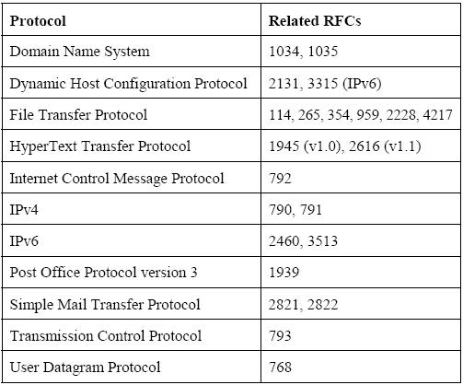
Some RFCs

Slide 39
Open
Discussions

