Slide 1
ELEC S212 (Sept. 2018)
Network
Programming and Design
Surgery 3
(Essentials of TCP/IP part 1)
Course Coordinator : Dr. Steven Choy
Tutor : Mr. Joe Lee
URL of my teaching website : http://learn.ouhk.edu.hk/~t441051/s212
P.<number>
Notes:
CT212 (02/03)-Network Programming and design
27 April, 2002
School of Science & Technology

Slide 2
Agenda for Surgery 3
TCP/IP basic concepts
Internet Layer
  IP addressing
  Subnet,
  IP Routing, Routing Table,
  Routing protocols,
  CIDR, ICMP
Address translation
  ARP : IP address -> MAC address
  RARP : MAC address -> IP address
IPv6
ICMP
P.<number>
Notes:
CT212 (02/03)-Network Programming and design
27 April, 2002
School of Science & Technology

Slide 3
5 questions for communication between 2 s/w (eg. Client & server) on 2 different machines
  How to identify a machine?
  How to identity a s/w running in a machine?
  How to transfer data from one machine to another?
  How to ensure all data are correctly received by destination s/w?
  What to do if there is network congestion due to :
    Transmitting host sends out data too fast?
    receiving capability of destination machine is not enough (eg. Less processing power, memory, NIC speed, etc) ?
P.<number>
Notes:
CT212 (02/03)-Network Programming and design
27 April, 2002
School of Science & Technology

Slide 4
~~Basic concept~~
P.<number>
Notes:
CT212 (02/03)-Network Programming and design
27 April, 2002
School of Science & Technology

Slide 5
Basic concepts
Encapsulation & de-capsulation
De-multiplexing
Meaning of port number
P.<number>
Notes:
CT212 (02/03)-Network Programming and design
27 April, 2002
School of Science & Technology

Slide 6
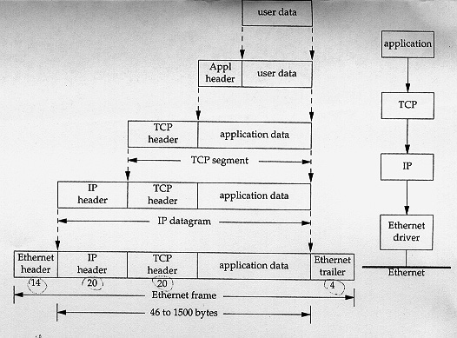
Encapsulation (1)
Sending side
P.<number>
Notes:
CT212 (02/03)-Network Programming and design
27 April, 2002
School of Science & Technology

Slide 7
Encapsulation (2)
For sending side
Add header to data from upper before sending to lower layer
Different layer has different header
Each header has different fields
P.<number>
Notes:
CT212 (02/03)-Network Programming and design
27 April, 2002
School of Science & Technology

Slide 8
De-capsulation (1)
Receiving side
P.<number>
Notes:
CT212 (02/03)-Network Programming and design
27 April, 2002
School of Science & Technology

Slide 9
De-capsulation (2)
For receiving side
Before sending data to upper layer
  Process fields of header & act accordingly
  Remove header
P.<number>
Notes:
CT212 (02/03)-Network Programming and design
27 April, 2002
School of Science & Technology

Slide 10
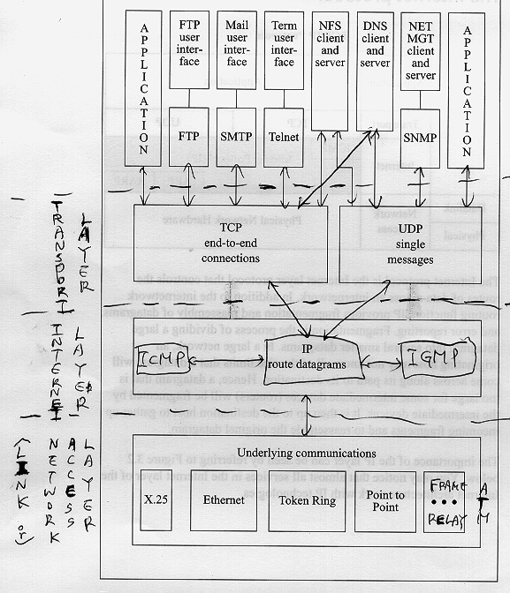
Multiple protocols in each layer
P.<number>
Notes:
CT212 (02/03)-Network Programming and design
27 April, 2002
School of Science & Technology

Slide 11
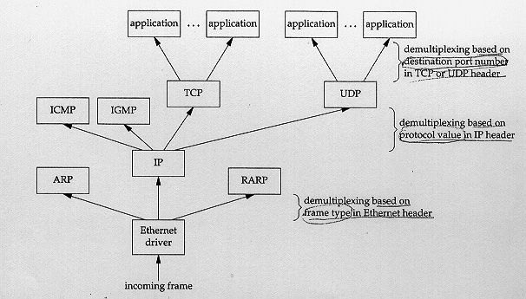
De-multiplexing
P.<number>
Notes:
CT212 (02/03)-Network Programming and design
27 April, 2002
School of Science & Technology

Slide 12
Meaning of port number
Port number is 16 bit;
Each application within a host is uniquely identified by a port number and protocol type of transport layer (TCP or UDP);
Port number usually refers to the port used by server side of an application
  Eg. TCP 2046 represents TCP application. Its server side uses port 2046
Some ports are reserved. Those ports are called well-known ports
Your application should NOT use well-known or registered port.
P.<number>
Notes:
CT212 (02/03)-Network Programming and design
27 April, 2002
School of Science & Technology

Slide 13
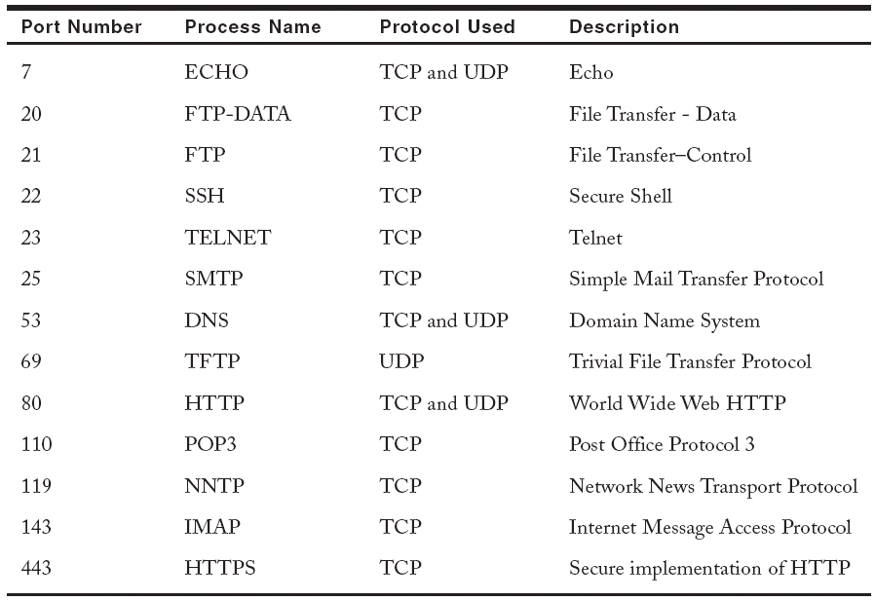
Well-known Ports (1)
Origins of the Internet • Internet Reference Model • Internet Protocol • IP Routing • TCP • UDP

Slide 14
Well-known Ports (2)
The IANA (Internet Assigned Number Authority) divides the port numbers into 3 ranges:
  Well-known ports: Ports 0 – 1023 are assigned and controlled by IANA.
  Registered ports: Ports 1024 – 49151 are not assigned or controlled by IANA. They can be registered with IANA to prevent duplication.
  Dynamic ports: Ports 49152 – 65535 are neither controlled nor registered. They can be used by any process.
Origins of the Internet • Internet Reference Model • Internet Protocol • IP Routing • TCP • UDP

Slide 15
~~~~~~~~ Internet Layer ~~~~~~~~~
IP address
IP subnet & CIDR
IP routing
IP fragmentation & reassembly
ARP & RARP(strictly speaking, they are between “Internet” and “network-access” layer
P.<number>
Notes:
CT212 (02/03)-Network Programming and design
27 April, 2002
School of Science & Technology

Slide 16
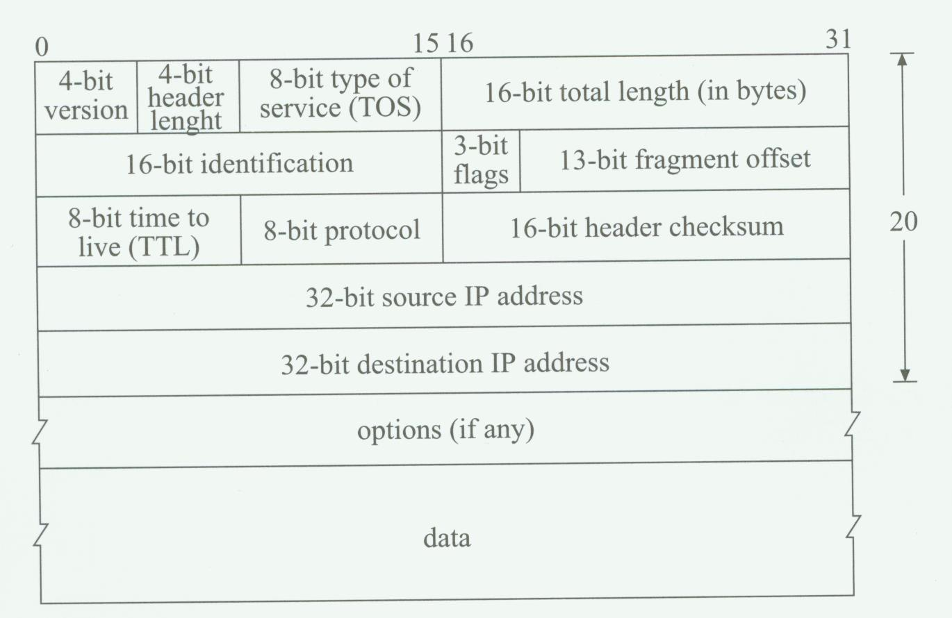
IP packet format
P.<number>
Notes:
CT212 (02/03)-Network Programming and design
27 April, 2002
School of Science & Technology

Slide 17
IP address (1)
32 bit for IPv4;
128 bit for IPv6
In INTERNET, IP address uniquely identify
    interface
    host
    network (131.21.0.0)
    Subnet (131.21. 4.0)
    Broadcast address (131.21.255. 255 or 131.21.4.255)
P.<number>
Notes:
CT212 (02/03)-Network Programming and design
27 April, 2002
School of Science & Technology

Slide 18
IP Address (2)
IP-v4 classful address :
  2 formats :
    Decimal : 192.123.44.23 (note each field between period is 0 ~ 255), more convenient
    Binary : 11000000.01111011.00110100.00010111
  Composed of 2 portions – network portion, host portion
  All hosts of same network must have same value on network portion
  Based on first 4 bits (MSB) of IP address, it is classified into 5 classes : class A through E. Only Class A through C can be assigned to a machine/host.
P.<number>
Notes:
CT212 (02/03)-Network Programming and design
27 April, 2002
School of Science & Technology

Slide 19
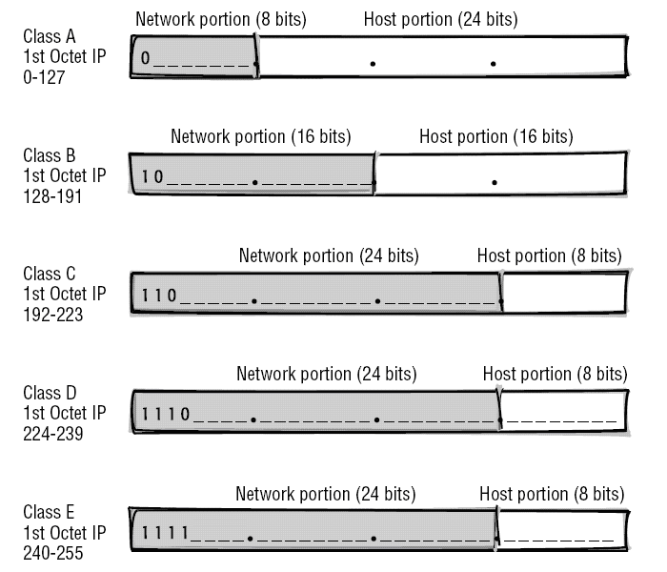
IP Address (2)
Origins of the Internet • Internet Reference Model • Internet Protocol • IP Routing • TCP • UDP

Slide 20
IP Address (3)
Network mask is used to specify which part of an IP address is network-portion.
Consecutive bit of value “1” specify corresponding bit as network portion
Class | (Default) network mask
A | 255.0.0.0
B | 255.255.0.0
C | 255.255.255.0
P.<number>
Notes:
CT212 (02/03)-Network Programming and design
27 April, 2002
School of Science & Technology

Slide 21
IP Address (4)
Class | Network portion | Host portion | number of usable network | number of usable hosts per network
A | 0~127 | 0.0.1~ 255.255.254 | 126 | 2²⁴-2
B | 128.0~ 191.255 | 0.1~ 255.254 | 2¹⁴ | 2¹⁶-2
C | 192.0.0~ 223.255.255 | 1~254 | 2²¹ | 2⁸-2
D | 224.0.0.0~239.255.255.255 | N/A | multicast | N/A
E | 240.0.0.0~255.255.255.255 | N/A | experiment | N/A
P.<number>
Notes:
CT212 (02/03)-Network Programming and design
27 April, 2002
School of Science & Technology

Slide 22
IP Address (5)
Reserved IP addresses :
  used as src. address in BOOTP
    0.0.0.0
    All zeros on network portion
  Loopback address - 127.x.x.x
  Specify a network : All zeros on host portion
  Broadcast address :
    All 1s on host portion
    255.255.255.255
  Class D & E
P.<number>
Notes:
CT212 (02/03)-Network Programming and design
27 April, 2002
School of Science & Technology

Slide 23
5 questions for communication between 2 s/w (eg. client & server) on 2 different machines
How to identify a machine → IP address
How to identity a s/w running in a machine → (IP address + transport layer protocol type + port number )
How to transfer data from one machine to another??
How to ensure all data are correctly received by destination s/w ??
What to do if there is network congestion due to :
  Transmitting host sends out data too fast;
  receiving capability of destination machine is not enough (eg. Less processing power, memory, NIC speed, etc) ??
P.<number>
Notes:
CT212 (02/03)-Network Programming and design
27 April, 2002
School of Science & Technology

Slide 24
Functions of internet layer
Functions of internet layer :
  Addressing scheme: Provide unique identification (i.e. logical IP address) to an interface of INTERNET node (eg. Host, router) or network/subnet
    Classful
    Classless (CIDR)
  Packet forwarding (or routing)
  Fragmentation & reassembly
P.<number>
Notes:
CT212 (02/03)-Network Programming and design
27 April, 2002
School of Science & Technology

Slide 25
IP Subnet (1)
What is sub-netting?
  Divide a large network into a number of smaller subnets
  Each subnet is also a network, a broadcast domain. Subnets are connected by router (not hub/LAN switch)
How to sub-net?
  Network mask changes to subnet mask
  extends continuous ones towards right to host portion. The extension part is called subnet portion. The network mask is now called subnet mask.
Each IP address now consists of 3 portions
  Network, subnet, host portion
Why sub-netting :
  Better utilization of IP addressing space
  Reduces network congestion by reducing broadcast domain
  Reduce number of hosts per subnet => better performance in Ethernet
P.<number>
Notes:
CT212 (02/03)-Network Programming and design
27 April, 2002
School of Science & Technology

Slide 26
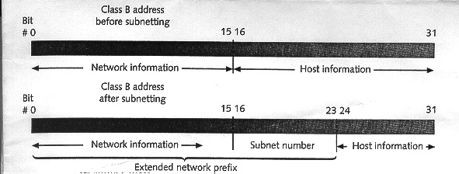
IP Subnet (2)
P.<number>
Notes:
CT212 (02/03)-Network Programming and design
27 April, 2002
School of Science & Technology

Slide 27
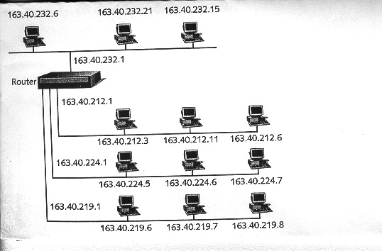
IP Subnet (3)
P.<number>
Notes:
CT212 (02/03)-Network Programming and design
27 April, 2002
School of Science & Technology

Slide 28
IP Subnet (4)
Scenario 1 :
Class A network : 12.0.0.0
  default network mask = 255.0.0.0
    Number of networks = 1
    Number of hosts per network = 2 ²⁴ -2
  subnet mask=255.255.0.0
    Number of subnets = 256 –2 = 254
    Number of hosts per network = 2 ¹⁶ –2
  Effect : one class A network increases from 1 to 254 subnets but the number of hosts per subnet decreases from (2 ²⁴ –2) to (2 ¹⁶ –2)
P.<number>
Notes:
CT212 (02/03)-Network Programming and design
27 April, 2002
School of Science & Technology

Slide 29
IP Subnet (5)
Scenario 2 :
Class B network : 158.182.0.0
  default network mask = 255.255.0.0
    Number of network = 1
    Number of hosts per network = 2 ¹⁶ -2
  subnet mask=255.255.240.0
    Number of network = 2⁴ – 2 = 14
    Number of hosts per network = 2 ¹² – 2 = 4094
  Effect : one class B network increases from 1 to 14 subnets but the number of hosts per subnet decreases from (2 ¹⁶ –2) to 4094
P.<number>
Notes:
CT212 (02/03)-Network Programming and design
27 April, 2002
School of Science & Technology

Slide 30
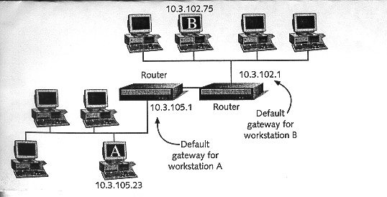
IP default gateway
P.<number>
Notes:
CT212 (02/03)-Network Programming and design
27 April, 2002
School of Science & Technology

Slide 31
IP Routing principle
Unreliable; hop-by-hop routing
  Each hop (router) only provide IP address of next best hop (router) to destination network/subnet
Each router/host has a routing table, from which routing decision is made
Routing decision is made based on destination IP address of incoming packet and content of routing table of router.
Contents of routing table can be :
  Dynamic, learned from routing protocols (eg. RIP, OSPF, IGRP, EIGRP)
  Default route by hard-coded or learned from routing protocol
  Static by hard-coded
  Directly connected network/subnet
P.<number>
Notes:
CT212 (02/03)-Network Programming and design
27 April, 2002
School of Science & Technology

Slide 32
IP Routing table (1)
Each entry of routing table must contain at least following columns :
  IP address of destination network/subnet
  IP address of next hop (router) to destination AND/OR Outgoing interface to next hop
    Note next hop is sometimes called gateway
  metric for that route (except for directly-connected route)
Default gateway :
  Definition : When there is no entry in routing table matching destination IP address, entry of default gateway will be used. Destination is represented by 0.0.0.0/0.0.0.0
  Host with single interface : simplify by using default gateway entry
  One more usage of default gateway. What is it?
P.<number>
Notes:
CT212 (02/03)-Network Programming and design
27 April, 2002
School of Science & Technology

Slide 33
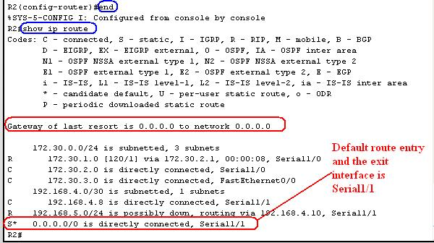
IP Routing table (2)
P.<number>
Notes:
CT212 (02/03)-Network Programming and design
27 April, 2002
School of Science & Technology

Slide 34
IP routing protocol
features | RIP | OSPF
Protocol type | Distance vector | Link state
Routing update | Whole routing table to neighboring routers every 30 seconds | Link state advertisement to each router of the network.
Metric used | Less meaningful : number of hop count | More meaningful : inversely proportional to bandwidth of link
Converging speed | slower | faster
scalability | Less : max. hop count is 15 | More : no hop count limit
CPU &memory required | less | More
P.<number>
Notes:
CT212 (02/03)-Network Programming and design
27 April, 2002
School of Science & Technology

Slide 35
IP - CIDR (1)
Classless InterDomain Routing (CIDR)
No more class boundary or subnet on IP address
Combine multiple continuous smaller subnets (eg. Class C) into a larger supernet or CIDR block
Representation of CIDR network : prefix + length
  Eg. 158.182.192. 0 /12
Why CIDR ?
  Better utilization of IP addressing space
  Reduce size of routing table of INTERNET routers.
P.<number>
Notes:
CT212 (02/03)-Network Programming and design
27 April, 2002
School of Science & Technology

Slide 36
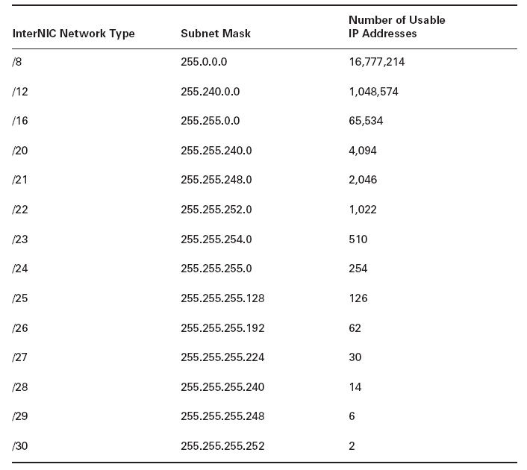
IP - CIDR (2)

Slide 37
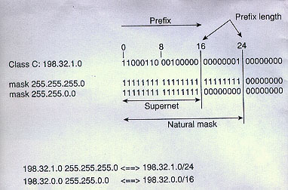
IP - CIDR (3)
P.<number>
Notes:
CT212 (02/03)-Network Programming and design
27 April, 2002
School of Science & Technology

Slide 38
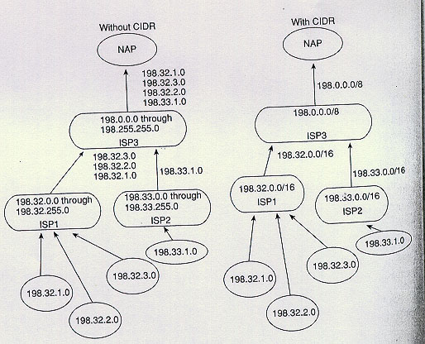
IP - CIDR (4)
P.<number>
Notes:
CT212 (02/03)-Network Programming and design
27 April, 2002
School of Science & Technology

Slide 39
ARP (1)
ARP stands for Address Resolution Protocol/
Function : Get MAC address of other TCP/IP host, on the same segment, from IP address of that host
  (i.e. IP address -> MAC address)
ARP can be understood under 2 cases:
  Communication between hosts at same LAN (i.e. destination at local network)
    Eg. between host_1 and host_2
  Communication between hosts at different LANs (i.e. destination at remote network)
    Eg. between host_1 and host_3
P.<number>
Notes:
CT212 (02/03)-Network Programming and design
27 April, 2002
School of Science & Technology

Slide 40
ARP (2)
Host_1
Host_2
Host_3
MAC_1
IP_1
MAC_2
IP_2
MAC_3
IP_3
MAC_4
Router_A
IP_4
IP_5
MAC_5
P.<number>

Slide 41
ARP (3) – local network
Host_1
Host_2
Host_3
MAC_1
IP_1
MAC_2
IP_2
MAC_3
IP_3
MAC_4
Router_A
IP_4
1. Host_1 broadcasts “ARP Request”
IP_5
MAC_5
2. Host_2 unicasts “ARP reply”
(Step 1 & 2 : ARP for IP_2)
3. Host_1 sends frame with src. IP=IP_1, dest. IP=IP_2, src. MAC=MAC_1, dest. MAC=MAC_2
P.<number>

Slide 42
ARP (4) – remote network
Host 1
Host 2
Host 3
MAC_1
IP_1
MAC_2
IP_2
MAC_3
IP_3
MAC_4
Router_A
1. Host_1 ARP for IP_4
IP_4
IP_5
MAC_5
2. Host_1 sends frame with src. IP=IP_1, dest. IP=IP_3, src. MAC=MAC_1, dest. MAC=MAC_4
3. ARP for IP_3
4. Router_A sends frame with src. IP=IP_1, dest. IP=IP_3, src. MAC=MAC_5, dest. MAC=MAC_3
P.<number>

Slide 43
ARP Cache
Essential to the efficient operation of ARP is the maintenance of a cache on each host/router
The cache maintains the recent IP to MAC address mappings => no ARP is invoked if the expected IP/MAC mapping is already existed in ARP cache.
Each cache entry will be time-out after some time (eg. 10 minutes)
P.<number>

Slide 44
RARP (Reverse Address Resolution Protocol)
Function : Reverse of ARP
  MAC address -> IP address
Obsolete application : diskless station get its IP address from RARP server
Sequence :
  Client A broadcast a RARP request with its MAC address,
  RARP server looks for its IP, MAC pair table, replies (unicast) with A’s IP and MAC address
Limitation : RARP can’t pass through router
  Leads to development of DHCP
P.<number>
Notes:
CT212 (02/03)-Network Programming and design
27 April, 2002
School of Science & Technology

Slide 45
IP V6
Previous discussion is for IPv4.
IPv6 is compatible with IPv4 but enhanced with followings:
  IP address : 32 bits -> 128 bits => more IP available
  Support QoS for timing critical application such as Voice over IP, video conference, etc.
  Support security extension for authenticating source, providing integrity & encryption.
  Header processing is speed up to increase performance
  Addition of anycast address, which allows messages to be sent to any of several possible service providers or to any of a related group of remote destinations, with the idea that any one of them can manage the forwarding of the packet to others.
More : http://www.ipv6.org
P.<number>
Notes:
CT212 (02/03)-Network Programming and design
27 April, 2002
School of Science & Technology

Slide 46
5 questions for communication between 2 s/w (eg. client & server) on 2 different machines
How to identify a machine → IP address
How to identity a s/w running in a machine → (IP address + transport layer protocol type + port number )
How to transfer data from one machine to another (Router + routing table)
How to ensure all data are correctly received by destination s/w ??
What to do if there is network congestion due to :
  Transmitting host sends out data too fast;
  receiving capability of destination machine is not enough (eg. Less processing power, memory, NIC speed, etc) ??
P.<number>
Notes:
CT212 (02/03)-Network Programming and design
27 April, 2002
School of Science & Technology

Slide 47
Open
Discussions
P.<number>
Notes:
CT212 (02/03)-Network Programming and design
27 April, 2002
School of Science & Technology

