Slide 1
ELEC S212 (Sept. 2018)
Network
Programming and Design
Surgery 4
(Essentials of TCP/IP part 2)
Course Coordinator : Dr. Steven Choy
Tutor : Mr. Joe Lee
URL of my teaching website : http://learn.ouhk.edu.hk/~t441051/s212
P.<number>
Notes:
CT212 (02/03)-Network Programming and design
27 April, 2002
School of Science & Technology

Slide 2
Agenda for Surgery 4
Transport layer
  TCP
    Reliability
    Flow control
  UDP
Application Layer
  DNS
  DHCP
Open Discussion
P.<number>
Notes:
CT212 (02/03)-Network Programming and design
27 April, 2002
School of Science & Technology

Slide 3
5 questions for communication between 2 s/w (eg. Client & server) on 2 different machines
How to identify a machine → IP address
How to identity a s/w running in a machine → IP address + transport layer protocol type + port number
How to transfer data from one machine to another → routing table + IP layer
How to ensure all data are correctly received by destination s/w ??
What to do if there is network congestion due to :
  Transmitting host sends out data too fast;
  receiving capability of destination machine is not enough (eg. Less processing power, memory, NIC speed, etc) ??
P.<number>
Notes:
CT212 (02/03)-Network Programming and design
27 April, 2002
School of Science & Technology

Slide 4
~~~~~ Transport Layer ~~~~~
TCP : connection-oriented
UDP : connectionless
P.<number>
Notes:
CT212 (02/03)-Network Programming and design
27 April, 2002
School of Science & Technology

Slide 5
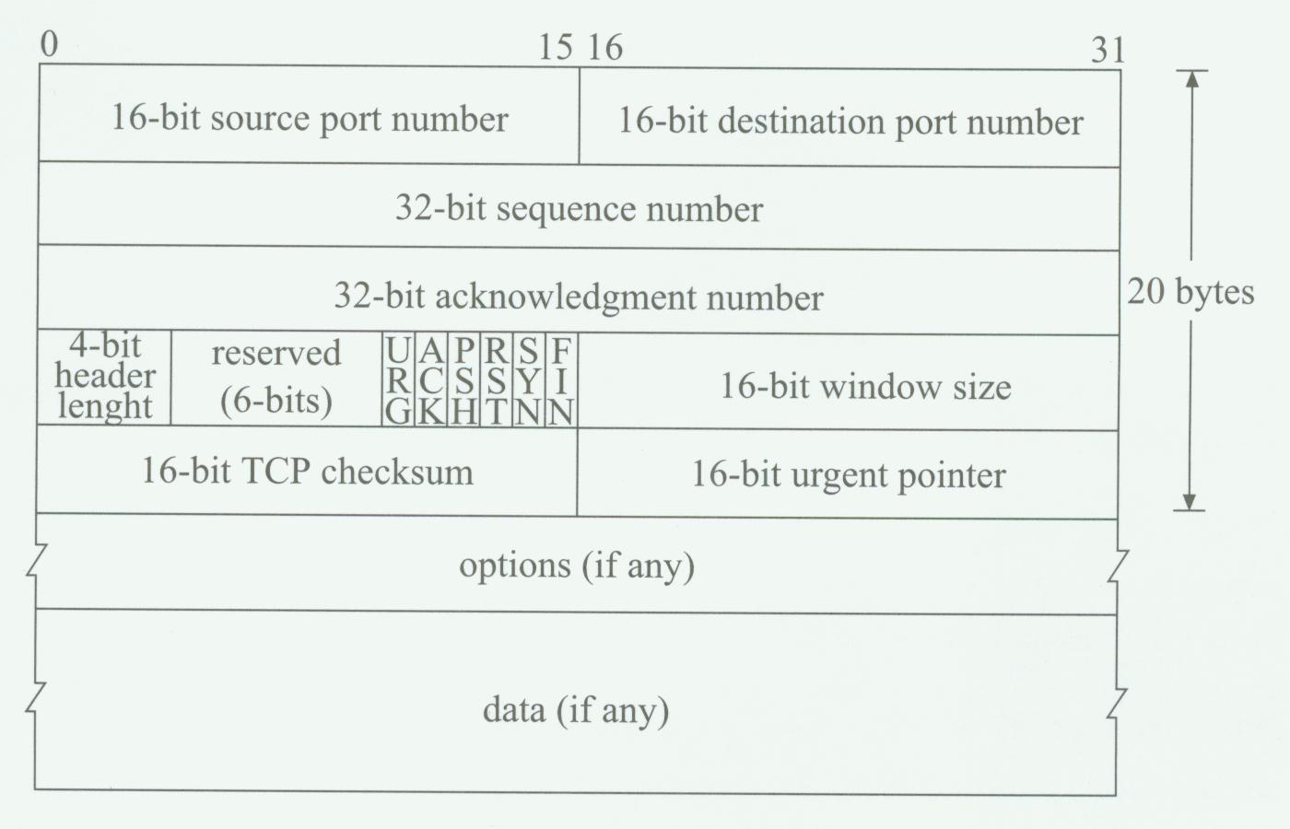
TCP segment format
P.<number>
Notes:
CT212 (02/03)-Network Programming and design
27 April, 2002
School of Science & Technology

Slide 6
TCP connection establishment & termination (2)
Connection-oriented; full-duplex
stream data transfer - segmenting data from application
Data transfer involves 3 steps :
  Connection establishment (3-way handshake)
  Actual data transfer
  Connection termination (4-way)
Some terms:
  sequence number – identify each byte of segment data
  acknowledge number – sequence number of next byte of data sender expects to receive
  delayed acknowledge – acknowledgement does not respond immediately for each received segment, wait until multiple segments are received => save bandwidth and processing power
P.<number>
Notes:
CT212 (02/03)-Network Programming and design
27 April, 2002
School of Science & Technology

Slide 7
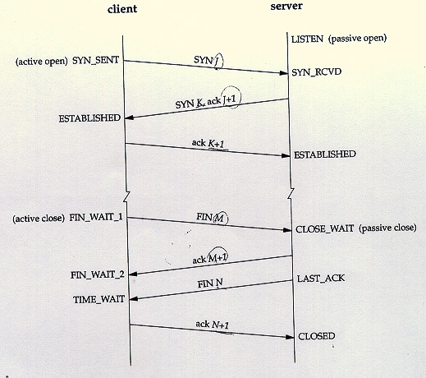
TCP connection establishment & termination (1)
P.<number>
Notes:
CT212 (02/03)-Network Programming and design
27 April, 2002
School of Science & Technology

Slide 8
TCP – reliability (1)
Transmission may be unreliable due to :
  packet loss or corruption during transmission
  packet duplication
To prevent packet loss :
  Each packet is identified by a sequence number. Sender starts a timer for each packet sending out.
  Receiver sends +ve acknowledge (ACK) some delays after receiving packet
  If sender does not receive ACK for a sent packet when timer expires (i.e. timeout), sender retransmits that packet
Retransmission may lead to duplicate packet. Duplicated packet is discarded by receiver.
Reliability is provided by :
  Sequence number, Ack. number, delayed ack., Timeout & Retransmission, discard duplicate
P.<number>
Notes:
CT212 (02/03)-Network Programming and design
27 April, 2002
School of Science & Technology

Slide 9
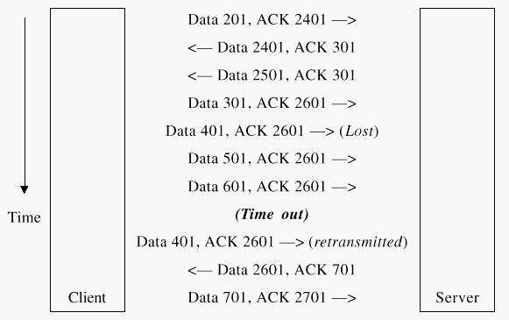
TCP – reliability (2)
Segment size = 100 byte
No data, Ack 401
P.<number>
Notes:
CT212 (02/03)-Network Programming and design
27 April, 2002
School of Science & Technology

Slide 10
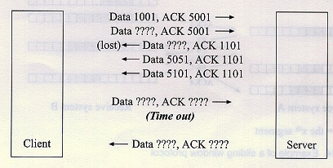
TCP – reliability (3)
Segment size = 50 byte
P.<number>
Notes:
CT212 (02/03)-Network Programming and design
27 April, 2002
School of Science & Technology

Slide 11
TCP – reliability (4)
Segment size = 50 byte
1051
P.<number>
Notes:
CT212 (02/03)-Network Programming and design
27 April, 2002
School of Science & Technology

Slide 12
TCP – reliability (5)
Segment size = 50 byte
1051
5001
P.<number>
Notes:
CT212 (02/03)-Network Programming and design
27 April, 2002
School of Science & Technology

Slide 13
TCP – reliability (6)
Segment size = 50 byte
1051
5001
1101, 5001
Refer to lost “Data 5001, ACK1101”
P.<number>
Notes:
CT212 (02/03)-Network Programming and design
27 April, 2002
School of Science & Technology

Slide 14
TCP – reliability (7)
Segment size = 50 byte
1051
5001
1101, 5001
Refer to lost “Data 5001, ACK1101”
5001, 1101
P.<number>
Notes:
CT212 (02/03)-Network Programming and design
27 April, 2002
School of Science & Technology

Slide 15
TCP – flow control (1)
When sender sends out data at a rate much faster than that can be handled by either intermediate router(s) and receiver
  => traffic congestion
  => data may be lost
  => need re-transmission
  => inefficient bandwidth utilization
Sender-side flow control – sliding windows buffering.
  Buffer size is integral multiple of segment size.
  Sender transmits data continuously until number of segments sent without acknowledge equals length of window.
P.<number>
Notes:
CT212 (02/03)-Network Programming and design
27 April, 2002
School of Science & Technology

Slide 16
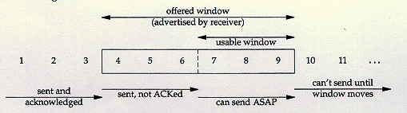
TCP – Flow control (2)
Sender’s view (sliding window size = 6),
segment 1,2,3 are sent and ACKed,
segment 4,5,6 are sent but not ACKed
P.<number>
Notes:
CT212 (02/03)-Network Programming and design
27 April, 2002
School of Science & Technology

Slide 17
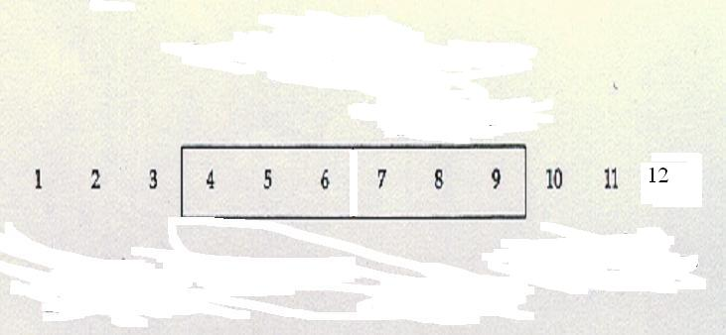
TCP – Flow control (3)
Ack for segment 4 is received
Usable window
Sent but NOT Ack
Can’t send until window moves
Can send ASAP
Sent & Ack
P.<number>
Notes:
CT212 (02/03)-Network Programming and design
27 April, 2002
School of Science & Technology

Slide 18
TCP – Flow control (4)
segment 7 & 8 are sent
Usable window
Sent but NOT Ack
Can’t send until window moves
Can send ASAP
Sent & Ack
P.<number>
Notes:
CT212 (02/03)-Network Programming and design
27 April, 2002
School of Science & Technology

Slide 19
TCP – Flow control (5)
segment 5 & 6 are ACKed
Usable window
Can’t send until window moves
Sent but NOT Ack
Can send ASAP
Sent & Ack
P.<number>
Notes:
CT212 (02/03)-Network Programming and design
27 April, 2002
School of Science & Technology

Slide 20
TCP – Flow control (6)
segment 9 & 10,11,12 are sent
No Usable window
Sent but NOT Ack
Can’t send until window moves
No segment can send
Sent & Ack
P.<number>
Notes:
CT212 (02/03)-Network Programming and design
27 April, 2002
School of Science & Technology

Slide 21
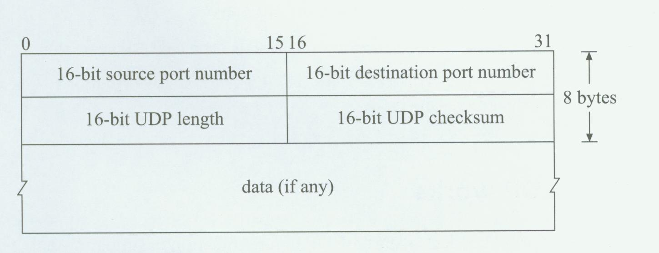
UDP datagram format
P.<number>
Notes:
CT212 (02/03)-Network Programming and design
27 April, 2002
School of Science & Technology

Slide 22
UDP (1)
User Data Protocol (UDP)
  Connectionless
  Discrete datagram
  NO Sequence number, Ack., timer & retransmission
    Unreliable (i.e. transmitted data will be lost)
  Connection set-up is NOT required
    less overhead than TCP
    Transmission speed is better than TCP
P.<number>
Notes:
CT212 (02/03)-Network Programming and design
27 April, 2002
School of Science & Technology

Slide 23
UDP (2)
What kind of application should use UDP?
  Application which accepts minor data error
    eg multi-media application.
  Application which requires less transmission latency,
    eg. VoIP, Video conference.
P.<number>
Notes:
CT212 (02/03)-Network Programming and design
27 April, 2002
School of Science & Technology

Slide 24
5 questions for communication between 2 s/w (eg. Client & server) on 2 different machines
How to identify a machine → IP address
How to identity a s/w running in a machine → IP address + transport layer protocol type + port number
How to transfer data from one machine to another → routing table + IP layer
How to ensure all data are correctly received by destination s/w -> TCP reliability
What to do if there is network congestion due to :
  Transmitting host sends out data too fast;
  receiving capability of destination machine is not enough (eg. Less processing power, memory, NIC speed, etc) -> TCP flow control
P.<number>
Notes:
CT212 (02/03)-Network Programming and design
27 April, 2002
School of Science & Technology

Slide 25
~~~~ Application Layer ~~~~~
DNS
DHCP
THREE INTERNET non-profit organization
P.<number>
Notes:
CT212 (02/03)-Network Programming and design
27 April, 2002
School of Science & Technology

Slide 26
DNS (1)
Most humans find names easier to remember than IP addresses.
The Domain Name System (DNS) was designed to map names to IP addresses and vice versa.
DNS organizes the name space in a hierarchical structure to decentralize the responsibilities involving naming.
Origins of the Internet • Internet Reference Model • Internet Protocol • IP Routing • TCP • UDP

Slide 27
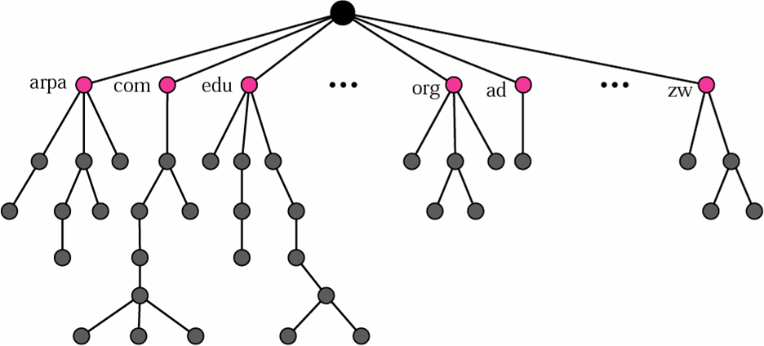
DNS (2)
DNS can be pictured as an inverted hierarchical tree structure with one root node at the top and a maximum of 128 levels.
Origins of the Internet • Internet Reference Model • Internet Protocol • IP Routing • TCP • UDP

Slide 28
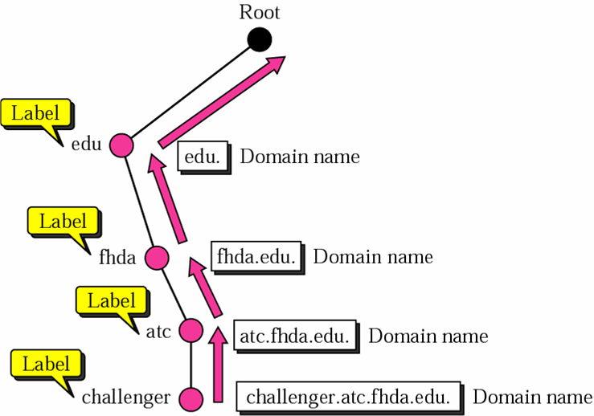
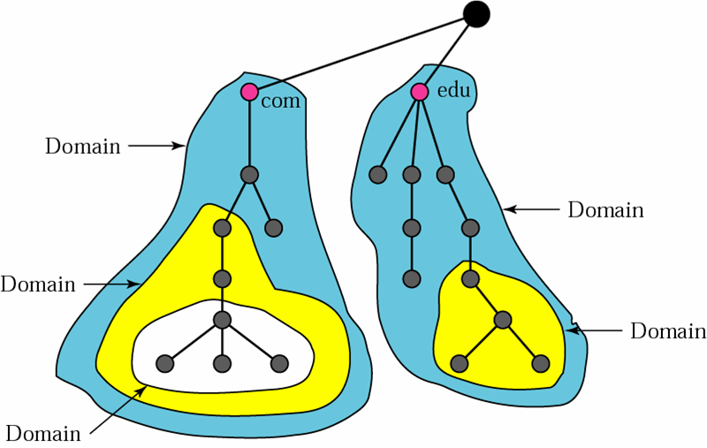
DNS (3)
A domain is defined as any subtree of the domain name space.
Each node in the tree has a domain name.
The DNS database is distributed across DNS servers. Each DNS server has jurisdiction over its zone.
Origins of the Internet • Internet Reference Model • Internet Protocol • IP Routing • TCP • UDP

Slide 29
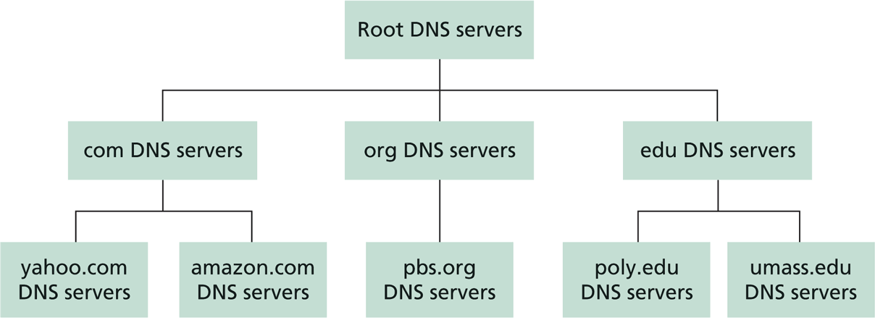
DNS (4)
At the top of the hierarchy is the root domain. A root server’s zone is the entire DNS tree.
Origins of the Internet • Internet Reference Model • Internet Protocol • IP Routing • TCP • UDP

Slide 30
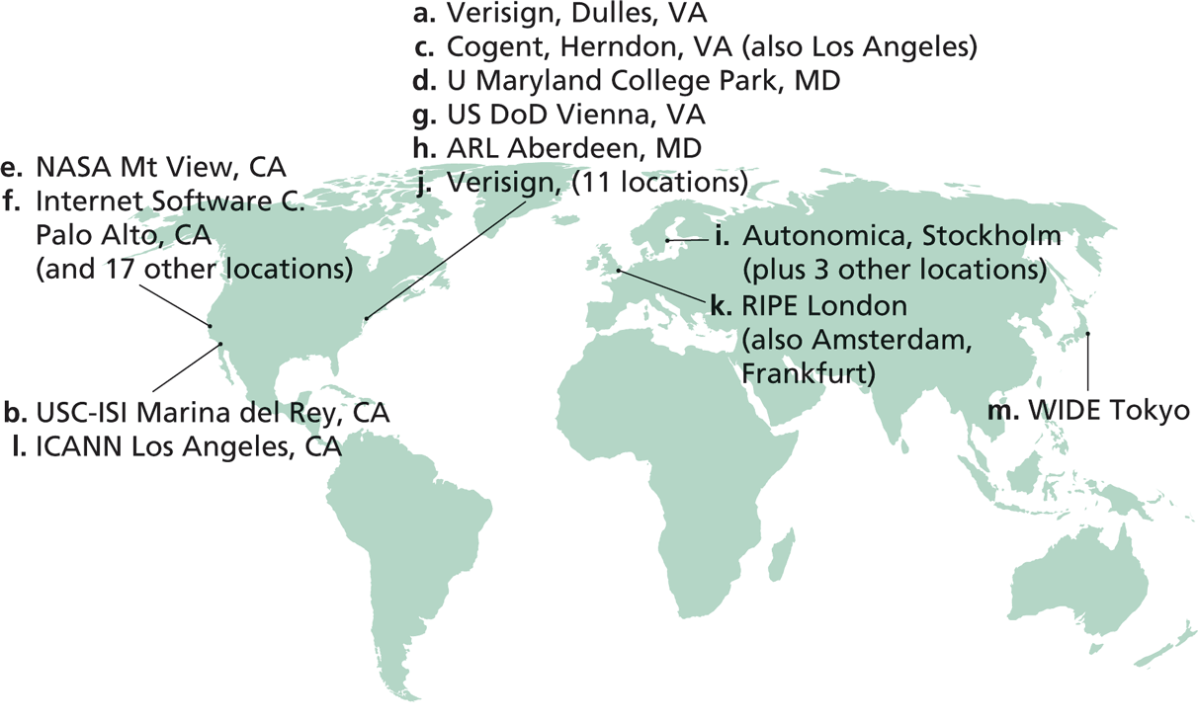
DNS (5)
There are 13 root DNS servers (designated from a to m):
https://en.wikipedia.org/wiki/Root_name_server#Root_server_addresses
Origins of the Internet • Internet Reference Model • Internet Protocol • IP Routing • TCP • UDP

Slide 31
DNS (6)
Top-level domains (TLD) include com, org, net, edu, and gov, and all of the country domains such as hk, cn, uk, and jp.
Every organization with publicly accessible hosts on the Internet must provide publicly accessible DNS records that map the names of those hosts to IP addresses.
These DNS records are provided by the organization’s authoritative name server.
Origins of the Internet • Internet Reference Model • Internet Protocol • IP Routing • TCP • UDP

Slide 32
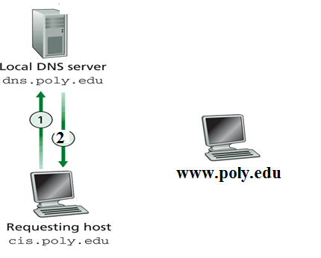
Local DNS Resolution
Host “cis.poly.edu” request for IP address of “www.poly.edu”

Slide 33
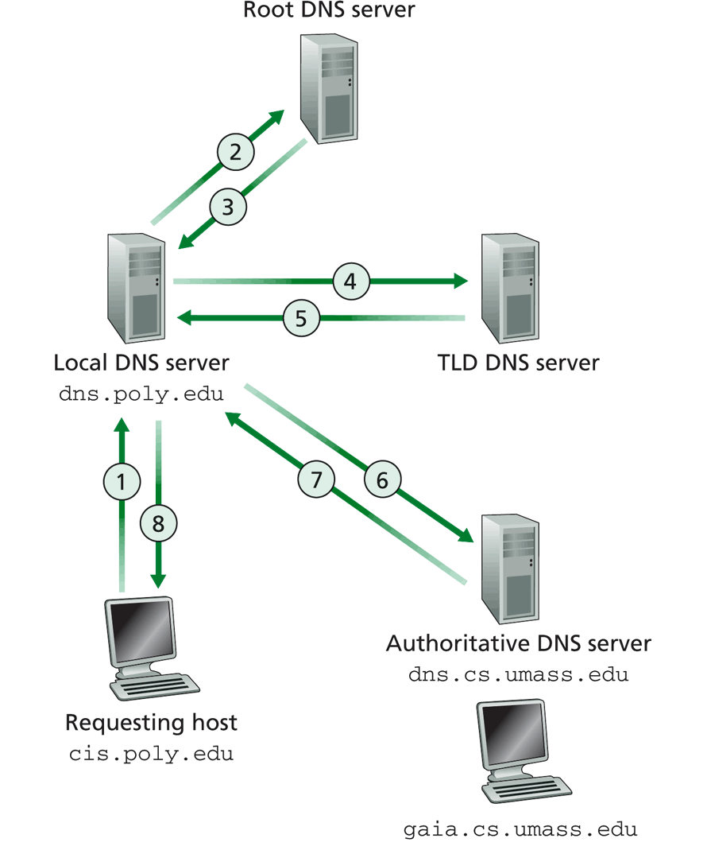
Non-local DNS Resolution
Host “cis.poly.edu” request for IP address of “gaia.cs.umass.edu”
the host “cis.poly.edu” sends its request to its local DNS server.
Local DNS server sends request to multiple servers before getting the answer.
Origins of the Internet • Internet Reference Model • Internet Protocol • IP Routing • TCP • UDP

Slide 34
DHCP (1)
maintains and provides auto-configuration of clients
  Client’s IP address, subnet mask, IP address of default router, IP address of DNS server, other options
  Lease time for IP assignment can be finite. Allows release and reallocation of configuration information => dynamic
  Note that permanent allocation is still possible
UDP 67, 68
P.<number>
Notes:
CT212 (02/03)-Network Programming and design
27 April, 2002
School of Science & Technology

Slide 35
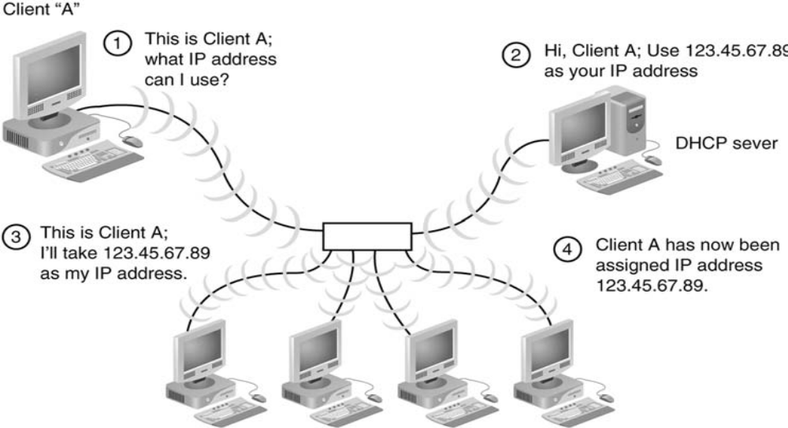
DHCP (2)
The leasing process consists of 4 steps (DORA): Discovery, Offer, Request, Acknowledgement
Origins of the Internet • Internet Reference Model • Internet Protocol • IP Routing • TCP • UDP

Slide 36
THREE INTERNET non-profit organization
  IANA - oversees allocation of port number of Internet Protocol;
  ICANN & Regional Internet Registries (RIRs) - registry and allocation of IP address space
      APNIC for Asia Pacific region
      ARIN for Canada, the United States, and many Caribbean and North Atlantic islands.
      RIPE NCC for Europe, the Middle East and parts of Central Asia
      AFRINIC for African region
      LACNIC for Latin America and parts of the Caribbean
  INTERNIC - domain name registration
P.<number>
Notes:
CT212 (02/03)-Network Programming and design
27 April, 2002
School of Science & Technology

Slide 37
Open
Discussions
P.<number>
Notes:
CT212 (02/03)-Network Programming and design
27 April, 2002
School of Science & Technology

