Slide 1
ELEC S212 (Sept. 2018)
Network
Programming and Design
Surgery 6 for All groups
(Network/Socket Programming)
Course Coordinator : Dr. Steven Choy
Tutor : Joe
URL of my teaching website : http://learn.ouhk.edu.hk/~t441051/s212
P.<number>
Notes:
CT212 (02/03)-Network Programming and design
27 April, 2002
School of Science & Technology

Slide 2
Agenda for Surgery 6
Client/server architecture
Process concepts in UNIX
Process forking :
  Fork child process with basic system calls – fork(), wait(), exit()
3 mechanisms for process communication:
  IPC
  ** Socket programming
  RPC concept
P.<number>
Notes:
CT212 (02/03)-Network Programming and design
27 April, 2002
School of Science & Technology

Slide 3
Objective of Surgery 6
Discuss client/server architecture
Discuss concepts of process
Discuss the use of sockets for inter-process communication.
Identify and describe different modes of socket communication.
Describe the process of socket programming with TCP
Describe the process of socket programming with UDP
Develop network applications using sockets
Explain the operations of Remote Procedure Calls (RPCs).
P.<number>
Notes:
CT212 (02/03)-Network Programming and design
27 April, 2002
School of Science & Technology

Slide 4
What is
client/server architecture?
P.<number>

Slide 5
Client-Server Architecture (1)
Classification of client and server in terms of service
2. Provide service
Client
Server
1. Request service
Client requests service from server
Server responds with providing service or error message to client
This model allows client and server part of the network application to be developed independently to each other => speed up developing
P.<number>

Slide 6
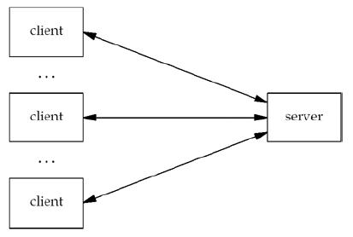
Client-Server Architecture (2)
One server can provide service to multiple clients simultaneously.
P.<number>

Slide 7
Client/server architecture (3)
A more general definition for network application:
  Client is a process running in a machine
  Server is a daemon process running in same machine or another machine. For latter case, client machine and server machine are connected by network (eg. INTERNET).
  You can view the network application as communication between 2 processes (client process & server process) via network.
  Eg. SSH, ftp, etc.
Currently, there is a trend of web-based network programming. Web-based means the SERVER is accessed via web browser.
P.<number>

Slide 8
Client/server architecture (4)
Client and server in the same machine
Client
Process
. . . . . .
Daemon
Server process
Kernel
Client and server in different machines
Machine 1
Machine 2
Daemon Server
Process
Client process
Kernel
Kernel
Network
P.<number>
(Distributed System)

Slide 9
What is process?
P.<number>

Slide 10
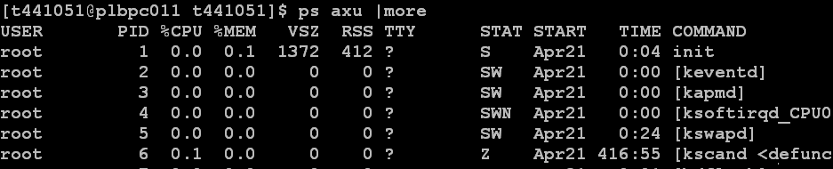
Process concept (1)
Each instance of executing program is a process.
Each process is identified by an unique process id (pid). 0 ~ 30000.
Name of executing command/Program
User ID
Process ID
P.<number>

Slide 11
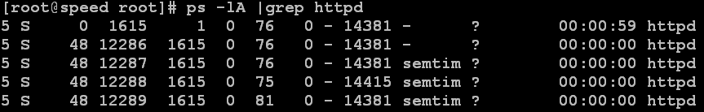
Process concept (2)
Executing same program twice creates 2 processes of different process ids
A process can fork one or more child processes, resulting a process tree. The process and forked processes are in parent-child relationship (ppid, pid)
P.<number>

Slide 12
Process concept (3)
How to list running processes in UNIX system :
  “ps -lA“ or “ps aux” or “ps –ef”
How to kill a running process :
  “kill -9 process_id”
P.<number>

Slide 13
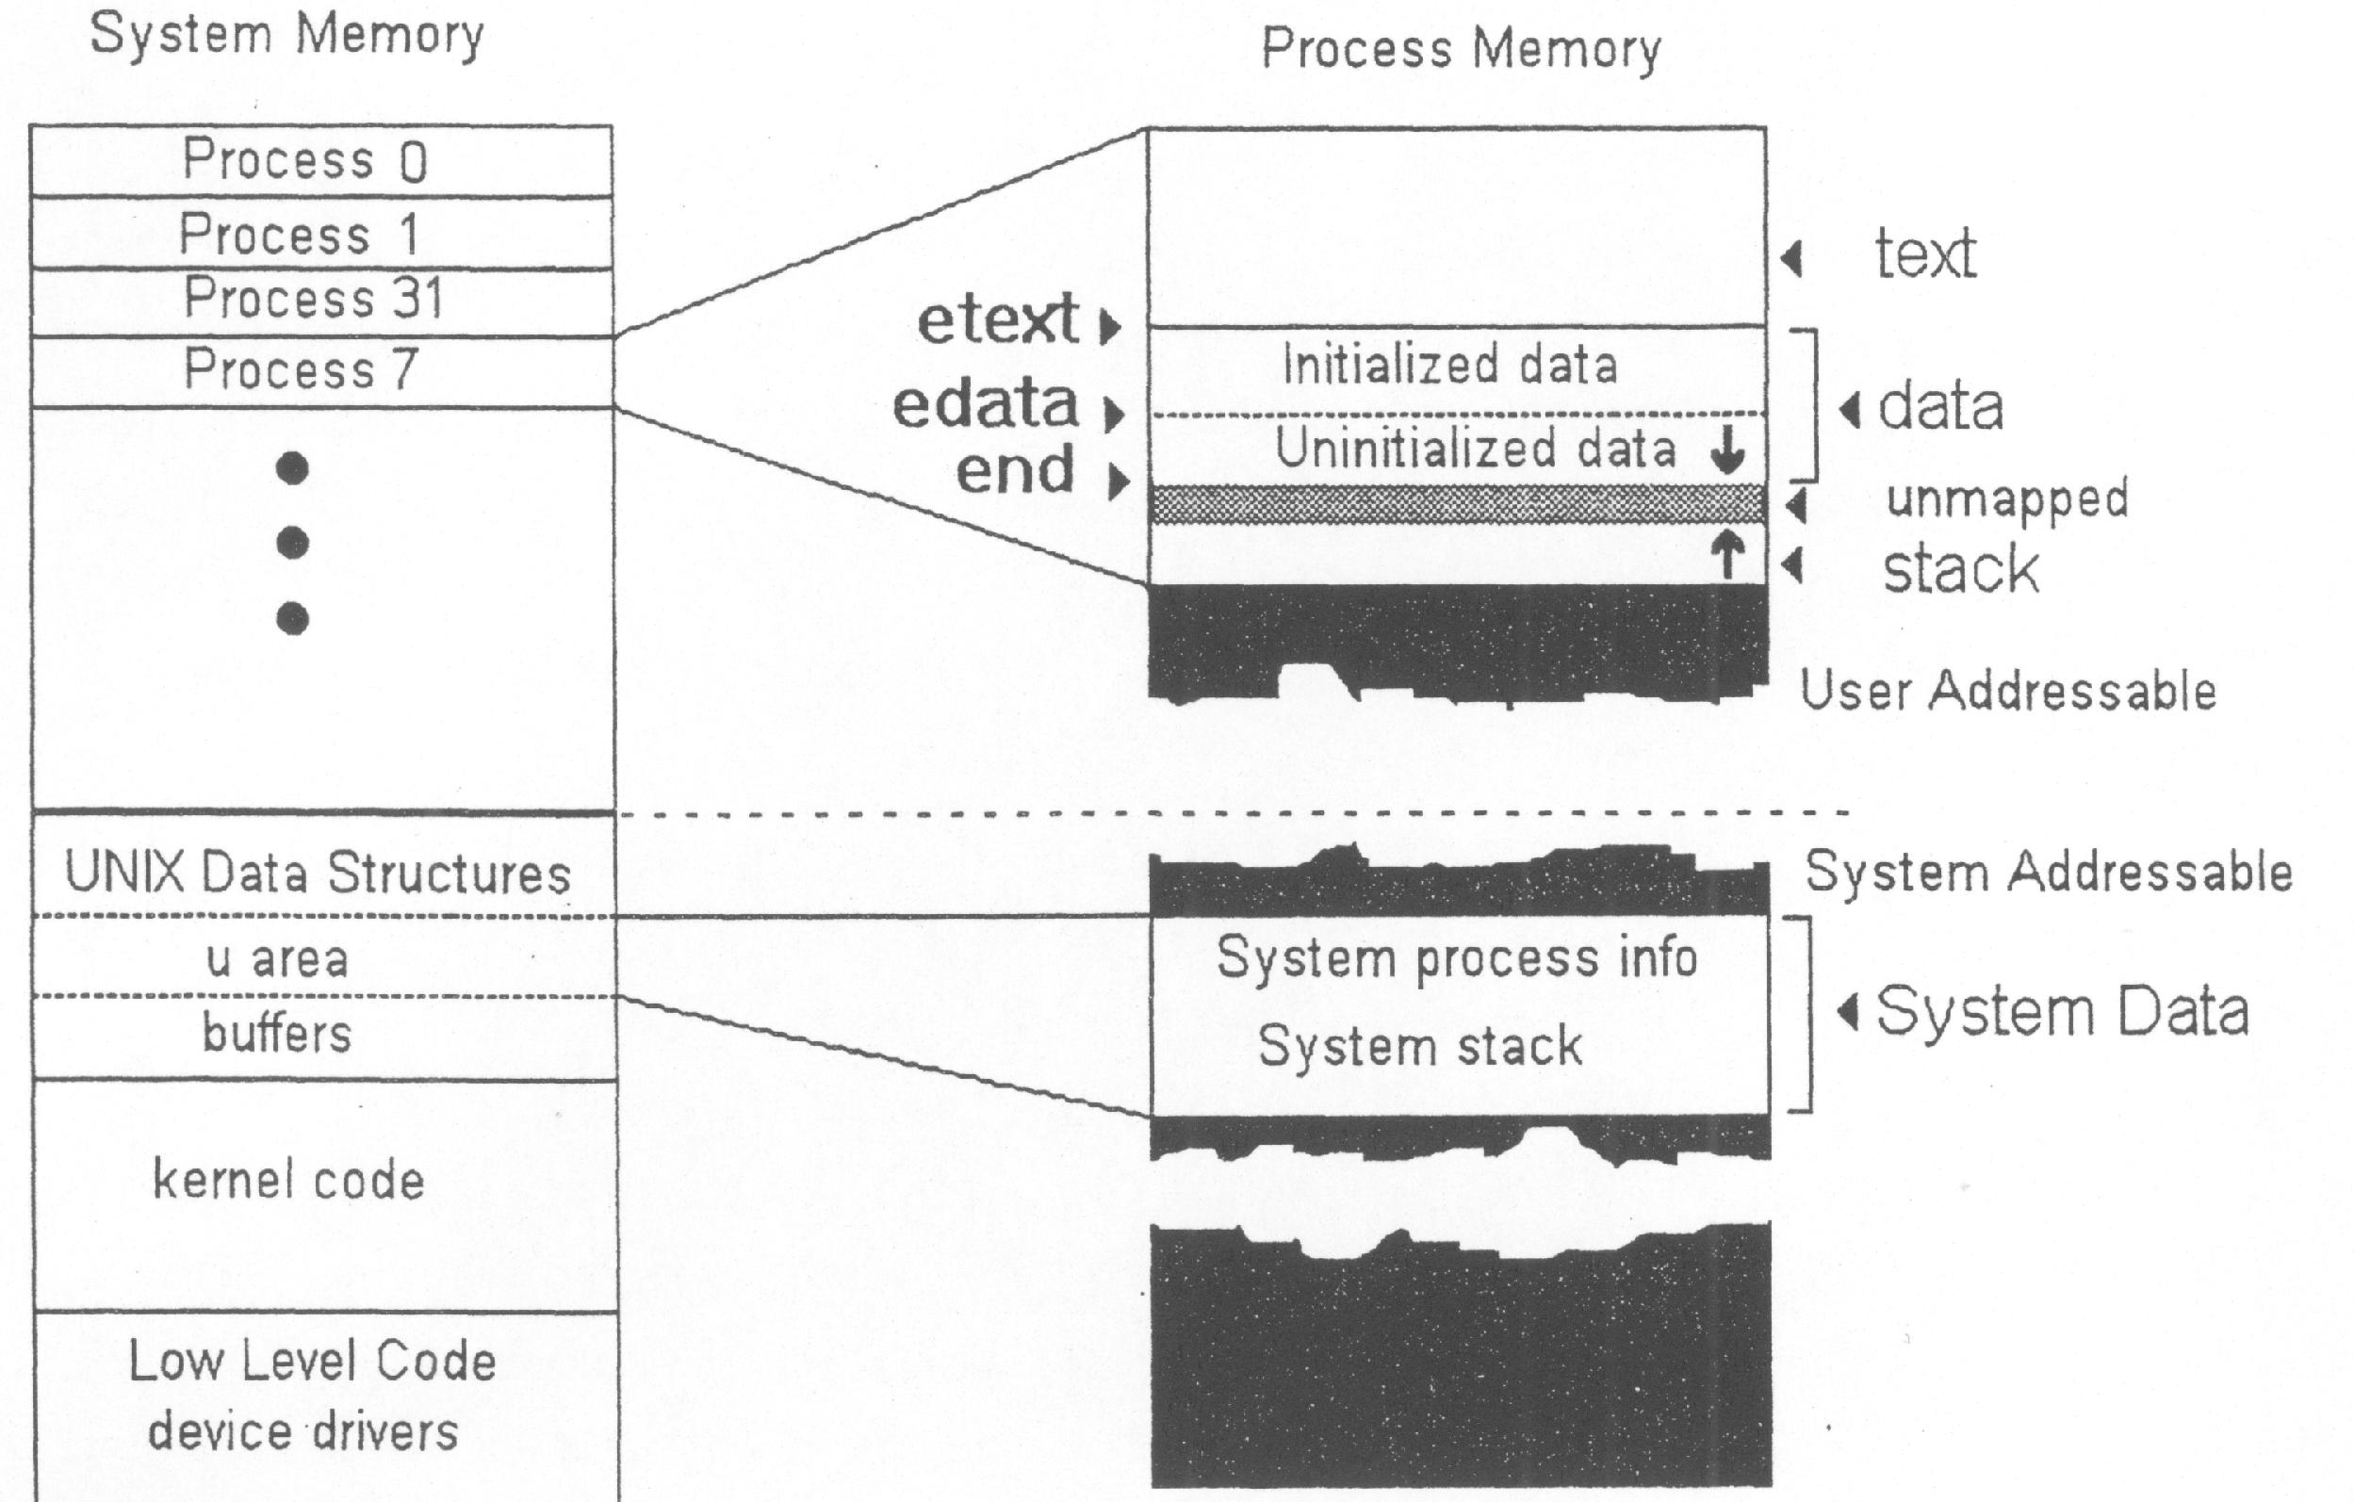
Process concept (4)
P.<number>
Notes:
CT212 (02/03)-Network Programming and design
27 April, 2002
School of Science & Technology

Slide 14
Process concept (5) – process environment
Each process is associated with following attributes:
  Process id (pid), parent process id (ppid)
  User id (uid) - Id of user who start the process
  Effective user id (euid) – if user, who is not owner of the executable file, starts the executable file
  process group id (gid), effective process group id (egid) – similar to uid, euid
  File descriptor – refer to next page
P.<number>
Notes:
CT212 (02/03)-Network Programming and design
27 April, 2002
School of Science & Technology

Slide 15
Process concept (6) – file descriptor
An integer used to identify a file that has been opened by a process.
Used to reference to the file by the process
Procedures for handling file descriptor (similar to file handling in C programming) :
  Initialize : fd=open(“…..”)
  Read/write the file : read(fd,..), write(fd,…)
  Destruct : close(fd)
3 predefined file descriptor :
  0 – stdin (standard input, keyboard)
  1 – stdout (standard output, display)
  2 – stderr (standard error)
P.<number>
Notes:
CT212 (02/03)-Network Programming and design
27 April, 2002
School of Science & Technology

Slide 16
Basic system call (fork)
P.<number>

Slide 17
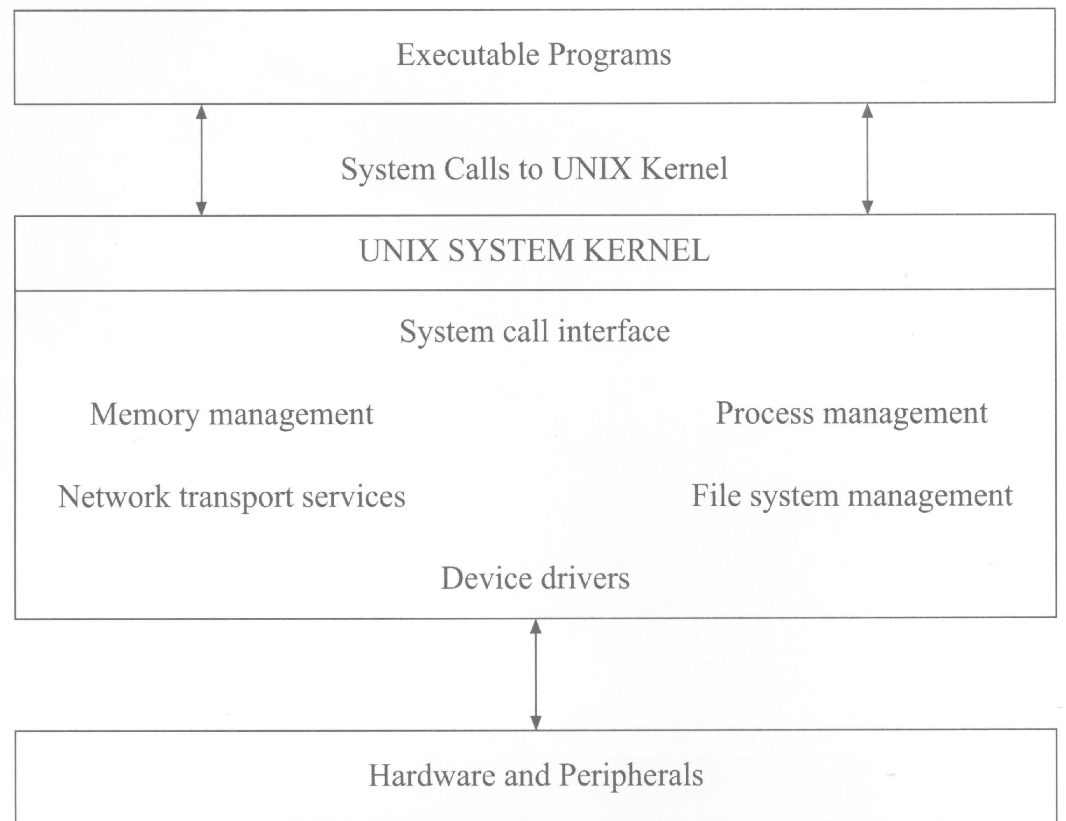
Basic System Call (1)
P.<number>
Notes:
CT212 (02/03)-Network Programming and design
27 April, 2002
School of Science & Technology

Slide 18
Basic System Call (2) – fork (1)
main()
{ ….
pid=fork();
….
}
When fork() is executed, kernel makes two identical copies of address spaces, one for the parent and the other for the child. Both processes will start their execution at the next statement following the fork() call.
Parent process
main()
{ ….
pid=fork();
….
}
Child process
main()
{ ….
pid=fork();
….
}
+
P.<number>
Notes:
CT212 (02/03)-Network Programming and design
27 April, 2002
School of Science & Technology

Slide 19
Basic System Call (3) – fork (2)
main()
{pid=fork();
switch(pid)
{case -1: // fork failure
FailureRoutine();
case 0: //code for child process
ChildProcess();
default: //code for parent process
ParentProcess(); }
Void FailureRoutine() {…..}
Void ChildProcess() {…..}
Void ParentProcess() {….}
}
Typical coding for forking.
System call fork() :
1. returns the child process ID to the parent process (i.e. pid=positive=child process id)
2. returns 0 to the child process (i.e. pid=0)
Both processes have identical but separate address spaces, variables initialized before the fork() call have the same values in both address spaces. Since every process has its own address space, any modifications will be independent of the others
P.<number>
Notes:
CT212 (02/03)-Network Programming and design
27 April, 2002
School of Science & Technology

Slide 20
Basic System Call (4) – fork (3)
process
fork()
Parent process
+
Child process
Parent process is responsible to remove child process when child process ends with exit(). So, parent process wait() until receiving exit status of child process.
Parent process completes all its necessary codes but cannot end
exit()
Child process ends
wait()
Wait for end of child process
Parent process exit
P.<number>
Notes:
CT212 (02/03)-Network Programming and design
27 April, 2002
School of Science & Technology

Slide 21
Basic System Call (5) – fork (4)
process
fork()
Parent process
+
Child process
invoke other program by execvp()
Parent process
Child process
wait()
Wait for end of child process
exit()
Parent process exit
P.<number>
Notes:
CT212 (02/03)-Network Programming and design
27 April, 2002
School of Science & Technology

Slide 22
Basic System Call (6) – fork (5)
Child process inherits from parent process
  Uid, euid, gid, egid, environment variables, open file descriptors, current working dir., root dir.
However, child process has its separate pid,
Use “sprintf() + write()” instead of “printf()” when output to stdout. Printf() is "buffered" and the output will not be sent to screen immediately. You may not get the right order of the expected result
Demo with programs fork1.c, fork2.c, fork3.c
P.<number>
Notes:
CT212 (02/03)-Network Programming and design
27 April, 2002
School of Science & Technology

Slide 23
Basic System Call (7) – Zombie process
Parent process will not remove child process until it has seen the exit status of child process.
This exit status is sent by exit() at the end of child process.
If child process ends without exit(), it will left inactive and not removed. Child in this status is called zombie process.
Zombie process cannot be killed and removed. They will clutter up the system and should be avoided.
Zombie process can only be removed by reboot of system.
P.<number>
Notes:
CT212 (02/03)-Network Programming and design
27 April, 2002
School of Science & Technology

Slide 24
Process communication by
Socket programming
P.<number>

Slide 25
3 mechanisms for process communication
IPC
  For processes within same machine only
  Limited in usage
**Socket programming
  For processes within same/different machines
  Most important and widely accepted
RPC
  For processes within same/different machines
  Some limitations
P.<number>
Notes:
CT212 (02/03)-Network Programming and design
27 April, 2002
School of Science & Technology

Slide 26
IPC (1)
A generic term to describe the methods the processes within same machine use to communicate with each other.
  Unnamed Pipes
  Named pipe - FIFOs
  Message queues
  Semaphores & Shared memory
P.<number>
Notes:
CT212 (02/03)-Network Programming and design
27 April, 2002
School of Science & Technology

Slide 27
IPC (2)
Process communication is within same machine => usage limitation
File
Server
Memory
Server
Client
Process
Client
Process
. . . . . .
Kernel
P.<number>

Slide 28
Socket programming – between same/different machine(s)
Client and server in the same machine
Client
Process
. . . . . .
Daemon
Server process
Kernel
Client and server in different machines
Machine 1
Machine 2
Daemon Server
Process
Client process
Kernel
Kernel
Network
P.<number>
(Distributed System)

Slide 29
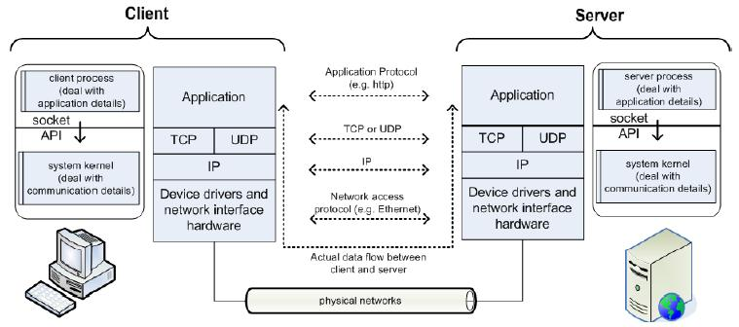
Socket concepts (1)
P.<number>
Notes:
CT212 (02/03)-Network Programming and design
27 April, 2002
School of Science & Technology

Slide 30
Socket concepts (2)
Socket is an API provided by C library.
It is “programming language and protocol independent”
Often refers to BSD socket
Why socket ?
  Through IPC, only processes of same machine can communicate.
  Through socket, processes of same/different machines can communicate.
  Socket programming is more complicated & less efficient than IPC but its ability of across-machine makes it override IPC.
P.<number>
Notes:
CT212 (02/03)-Network Programming and design
27 April, 2002
School of Science & Technology

Slide 31
Socket concepts (3)
Each communication channel/association involves 2 end points. A socket corresponds to end point on each side
In TCP/IP :
  An association is uniquely identified by 5-tuple (transport protocol type, local IP , local port, remote IP, remote port)
  A socket is uniquely identified by 3-tuple (transport protocol type, local IP , local port)
When creating a socket, a file descriptor (a 16-bit integer) is returned. You access the socket through the file descriptor.
There are 3 characteristics of a socket :
  Connection mode
  Socket type
  Communication domain
P.<number>
Notes:
CT212 (02/03)-Network Programming and design
27 April, 2002
School of Science & Technology

Slide 32
Socket concepts (4) – connection mode
To design a socket application, you have to choose its connection mode :
  Connection-oriented mode :
    Similar to telephone system - setup connection, data transfer, break setup
    Transport layer protocol is TCP
    Reliable, bi-directional, no record boundary, in-order, unduplicated, more overhead
    Corresponds to stream socket type
  Connectionless mode :
    Similar to postal system – no setup connection before data transfer
    Transport layer protocol is UDP
    Unreliable, bi-directional, have record boundary, may be out-of-order and duplicated, faster. Reliability is provided by the application.
    Corresponds to datagram socket type
P.<number>
Notes:
CT212 (02/03)-Network Programming and design
27 April, 2002
School of Science & Technology

Slide 33
Socket concepts (5) – socket type
Processes are presumed to communicate only between sockets of the same type.
4 types of socket is available :
  Stream socket (SOCK_STREAM) – to implement connection-oriented connection mode application, e.g. telnet, ssh, http
  Datagram socket (SOCK_DGRAM) – to implement connectionless connection mode application, e.g. IP telephony
  Raw socket (SOCK_RAW) – for developing new communication protocol
  Seguenced packet socket (SOCK_SEQPACKET) – similar to stream socket but maintains message boundary. However, TCP/IP does not support message boundary.
P.<number>
Notes:
CT212 (02/03)-Network Programming and design
27 April, 2002
School of Science & Technology

Slide 34
Socket concepts (6) - domain
Communication domain involves how to uniquely identify a socket (i.e. its addressing format) and the protocol used for communication
There are 4 communication domains available :
  INTERNET domain – using TCP/IP
  UNIX domain – for on-system communication
  NS domain – using Xerox standard communication protocol
  ISO OSI domain – using ISO OSI protocol
P.<number>
Notes:
CT212 (02/03)-Network Programming and design
27 April, 2002
School of Science & Technology

Slide 35
Socket concepts (7)
  Connection mode (2 modes only)
    Connection-oriented mode
    Connectionless mode
  Socket type (2 types only, one-to-one mapping to connection mode)
    Stream socket (SOCK_STREAM) mapped to Connection-oriented mode
    Datagram socket (SOCK_DGRAM) mapped to Connectionless mode
  Communication domain (one domain only)
    INTERNET domain
Practically, we only need to handle 2 cases only in TCP/IP domain.
P.<number>
Notes:
CT212 (02/03)-Network Programming and design
27 April, 2002
School of Science & Technology

Slide 36
Socket concepts (8) -– struct sockaddr
Pre-defined in file <netinet/in.h> (i.e. /sys/include/netinet/in.h in “ucourse”).
To specify port number and IP address
In INTERNET domain, it refers to sockaddr_in,
struct sockaddr_in {
  short sin_family; /* AF_INET */
  u_short sin_port; /* 16-bit port number , network byte order */
  struct in_addr sin_addr; /* 32-bit IP address, network byte order */
  char sin_zero[8]; /* unused, always set to zero */
  };
  struct in_addr {
  u_long s_addr;
  };
P.<number>
Notes:
CT212 (02/03)-Network Programming and design
27 April, 2002
School of Science & Technology

Slide 37
Byte Ordering of Integers
Different CPU architectures have different byte ordering
memory
address A +1
memory
address A
Stored at little-endian computer
high-order byte
low-order byte
Integer representation (2 byte)
D3
F2
Stored at big-endian computer
low-order byte
high-order byte
P.<number>

Slide 38
Byte Ordering Problem
Question: What would happen if two computers with different integer byte ordering communicate?
Answer:
    Nothing if they do not exchange integers!
    But: If they exchange integers, they would get the
    wrong order of bytes, therefore, the wrong value!
Example:
Message is: [Hello,1]
Message is: [Hello,512]
Processing
Processing
Message in Memory of
little-endian Computer
Message in Memory of
of big-endian Computer
Message is sent
across Network
48 45 4C 4C 6F 01 00
48 45 4C 4C 6F 01 00
P.<number>

Slide 39
Byte Ordering Solution
There are two solutions if computers with different byte ordering system want to communicate
  They must know the kind of architecture of the sending computer
  (bad solution, it has not been implemented)
  Introduction of a network byte order. The functions are:
uint16_t htons(uint16_t host_16_bit_value)
uint32_t htonl(uint32_t host_32_bit_value)
uint16_t ntohs(uint16_t net_16_bit_value)
uint32_t ntohl(uint32_t net_32_bit_value)
Note: use for all integers (short and long), which are sent across the network
  Including port numbers and IP addresses
P.<number>

Slide 40
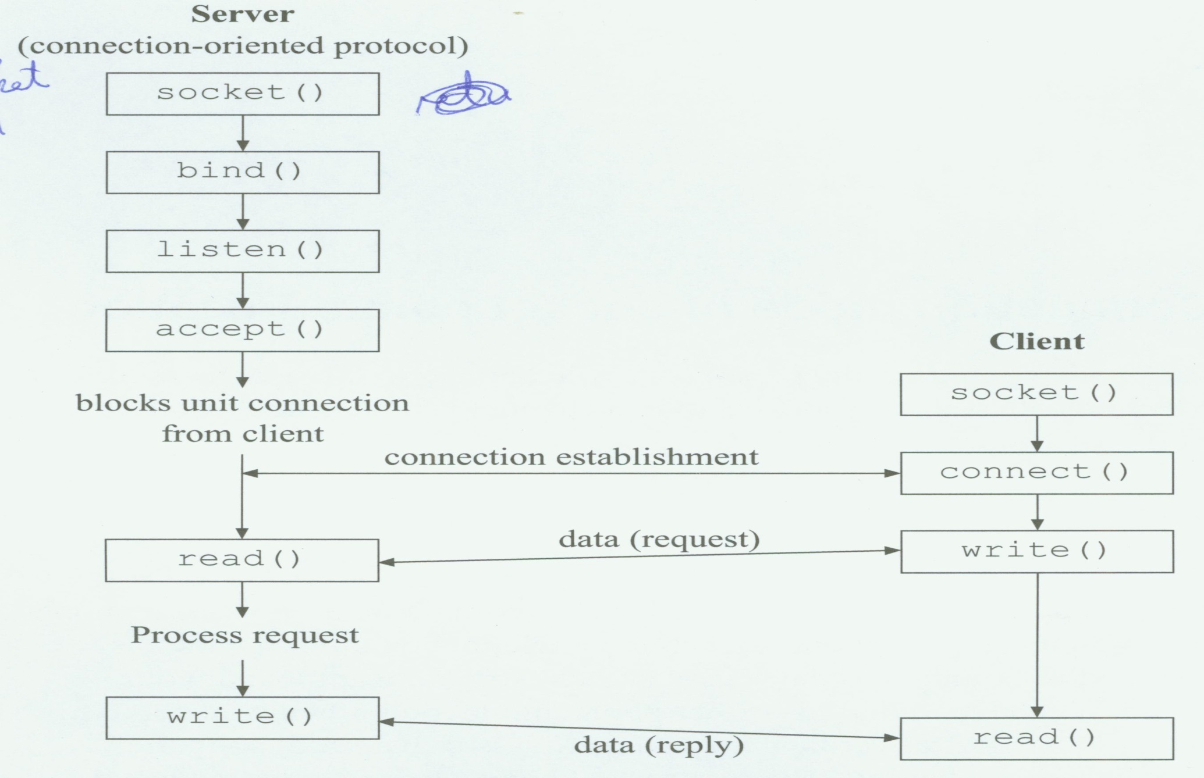
Socket programming (1) – “connection-oriented”
P.<number>
Notes:
CT212 (02/03)-Network Programming and design
27 April, 2002
School of Science & Technology

Slide 41
Socket programming (2) –
“connection-oriented” client
Programming flow:
  Create stream socket (socket() )
  Connect to server IP and port (connect() )
  While still connected:
    send message to server (send() or write() )
    receive (recv() or read() ) data from server and process it
  Close TCP connection and Socket (close())
demo programs :
  stream_client.c
P.<number>

Slide 42
Socket programming (3) –
“connection-oriented” server
Programming flow:
  Create stream socket (socket() )
  Bind server port to server socket (bind() )
  Listen for new client (listen() )
  While
    accept user connection and create a new socket (accept() )
    data arrives from client (recv() or read() )
    data has to be send to client (send() or write() )
demo programs :
  stream_server.c
P.<number>

Slide 43
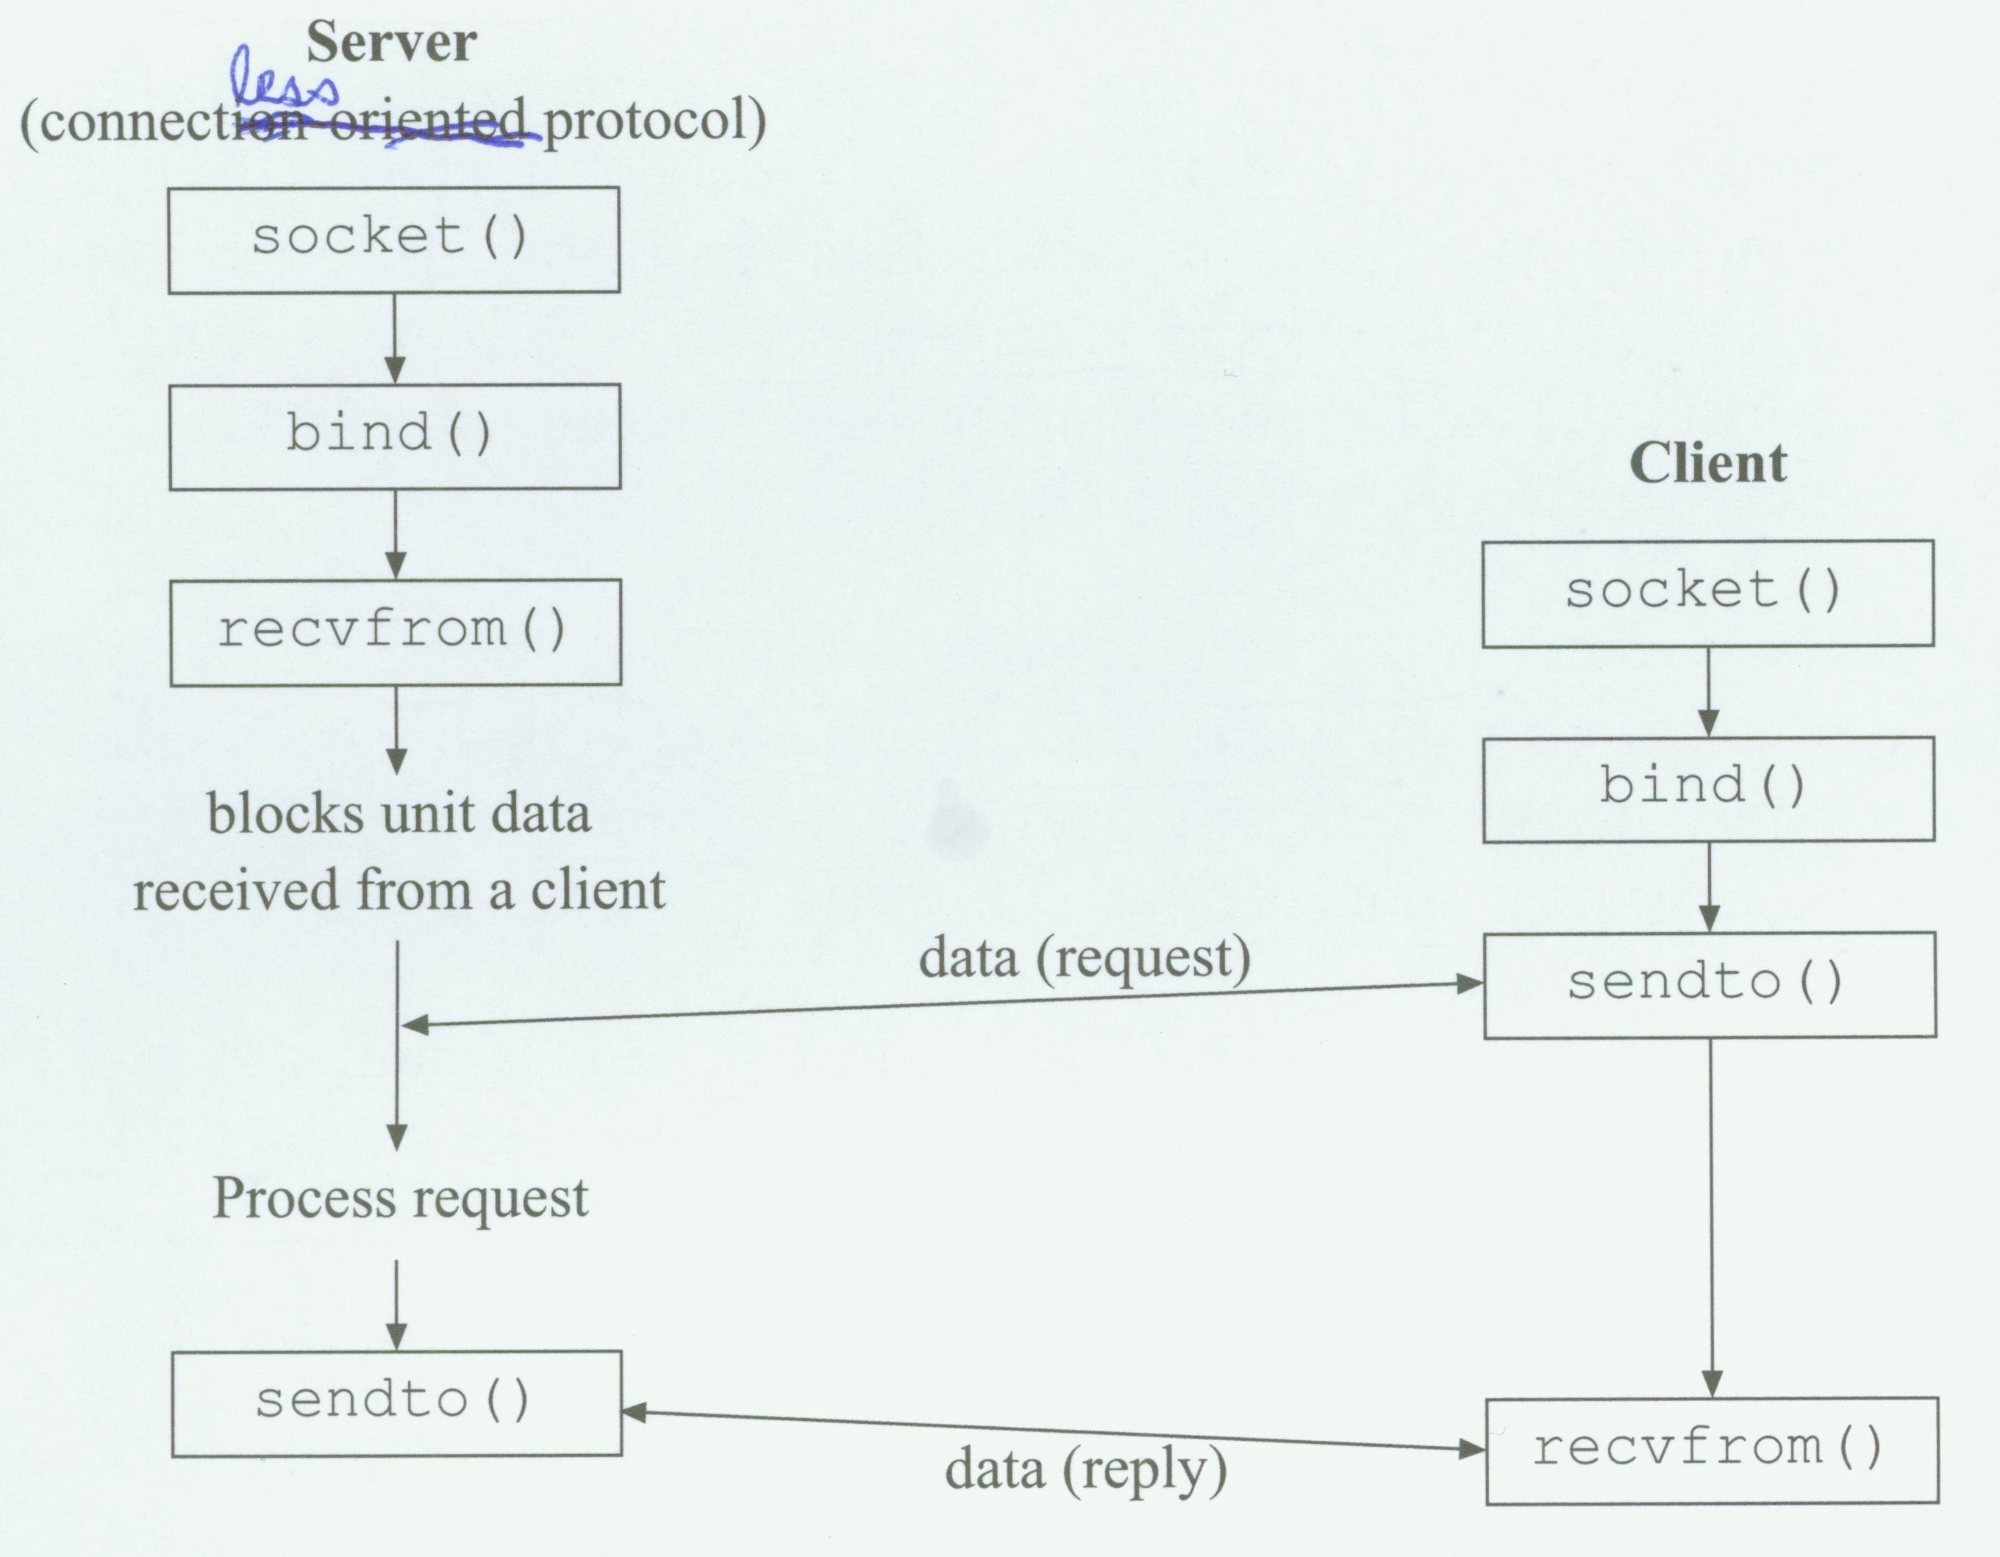
Socket programming (4) – connectionless
P.<number>
Notes:
CT212 (02/03)-Network Programming and design
27 April, 2002
School of Science & Technology

Slide 44
Socket programming (5) –
“connectionless” client
Programming flow:
  Create stream socket (socket() )
  Bind client port to client socket (bind() )
  While still connected:
    send message to server (sendto())
    receive (recvfrom()) data from server and process it
  Close TCP connection and Socket (close())
demo programs :
  dgram_client.c
P.<number>

Slide 45
Socket programming (6) –
“connectionless” server
Programming flow:
  Create stream socket (socket() )
  Bind server port to server socket (bind() )
  While (1)
    data arrives from client (recvfrom())
    data has to be send to client (sendto())
  Close TCP connection and Socket (close())
demo programs :
  dgram_server.c
P.<number>

Slide 46
Socket programming (7) – socket()
To create a socket. Similar to open a file.
Require for all types of server & client
socket() returns -1 on error
#include <sys/types.h>
#include <sys/socket.h>
int sock_descriptor
sock_descriptor=socket(int family, int type, int protocol);
  family specifies domain and can be AF_INET (INTERNET domain) or AF_Unix (UNIX domain)
  Type specifies socket type & can be SOCK_STREAM, SOCK_DGRAM, SOCK_RAW, SOCK_SEQPACKET
  Protocol specifies transport layer protocol type and can be TCP or UDP or 0. If you use 0 for protocol type, the system will select appropriate protocol for you based on your selected domain and socket type. Note that SOCK_STREAM must use TCP while SOCK_DGRAM must use UDP.
P.<number>
Notes:
CT212 (02/03)-Network Programming and design
27 April, 2002
School of Science & Technology

Slide 47
Socket programming (8) – bind()
To associate socket to a port number & IP address of the local machine. Required for server & connectionless client only.
Before binding, appropriate values must be assigned to field members of a variable which is of struct sockaddr_in
bind() returns -1 on error
For server : the port number must be fixed & greater than 1024
#include <sys/types.h>
#include <sys/socket.h>
#define MYPORT 1400
struct sockaddr_in my_addr;
my_addr.sin_family = AF_INET; // host byte order
my_addr.sin_port = htons(MYPORT); // short, network byte order
my_addr.sin_addr.s_addr = htonl(INADDR_ANY); // use my IP address
// short, network byte order
memset(&(my_addr.sin_zero), '\0', 8); // zero the rest of the struct
int bind(int sock_descriptor, (struct sockaddr_in *)&my_addr, sizeof(struct sockaddr_in));
P.<number>
Notes:
CT212 (02/03)-Network Programming and design
27 April, 2002
School of Science & Technology

Slide 48
Socket programming (9) – bind()
For connectionless client, port number can be any unused value, and IP address is automatically got through INADDR_ANY.
#include <sys/types.h>
#include <sys/socket.h>
struct sockaddr_in my_addr;
my_addr.sin_family = AF_INET; // host byte order
my_addr.sin_port = htons(0); // for connectionless client,
// choose an unused port at random
my_addr.sin_addr.s_addr = htonl(INADDR_ANY); // use my IP address
// short, network byte order
memset(&(my_addr.sin_zero), '\0', 8); // zero the rest of the struct
int bind(int sock_descriptor, (struct sockaddr_in *)&my_addr, sizeof(struct sockaddr_in));
P.<number>
Notes:
CT212 (02/03)-Network Programming and design
27 April, 2002
School of Science & Technology

Slide 49
Socket programming (10) – listen()
Prepare a socket to accept connections.
Only required for connection-oriented server
Server is waiting for clients’ requests. Clients’ requests are queued until server services them by calling accept() system call.
listen() returns -1 on error
int listen(int sock_descriptor, int backlog);
  backlog is the number of connections allowed on the incoming queue while it waits for the server to execute the accept() system call.
  Most system silently limit backlog to 20
  Value 5 or 10 is a good candidate
P.<number>
Notes:
CT212 (02/03)-Network Programming and design
27 April, 2002
School of Science & Technology

Slide 50
Socket programming (11) – accept()
To accept & service incoming connection request in the queue
Only required for connection-oriented server
return a brand new socket file descriptor to use for this single connection. This new socket will use another port number. The original socket is still listening on original port for future client requests and the newly created socket is used for exchanging data with connected client
In a while loop, call accept(), then fork() a child process to actually service client request while parent process continues to listen for other client requests
accept() returns -1 on error
P.<number>
Notes:
CT212 (02/03)-Network Programming and design
27 April, 2002
School of Science & Technology

Slide 51
Socket programming (12) – accept()
#include <sys/socket.h>
int ori_sock_descriptor, new_sock_descriptor
struct sockaddr_in peer_addr; // connector's address information
ori_sock_descriptor=socket(…); bind(…); listen(…); …..
while (1) { // main accept loop
new_sock_descriptor=accept(int ori_sock_descriptor,
struct sockaddr_in *)&peer_addr, sizeof(struct sockaddr_in)); //blocking
if (new_sock_descriptor < 0 )
error_handle(“accept error”);
if ( fork() == 0 ) //child process
{ close(ori_sock_descriptor);
….. // routine for processing the request
exit(0);
}
close(new_sock_descriptor); //parent process
}
P.<number>
Notes:
CT212 (02/03)-Network Programming and design
27 April, 2002
School of Science & Technology

Slide 52
Socket programming (13) – connect()
Required for connection-oriented client only
called after socket() on stream client
Only need to know server’s IP address and port listening to
Local port used in client is chosen by kernel and we don’t need to take care
P.<number>
Notes:
CT212 (02/03)-Network Programming and design
27 April, 2002
School of Science & Technology

Slide 53
Socket programming (14) – read(), write
For data transfer
Similar to file I/O
#include <sys/types.h>
#include <sys/uio.h>
#include <sys/socket.h>
int read(int sockfd, char *buf, int buf_size);
int write(int sockfd, char *buf, int buf_size);
P.<number>
Notes:
CT212 (02/03)-Network Programming and design
27 April, 2002
School of Science & Technology

Slide 54
Socket programming (15) – sendto(), recvfrom()
For data transfer
Similar to read(), write() but with one more flag
#include <sys/types.h>
#include <sys/socket.h>
int sendto(int sockfd, char *buf_to_send, int buf_size, int flag, (struct sockaddr_in *)&receiver_addr_info, length_of_sockaddr_in)
int recvfrom(int sockfd, char *buf, int buf_size, int flag, (struct sockaddr_in *)&receiver_addr_info, length_of_sockaddr_in )
P.<number>
Notes:
CT212 (02/03)-Network Programming and design
27 April, 2002
School of Science & Technology

Slide 55
Socket programming (16) – summary (1)
Functions classification :
System calls :
  Startup / close
  Data transfer
  Option control – getsockopt(), setsockopt(), fcntl(), iocntl()
  Other
Network configuration lookup :
  IP address
  Port number
  Other
Utility function
  Data conversion – ntohs()/ntohl(), htons()/htonl()
  Address manipulation – inet_ntoa()/inet_addr()
  Error handling
P.<number>
Notes:
CT212 (02/03)-Network Programming and design
27 April, 2002
School of Science & Technology

Slide 56
Socket programming (17) – summary (2)
System calls :
  socket() – create a socket and returns its descriptor
  bind() – associate a socket with local IP & port number
  listen() – establish queue for connection request
  accept() – accept a connection request
  connect() – initiate a connection to remote host
  write() – send data to a socket
  read() – read data from a socket
  sendto() - send data to a socket
  recvfrom() - read data from a socket
  close() – close a socket descriptor
P.<number>
Notes:
CT212 (02/03)-Network Programming and design
27 April, 2002
School of Science & Technology

Slide 57
Socket programming (18) - summary (3)
Network configuration lookup functions :
  gethostbyname() – given a dns-name, returns a structure which contains IP and port number
  getservbyname() – given service name & protocol, returns a structure which contains its dns-name and port number
  gethostname() – return hostname
  getservbyport()
  getservent()
  getprotobyname(), getprotobynumber(),getprotobyent()
  getnetbyname(), getnetbyaddr(),getnetent()
Please refer to URL : http://support.sas.com/documentation/onlinedoc/sasc/doc700/html/lr2/lr2sfr.htm for a list of socket functions.
P.<number>
Notes:
CT212 (02/03)-Network Programming and design
27 April, 2002
School of Science & Technology

Slide 58
Socket programming (19) –summary (4)
Useful header files :
  <sys/types.h>
  <sys/socket.h>
  <netinet/in.h>
  <netdb.h>
  <arpa/inet.h>
  <stdio.h>
  <stdlib.h
  <unistd.h>
  <errno.h>
  <string.h>
P.<number>
Notes:
CT212 (02/03)-Network Programming and design
27 April, 2002
School of Science & Technology

Slide 59
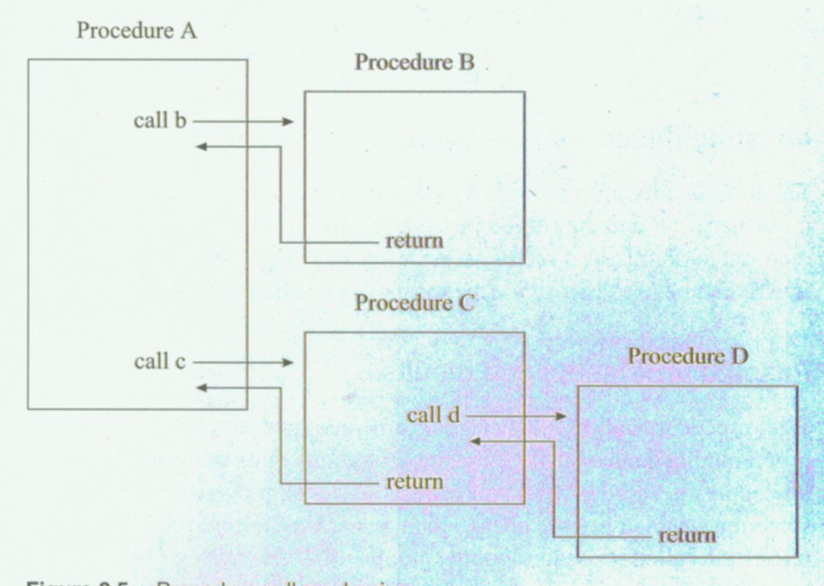
RPC (1) – Review of traditional procedure call
Procedure A : calling procedure
Procedure B : called procedure
P.<number>
Notes:
CT212 (02/03)-Network Programming and design
27 April, 2002
School of Science & Technology

Slide 60
RPC (2) – RPC concepts (1)
Why RPC?
  It is similar to procedure call for traditional program and procedure call mechanism is well-understood.
What is RPC?
  Stands for Remote Procedure Call.
  Another mechanism for developing distributed client/server application.
  Calling procedure in client machine, called procedure in another server machine.
  It includes RPC facility & a set of procedures
  Ideal RPC : total transparency to calling & called procedure via RPC facility (i.e. both don’t aware the other is located & running on another machine)
P.<number>
Notes:
CT212 (02/03)-Network Programming and design
27 April, 2002
School of Science & Technology

Slide 61
RPC (3) – RPC concepts (2)
3 difficulties in achieving transparency :
  Locating the called procedure
    Remote hostname + pathname of called procedure
    Specify remote machine by DNS
  Passing argument values & results
    Called by value -> OK
    Call by reference : 2 issues to be solved & handled by RPC facility
      No common addressing space between calling & called procedure
      Difference in data representation in client & server machine. Solved by marshalling
  Binding called procedure to calling procedure
    2 types of traditional binding :
      Link both calling & called procedure into a single program file
      Called procedure is dynamically linked & loaded into memory during being called.
P.<number>
Notes:
CT212 (02/03)-Network Programming and design
27 April, 2002
School of Science & Technology

Slide 62
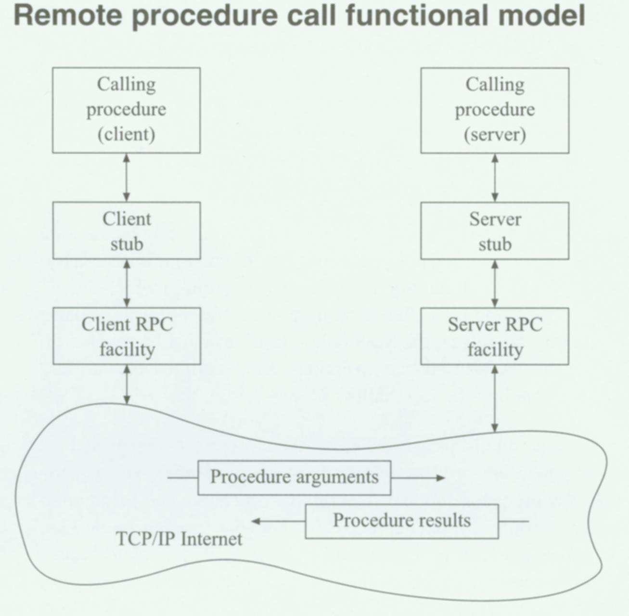
RPC (4) – RPC functional model (1)
P.<number>
Notes:
CT212 (02/03)-Network Programming and design
27 April, 2002
School of Science & Technology

Slide 63
RPC (5) – RPC functional model (2)
Client stub : an module which mimics the presence of the actual procedure to which the calling procedure is attempting to pass control. To complete the calling, it requests the services of the remote procedure call facility.
On receiving a service request, remote RPC facility determine if the requested server procedure already loaded. If it does not, just load it & pass control to it.
P.<number>
Notes:
CT212 (02/03)-Network Programming and design
27 April, 2002
School of Science & Technology

Slide 64
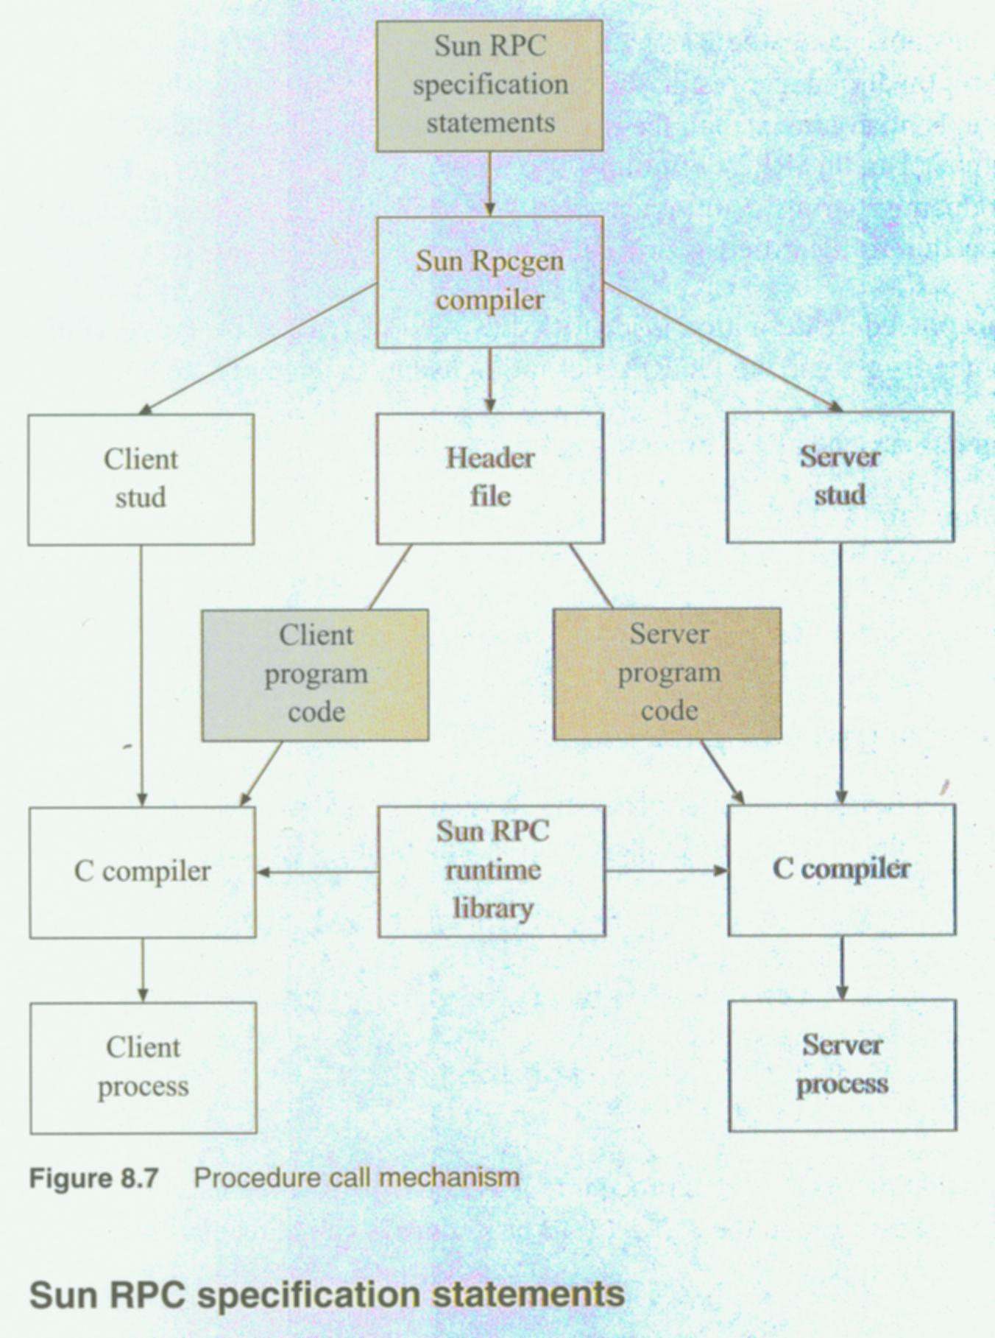
RPC (6) – Sun RPC mechanism
P.<number>
Notes:
CT212 (02/03)-Network Programming and design
27 April, 2002
School of Science & Technology

Slide 65
Open
Discussions
P.<number>
Notes:
CT212 (02/03)-Network Programming and design
27 April, 2002
School of Science & Technology

